Slide 1
Professional Driver Safety
Adapted from Slides Provided by the Minnesota Safety Council

Slide 2
“Safety does NOT happen
by accident”

Slide 3
Shattered Dreams
MN State Patrol
The video was released on June 1st. To date, it has nearly 20,000 views.

Slide 4
Self-Appraisal
How many of us are good
drivers?
Why?
Up to 90% of drivers think they
are better than the average driver
Notes:
DISCUSSION ABOUT PROFESSIONALS / HABITS AND COACHING

Slide 5
What color is a yield sign?

Slide 6
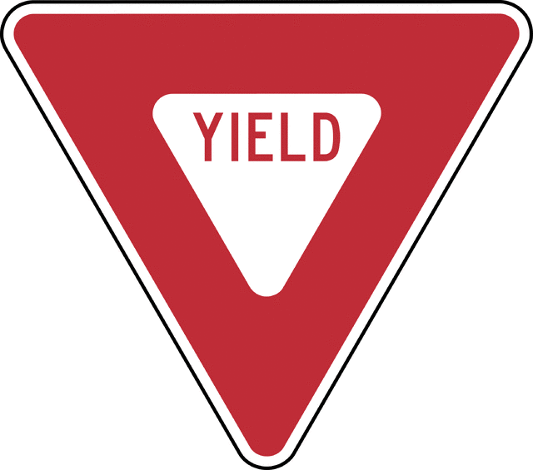
What color is a yield sign?

Slide 7

What is a proper stop?

Slide 8
What is a proper Stop?
If there is a solid white bar or a crosswalk painted across the intersection, you should stop before it, so that you don't block it. If there is no painted stopping line, then stop slightly before the stop sign so that you can see in all directions at the intersection
A complete stop is when there is no forward momentum and the needle on the speedometer is at 0. In a rolling stop, the car wheels are still in motion and the car is moving at less than 5 m.p.h. Failing to come to a complete stop at a stop sign is a traffic violation.

Slide 9
For most of us driving is the most dangerous thing we do

Slide 10
Defensive Driving
Most drivers do not think of driving as a difficult task
Most drivers don’t think about the hazards involved
Most drivers do not think they will be involved in a collision

Slide 11
The Other Driver
You have to drive for yourself and everyone else on the road
Many drivers are overconfident
Don’t recognize potential hazards
Don’t accept responsibility (“It’s the other guys fault”)
Do not see the importance of speed limits and traffic laws
Notes:
11

Slide 12
Statistics
30% of drivers ran a red light in the past week
26% of drivers rolled through a stop sign
2/3 of all drivers admit they regularly exceed what they consider to be a safe speed
8% drove under the influence
Notes:
12

Slide 13
Roads and Highways
Times have changed
Most roads were designed decades ago for ½ the traffic
Since 1965 Minnesota added:
  Over 2 million more drivers
  2.8 million more vehicles
  39.7 billion more annual miles

Slide 14
Smith System
Are you Playing With A Full Deck?

Slide 15
Session 1
Van Characteristics and Inspections
Van Characteristics & Inspections

Slide 16
The Five Keys
Aim high in steering
1
Get the big picture
2
Keep your eyes moving
3
Leave yourself and out
4
Make sure they see you
5

Slide 17
#1 Aim High in Steering ®
Look down the road further that it’s normal to look

Slide 18
#1 Aim High in Steering ®
We need to expand our eyes' lead time

Slide 19
#2 Get the big picture ®
Look down the road further that it’s normal to look
360º Awareness
Check your mirrors every 3-5 Seconds

Slide 20
#2 Get the big picture ®
These can all be vision barriers
Following distance is more than stopping distance

Slide 21
#3 Keep your eyes moving ®
Peripheral vision is 180º
Central cone vision is 3º
Blank and fixed stares
Keep your eyes moving every 2 seconds

Slide 22
#3 Keep your eyes moving ®
Don’t fixate
Scan the entire area
Don’t forget the front, sides and top
Back slowly

Slide 23
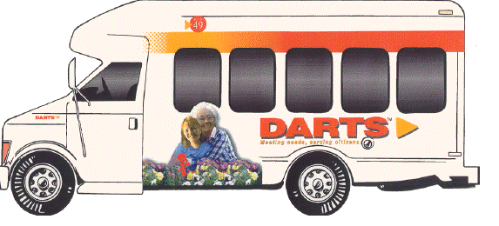
#4 Leave yourself an out ®
Think “space” when pulling up to a car in front of you or selecting a parking/backing environment

Slide 24
Answer Questions on Pages 6 and 7

Slide 25
Page 6
1. List Items you should check when inspecting:
  Outside the Van:
  Inside the Van:
  Other

Slide 26
Page 7
2. What is your organization's policy regarding inspecting your vehicle?
3. Where are the blind sports on the vehicle you drive?
4. Proper mirror adjustment will eliminate all your blind spots?
5. How should you adjust your mirrors?

Slide 27
Safety
Traffic crashes are the leading cause of death for persons age 6 months – 34 years old

Slide 28
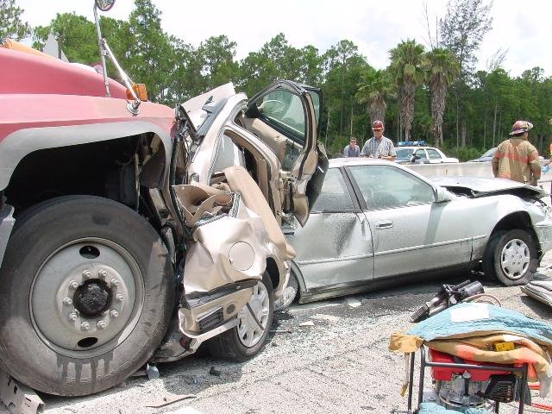

Slide 29
Traffic Crashes
The majority of fatal and serious injury crashes occur:
During daylight hours
In good weather
On dry roads

Slide 30
Risk on the road
A crash occurs every 5 seconds
Traffic injury every 10 seconds
A fatality every 12 minutes
Alcohol related fatality every 31 minutes
Pedestrian killed every 113 minutes

Slide 31
In 2018…
381 people died on Minnesota highways, an increase of 24 people from 2017.
27,877 were injured, a decrease from last year; most not seriously.
There were 79,215 crashes; 1,341 people had severe/serious injuries.
172,115 people were involved in crashes; 146,107 motor vehicles were involved in crashes.
609 crashes involved at least 1 bicyclist, 1,109 crashes involved at least one pedestrian, one in five fatalities were less than 25 years of age, 8,374 crashes were classified as “hit and run”
The economic loss to Minnesota from these crashes was $1.8 billion

Slide 32
Today
156 People will be killed in crashes
4396 people will be seriously injured

Slide 33
What is a preventable collision?
The driver failed to do everything
REASONABLE
to avoid the collision
An accident may be preventable
even if you are not at fault
Notes:
Discuss what the criteria for preventable accidents are. The next slides will give you opportunities to discuss different scenarios.

Slide 34



Why do people have collisions?
“I thought
the light
was green”
The road was
slippery
What excuses
have
you
heard?
“I didn’t
see them”
“I had the
right of way!”
Notes:
What excuses have you heard? The slide has four excuses and then challenges drivers to think of others….
The Road was slippery
I didn’t see them
I thought the light was green
I had the right of way
What excuses have you heard?

Slide 35
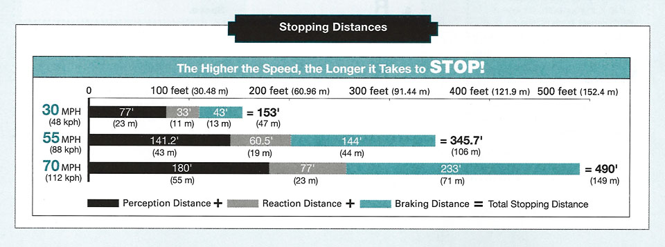
Stopping Distances
The Higher the Speed, the Longer it Takes to STOP!
Notes:
35
The Higher the Speed, the Longer it Takes to STOP!

Slide 36
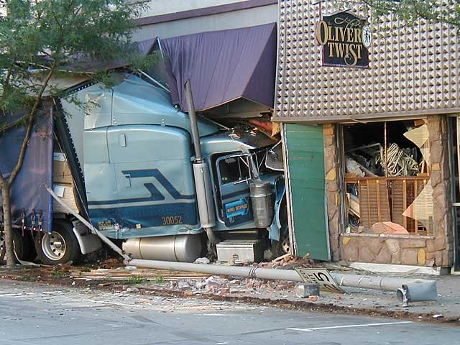

Slide 37
Cost to Employer
Per crash - $24,356
Per injury crash - $128,178
Per fatal crash- ??????

Slide 38
Collisions
The average driver will be involved in a collision once every ten years
Six collisions in your lifetime
Each is a potential threat on YOUR LIFE

Slide 39
Session 2
Scanning, Cushion of safety and Communicating

Slide 40
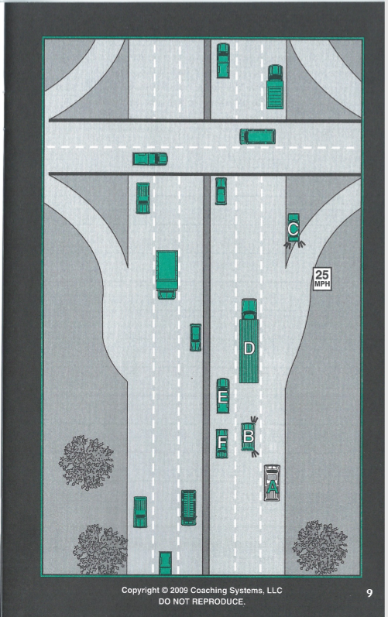
Page 8 & 9
6. In this situation these drivers are on a multi lane highway. What are the hazards (if any) that A is facing what should A do to minimize the risk?
If Exiting:
If Continuing on the Highway:

Slide 41
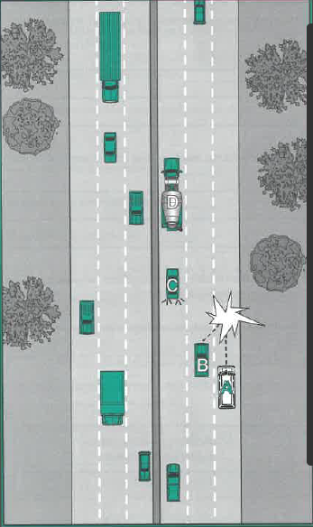
Page 10 & 11
7. In this situation “A” was driving on a multi-lane highway with no other vehicles in front or behind. The driver of “B” pulled right into “A’s” lane colliding with A. A said they couldn’t do anything to prevent the collision. How would have you handled this situation to prevent.

Slide 42
Page 12
8. How can “covering the brake” Assist you?
9. What Components Make up your total Stopping Distance?
10. What are the variables for each of the components of your total stopping distance?

Slide 43
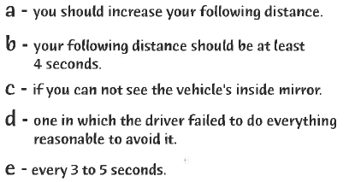
Page 13
1. When traveling in ideal conditions ____
2. You should assume that you are in another driver's blind spot _____
3. You should check your mirrors _____
4. In adverse weather conditions _____
5. A preventable collision is ______

Slide 44
Additional Questions
What is owning the intersection?
Should you ever wave another driver through an intersection?
Who has the right of way?
What is the proper way to stop at a stop sign?

Slide 45
Session 3
Reading Traffic Situations Part 1

Slide 46
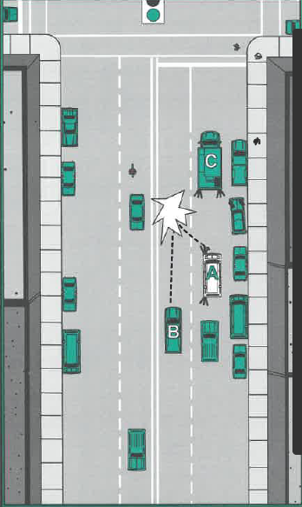
Page 14 & 15
Question #11
How would you have handled this situation prior to the collision?
Was this a preventable collision?

Slide 47
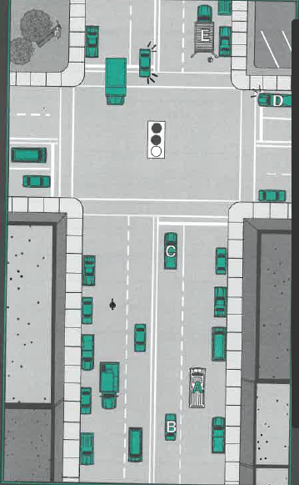
Pages 16 & 17
Question #12
If you were driving “A” what hazards (if any) are you facing and how would you handle each one?

Slide 48
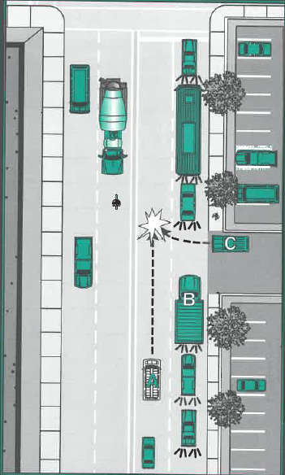
Pages 18 & 19
Question #13
If you were “A” and driving in the left Lane No one in front of you. However Truck B stopped and waived “C” that it was ok to enter the street and when “C” did he crossed into your lane and collided with you.
What are the contributing factors in this situation?

Slide 49
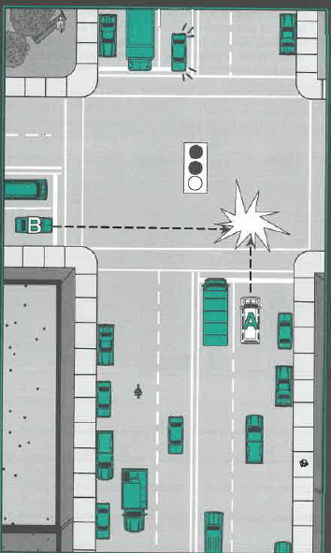
Pages 20 & 21
Question #14
In this situation the light has just turned green and you are “A” started through the intersection, Vehicle “B” continued through the intersection on the cross street and collided with you.
Was this a preventable collision?
If so, how could each of the drivers prevented this collision?

Slide 50
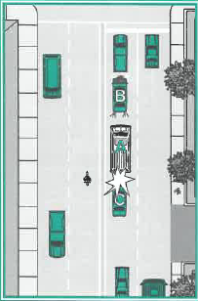
Page 22
Question #15
You “A” were stopped in a line of traffic. The driver of “B” got out of his car and raised the hood. You backed up to get around “B” but when you did you ran into the vehicle behind “C”, you didn’t know “C” was there- you couldn’t see out your rear window because of some luggage.
What were the factors that contributed to this collision and how could it have been prevented?

Slide 51
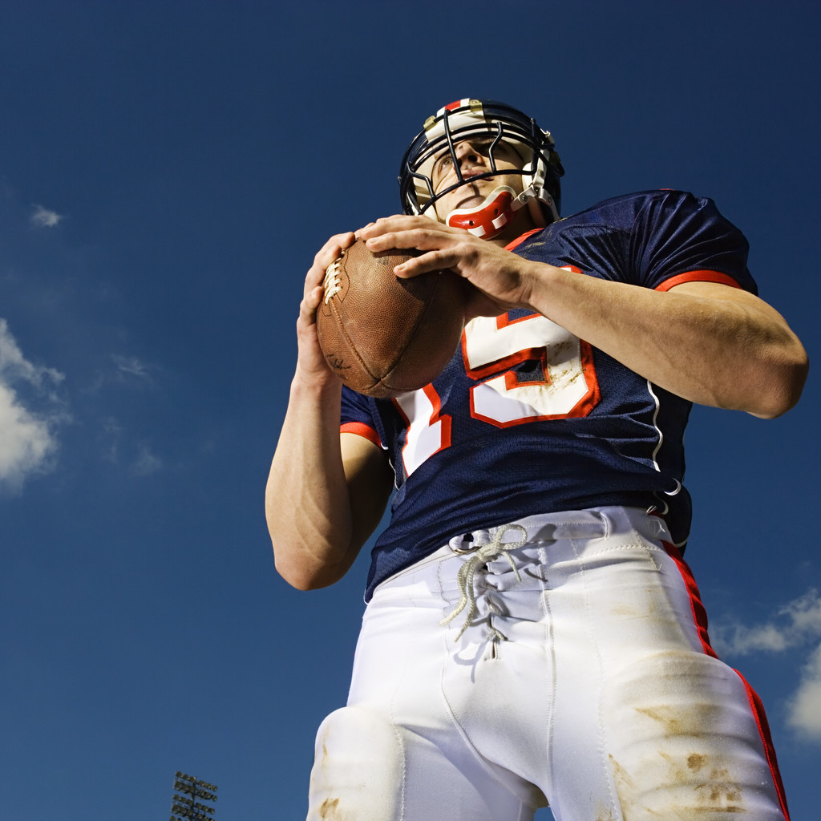
IT’S ALL ABOUT DEFENSE

Slide 52
THE BEST DEFENSE
IS A GOOD OFFENSE

Slide 53
Defensive Driving
Defensive Driving is driving to save lives time and money in spite of the conditions around you and the actions of others

Slide 54
Defensive Driving
Making safe and legal driving decisions
Creating a safe, stress free environment around your vehicle
Driving to your destination safely without a ticket, crash, or affecting other’s safety
Practicing common sense, courtesy, and cooperation
Recognizing the risks of hazardous driving behaviors and conditions

Slide 55
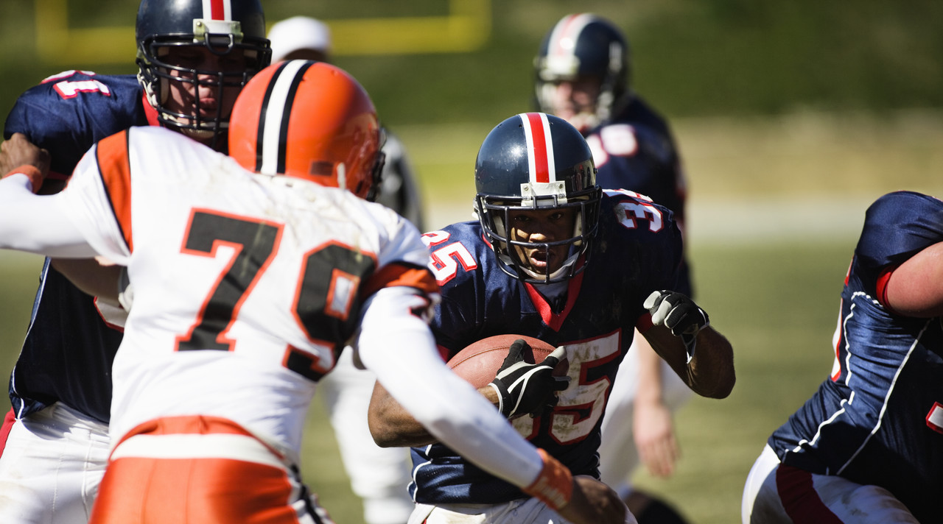
RECOGNIZE THE HAZARD
UNDERSTAND THE DEFENSE

Slide 56
Recognize the hazard
Scan ahead, around, and behind your vehicle
In urban areas, scan one block ahead
In rural area or on expressways, scan to the next hill, curve, or overpass
Check mirrors every 3 – 5 seconds
Use the "what if?" strategy
Notes:
57
Read the hazard.
Scan ahead, around and behind your vehicle.
In urban areas scan one block ahead.
In rural areas or on expressways, scan to the next hill, curve or overpass.
Check your mirrors every 3 – 5 seconds.
Use the what if strategy?

Slide 57
Understand the defense
Know what to do to avoid a traffic hazard
Know the consequences of your driving choices
Know the basic defenses:
  Use effective scanning patterns
  Slow down
  Use a safe following distance
Notes:
58
Understand the defense.
Know what to do to avoid a traffic hazard.
Know the consequences of your driving choices.
Know the basic defenses:
Use effective scanning patterns.
Slow down.
Use a safe following distance.

Slide 58
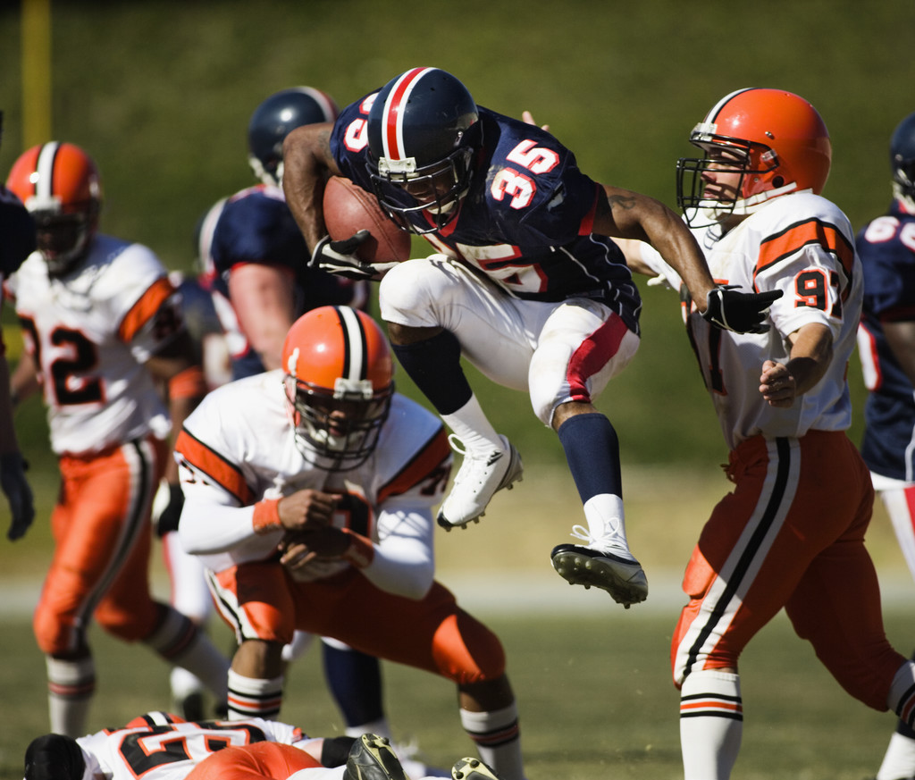
ACT TIMELY AND CORRECTLY

Slide 59
Act in Time
  Always stay alert, focus on the driving task so you don’t lose response time.
  Choose the safest driving maneuver to avoid a crash.
  Remember other drivers may act in time, but they may act incorrectly
Notes:
60
Act in Time.
Always stay alert, focus on the driving task so you don’t lose response time.
Choose the safest driving maneuver to avoid a crash.
Remember other drivers may act in time, but they may act incorrectly.

Slide 60
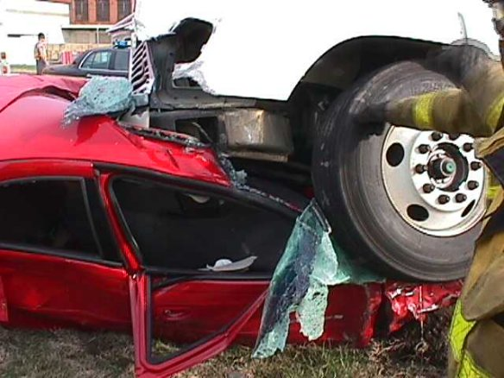

Slide 61
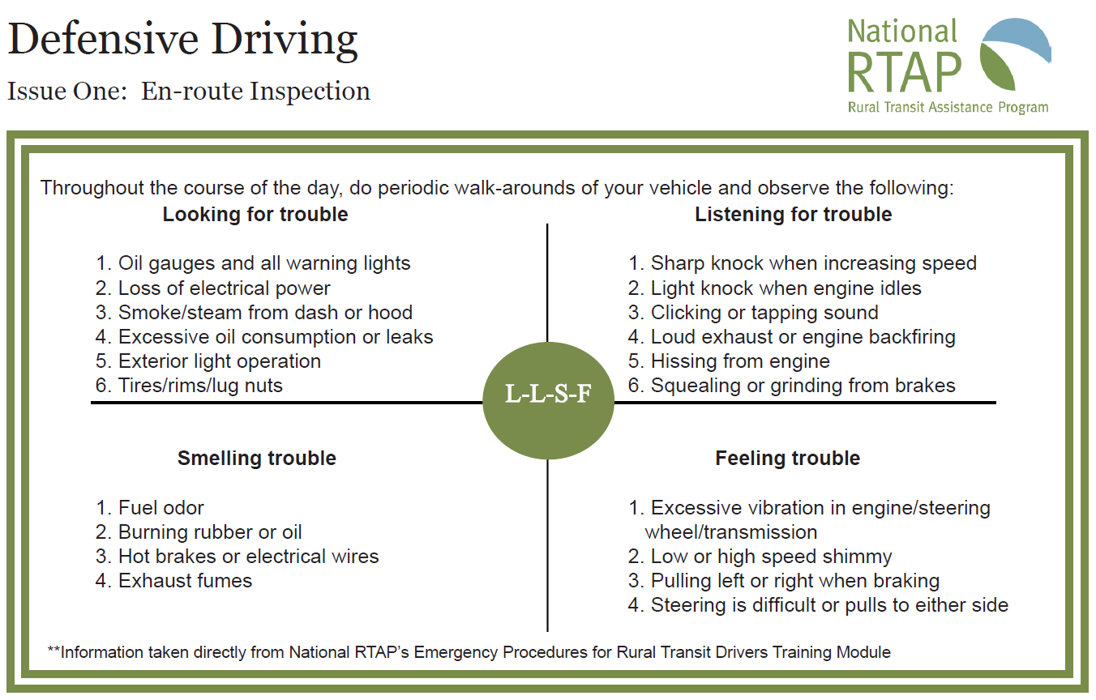

Slide 62
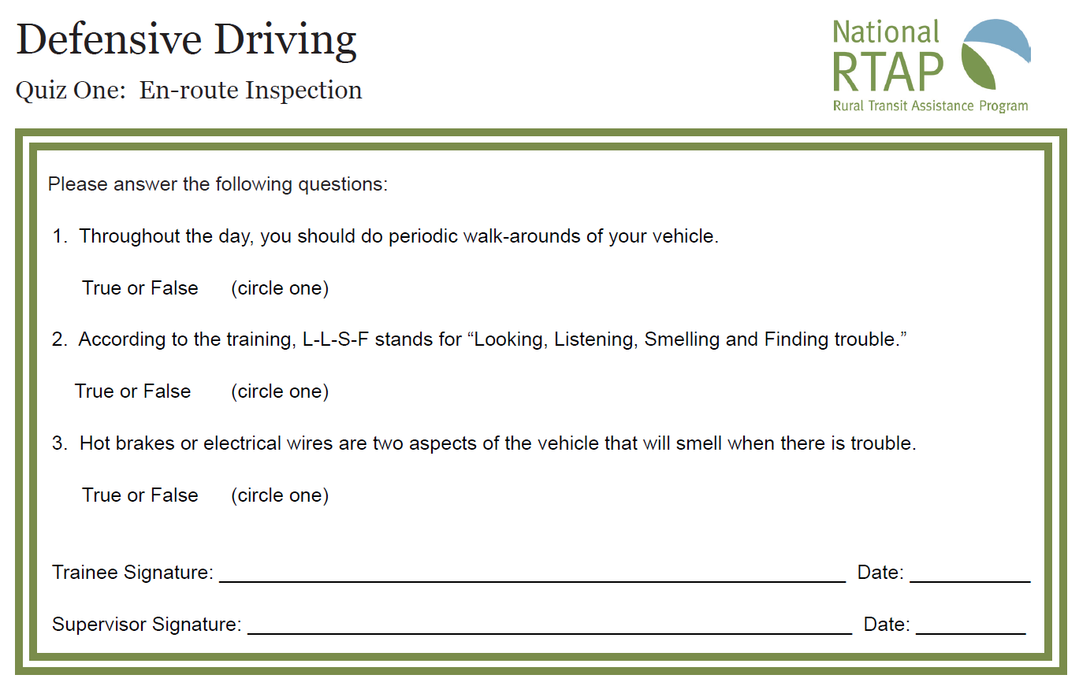

Slide 63
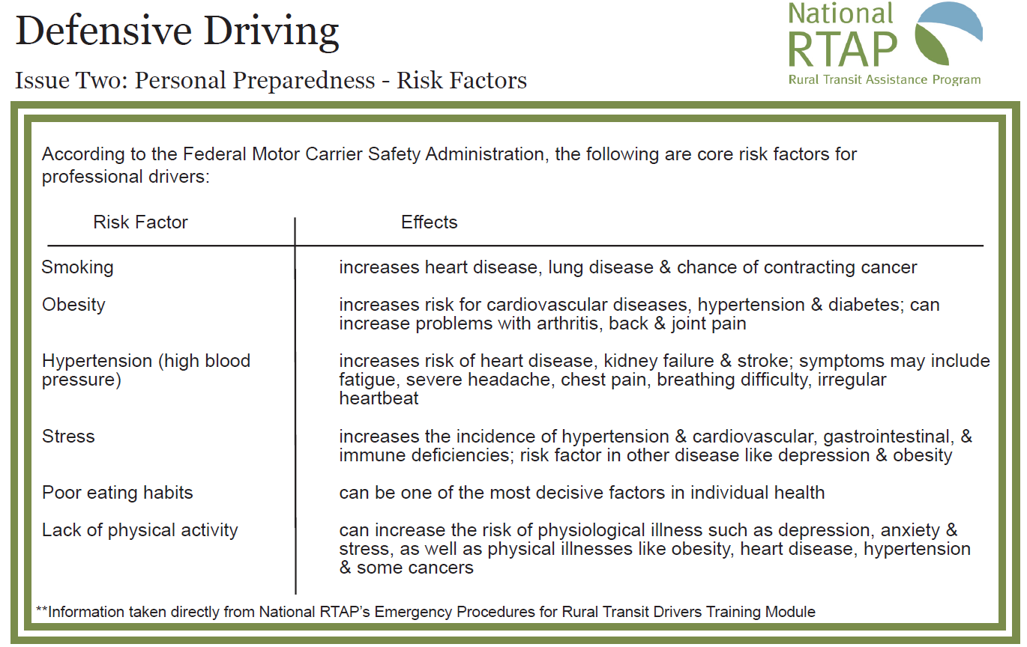

Slide 64
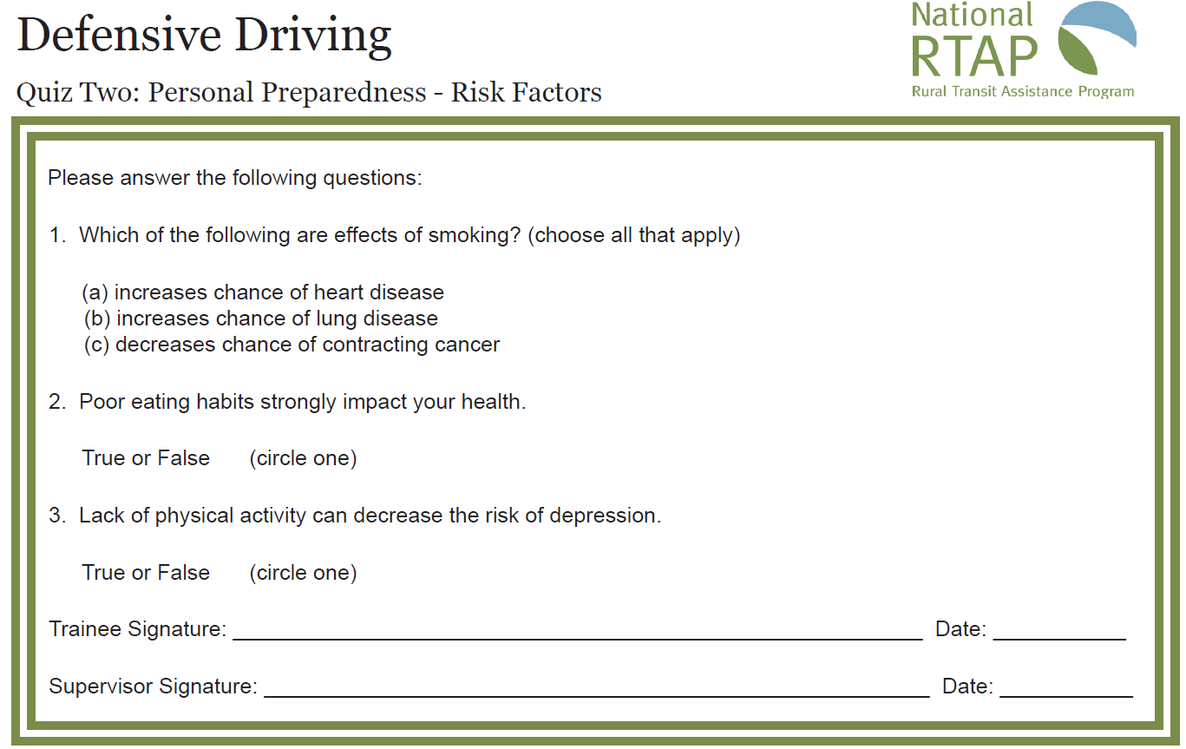

Slide 65
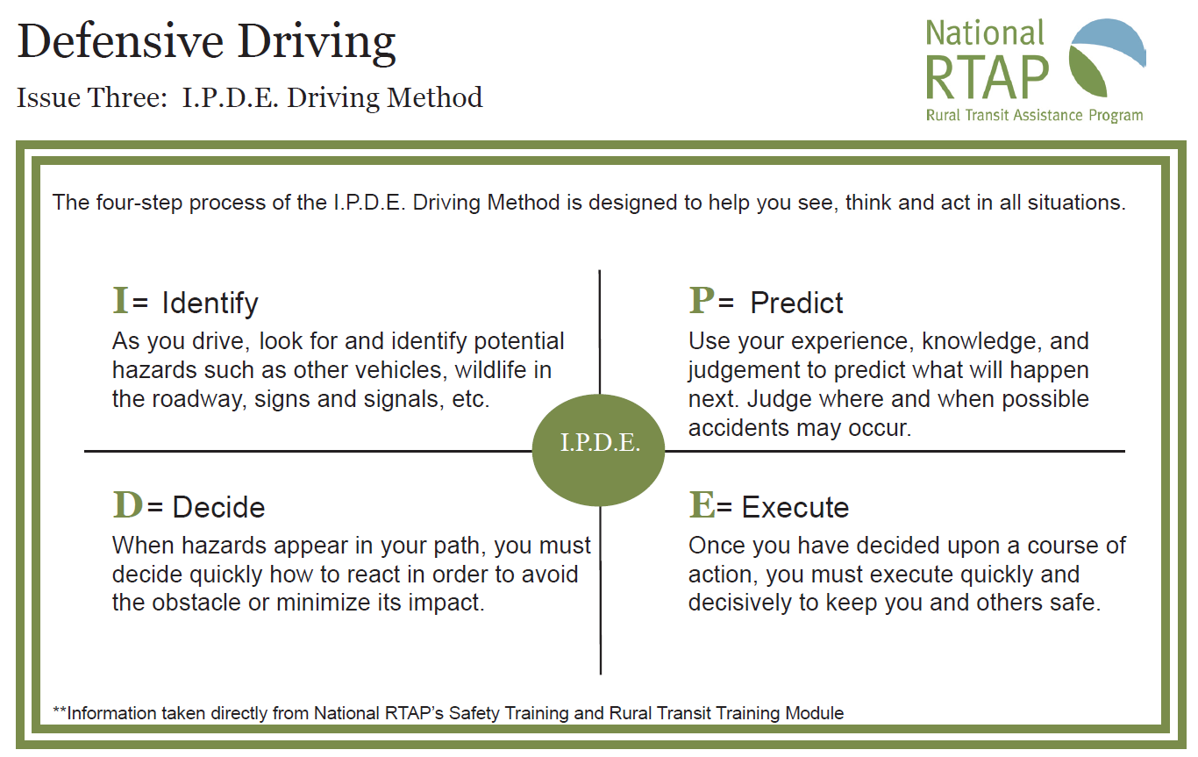

Slide 66
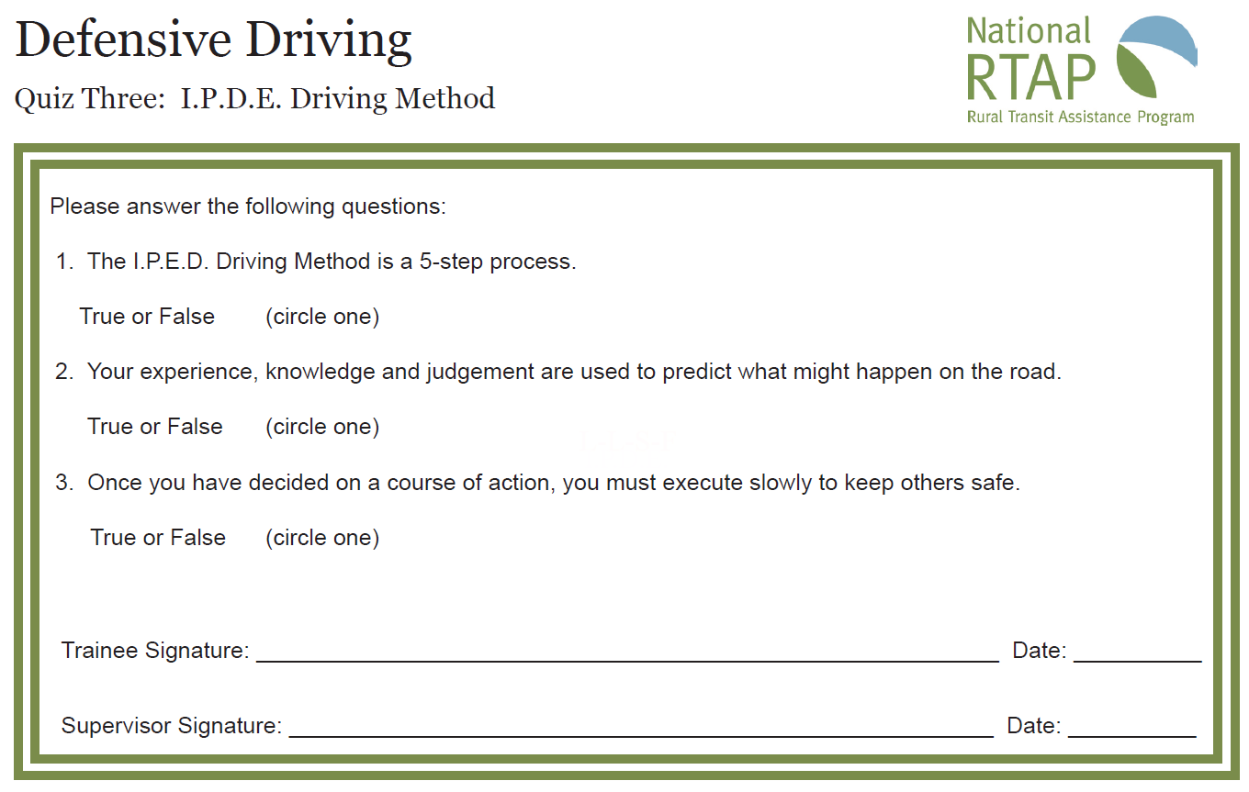

Slide 67
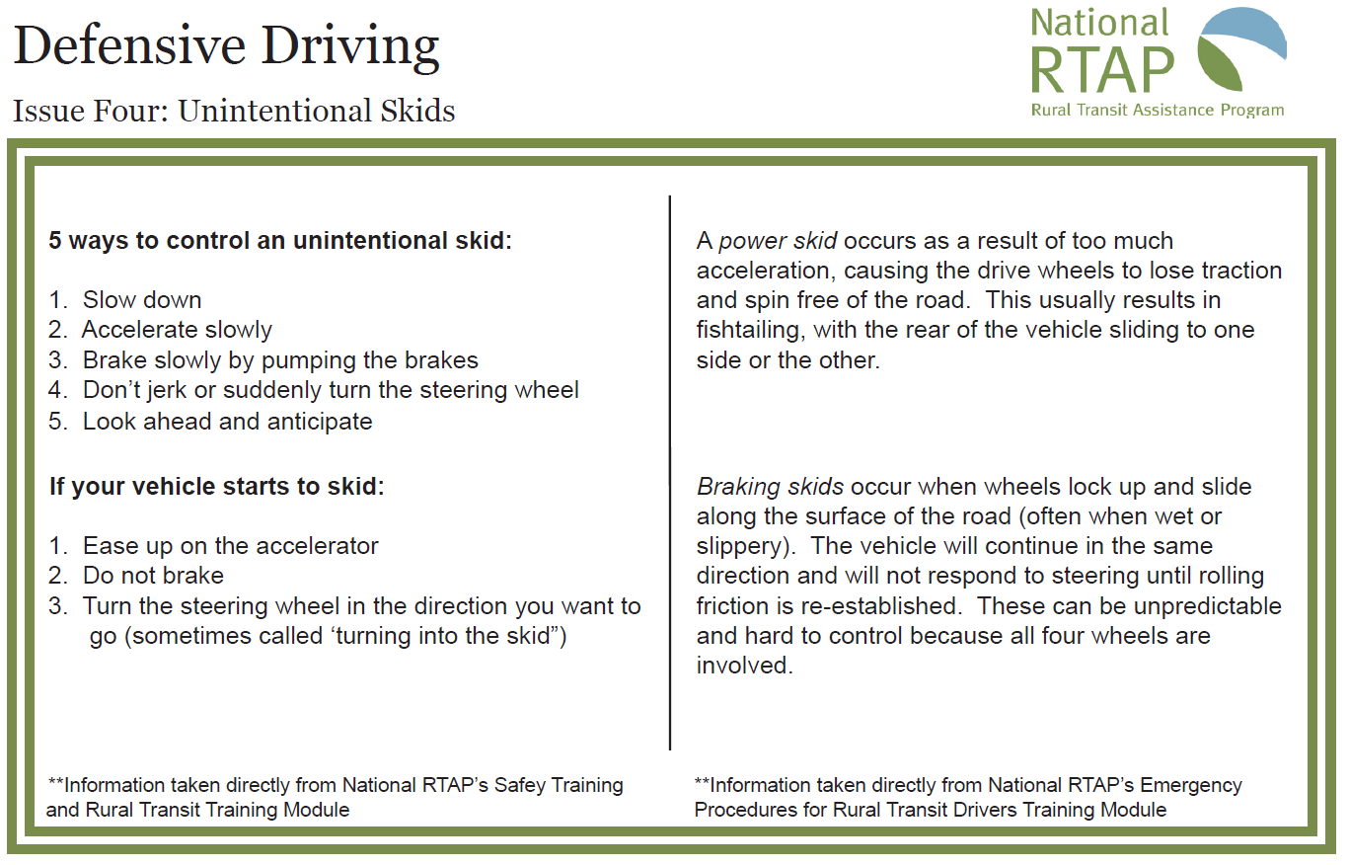

Slide 68
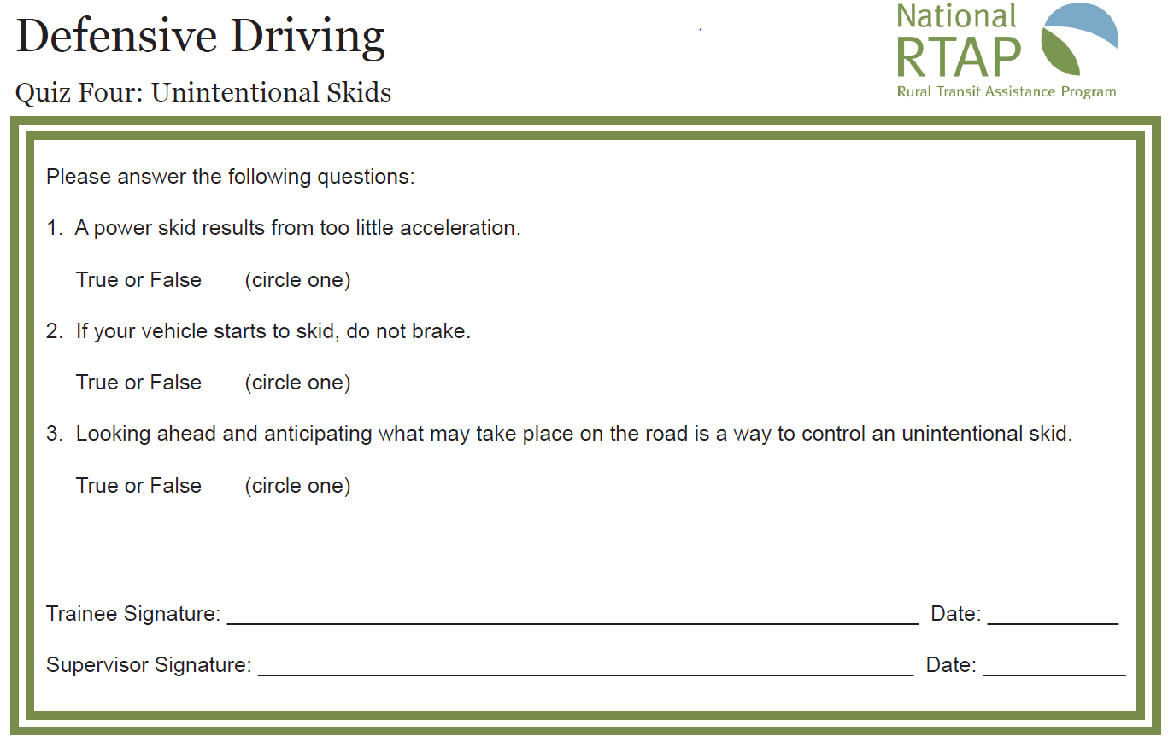

Slide 69
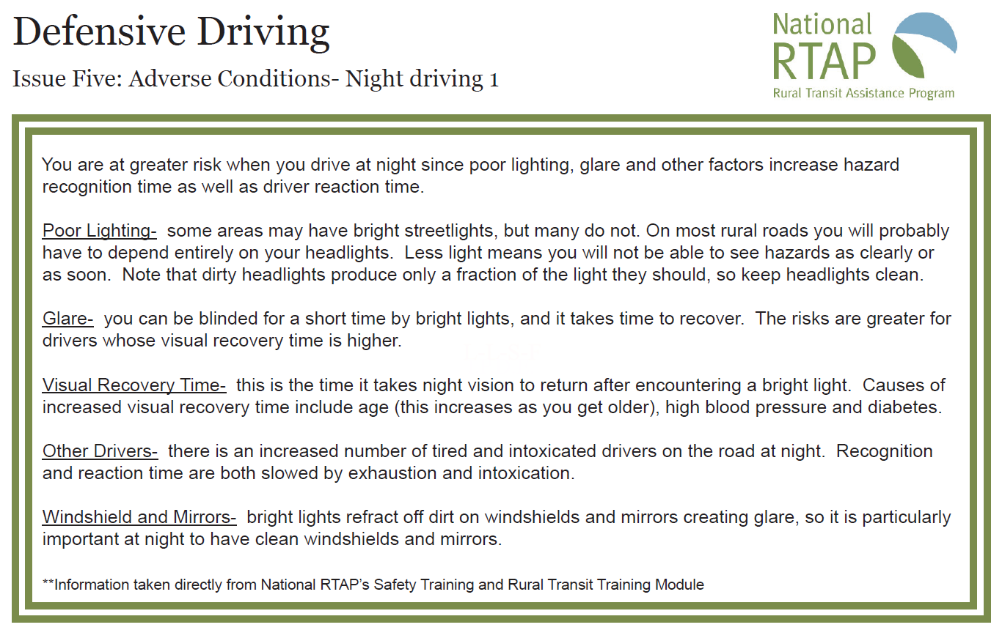

Slide 70
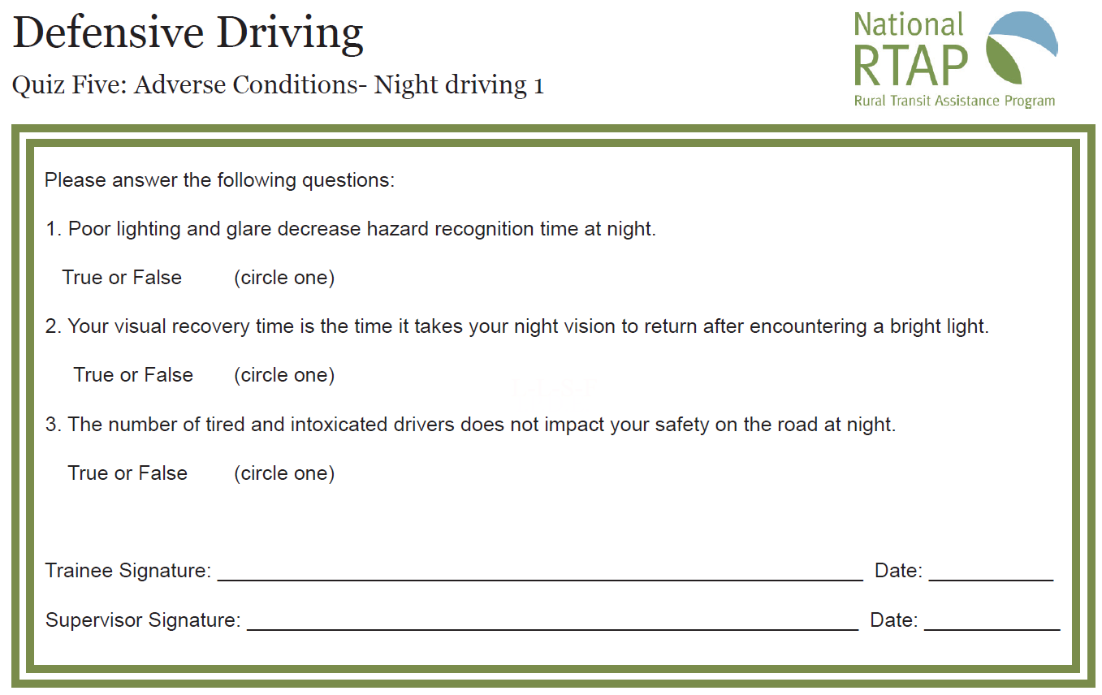

Slide 71
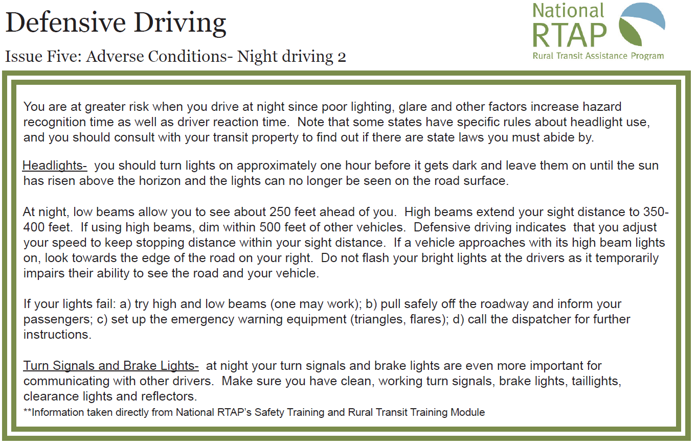

Slide 72
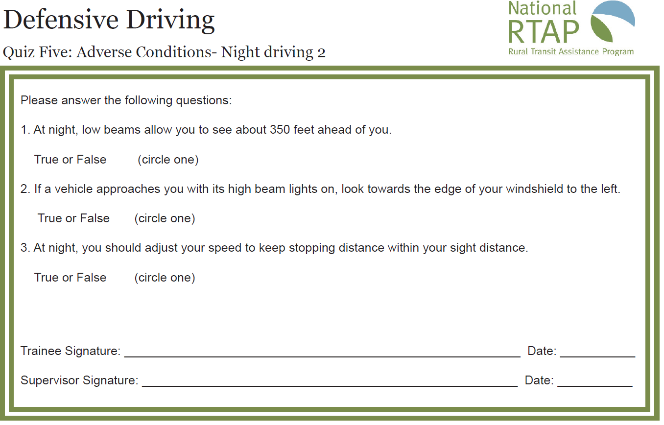

Slide 73
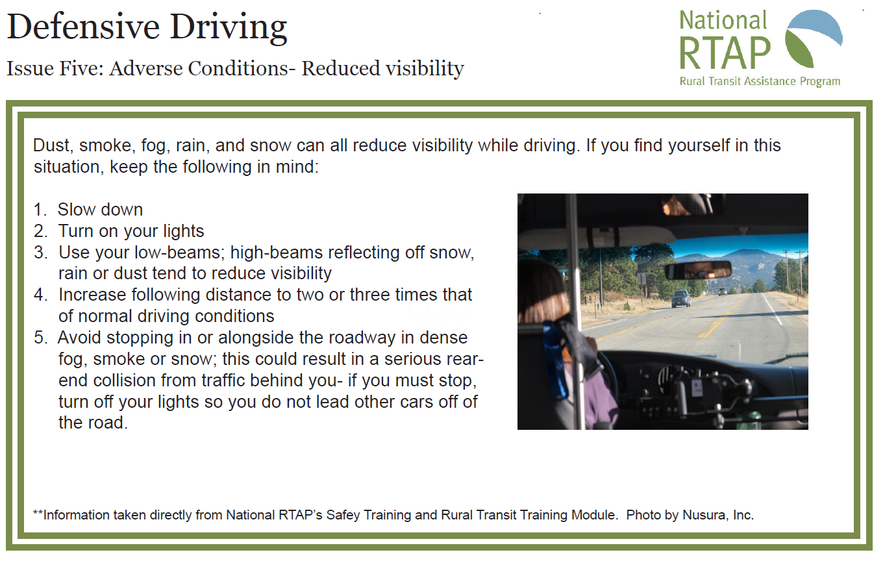

Slide 74
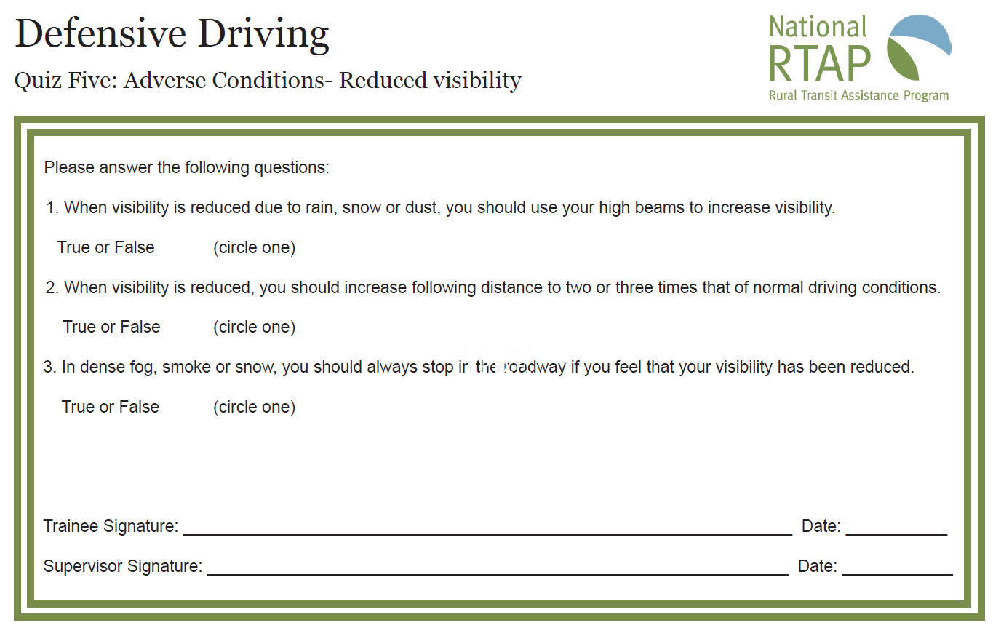

Slide 75
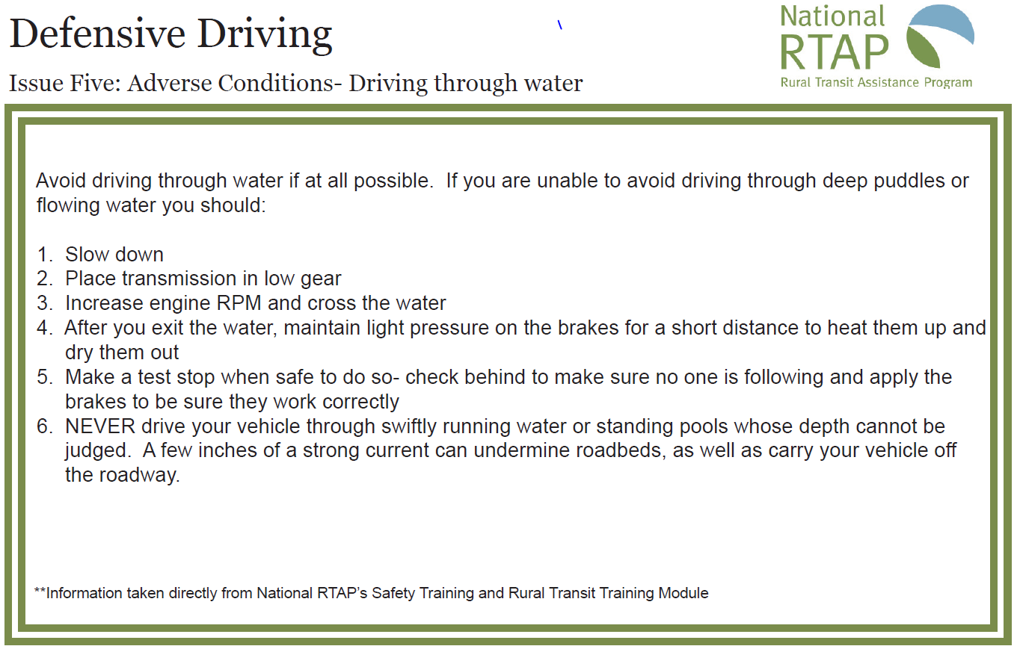

Slide 76
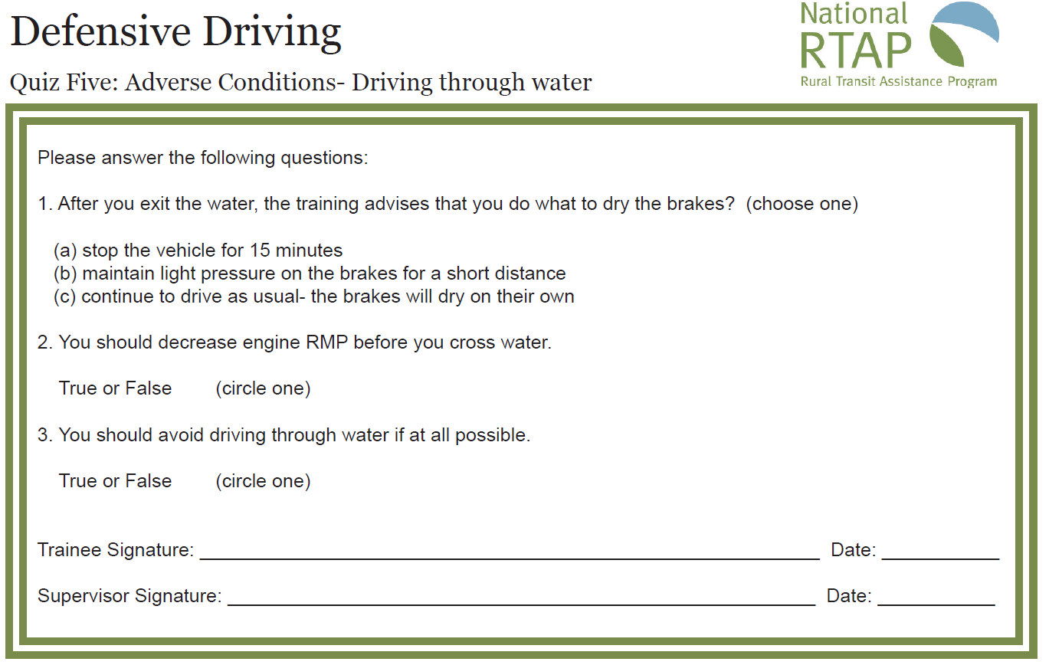

Slide 77
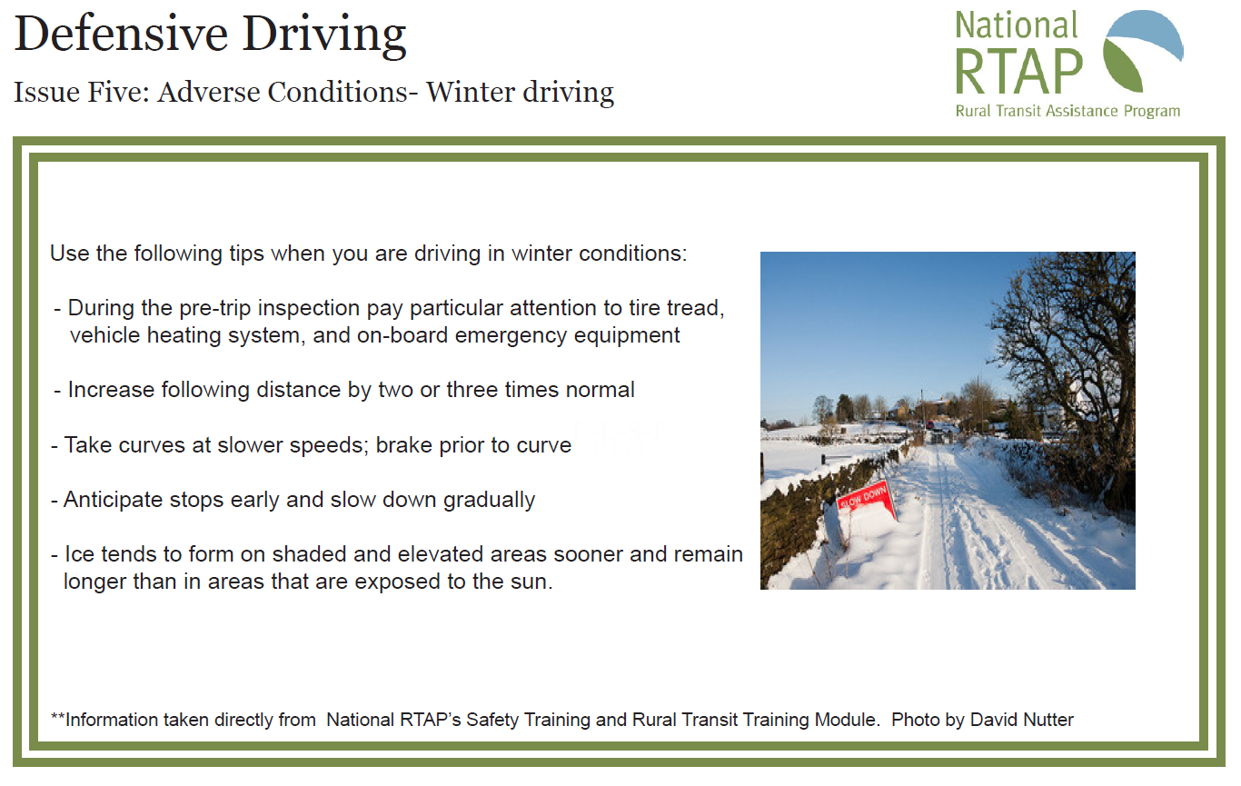

Slide 78
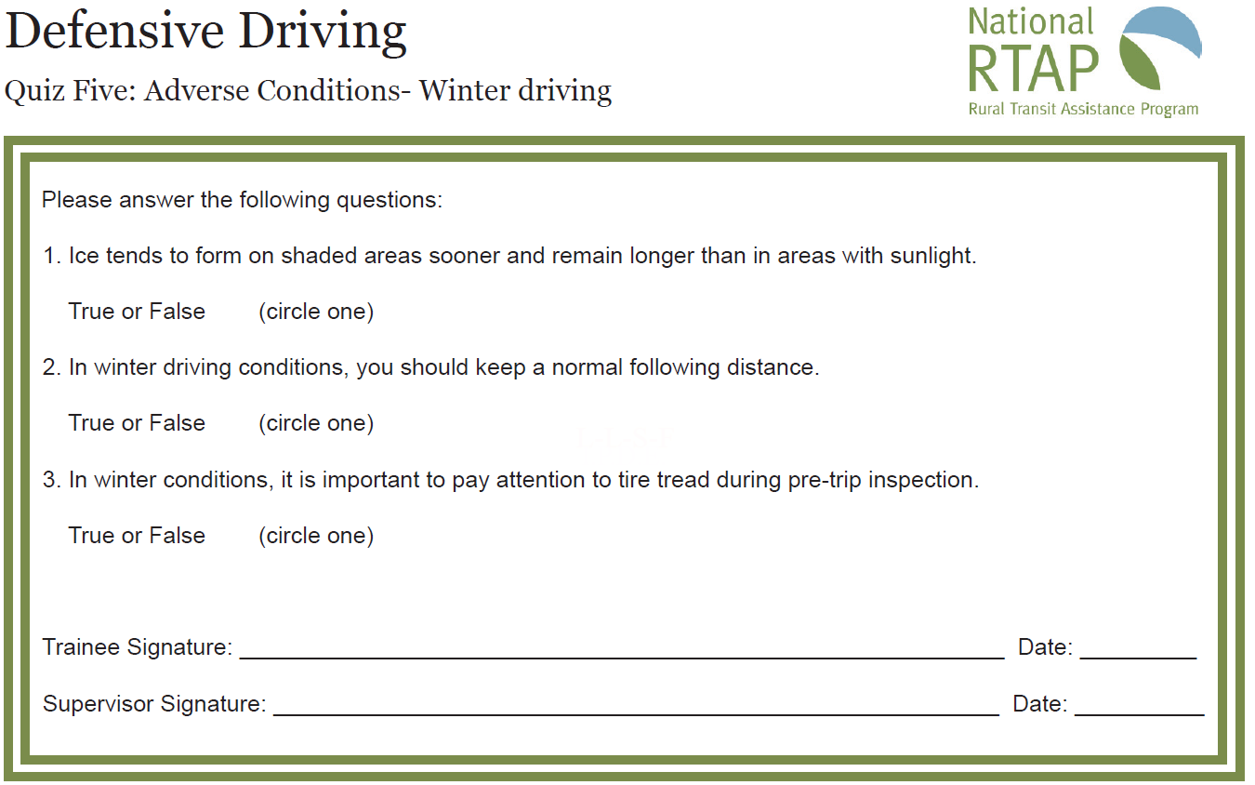

Slide 79
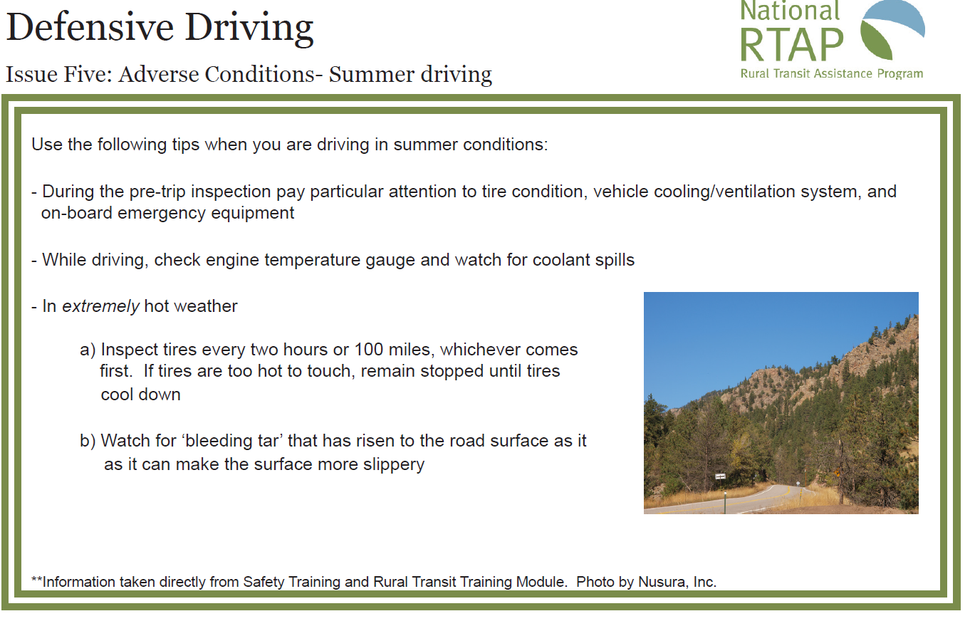

Slide 80
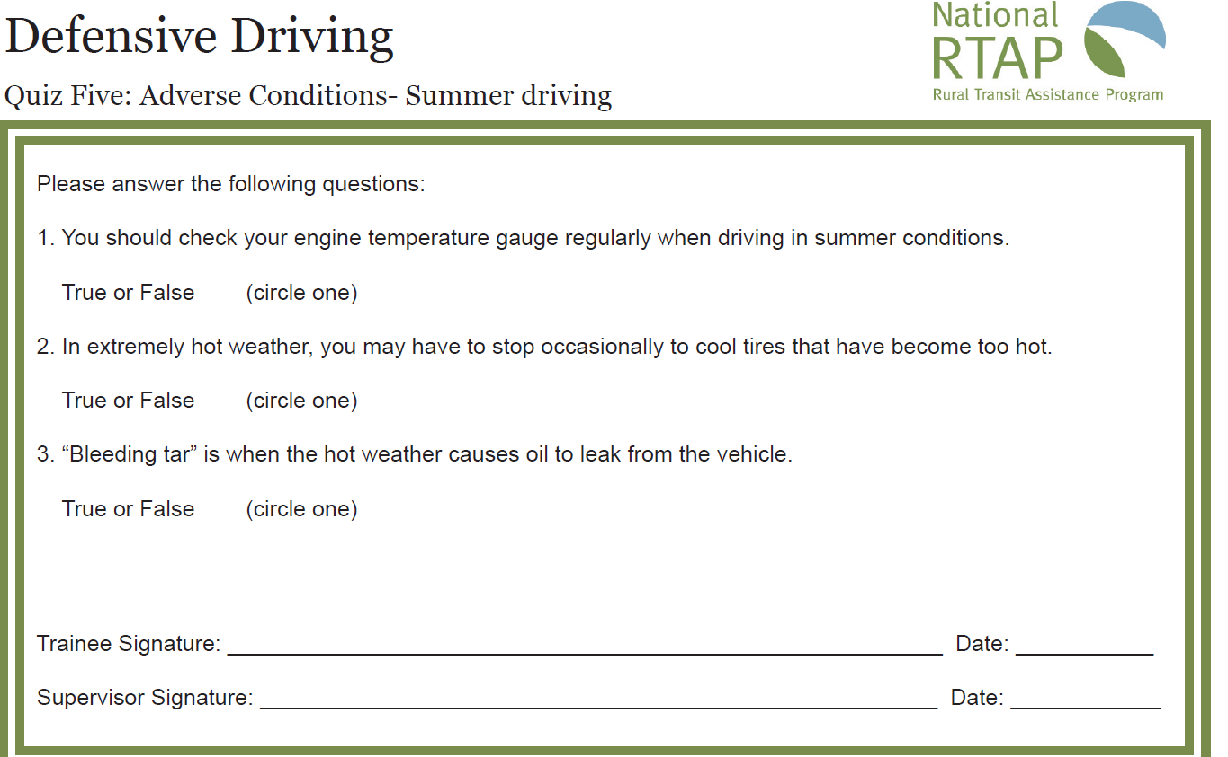

Slide 81
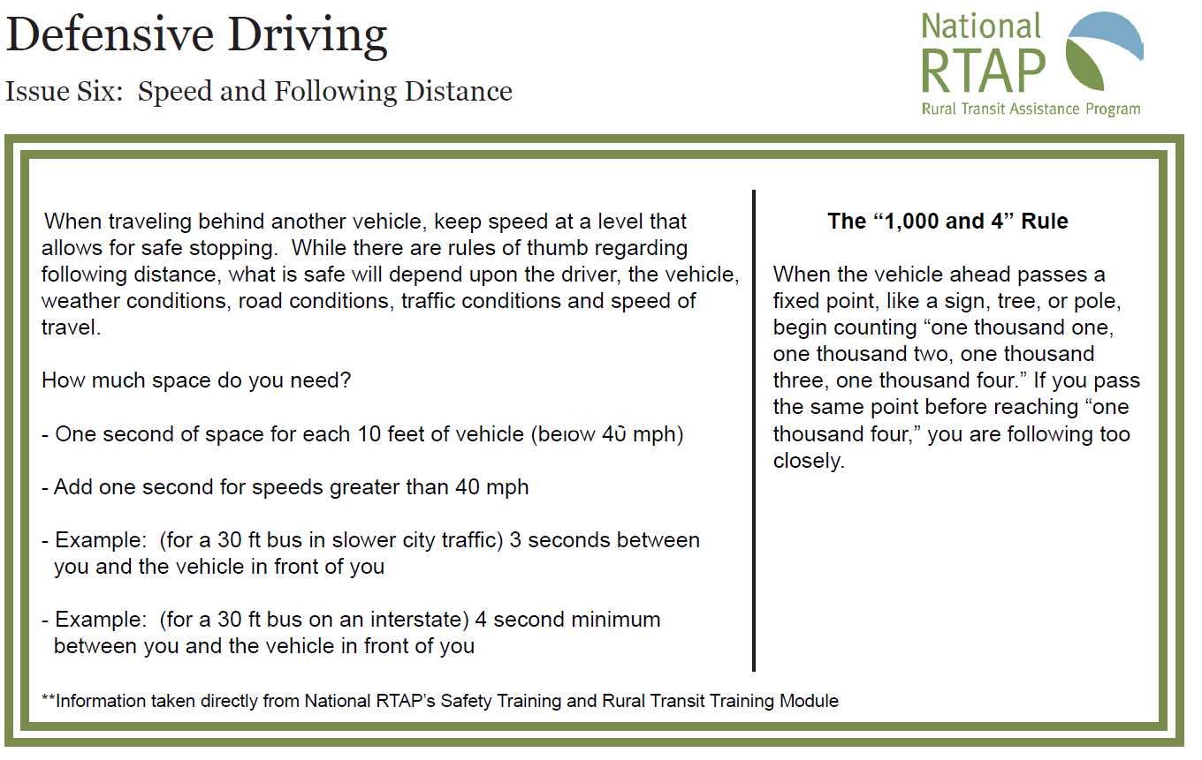

Slide 82
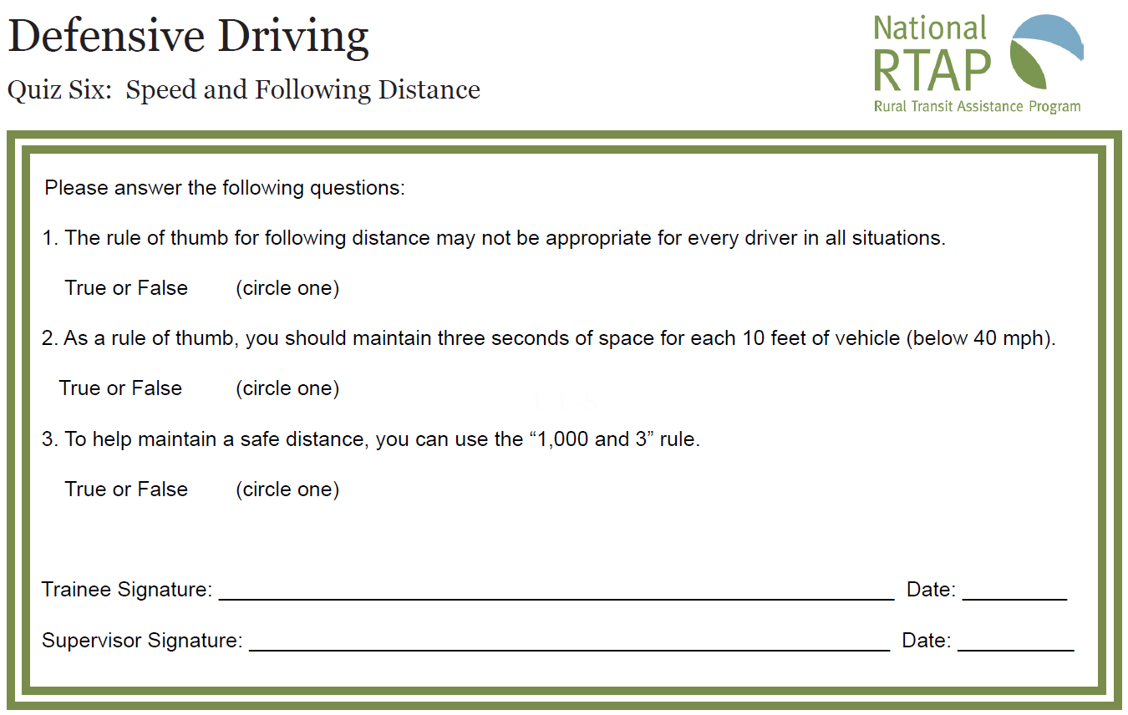

Slide 83
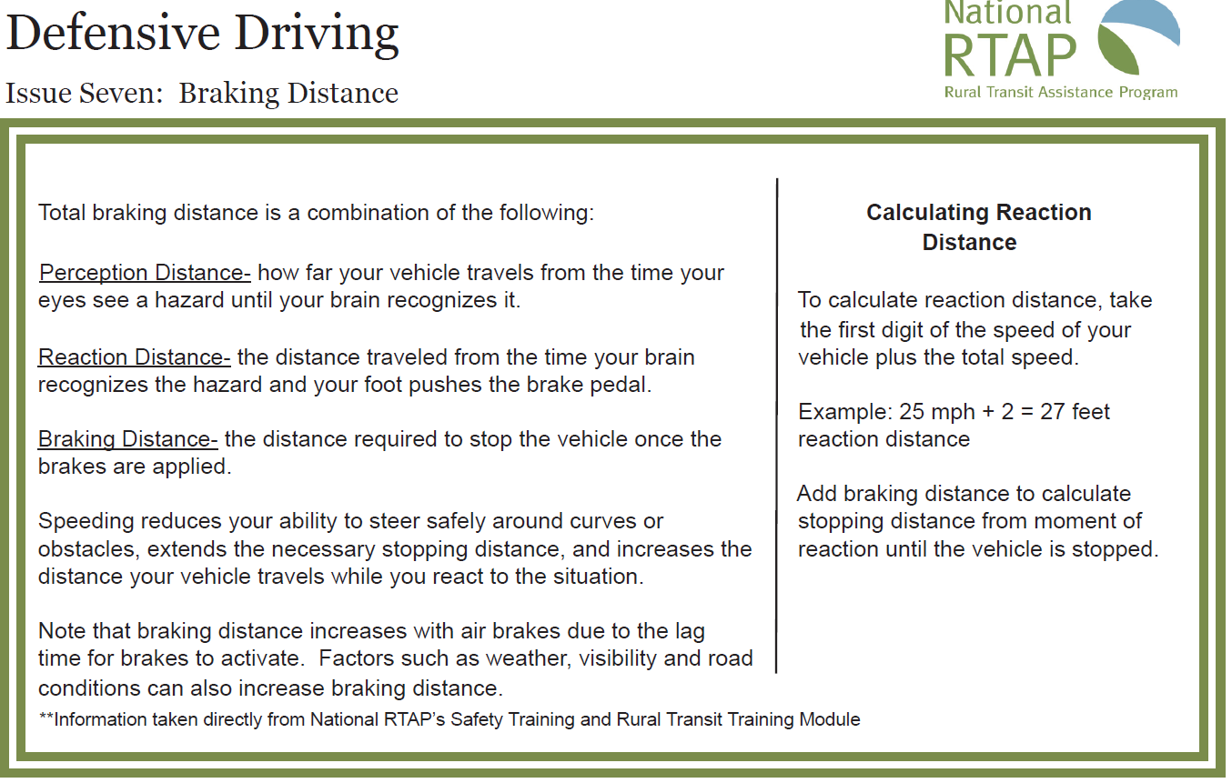

Slide 84
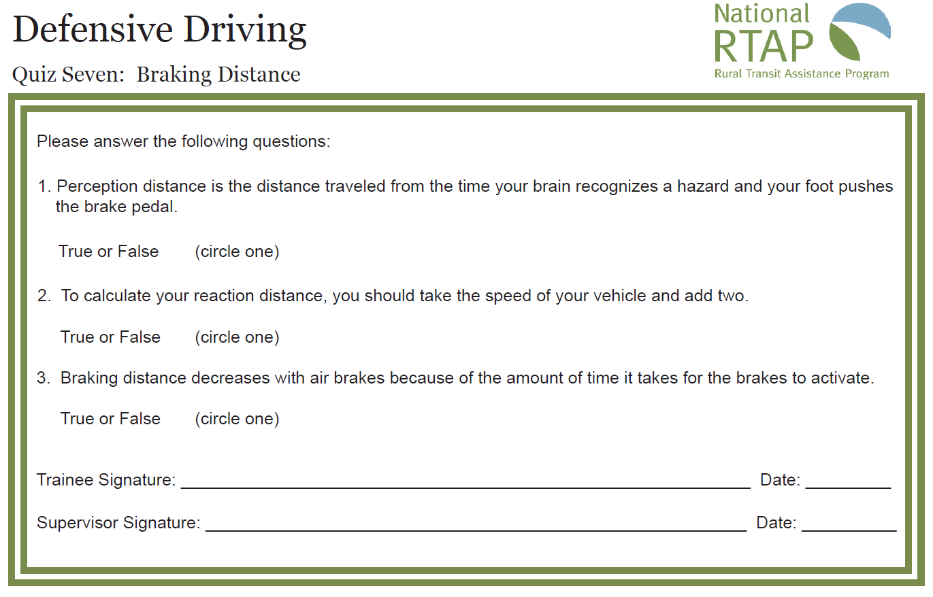

Slide 85
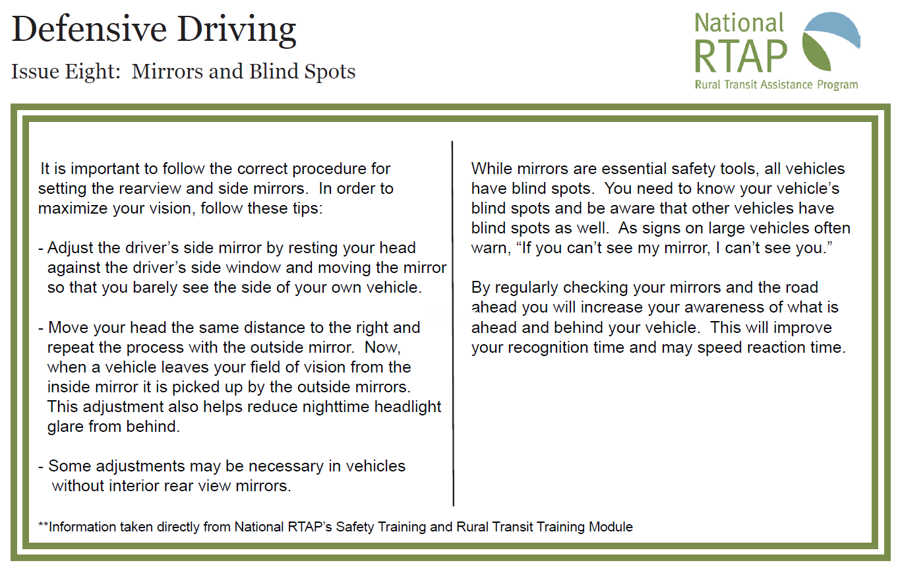

Slide 86
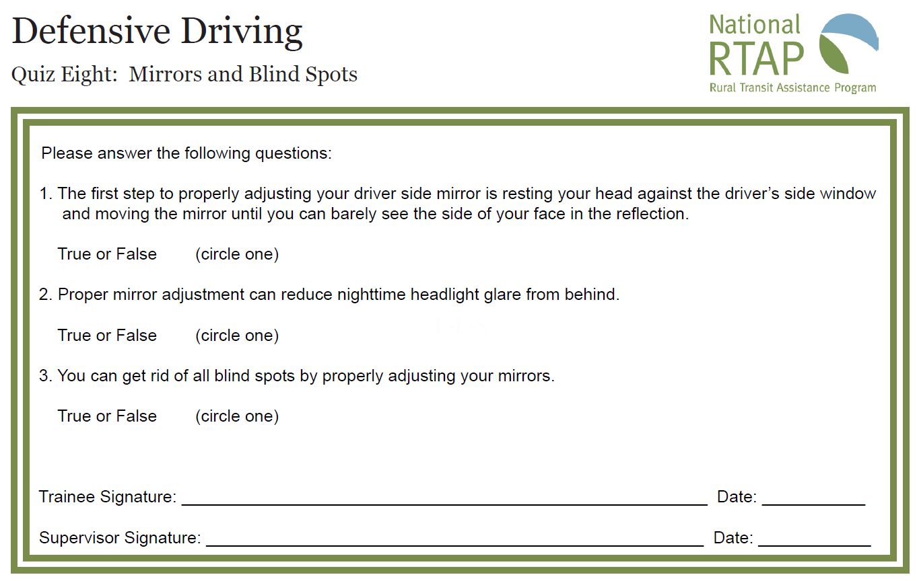

Slide 87
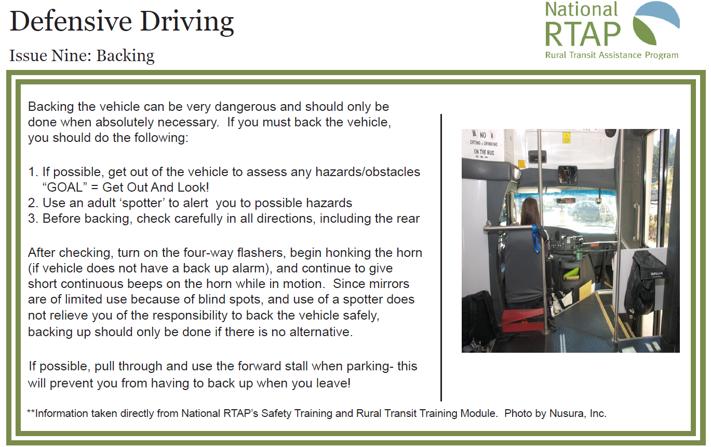

Slide 88
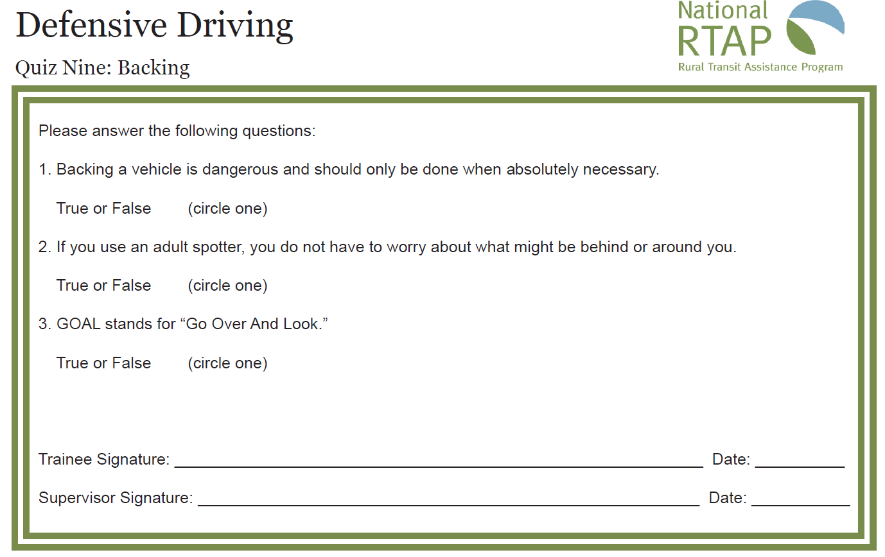

Slide 89
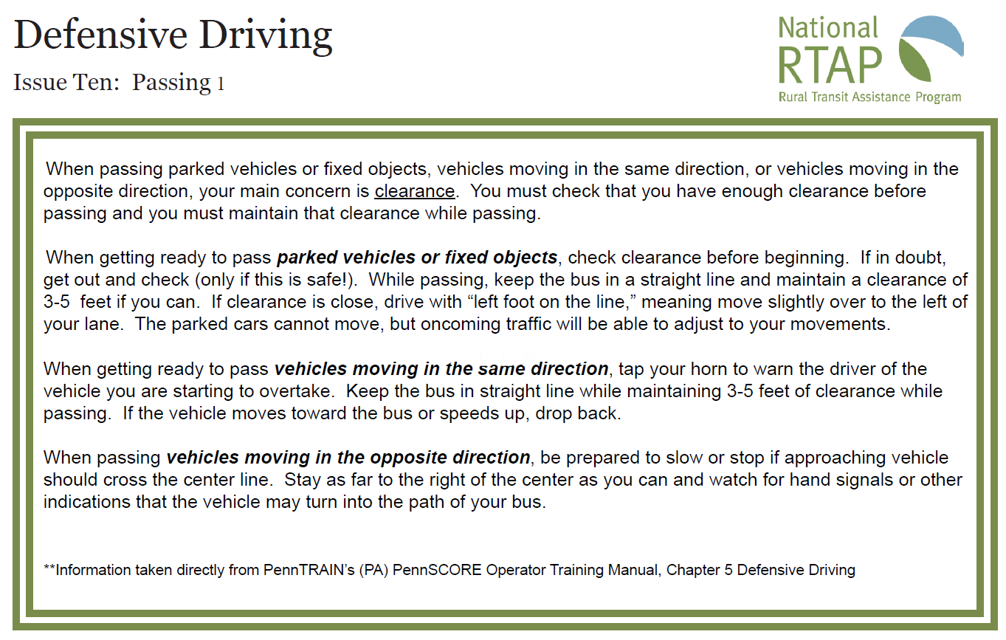

Slide 90
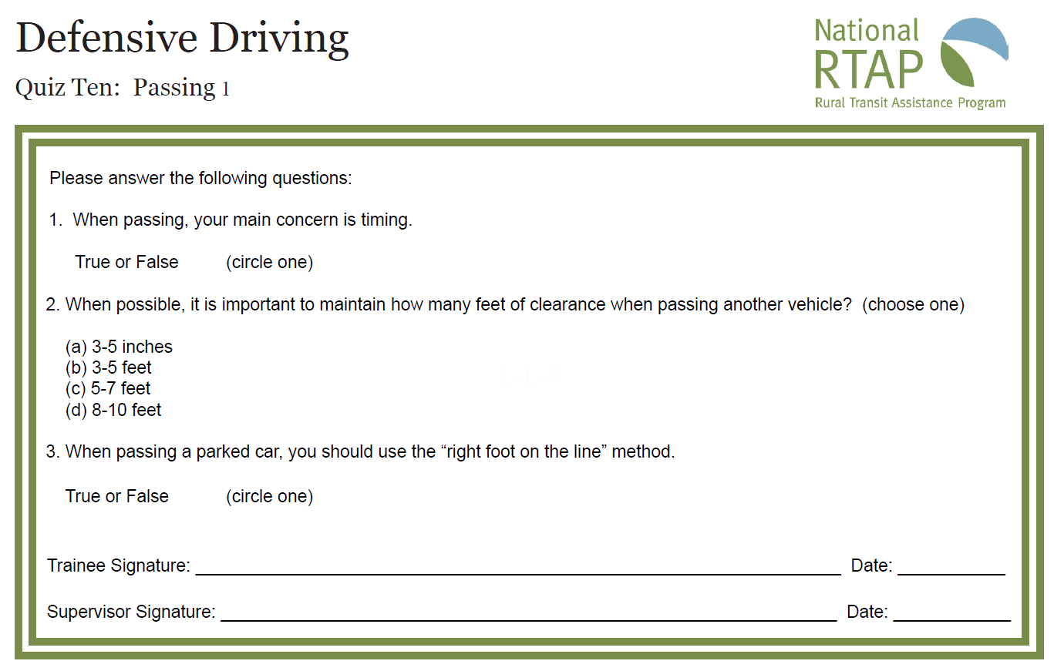

Slide 91
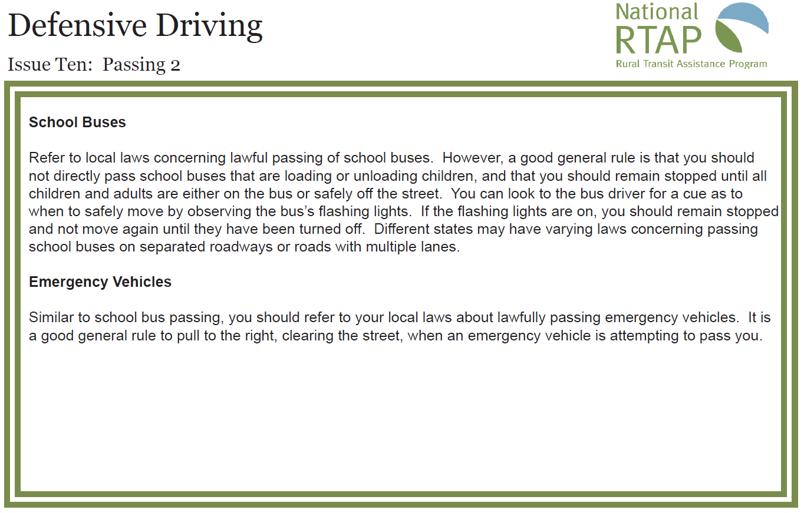

Slide 92
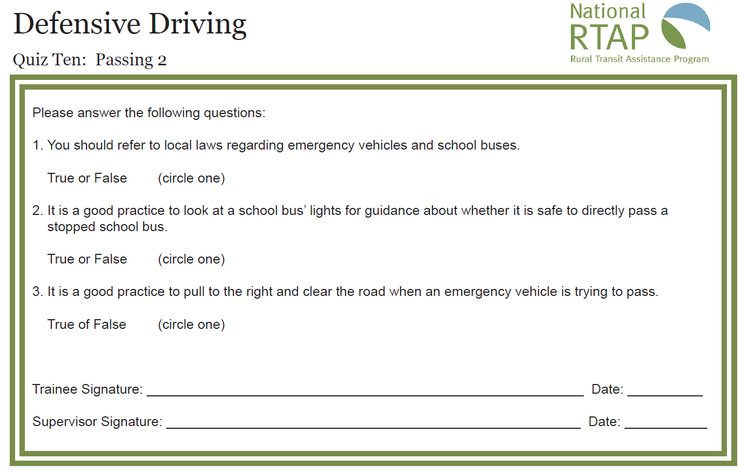

Slide 93
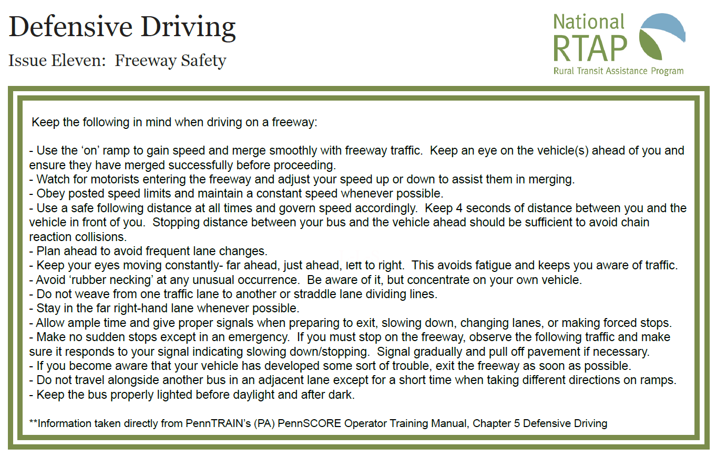

Slide 94


Slide 95


Slide 96


Slide 97


Slide 98


Slide 99


Slide 100


Slide 101
Session 4
Reading Traffic Situations: Part 2

Slide 102

Page 23
Question #16
You, “A” were driving on a two lane road where you drive almost everyday. You were very aware of the side road and vegetation. You spotted another vehicle “B” nosing out of a side road. You covered the brake as a precaution and made eye contact with the driver. You thought for certain that the driver would stay put. Instead the driver pulled out right in front of you and you collided.
What was wrong with “A’s” thinking in this situation?
How would you have handled this situation?

Slide 103

Pages 24 & 25
Question #17
In this situation assume that you are driving “A”
What hazards are you facing and how would you handle them
1. If exiting?
2. If not exiting?

Slide 104

Pages 26 & 27
If you were the driver of “A” in this situation how would you handle this situation?

Slide 105
What are the Fatal Four?
  Speeding.
  Right of Way.
  Driving Left of Center.
  Tailgating.
Notes:
106
What are the Fatal Four?
Speeding.
Right of Way.
Driving Left of Center.
Tailgating.

Slide 106

Speeding
Contributing factor in fatal crashes.
#1 unsafe driving behavior that contributes to violations and crashes.
Exceeding the posted speed limit or driving at an unsafe speed was the most common driving error and it costs nearly $41 billion annually.
Notes:
107
Contributing factor in fatal crashes.
#1 unsafe driving behavior that contributes to violations and crashes.
Exceeding the posted speed limit or driving at an unsafe speed was the most common driving error and it costs nearly $41 billion annually.

Slide 107
Determining the Safest Driving Speed
Know the speed limit.
Assess the driving conditions.
  The legal and posted speed limit may still be too fast.
  Adjust your vehicle speed to the conditions that require a slower and safe speed.
Notes:
108
Know the speed limit.
Assess the driving conditions.
The legal and posted speed limit may still be too fast.
Adjust your vehicle speed to the conditions that require a slower and safe speed.

Slide 108
Determining the Safest Driving Speeded
For every 10 miles per hour over 50 miles an hour, the risk of death in a traffic crash is doubled.
You may be required to reduce your speed in many driving situations. It is important to remember that increasing speed decreases your field of vision and puts you at greater risk of being involved in a crash.
Notes:
109
For every 10 miles per hour over 50 miles and hour, the risk of death in a traffic crash is doubled.
Review the chart.

Slide 109
Determining the Safest Driving Speeded
Minnesota’s basic speed law requires you to drive at a speed no faster than is reasonable under existing conditions. These include weather, traffic, and road conditions.
Driving faster than the posted speed limit is illegal. The posted speed limit is the maximum speed permitted on that particular road. However, the speed limit on two-lane highways with a posted speed limit of 55 mph or higher is increased by 10 mph when the driver is lawfully passing another vehicle in the same direction.
Minimum speed limits may be posted on some roads. It is illegal to drive slower than the posted minimum speed under normal weather, traffic, and road conditions.
Note: If you approach an intersection at an unlawful speed, you lose the right-of-way privilege associated with driving at a lawful speed.

Slide 110
Right of Way
"Nobody ever yielded their way into a collision."
It is not about who has the right of way.
It is about who shall yield the right of way.
Notes:
111
It is not about who has the right of way.
It is about who shall yield the right of way.

Slide 111



Slide 112
Right of Way and Yielding
Right-of-way and yielding laws help traffic flow smoothly and safely. They are based on courtesy and common sense. Violation of these laws is a leading cause of traffic crashes.
When two vehicles reach an intersection at the same time, and there is no traffic light or signal, the driver of the vehicle on the left must yield to the vehicle on the right.
When two vehicles reach an intersection at the same time, and all-way stop signs or flashing red traffic lights control the intersection, the driver on the left must yield right of way to the driver on the right
Drivers in the right lane of traffic must yield right of way to transit and metro mobility buses attempting to merge from a bus stop or shoulder. This includes yielding the right of way to any school bus attempting to enter that lane from a shoulder, a right-turn lane, or other location where the school bus has stopped to load or unload passengers. The school bus must use the left turn signal to indicate intent to move into the right-hand lane of traffic.

Slide 113
Right of Way
A good majority of urban crashes occur at intersections.
Intersection crashes in rural areas, although less common are often more serious because speed limits are higher.
Right-of-way violations are related to more injuries than any other improper driving behavior.
Notes:
114
A good majority of urban crashes occur at intersections.
Intersection crashes in rural areas, although less common are often more serious because speed limits are higher.
Right-of-way violations are related to more injuries than any other improper driving behavior.

Slide 114

Driving Left of Center
No vehicle shall be driven to the left side of the center of the roadway in overtaking and passing another vehicle proceeding in the same direction unless such left side is clearly visible and is free of oncoming traffic for a sufficient distance ahead to permit such overtaking and passing to be completely made ...
The manner in which you made the turn and caused the accident, or the manner in which you pulled your "car forward and out of the way" after the accident? The center of the road is the center of the road, whether or not it's marked

Slide 115
Tailgating
Final unsafe driving behavior that results in many crashes and violations.
Biggest hazard is a rear-end collision.
Ability to stop depends on vehicle weight, speed, road surface, driver and weather conditions.
Notes:
116
Final unsafe driving behavior that results in many crashes and violations.
Biggest hazard is a rear-end collision.
Ability to stop depends on vehicle weight, speed, road surface, driver and weather conditions.

Slide 116

What Do I Do With A Tailgater?
Notes:
117
Write down your answers on what you do with a tailgater.

Slide 117

Tailgating
Notes:
118
Final unsafe driving behavior that results in many crashes and violations.
Biggest hazard is a rear-end collision.
Ability to stop depends on vehicle weight, speed, road surface, driver and weather conditions.

Slide 118
Delayed Acceleration
You are the first vehicle at an intersection.
When the light turns green, wait two seconds before accelerating.
Notes:
119
You are the first vehicle at an intersection.
When the light turns green, wait two seconds before accelerating.

Slide 119
Defensive Driver Tips
Never enter an intersection you cannot exit.
Wait for the intersection to clear before entering it.
Be courteous in spite of other drivers being in a hurry.
Notes:
120
Never enter an intersection you cannot exit.
Wait for the intersection to clear before entering it.
Be courteous in spite of other drivers being in a hurry.

Slide 120
Distractions
Would you let a doctor operate on you while talking on a cell phone?
Safe driving requires all of your attention
Notes:
121

Slide 121
Distractions
Cell Phone Use:
People are as impaired when they drive and talk on a cell phone as they are when they drive intoxicated at the legal blood-alcohol limit of 0.08%.
Cell phone users are 5.36 times more likely to get into an accident than undistracted drivers.
Text messaging increases the risk of crash or near-crash by 23 times.
Sending or reading a text message takes your eyes off the road for about 5 seconds, long enough to cover a football field while driving at 55 mph

Slide 122
Distractions
Over 84% of drivers recognize the danger from cell phone distractions and find it “unacceptable” that drivers text or send email while driving.
Nevertheless, 36% of these same people admit to having read or sent a text message or e-mail while driving in the previous month
Notes:
123

Slide 123
Distractions
On average it takes 5 seconds to dial a cell phone
In one second at 55 MPH you can:
  Travel 80.7 feet
  Cross 4 lanes of traffic
Notes:
124

Slide 124
Distractions
200 Million cell phones in the United States (2005)
Recent: Hands free not a solution
May increase the danger
Notes:
125

Slide 125
Distractions
It takes only a second for road conditions to change
Every distracted second holds the potential for danger
65 MPH = 95.3 feet per second
Notes:
126

Slide 126
Distractions
Common distractions:
  Cell Phone
  Coffee
  Eating while driving
  Reading maps or directions
  Radio
Driver distractions are the cause of 25% of all collisions
Notes:
127

Slide 127


Slide 128


Slide 129


Slide 130


Slide 131


Slide 132


Slide 133
Session 5
Special Considerations

Slide 134
Page 28
19. Complete the following Sentenance
You should avoid ____ whenever possible
20. If you can not avoid backing, what are some steps you should take?_______
21. Complete the following sentence: Even in daylight hours when my windshield wipers are on I should?_______
22. At what speed and conditions can your vehicle hydroplane?

Slide 135
Page 29
23. If you are backing and are using a spotter, what are the safety consideration you should observe?_______
24. What are some of the hazards of driving in adverse conditions such as night and fog? ____
How do you compensate?

Slide 136
Are You A Psychological Time Bomb Behind the Wheel?
Notes:
137
Are You A Psychological Time Bomb Behind the Wheel?
Page 16

Slide 137
Questions To Ask Yourself
How easily do you become enraged by the actions of other drivers?
How often do you get angry while driving?
When you do get angry, do you take retaliatory, hostile actions?
Do you engage in “road rage” behavior?
Notes:
138
How easily do you become enraged by the actions of other drivers?
How often do you get angry while driving?
When you do get angry, do you take retaliatory, hostile actions?
Do you engage in “road rage” behavior?

Slide 138
Road Rage!!!
The violent actions that result when anger becomes rage
Increasing at 7% per year
50% increase in last seven years
Notes:
139

Slide 139
Road Rage!!!
Traffic experts believe that there is a close tie between road rage and distracted driving
Notes:
140

Slide 140
Taking Control of Aggressive Driving
Do you know the difference between aggressive driving and road rage?
Notes:
141
Do you know the difference between aggressive driving and road rage?

Slide 141
Aggressive Driving
Driving in a bold, selfish, or pushy manner without regard to the rights or safety of other drivers.
It is a ticketable offense.
Notes:
142
Driving in a bold, selfish, or pushy manner without regard to the rights or safety of other drivers.
It is a ticket able offense.

Slide 142
Dynamics Related to Aggressive Driving
Driving under the influence of impaired emotions.
Behavior is characterized by:
  impatience and inattentiveness,
  a power struggle, that often escalates into recklessness and road rage.
Notes:
143
Driving under the influence of impaired emotions.
Behavior is characterized by impatience and inattentiveness, a power struggle, that often escalates into recklessness and road rage.

Slide 143
Road Rage
Use of a vehicle as a weapon with intent to do harm.
Physical assault of a person or vehicle as a result of a traffic incident.
A criminal offense.
Notes:
144
Use of a vehicle as a weapon with intent to do harm.
Physical assault of a person or vehicle as a result of a traffic incident.
A criminal offense.

Slide 144

Notes:
145

Slide 145

Work Zones
Notes:
146
Work Zones

Slide 146

Roundabouts

Slide 147

Make sure you get the big picture also means look at the road for the directional advice they have painted for you…..

Slide 148

Truckee California

Slide 149

One lane round about.

Slide 150

WOW!!!!!!!

Slide 151

Another two lane round about.

Slide 152

Roundabouts

Slide 153


Slide 154
Railroad Crossings
11 times more likely to be fatal
Do not shift gears while crossing tracks
Don’t rely on RR crossing warning lights or gates
Watch for vehicles that are required to stop at crossings
Look for a second train

Slide 155


Slide 156


Slide 157


Slide 158


Slide 159


Slide 160


Slide 161


Slide 162
Self Appraisal
1. What is considered to be a safe following distance in ideal conditions when traveling at 50 mph?
2. What three Major factors determine your total stopping distance?
P______ D_____
R______ D_____
B______ D_____
3. How often should you check your mirrors?
4. Average reaction time is estimated to be?
5. What is your reaction time?
6. What can you do to reduce your reaction distance?

Slide 163
Self Appraisal
7. How far ahead should you Scan?
in the city?_______ on the highway____
8. Where are the blind spots on the vehicle you drive?
9. Can you do anything to reduce your blind spots?
10. About how far before a turn should you signal?
11. You should avoid backing whenever possible. However, when you must back what are some safety considerations you should keep in mind?

Slide 164
Self Appraisal
12. At what speed can your vehicle hydroplane?
13. How do you know when you are in another driver's blind spot?
14. What is your organization’s policy for using a communication device when driving?
15. What is the most hazardous situation on the route you usually drive?
16. What should you do when you have a tailgater?
17. What does the term “move over law” mean to you?

Slide 165
Physical Conditions
Mobility
  Some have physical limitations.
  May have difficulty performing even simple driving tasks
    such as turning to check blind spots around the vehicle,
    reaching the brake pedal in an emergency or
    adjusting mirrors.
Notes:
166
Mobility
Some have physical limitations.
May have difficulty performing even simple driving tasks such as turning to check blind spots around the vehicle, reaching the brake pedal in an emergency or adjusting mirrors.

Slide 166
Physical Conditions
Age
  You cannot change your age, but you can make up for it.
  Know your limitations and drive accordingly.
Notes:
167
Age
You cannot change your age, but you can make up for it.
Know your limitations and drive accordingly.
Experienced drivers have more patience, but fewer physical skills.
Younger drivers tend to have better eyesight, hearing and reaction time, but lack experience in recognizing hazards.

Slide 167
Remember a Defensive Driver…
Gives full attention to driving
Identifies hazards before they become dangerous situations
Drivers according to conditions

Slide 168
Remember
While you were in this class…
  40 people were killed!
  2880 were seriously injured
  There were 34 commercial vehicle crashes in Minnesota

Slide 169
In a perfect world…
Everyone would pay attention
Everyone would drive according to conditions
Everyone would show courtesy towards each other
I would be out of a job!!!

Slide 170
“It’s better to be careful a hundred times than to get killed once”
—Mark Twain

Slide 171
Safety does not happen by
ACCIDENT

Slide 172
THANK YOU!

