Slide 1
Driver Refresher Course
Rural Transit Assistance Program (RTAP)

Slide 2
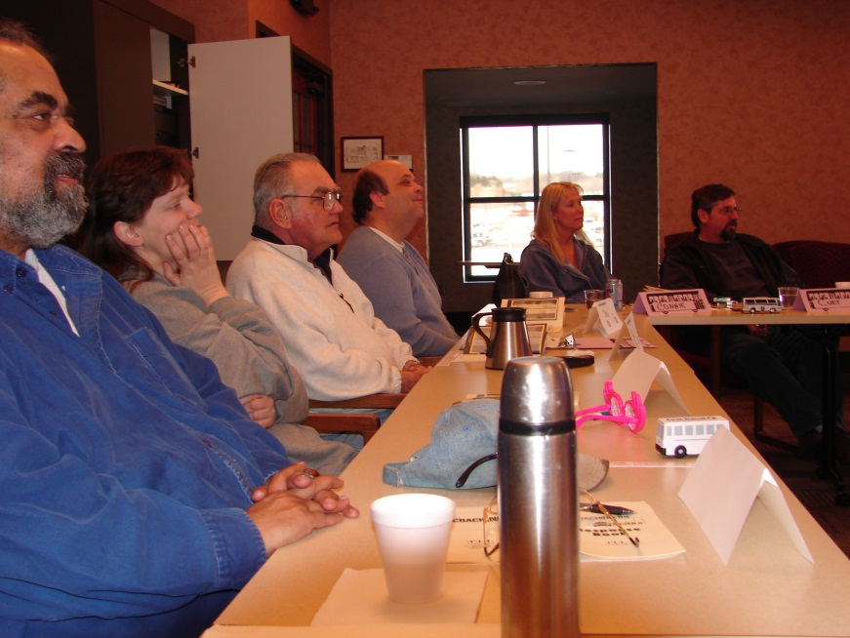
Welcome Drivers…
Housekeeping
Refreshments
Introductions

Slide 3
Class Overview…
What you will learn today

Slide 4
Abuse Prevention
You are the “eyes” and “ears” of your community…

Slide 5
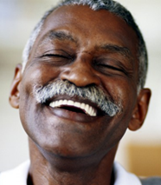
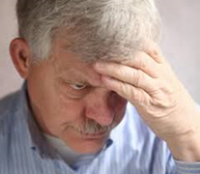
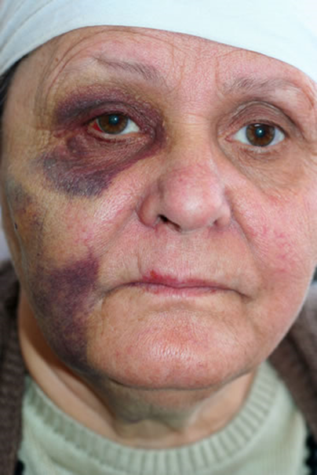
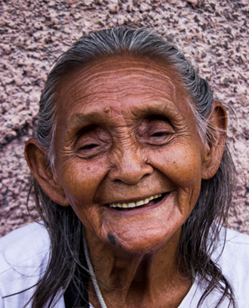
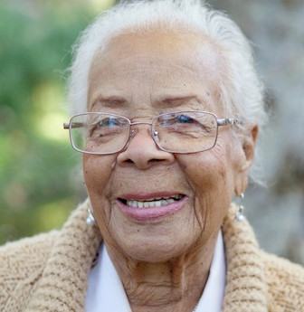
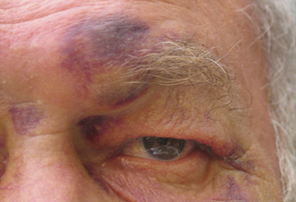
Who is a vulnerable adult?
Maltreatment Awareness
Notes:
Identify the maltreatment reporting requirements and process
Recognize potential impacts of reporting maltreatment
Identify professional boundaries to avoid accusations of maltreatment
Describe de-escalation techniques that reduce risk of harm in emotionally charged situations
When you have completed all the topics in this lesson, you will complete a short assessment to see how much you have learned.

Slide 6
A vulnerable adult can be anyone over the age of 18 who:
Maltreatment Awareness
Who is a vulnerable adult?
Has a physical, mental, or emotional disorder that makes it difficult for the person to care for themselves without help and to protect themselves from maltreatment.
Is in a hospital, nursing home, transitional care unit, assisted living, housing with services, board and care, foster care, or other licensed care facility.
Receives services such as home care, day services, personal care assistance, or other licensed services.
Minnesota Department of Human Services
Notes:
At the end of this training class, you will be able to:
Understand the MN laws pertaining to the Vulnerable Adult Act (VAA) and the Maltreatment of Minors Act (MMA)
Determine vulnerability given a scenario
Recognize maltreatment given a scenario

Slide 7
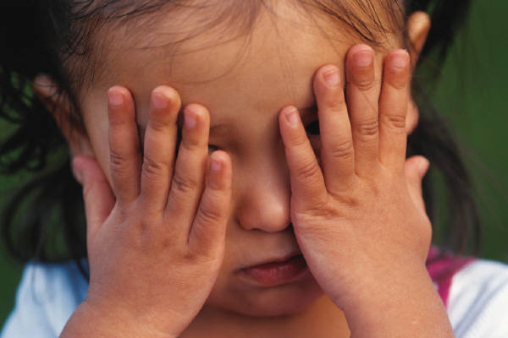
Vulnerable Adults and Minors…
Maltreatment Awareness
Minnesota’s Vulnerable Adults Act
  Types of maltreatment
Minnesota’s Maltreatment of Minors Act
  Types of abuse

Slide 8
What can be done to protect vulnerable adults and minors?
Maltreatment Awareness
The Minnesota Vulnerable Adults Act (VAA) was enacted in 1980 to ensure that vulnerable adults are safe in their living environments and in the receipt of health care and supportive services.
Executive Summary
https://www.house.leg.state.mn.us/hrd/pubs/vuladult.pdf
Notes:
Identify the maltreatment reporting requirements and process
Recognize potential impacts of reporting maltreatment
Identify professional boundaries to avoid accusations of maltreatment
Describe de-escalation techniques that reduce risk of harm in emotionally charged situations
When you have completed all the topics in this lesson, you will complete a short assessment to see how much you have learned.

Slide 9

Maltreatment Awareness
What is the Maltreatment of Minors Act?
The intent of the Maltreatment of Minors Act (MOMA) is to:
protect children and promote child safety;
strengthen the family;
make the home, school, and community safe for children by promoting responsible child care in all settings; and
provide, when necessary, a safe temporary or permanent home environment for physically or sexually abused or neglected children.
Notes:
How the Maltreatment of Minors Act (MOMA) protects minors:
MOMA was established to protect all children under the age of 18. All minors are considered to be vulnerable to physical abuse, neglect, or sexual abuse. This legislation protects minors by making the home, school and community safe for children. It provides for voluntary and required reporting of neglect and physical or sexual abuse of children that occurs in the home, school and community settings. It also provides for a safe home environment for physically or sexually abused or neglected children when necessary.

Slide 10
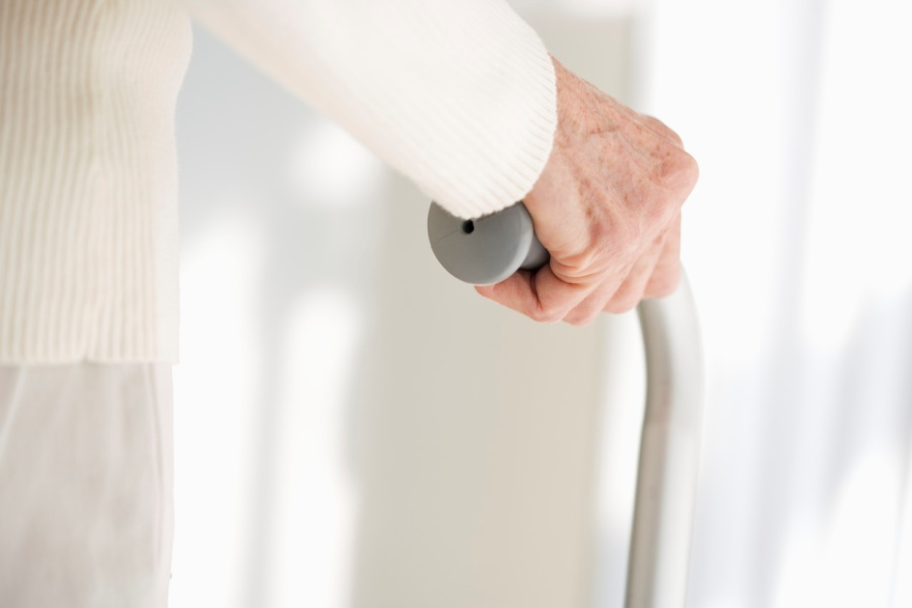
What is maltreatment of a vulnerable adult?
Maltreatment Awareness
Neglect
Two Types:
Staff inaction
Self-neglect
Notes:
Neglect is the failure to supply a vulnerable person with the basic care and services needed to obtain or maintain physical or mental health and safety. Care and services include things like food, clothing, shelter, healthcare and supervision.
Neglect can occur in many different areas of a person's life and may be the result of staff inaction, or self-neglect.
Knowing when a person has been neglected may be nearly impossible if you are unfamiliar with a passenger or have just picked them up for the first time. As you become familiar with your passengers and what is 'normal' for them, you will notice there are changes that may be signs of neglect.
Because drivers do not provide most of the basic needs of their passengers, it is necessary to watch for signs of neglect from their places of residence or work.
Staff inaction neglect occurs when a vulnerable person is not receiving the care or supervision they need from someone who is responsible to care for them.

Slide 11
What is maltreatment of a vulnerable adult?
Maltreatment Awareness
Type of Maltreatment | Kinds | Examples
Abuse | Criminal Activity Staff Inaction | Physical assault Sexual abuse
Neglect | Staff Inaction Self | Caretaker fails to supply basic needs Inability to take care of self
Financial Exploitation | Stealing Third party exploitation Harassment, deception, or fraud Forcing against will | Taking money or possession Forcing payment for service not desired Tricking someone into payment Making someone feel obligated
Notes:
This chart is a snapshot of the 3 categories of maltreatment that apply to vulnerable adults; abuse, neglect and financial exploitation. Let's look at the definitions and review each category starting with abuse.

Slide 12
Who is a minor?
Maltreatment Awareness
Minnesota Statute 645.451 defines a “minor” as an individual under the age of 18.
Notes:
Identify the maltreatment reporting requirements and process
Recognize potential impacts of reporting maltreatment
Identify professional boundaries to avoid accusations of maltreatment
Describe de-escalation techniques that reduce risk of harm in emotionally charged situations
When you have completed all the topics in this lesson, you will complete a short assessment to see how much you have learned.

Slide 13
What is maltreatment of a minor?
Maltreatment Awareness
Myths and facts about child abuse and neglect
Myth: Only bad people abuse their children.
Fact: Not all abusive parents or guardians intentionally harm their children. Many have been victims of abuse themselves and don’t know any other way to parent. Others may be struggling with mental health issues or substance abuse problems.
https://www.helpguide.org/articles/abuse/child-abuse-and%20neglect.htm
Notes:
How the Maltreatment of Minors Act (MOMA) protects minors:
MOMA was established to protect all children under the age of 18. All minors are considered to be vulnerable to physical abuse, neglect, or sexual abuse. This legislation protects minors by making the home, school and community safe for children. It provides for voluntary and required reporting of neglect and physical or sexual abuse of children that occurs in the home, school and community settings. It also provides for a safe home environment for physically or sexually abused or neglected children when necessary.

Slide 14
Maltreatment Awareness
What is maltreatment of a minor?
Myths and facts about child abuse and neglect
Myth: Most child abusers are strangers.
Fact: While abuse by strangers does happen, most abusers are family members or others close to the family.
https://www.helpguide.org/articles/abuse/child-abuse-and%20neglect.htm
Notes:
How the Maltreatment of Minors Act (MOMA) protects minors:
MOMA was established to protect all children under the age of 18. All minors are considered to be vulnerable to physical abuse, neglect, or sexual abuse. This legislation protects minors by making the home, school and community safe for children. It provides for voluntary and required reporting of neglect and physical or sexual abuse of children that occurs in the home, school and community settings. It also provides for a safe home environment for physically or sexually abused or neglected children when necessary.

Slide 15
What is the Vulnerable Adults Act?
Maltreatment Awareness
In addition, the Vulnerable Adults Act (VAA) requires:
reporting of suspected maltreatment of vulnerable adults,
provision for the voluntary reporting of maltreatment of vulnerable adults,
investigation of the reports, and
provision of protective and counseling services in appropriate cases.
Notes:
How the Maltreatment of Minors Act (MOMA) protects minors:
MOMA was established to protect all children under the age of 18. All minors are considered to be vulnerable to physical abuse, neglect, or sexual abuse. This legislation protects minors by making the home, school and community safe for children. It provides for voluntary and required reporting of neglect and physical or sexual abuse of children that occurs in the home, school and community settings. It also provides for a safe home environment for physically or sexually abused or neglected children when necessary.

Slide 16
Who is Required to Report Maltreatment?
Maltreatment Awareness
Notes:
How the Maltreatment of Minors Act (MOMA) protects minors:
MOMA was established to protect all children under the age of 18. All minors are considered to be vulnerable to physical abuse, neglect, or sexual abuse. This legislation protects minors by making the home, school and community safe for children. It provides for voluntary and required reporting of neglect and physical or sexual abuse of children that occurs in the home, school and community settings. It also provides for a safe home environment for physically or sexually abused or neglected children when necessary.

Slide 17

How to report maltreatment…
Maltreatment Awareness
Are you mandated?
Using a Common Entry Point
Reporting inside your organization
Your role as an “observer”

Slide 18
Who is required to report maltreatment?
Maltreatment Awareness
Minnesota Statutes 626.557, Reporting of Maltreatment of Vulnerable Adults; and 626.556, Reporting of Maltreatment of Minors state:
A person required to report maltreatment, a mandated reporter, includes
    law enforcement,
    educators,
    doctors,
    nurses,
    social workers, and
    other licensed professionals.
Notes:
How the Maltreatment of Minors Act (MOMA) protects minors:
MOMA was established to protect all children under the age of 18. All minors are considered to be vulnerable to physical abuse, neglect, or sexual abuse. This legislation protects minors by making the home, school and community safe for children. It provides for voluntary and required reporting of neglect and physical or sexual abuse of children that occurs in the home, school and community settings. It also provides for a safe home environment for physically or sexually abused or neglected children when necessary.

Slide 19
Maltreatment Awareness
Who is required to report maltreatment?
Minnesota Statutes 626.557, Reporting of Maltreatment of Vulnerable Adults; and 626.556, Reporting of Maltreatment of Minors state:
However,
anyone who suspects maltreatment can voluntarily report.
Notes:
How the Maltreatment of Minors Act (MOMA) protects minors:
MOMA was established to protect all children under the age of 18. All minors are considered to be vulnerable to physical abuse, neglect, or sexual abuse. This legislation protects minors by making the home, school and community safe for children. It provides for voluntary and required reporting of neglect and physical or sexual abuse of children that occurs in the home, school and community settings. It also provides for a safe home environment for physically or sexually abused or neglected children when necessary.

Slide 20
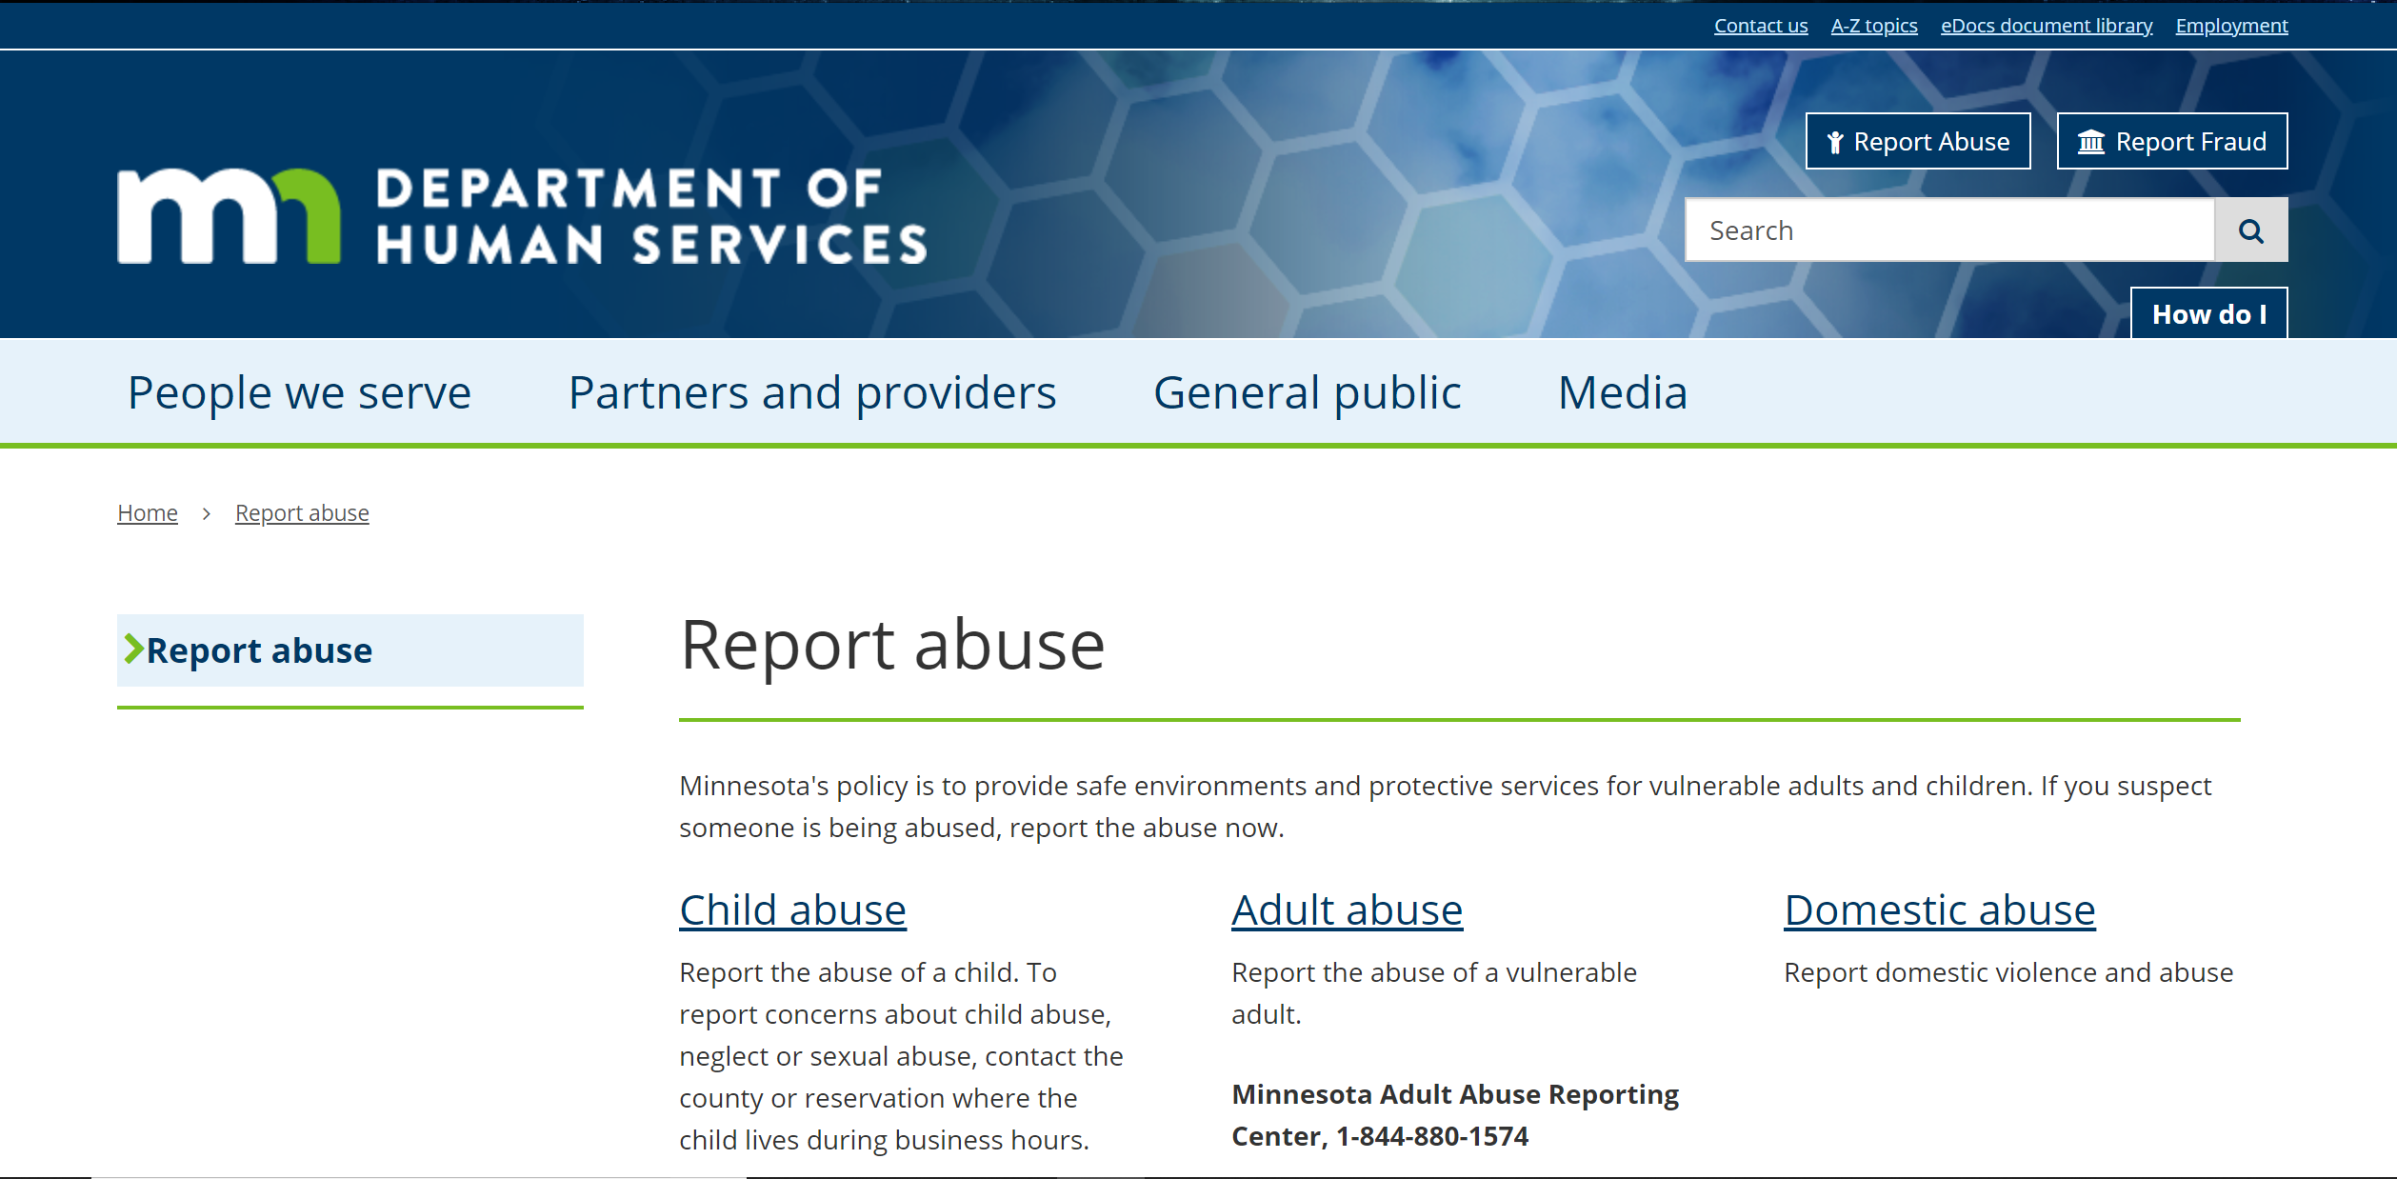
Who is required to report maltreatment?
Maltreatment Awareness
https://mn.gov./dhs/report-abuse/
Notes:
How the Maltreatment of Minors Act (MOMA) protects minors:
MOMA was established to protect all children under the age of 18. All minors are considered to be vulnerable to physical abuse, neglect, or sexual abuse. This legislation protects minors by making the home, school and community safe for children. It provides for voluntary and required reporting of neglect and physical or sexual abuse of children that occurs in the home, school and community settings. It also provides for a safe home environment for physically or sexually abused or neglected children when necessary.

Slide 21

Statistics
Maltreatment Awareness
The National Crime Victim Survey found that:
people with disabilities experience higher rates of violence than people without disabilities
  40 victimizations per 1,000 persons with disabilities compared to about 20 per 1,000 without disabilities, and
people with cognitive disabilities (or intellectual disabilities) experienced the highest risk of violent victimization
Notes:
How the Maltreatment of Minors Act (MOMA) protects minors:
MOMA was established to protect all children under the age of 18. All minors are considered to be vulnerable to physical abuse, neglect, or sexual abuse. This legislation protects minors by making the home, school and community safe for children. It provides for voluntary and required reporting of neglect and physical or sexual abuse of children that occurs in the home, school and community settings. It also provides for a safe home environment for physically or sexually abused or neglected children when necessary.

Slide 22
Statistics
Maltreatment Awareness
Other studies consistently demonstrate or suggest that people with intellectual disabilities are sexually victimized more often than others who do not have a disability.
For example,
25 percent of girls and women with intellectual disabilities who were referred for birth control had a history of sexual violence.
49 percent of people with intellectual disabilities will experience 10 or more sexually abusive incidents.
Notes:
How the Maltreatment of Minors Act (MOMA) protects minors:
MOMA was established to protect all children under the age of 18. All minors are considered to be vulnerable to physical abuse, neglect, or sexual abuse. This legislation protects minors by making the home, school and community safe for children. It provides for voluntary and required reporting of neglect and physical or sexual abuse of children that occurs in the home, school and community settings. It also provides for a safe home environment for physically or sexually abused or neglected children when necessary.

Slide 23
Statistics
Maltreatment Awareness
Perpetrators are often those who are known by the victim, such as:
      family members,
      acquaintances,
      residential care staff,
      transportation providers, and
      personal care attendants.
Notes:
How the Maltreatment of Minors Act (MOMA) protects minors:
MOMA was established to protect all children under the age of 18. All minors are considered to be vulnerable to physical abuse, neglect, or sexual abuse. This legislation protects minors by making the home, school and community safe for children. It provides for voluntary and required reporting of neglect and physical or sexual abuse of children that occurs in the home, school and community settings. It also provides for a safe home environment for physically or sexually abused or neglected children when necessary.

Slide 24

Statistics
Maltreatment Awareness
The National Council on Aging suggests:
Approximately 1 in 10 Americans aged 60+ have experienced some form of elder abuse.
Some estimates range as high as 5 million elders who are abused each year.
One study estimated that only 1 in 14 cases of abuse are reported to authorities.
https://www.ncoa.org
Notes:
How the Maltreatment of Minors Act (MOMA) protects minors:
MOMA was established to protect all children under the age of 18. All minors are considered to be vulnerable to physical abuse, neglect, or sexual abuse. This legislation protects minors by making the home, school and community safe for children. It provides for voluntary and required reporting of neglect and physical or sexual abuse of children that occurs in the home, school and community settings. It also provides for a safe home environment for physically or sexually abused or neglected children when necessary.

Slide 25
Statistics
Maltreatment Awareness
The National Council on Aging suggests:
The abuser in almost 60% of elder abuse and neglect incidents is a family member
Two-thirds of perpetrators are adult children or spouses
Nearly half of those with dementia experienced abuse or neglect
Interpersonal violence also occurs at disproportionately higher rates among adults with disabilities
https://www.ncoa.org
Notes:
How the Maltreatment of Minors Act (MOMA) protects minors:
MOMA was established to protect all children under the age of 18. All minors are considered to be vulnerable to physical abuse, neglect, or sexual abuse. This legislation protects minors by making the home, school and community safe for children. It provides for voluntary and required reporting of neglect and physical or sexual abuse of children that occurs in the home, school and community settings. It also provides for a safe home environment for physically or sexually abused or neglected children when necessary.

Slide 26

Statistics
Maltreatment Awareness
The American Society for the Positive Treatment of Children found that in 2017:
4.1 million child maltreatment referral reports received
Child abuse reports involved 7.5 million children
74.9% of victims are neglected
18.3% of victims are physically abused
8.6% of victims are sexually abused
7.1% of victims are psychologically maltreated
https://americanspcc.org/child-abuse-statistics/
Notes:
How the Maltreatment of Minors Act (MOMA) protects minors:
MOMA was established to protect all children under the age of 18. All minors are considered to be vulnerable to physical abuse, neglect, or sexual abuse. This legislation protects minors by making the home, school and community safe for children. It provides for voluntary and required reporting of neglect and physical or sexual abuse of children that occurs in the home, school and community settings. It also provides for a safe home environment for physically or sexually abused or neglected children when necessary.

Slide 27
Maltreatment Awareness
Recognizing Something May Be Wrong
Notes:
How the Maltreatment of Minors Act (MOMA) protects minors:
MOMA was established to protect all children under the age of 18. All minors are considered to be vulnerable to physical abuse, neglect, or sexual abuse. This legislation protects minors by making the home, school and community safe for children. It provides for voluntary and required reporting of neglect and physical or sexual abuse of children that occurs in the home, school and community settings. It also provides for a safe home environment for physically or sexually abused or neglected children when necessary.

Slide 28



Maltreatment Awareness
Independent Living
Field Data Technician
Putting those skills to work
Powers of Observation

Slide 29

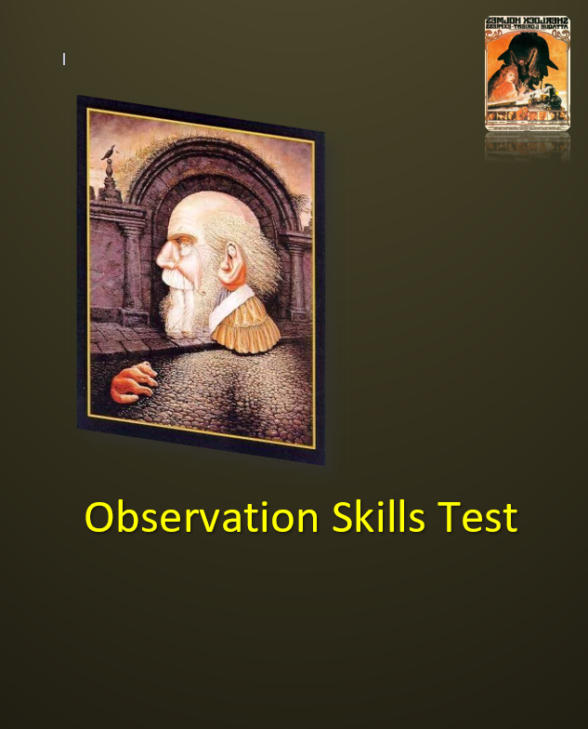
Recognizing something may be wrong
Maltreatment Awareness
Group Exercise
Observation Skills Test
Notes:
How the Maltreatment of Minors Act (MOMA) protects minors:
MOMA was established to protect all children under the age of 18. All minors are considered to be vulnerable to physical abuse, neglect, or sexual abuse. This legislation protects minors by making the home, school and community safe for children. It provides for voluntary and required reporting of neglect and physical or sexual abuse of children that occurs in the home, school and community settings. It also provides for a safe home environment for physically or sexually abused or neglected children when necessary.

Slide 30
Notes:
How the Maltreatment of Minors Act (MOMA) protects minors:
MOMA was established to protect all children under the age of 18. All minors are considered to be vulnerable to physical abuse, neglect, or sexual abuse. This legislation protects minors by making the home, school and community safe for children. It provides for voluntary and required reporting of neglect and physical or sexual abuse of children that occurs in the home, school and community settings. It also provides for a safe home environment for physically or sexually abused or neglected children when necessary.

Slide 31
IF YOUR SCORE IS | IT MEANS…
0 – 5 | Your observation skills are in need of a little work. You could improve your power of observation by focusing more on the world around you and taking notice of the details, color, and depth.
6 TO 11 | You have good observation powers. You don’t get lost in the little details. You may miss a few things that are going on around, but you notice the important things.
12 TO 16 | You have great observation powers. You notice much more than the average person. You are very in tune to the world around you and you notice the little things.
17 TO 21 | You have fantastic powers of observation. Not much gets by you.
Notes:
How the Maltreatment of Minors Act (MOMA) protects minors:
MOMA was established to protect all children under the age of 18. All minors are considered to be vulnerable to physical abuse, neglect, or sexual abuse. This legislation protects minors by making the home, school and community safe for children. It provides for voluntary and required reporting of neglect and physical or sexual abuse of children that occurs in the home, school and community settings. It also provides for a safe home environment for physically or sexually abused or neglected children when necessary.

Slide 32
Maltreatment Awareness
Recognizing something may be wrong
The observation skills we just tested are essential in recognizing maltreatment.
Another skill that is just as critical is LISTENING!
Notes:
How the Maltreatment of Minors Act (MOMA) protects minors:
MOMA was established to protect all children under the age of 18. All minors are considered to be vulnerable to physical abuse, neglect, or sexual abuse. This legislation protects minors by making the home, school and community safe for children. It provides for voluntary and required reporting of neglect and physical or sexual abuse of children that occurs in the home, school and community settings. It also provides for a safe home environment for physically or sexually abused or neglected children when necessary.

Slide 33
Recognizing something may be wrong
Maltreatment Awareness
Listening with Intent
Notes:
How the Maltreatment of Minors Act (MOMA) protects minors:
MOMA was established to protect all children under the age of 18. All minors are considered to be vulnerable to physical abuse, neglect, or sexual abuse. This legislation protects minors by making the home, school and community safe for children. It provides for voluntary and required reporting of neglect and physical or sexual abuse of children that occurs in the home, school and community settings. It also provides for a safe home environment for physically or sexually abused or neglected children when necessary.

Slide 34
Recognizing something may be wrong
Maltreatment Awareness
Most people do not listen with the intent to understand; we listen with the intent to reply.
We're either speaking or preparing to speak.
We're filtering everything through our own experiences, preparing to respond based on how what we hear has affected us.
Notes:
How the Maltreatment of Minors Act (MOMA) protects minors:
MOMA was established to protect all children under the age of 18. All minors are considered to be vulnerable to physical abuse, neglect, or sexual abuse. This legislation protects minors by making the home, school and community safe for children. It provides for voluntary and required reporting of neglect and physical or sexual abuse of children that occurs in the home, school and community settings. It also provides for a safe home environment for physically or sexually abused or neglected children when necessary.

Slide 35
Recognizing something may be wrong
Maltreatment Awareness
"Oh, I know exactly how you feel!"
"I went through the very same thing.
Let me tell you about my experience."
Notes:
How the Maltreatment of Minors Act (MOMA) protects minors:
MOMA was established to protect all children under the age of 18. All minors are considered to be vulnerable to physical abuse, neglect, or sexual abuse. This legislation protects minors by making the home, school and community safe for children. It provides for voluntary and required reporting of neglect and physical or sexual abuse of children that occurs in the home, school and community settings. It also provides for a safe home environment for physically or sexually abused or neglected children when necessary.

Slide 36
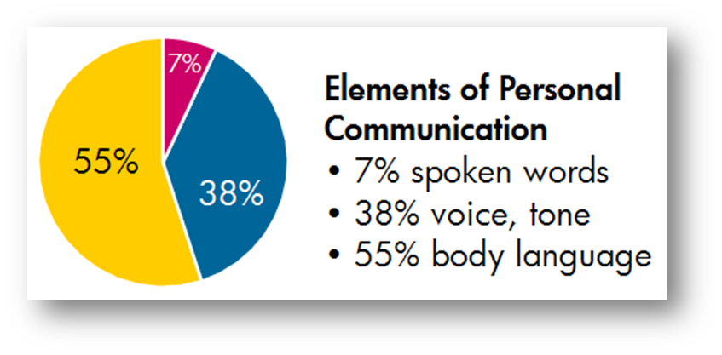
Recognizing something may be wrong
Maltreatment Awareness
Listening with intent involves much more than acknowledging that you heard the person or ensuring that you understand the words that were used.
Most communications experts estimate that:
Notes:
How the Maltreatment of Minors Act (MOMA) protects minors:
MOMA was established to protect all children under the age of 18. All minors are considered to be vulnerable to physical abuse, neglect, or sexual abuse. This legislation protects minors by making the home, school and community safe for children. It provides for voluntary and required reporting of neglect and physical or sexual abuse of children that occurs in the home, school and community settings. It also provides for a safe home environment for physically or sexually abused or neglected children when necessary.

Slide 37
Recognizing something may be wrong
Maltreatment Awareness
Listening with Intent
Hopefully you are listening with your ears.
More importantly however you must listen with your eyes and with your heart. You listen for:
  Feeling
  Meaning
  Behavior
Notes:
How the Maltreatment of Minors Act (MOMA) protects minors:
MOMA was established to protect all children under the age of 18. All minors are considered to be vulnerable to physical abuse, neglect, or sexual abuse. This legislation protects minors by making the home, school and community safe for children. It provides for voluntary and required reporting of neglect and physical or sexual abuse of children that occurs in the home, school and community settings. It also provides for a safe home environment for physically or sexually abused or neglected children when necessary.

Slide 38
Recognizing something may be wrong
Maltreatment Awareness
Listening with Intent
Listening with intent provides much more accurate data to work with.
Instead of preparing ourselves to respond to what is being said we are listening intently for the entire message.
Notes:
How the Maltreatment of Minors Act (MOMA) protects minors:
MOMA was established to protect all children under the age of 18. All minors are considered to be vulnerable to physical abuse, neglect, or sexual abuse. This legislation protects minors by making the home, school and community safe for children. It provides for voluntary and required reporting of neglect and physical or sexual abuse of children that occurs in the home, school and community settings. It also provides for a safe home environment for physically or sexually abused or neglected children when necessary.

Slide 39
Maltreatment Awareness
Recognizing something may be wrong
Listening with Intent
We are watching for visual cues that may either confirm or contradict the words being spoken.
  Does the person’s body language suggest they are uncomfortable with what they are saying or what we are asking?
  Is the person constantly looking away when answering your questions?
  Does the person’s tone of voice change?
Notes:
How the Maltreatment of Minors Act (MOMA) protects minors:
MOMA was established to protect all children under the age of 18. All minors are considered to be vulnerable to physical abuse, neglect, or sexual abuse. This legislation protects minors by making the home, school and community safe for children. It provides for voluntary and required reporting of neglect and physical or sexual abuse of children that occurs in the home, school and community settings. It also provides for a safe home environment for physically or sexually abused or neglected children when necessary.

Slide 40
Maltreatment Awareness
Recognizing something may be wrong
Listening with Intent
We are not projecting our personal experiences into the conversation.
Instead of occupying our mind with how to relate what the person is saying to something in our life, we are focusing on the person and their situation.
Notes:
How the Maltreatment of Minors Act (MOMA) protects minors:
MOMA was established to protect all children under the age of 18. All minors are considered to be vulnerable to physical abuse, neglect, or sexual abuse. This legislation protects minors by making the home, school and community safe for children. It provides for voluntary and required reporting of neglect and physical or sexual abuse of children that occurs in the home, school and community settings. It also provides for a safe home environment for physically or sexually abused or neglected children when necessary.

Slide 41

What you can do to prevent maltreatment…
Maltreatment Awareness
Receiving gifts from customers
Keeping conversations appropriate
Being mindful of body language

Slide 42
Defensive Driving
Driving professionally means driving safely…

Slide 43
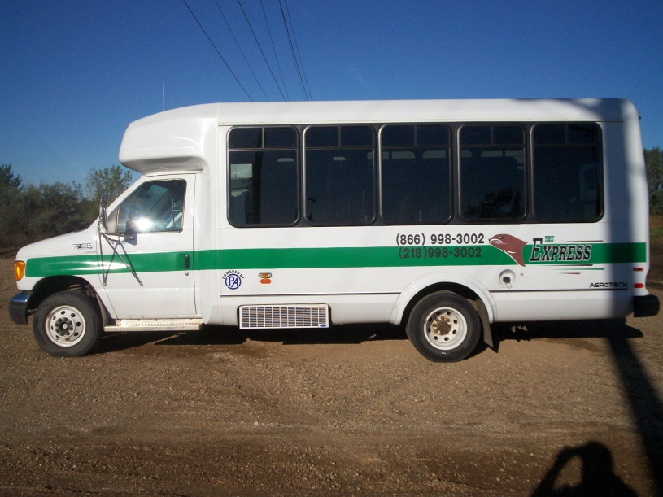
Why driving a bus is different…
Bus size
Bus shape
Bus weight
How weather and road conditions effect stability

Slide 44
Pre-trip vehicle inspection
What is your organization's policy regarding inspecting your vehicle?
Where are the blind spots on the vehicle you drive?
Proper mirror adjustment: will it eliminate all your blind spots?
How should you adjust your mirrors?

Slide 45
Risk on the road
A crash occurs every 5 seconds
Traffic injury every 10 seconds
A fatality every 12 minutes
Alcohol related fatality every 31 minutes
Pedestrian killed every 113 minutes

Slide 46
Risk on the road
37,133 people died in motor vehicle crashes in 2017 that is 673 fewer than in 2016. That comes after back-to-back years of increases.
Data also shows that alcohol-impaired driving played a role in 29% of all roadway deaths. Distracted drivers were involved in 8.5% of the fatalities, while drowsy driving accounted for 2.1%. Around 47% of vehicle occupants in fatal crashes were not using seat belts or other restraints.
Distracted driving crashes are under-reported and the NSC estimates that cell phone use alone accounted for 27% of 2015 car crashes.
In 2015, there were 3,477 people killed and an estimated additional 391,000 injured in crashes involving distracted drivers.

Slide 47
The Five KEYS
Aim high in steering
Get the big picture
Keep your eyes moving
Leave yourself and out
Make sure they see you

Slide 48
Defensive Driving
Making safe and legal driving decisions
Creating a safe, stress free environment around your vehicle
Driving to your destination safely without a ticket, crash, or affecting others’ safety
Practicing common sense, courtesy, and cooperation
Recognizing the risks of hazardous driving behaviors and conditions

Slide 49
Defensive Driving is driving to save lives, time, and money in spite of the conditions around you and the actions of others

Slide 50
Defensive Driving
  Act in time
  Always stay alert, focus on the driving task so you don’t lose response time.
  Choose the safest driving maneuver to avoid a crash.
  Remember: other drivers may act in time, but they may act incorrectly.
Notes:
50
Act in Time.
Always stay alert, focus on the driving task so you don’t lose response time.
Choose the safest driving maneuver to avoid a crash.
Remember other drivers may act in time, but they may act incorrectly.

Slide 51
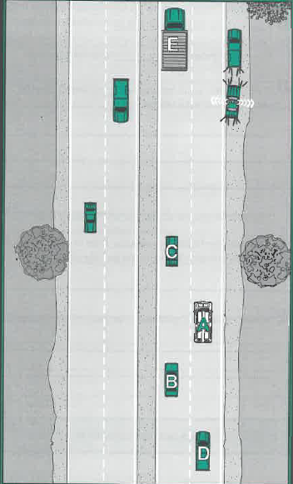
Pages 26 & 27
If you were the driver of “A” in this situation, how would you handle this situation?

Slide 52
Cell Phone Use
Who can tell me what the new cell phone law in MN is?
What does this mean to you?

Slide 53
Distractions
Cell Phone Use
People are as impaired when they drive and talk on a cell phone as they are when they drive intoxicated at the legal blood-alcohol limit of 0.08%.
Cell phone users are 5.36 times more likely to get into an accident than undistracted drivers.
Text messaging increases the risk of crash or near-crash by 23 times.
Sending or reading a text message takes your eyes off the road for about 5 seconds, long enough to cover a football field while driving at 55 mph

Slide 54
Distractions
Over 84% of drivers recognize the danger from cell phone distractions and find it “unacceptable” that drivers text or send email while driving.
Nevertheless, 36% of these same people admit to having read or sent a text message or e-mail while driving in the previous month.
Notes:
54

Slide 55
Distractions
On average it takes 5 seconds to dial a cell phone.
In one second at 55 mph you can:
Travel 80.7 feet
Cross 4 lanes of traffic
Notes:
55

Slide 56
Remember, a defensive driver:
Gives full attention to driving
Identifies hazards before they become dangerous situations
Drives according to conditions

Slide 57
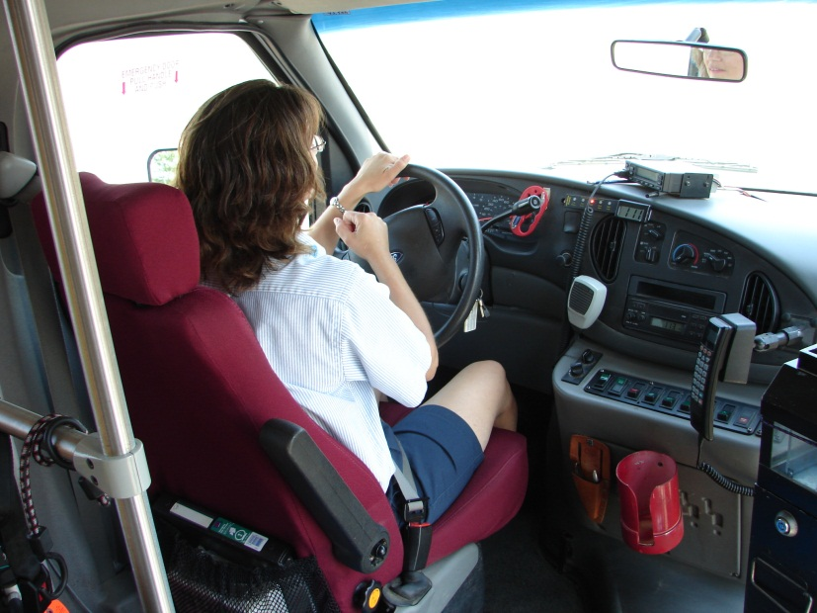
Skills for driving defensively…
Avoid backing your vehicle
4-second following distance
Don’t rush
Maintain a “cushion of safety”
Be aware of your surroundings

Slide 58

Driver Review and Discussion…
Review important points and key facts
What did I learn today?
Questions

Slide 59
Passenger Assistance
Respect and safety are the best customer service policies…

Slide 60
Characteristics of a Professional
Each is…
  …specially trained for a job
  …required to have special skills
  …required to meet licensing standards
  …provides a valuable service

Slide 61
Characteristics of a Professional
The final characteristic of a professional is high level performance at all times.
It’s easy to be positive, feel good, and treat others well when everything is fine. The difficulty comes when things are NOT going well. This is the true test of your skill as a professional.

Slide 62
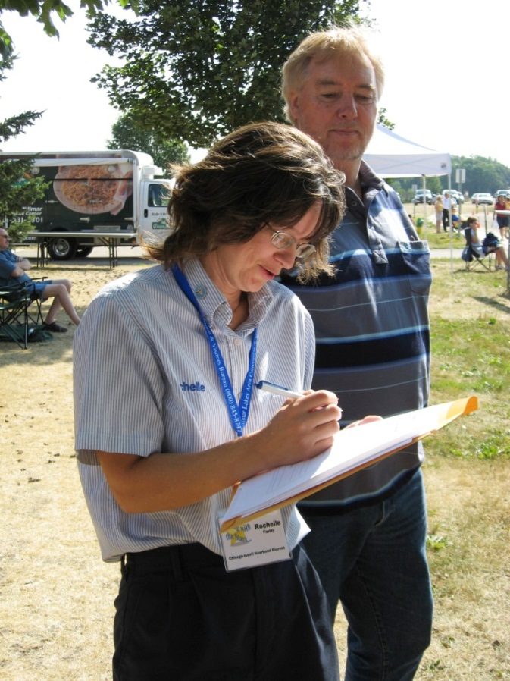
Professionals are prepared…
Know where you are going first
Resolve scheduling problems before departure
Dress professionally
  Uniform, sunglasses,
  non-slip shoes, and gloves

Slide 63
When being pleasant to passengers is not easy, try following one or more of these techniques:
Refocus — Think about positive things in order to stop thinking about negative things.
Talk it out — Talk with other operators and supervisors.
Understand — If there is a problem, contribute to the solution as best you can.

Slide 64
Characteristics of a professional
  Make the ride safe and comfortable
  Handle any problems that occur
  Follow special instructions
  Keep accurate and timely records of your work

Slide 65
Keep in mind
  Good performance is taken for granted – poor performance is always recognized.

Slide 66
Tips for talking with passengers
Support and explain agency policies when dealing with passengers.
Speak positively about your agency. Avoid talking about how tough your job is.
Talk over agency/organization problems with supervisors – NOT passengers.

Slide 67
Three basic rules or skills that you must know and follow:
Provide safe, reliable and expert service
      Drive safely and smoothly at all times
      Speak clearly, calmly, and with respect
      Offer assistance to every passenger

Slide 68
The driver is the most important asset of a transit agency. However, the most important person of the transit agency is the customer. Without the customer, there is no agency.

Slide 69
Consider these facts
  As a driver, you represent your employer.
  In the course of a day, you have more contact with the public than any other employee of your agency.
  A large number of motorists and pedestrians see your vehicle.

Slide 70
You are responsible for passenger safety. Therefore, assistance must be offered to every passenger, every day. You are responsible for assisting passengers in and out of the vehicle.

Slide 71
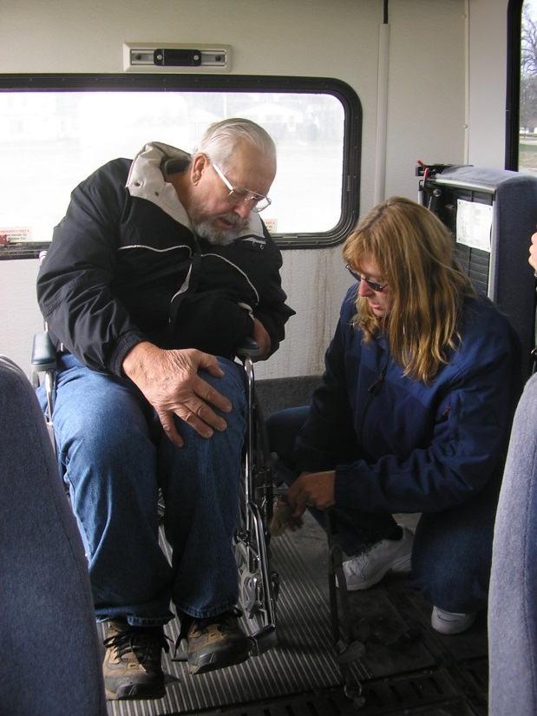
Passenger Assistance
"Assisting Your Transit Passengers" video
Working with wheelchairs and lifts
Working with your passengers
Guiding your passengers
Working with service animals

Slide 72


Slide 73
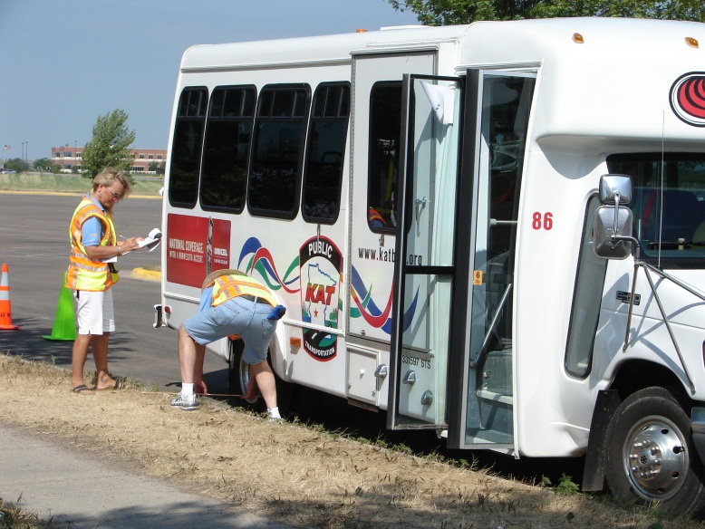
Pre-trip inspection: A MUST
Prevent breakdowns and emergencies
Perform a “visual” check
Inside and outside of vehicle
Use a check list

Slide 74
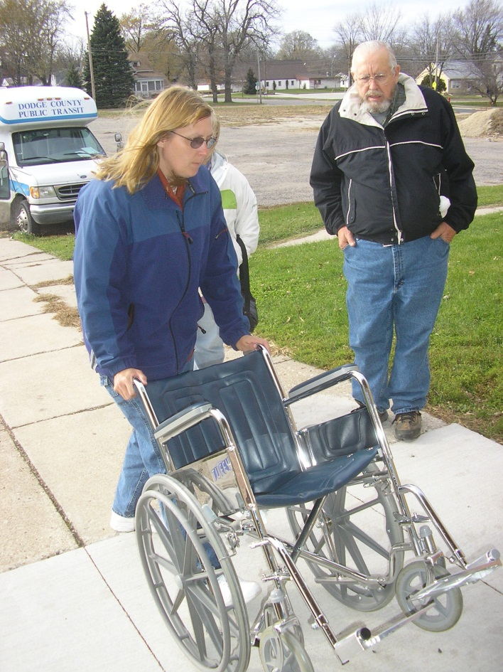
Working with wheelchairs and lifts…
Who can use a lift?
Lift basics
Wheelchair safety and etiquette
Securement basics

Slide 75

Working with your passengers…
Ask questions
Tell them what you are doing
Respect their space
Be aware of passenger comfort
Passengers are people

Slide 76
To understand your passenger’s point of view, put yourself in their place. Treat others as you would want to be treated, or how you would want a transportation vehicle operator to treat a member of your family.

Slide 77
Tips on communicating with passengers
Treat adults as adults
Offer assistance — ASK
  Speak directly to the passenger
  If you do not understand the passenger do not pretend that you did

Slide 78

Accommodating Service Animals…
Types of service animals
Types of disabilities requiring service animals
Focus on the animal’s purpose — not the passenger’s disability

Slide 79
Accommodating Service Animals...
Effective March 15, 2011, the ADA defines “service animal” in the following way:
Any animal that is individually trained to do work or perform tasks for the benefit of an individual with a disability, including a physical, sensory, psychiatric, intellectual, or other mental disability.

Slide 80
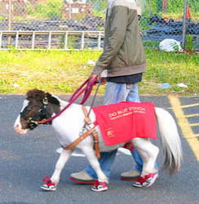
Accommodating Service Animals...
In some cases a miniature horse may be a service animal.

Slide 81
Accommodating Service Animals
Transit systems may ask two questions to determine whether an animal qualifies as a service animal.
  First – if the animal is required because of a disability.
  Second – what work or task the animal has been trained to perform.

Slide 82
Accommodating Service Animals
The ADA does not specifically mention requirements for service animal identification or animals in training.
Therefore, it is illegal to require a person with a service animal to provide proof.

Slide 83
Accommodating Service Animals
Examples of work or tasks include:
  Guiding individuals who are blind
  Alerting individuals who are deaf
  Pulling a wheelchair
  Assisting during a seizure

Slide 84
Accommodating Service Animals
Examples of work or tasks include:
  Alerting to the presence of allergens
  Retrieving items
  Providing support and assistance with balance and stability
  Preventing or interrupting impulsive or destructive behaviors

Slide 85
Accommodating Service Animals
The crime deterrent effects of an animal presence, and the provision of emotional support, well-being, comfort, or companionship do not constitute work or tasks.

Slide 86
Safety Issues
Service animals are socialized and trained to interact appropriately with other animals and people.
However, it is possible that a service animal could be provoked and become aggressive.

Slide 87
Safety Issues
A transit system may exclude any animal from your vehicle when the animal’s behavior poses a direct threat to the health or safety of others.
You MAY NOT make assumptions about any animal based on past experiences with other animals. Each situation must be considered individually.

Slide 88
Tips on Providing Assistance
  ASK the passenger what you can do to assist.
  Do not touch or give commands to a service animal unless asked to do so by the handler.
  If necessary, remind passengers that the service animal is working and not to distract it.

Slide 89
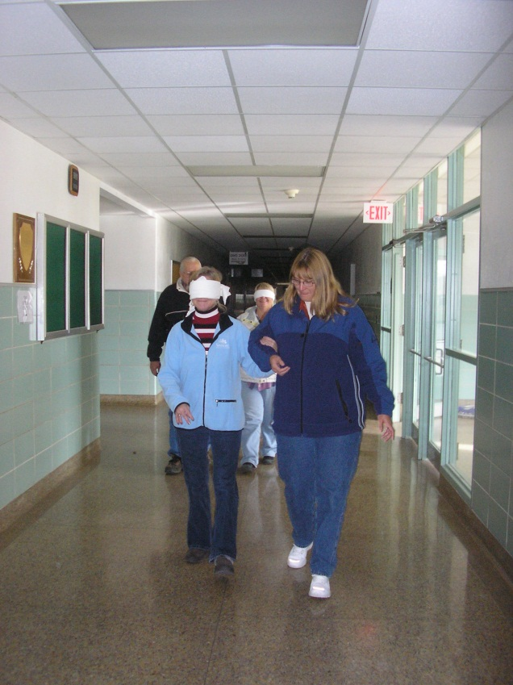
Guiding Your Passengers…
Offer your arm
Walk at a normal pace
Stay slightly ahead
Warn them about:
  Curbs
  Steps
  Inclines
  Low-hanging objects

Slide 90
Vision Loss
More than 25 million people in the United States have some vision loss (American Foundation for the Blind)
Vision loss may affect:
  Communication
  Independent Living
  Mobility
Vision loss increases with age

Slide 91
Assisting Passengers with Vision Loss
If you will be guiding a passenger who is blind, ask how you may assist them.
Permit the passenger to grab your arm.
Show the passenger where your arm is by placing his/her hand on your arm.
Stand alongside and slightly ahead of the person you are guiding.

Slide 92
Use the word STOP. It has only one meaning:
    Cease doing what you are doing

Slide 93
Technique
Linking Arms
  Hold your arm relaxed and straight at your side
  After asking if customer has a guide side preference (when appropriate), customer grips arm just above elbow
  Customer stays ½ pace behind your step

Slide 94
Hearing Impairments
The major barrier facing a person with a hearing impairment is one of communication. Unable to benefit from voice communication, persons with severe hearing impairment rely upon their eyes for signals to aid understanding.

Slide 95
National RTAP
Transporting Non-Ambulatory Passengers Issue One: Your Responsibility
As a driver, you are responsible for the safe boarding, securement, transport, and deboarding of people who use wheelchairs and other mobility devices. To a person who uses a wheelchair or other mobility device, a trained and empathetic driver makes a particularly large difference in their quality of life.
Regardless of the service you provide, you are expected to completely facilitate boarding and deboarding of people who use wheelchairs or other mobility devices. Understanding your agency’s policies is essential to fulfilling your responsibility to comply with the Americans with Disabilities Act (ADA) requirements and your responsibility to the safety of your passengers.

Slide 96
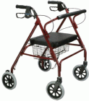
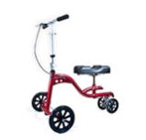
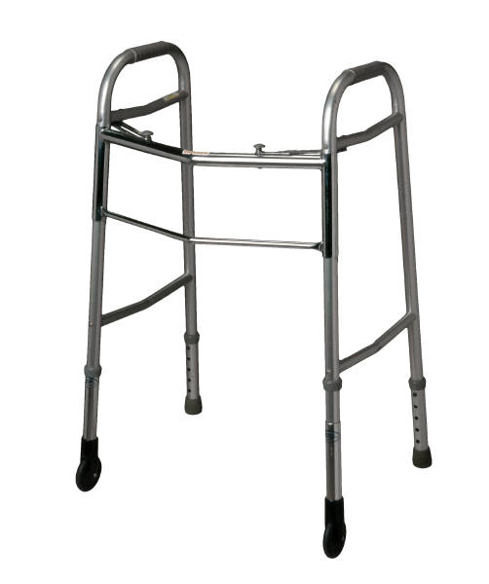
Walkers
Passengers using this device will lean fairly heavily on it. This device is particularly common among the elderly and may have a “seat” attached so the user may rest.
knee walker

Slide 97
Walkers
Passengers using walkers will be moving quite slowly since balance is a problem. Do not rush your passengers.
It will be extremely difficult, if not impossible, for the passenger to utilize the steps in your vehicle. Therefore, the ADA requires that this individual be permitted to use the accessible entrance for entry and exit of the vehicle.

Slide 98
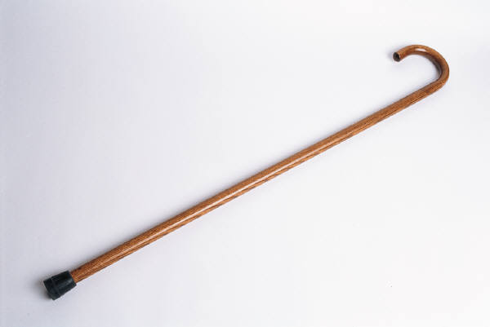
Canes
The primary function of a cane is to maintain balance when walking or standing.

Slide 99

Canes
The “white cane” is not used for support.
Only those individuals who are legally blind are entitled to use a “white cane”.

Slide 100
Canes
When providing assistance to a passenger using any type of cane, do so on the side of the passenger opposite the cane.
Be certain to ask your passenger if they would like assistance, and if so, how you may help.

Slide 101
What type of passenger assistance should I provide?
Ask your organization which pick up/drop off policy you use:
  Curb-to-curb
  Door-to-door
  Through door
Stay within the bounds of that policy:
  Protects your passengers
  Protects you

Slide 102
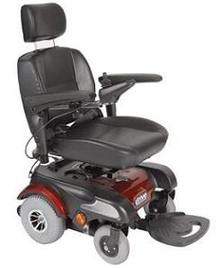
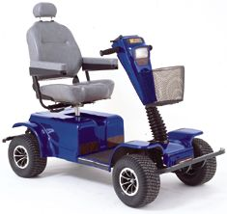
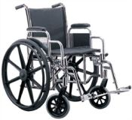
Definition of a Wheelchair
A mobility aid belonging to any class of three-or-more wheeled devices, usable indoors, designed or modified for and used by individuals with mobility impairments whether operated manually or powered.

Slide 103
Wheelchairs
The ADA no longer uses the term “Common Wheelchair” because the requirements for lift platforms and wheelchair spaces specify the appropriate dimensions for wheelchairs. Therefore, a device used by individuals with disabilities for mobility must fit an “envelope” which is 30 inches wide by 48 inches long.

Slide 104
Wheelchairs
The DOT rules do not require a transit system to accommodate devices that are not primarily designed or intended to assist persons with mobility disabilities.

Slide 105
Wheelchairs
The chair is as valuable to the user as the body part or function it has replaced. Wheelchair users consider their wheelchair to be a part, or extension, of their own body.
Unnecessary leaning on or touching the chair is similar to doing the same to the person.

Slide 106
Wheelchairs
Proper assisting techniques insure safety and comfort for the occupant. Just as you would for an ambulatory person, slowly and carefully move a person in a wheelchair by making your movements smooth and gentle.
Do not jerk or jolt, which can be very uncomfortable, or even painful for the person in the wheelchair.

Slide 107
Wheelchairs
Because of the wheelchair’s value to the occupant, it is important to treat it carefully. Take care not to scratch the tubing on corners of lifts or vehicle seats. The securement straps should not gouge or scar the frame of the chair.

Slide 108
Wheelchairs
The person is putting you in control when you are guiding the chair – move with confidence.
Prepare your passenger for movement by giving simple verbal cues when you are going to start.

Slide 109
Wheelchairs
Always report safety defects to the owner such as wheels coming off, spokes loose, underinflated tires, etc.

Slide 110
Wheelchairs
Wheelchairs pick up road shock each time the vehicle hits a bump. Care and judgment are needed to avoid unnecessary bumps or potholes. If the road is unavoidably bumpy, slow down and ease your way through.

Slide 111
Wheelchairs
Can the provider require a person to transfer from a wheelchair into a seat?
No.
Regulations allow the person to transfer if a seat is available. Such a move is the rider’s decision. The driver may suggest a transfer in a non-coercive manner.

Slide 112
Tips for drivers
Talk directly to the person in the wheelchair, rather than to the person pushing it. In an extended conversation, bring yourself to eye level of the seated person.
ASK if assistance is needed before you assist, including pushing a wheelchair.

Slide 113
Tips for Drivers
Whenever possible, place yourself on the low side of the person you are assisting.
When going up an incline ramp or curb, you should be behind the chair facing and walking forward; when coming down, you should be behind the chair holding onto the handgrips, facing the direction you are coming from.
Make sure you are checking behind you for obstacles, slippery spots, etc.

Slide 114
The information provided in this section covers general procedures that will apply to all lifts. Your agency may have specific policies pertaining to vehicle lift operations. It is recommended that you check with your supervisor concerning those policies.

Slide 115
Vehicle Lift Operations
Understand that these procedures are in place for safety reasons.
They have not been developed to hassle a driver or passenger.

Slide 116
Vehicle Lift Operations
Lifts are potentially hazardous equipment. They must be maintained and operated properly. Considerable caution and awareness is needed when operating a lift.
Only the vehicle driver should operate the lift.

Slide 117
Vehicle Lift Operations
These are general guidelines for lift operation – adhere to YOUR agency’s policies.
  At your destination, stop on level ground, put the vehicle in “park”, set the emergency brake.
  Make sure there is enough room for the lift platform to open without hitting obstacles.
  Activate emergency flashers

Slide 118
Vehicle Lift Operations
It is the responsibility of the vehicle operator to properly open, secure, and close the lift doors to load and unload the passenger on and off the lift platform and to properly use all lift functions.
Open the lift from the outside of the vehicle. Securely lock doors in open position.
Greet your passengers. Talk to them, not around them.

Slide 119
Vehicle Lift Operations
Ask your passenger if they would like assistance getting onto the platform.
The passenger may want to ride the lift facing the vehicle. Explain the hazard involved and request that the passenger ride on the lift with their back to the vehicle. Remember, however, under ADA, it is their choice.
Set the wheel locks on the wheelchair and, if the passenger is capable, ask them to hold the handrails on the lift.

Slide 120
Vehicle Lift Operations
If the passenger is using a motorized device ask them to turn the power off once on the lift.
If your lift is equipped with a passenger safety belt it must be utilized each time the lift is operated.

Slide 121
Vehicle Lift Operations
The lift must always be operated from the ground.
Do not remain in the vehicle while raising or lowering the lift platform.
Do not ride on the lift with passengers who are using a mobility device.

Slide 122
Vehicle Lift Operations
Stand on the ground with one hand holding the wheelchair and one hand operating the controls.
Raise the platform only a couple inches.
Check the front safety barrier to be certain it is locked.
Only after you are certain the barrier is locked, continue raising the lift platform to the vehicle floor level.

Slide 123
Vehicle Lift Operations
Put the lift controls in a secure location with one hand while holding the wheelchair with the other.
Release the wheel locks and push the chair into the vehicle. Reach in and lock one wheel.
Never leave a wheelchair on the platform unattended. When boarding, push it in. When exiting, pull it out.

Slide 124
Vehicle Lift Operations
This three step procedure may be difficult for some drivers. Therefore, ask the passenger if they can assist moving their wheelchair in and out of the vehicle.

Slide 125
Vehicle Lift Operations
Caution is needed when loading a power wheelchair into and out of your vehicle.
When boarding this passenger, ask them to turn the power to the device off after they have gotten onto the lift. When the lift comes up to floor level, ask the passenger to turn the power on again and only tap their controls for the direction you want them to travel. This may require two or three taps, but you want to be certain they are going in the correct direction.

Slide 126
Vehicle Lift Operations
When exiting the vehicle, again ask the passenger to tap their controls one, two, or three times to get them onto the lift platform. Once on the platform, ask them to turn off the power.
Make certain you are clear in your directions and that the passenger understands what you are saying.

Slide 127
Vehicle Lift Operations
Standees should stand in the center of the platform facing the direction they will travel.
If capable, the passenger should hold both handrails when on the platform.
The driver must determine if it is safe to ride the lift with the passenger or safer to operate the lift from the ground.
How you can best protect the passenger must be assessed with each standee use of the lift.

Slide 128
Manual Operation of the Lift
All Braun, RICON, and Maxon Mobility lifts are equipped with a hydraulic manual pump located within the plastic motor housing on the side of the lift.
A steel pump arm may be mounted on the inside or outside of this plastic housing.

Slide 129
Manual Operation of the Lift
NOTE: During manual operation of a paratransit/community transportation lift, the driver must be inside the vehicle. This is the only time under normal conditions that it is acceptable for the driver to operate the lift from inside the vehicle.

Slide 130
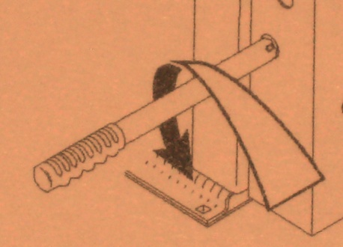
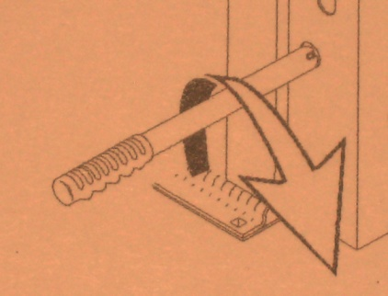
Manual Operation of the Lift
Manual lowering — to lower the platform manually, insert the pump handle onto the bleeder valve. Turn the pump handle counterclockwise just enough to allow the platform to drop slowly.
When the platform has reached the ground, tighten the valve by turning it clockwise.

Slide 131
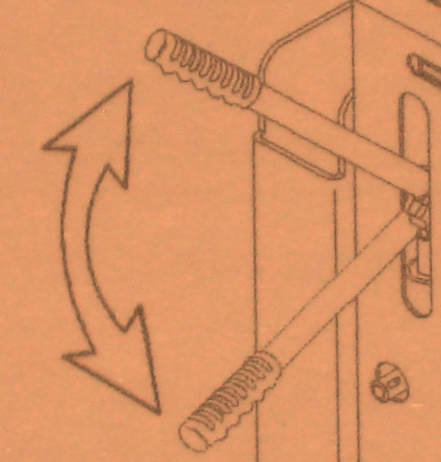
Manual Operation of the Lift
Manual raising — insert the pump handle into the pump opening. Pump the handle by raising and lowering it a full stroke. The platform will rise very slowly to floor level.

Slide 132
Vehicle Lift Operations
If your lift is fully automatic after moving your passenger off the lift, continue to pump the handle to fold the lift into the vehicle.
If your lift is not fully automatic, refer to the lift operating instructions which should be mounted directly on the lift.

Slide 133
403-Compliant Lifts
The 403 lift must be classified by the National Highway Traffic Safety Administration (NHTSA) as a Public Use Lift with a continuous lifting capacity of 800 pounds.

Slide 134
Vehicle Lift Operations
The driver should not ride on the lift with the passenger.
The lift is intended for one wheelchair and its occupant.

Slide 135
Wheelchair Securement
The securement system shall limit the movement of an occupied mobility aid to no more than 2” in any direction under normal vehicle operating conditions.
Since 1991 all vehicles must have securement locations for wheelchairs and other mobility aids that face rearward or forward.

Slide 136
Wheelchair Securement
Rearward facing is only permitted when a specific barrier is in place.
Side facing is never permitted.

Slide 137
Wheelchair Securement
Each system includes a minimum of four floor-mounted belts and a lap and shoulder belt.
The manufacturer of each system states that all belts shall be utilized each time the system is used.

Slide 138
Wheelchair Securement
Regardless of the type of securement system in the vehicle, the securement of the wheelchair is basically the same for each.
DO NOT TAKE SHORTCUTS – REMEMBER, THE PASSENGER’S SENSE OF SECURITY IS OF EXTREME IMPORTANCE.

Slide 140
Wheelchair Securement
Know the safety belt use law in your state along with the policies of your agency.
Then enforce them.

Slide 141
Wheelchair Securement
This belt is not a certified lap belt that is designed and tested for use in conjunction with the wheelchair and occupant securement system.
NEVER USE A POSTURAL SUPPORT BELT IN PLACE OF A PROPERLY CERTIFIED SEAT BELT AND SHOULDER HARNESS.

Slide 142
Your passengers literally place their lives in your hands when they board your vehicle.

Slide 143
Accident and Emergency Handling Procedures
In an accident or emergency, your responsibilities range from having the ability to protect yourself and your passengers from injury or death, to protecting yourself and your agency afterwards from fraudulent or excessive liability claims.

Slide 144
Accident and Emergency Handling Procedures
When there is an accident or emergency involving your vehicle or passengers, you are responsible for handling the situation in a way that lessens the risk of injury or death to your passengers and to yourself.

Slide 145
Accident and Emergency Handling Procedures
You must have thorough knowledge, and understanding, of the basic accident and emergency handling procedures in order to maintain that trust.

Slide 146
Accident and Emergency Handling Procedures
The four basic accident and emergency handling procedures are:
    Keep calm
    Protect your passengers, yourself, your vehicle
    Contact your dispatcher
    Complete the required reports
Each situation is going to be different. Therefore, 2 and 3 may be reversed while 1 and 4 remain constant.

Slide 147
Accident and Emergency Handling Procedures
These four steps are basic – your agency should have a very detailed and in-depth policy/guideline to follow in the event of an accident or incident.
Become familiar with these policies.

Slide 148
Evacuation
As a driver, you have an important responsibility for the welfare and safety of your passengers.
You must be prepared to provide evacuation assistance to all passengers.

Slide 149
The Evacuation Decision
If you smell smoke, see smoke, or smell gasoline or diesel fumes, evacuate the vehicle immediately.
Do not assume it is NOT an emergency.

Slide 150
Evacuation
Passengers in wheelchairs present two elements for assessment:
The first is whether or not conditions permit operation of the lift.
The second is whether or not to evacuate the passenger in their mobility device.

Slide 151
Evacuation
Passengers may be reluctant to leave their wheelchair behind because without it they become totally immobile. However, saving the passenger’s life is first priority.
If time and conditions permit, the wheelchair can be recovered later.

Slide 152
Evacuation
Be sure to identify portable oxygen devices and remove them from the vehicle.
Alert fire fighters to their presence and location.

Slide 153
Communicating with passengers and helpers
In an emergency, most passengers will look to you, the driver, for direction. You represent authority and must take initial control and take the lead.
Passengers should be advised that help is on the way, but for their safety, it is best that they leave or be assisted from the vehicle.

Slide 154
Communicating with passengers and helpers
The use of able-bodied passengers or passers-by, must be done with great care. The ability to remain calm and give clear and concise instructions to helpers will prevent unnecessary injuries.
Make it clear what commands will be used to start whatever you will be doing.

Slide 155
Communicating with passengers and helpers
Remember – as the driver of your vehicle, you are responsible for directing passengers and passers-by in giving assistance. However, once public safety personnel arrive on the scene, they will assume command and control of the emergency. At that point, your responsibility is seeing to the needs of your passengers.

Slide 156
Fire extinguishers
An essential piece of emergency equipment and all vehicles should have one.
A typical fire extinguisher has only 15-20 seconds of retardant.
In order for a fire extinguisher to be effective it must be used properly.

Slide 157
Fire extinguisher operation
  P. A. S. S.
      Pull the pin
      Aim toward fire
      Squeeze the handle
      Sweep at the base of the fire

Slide 158
Special considerations for fires
Fire extinguishers are an extremely valuable tool, but you must always remember that they are small and have a limited capacity. When confronted with a fire, your first concern should be in protecting the safety of your passengers and yourself. The fire extinguisher should be used to protect your exits while you evacuate the vehicle.

Slide 159
Review what you’ve learned…

Slide 160
Any more questions?

