Slide 1
Recognizing & Reporting Abuse for Transit Drivers
(Formerly known as Maltreatment Awareness)
Minnesota Department of Transportation, Office of Transit & Active Transportation, and
Rural Transit Assistance Program (RTAP)
/ 1

Slide 2
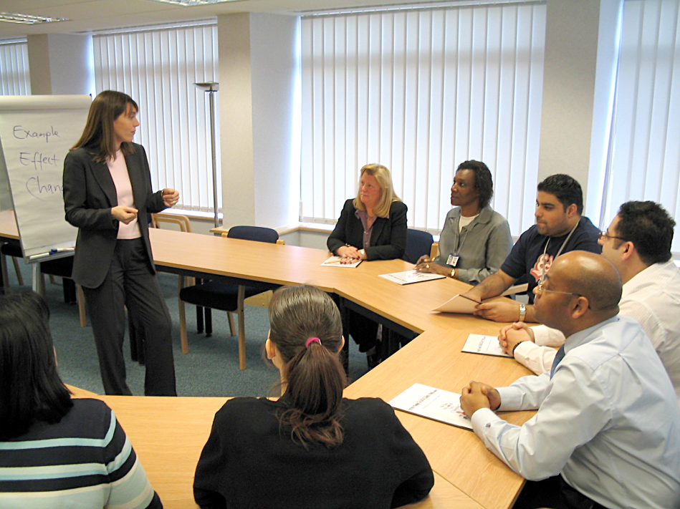
Welcome Drivers…
A class designed for transit drivers:
Helps you know who is vulnerable
How to recognize, report and prevent accusations of maltreatment
/ 2
Notes:
Welcome to the Maltreatment Awareness for Transit Drivers. This training is designed for those who transport minors or vulnerable adults via special transportation or local transit systems. This training is intended to help you identify who is vulnerable and how to recognize, report and prevent maltreatment within the scope of your duties.

Slide 3

Getting Started
For your comfort:
Restroom Location
Refreshments
Introductions:
Name
Organization
Why did you become a driver?
What do you hope to learn today?
/ 3
Notes:
Instructor: please note to the class the location of restrooms and
refreshments.
☺ Ice Breaker Event
Introductions
You may want to take this time to introduce yourself, your training and transit background and to have the trainees introduce themselves by sharing the following:
Their names
The transit organizations they work for
Why they have become drivers
What they hope to gain from the class

Slide 4
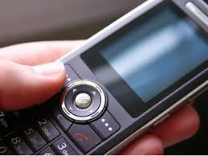
Class Schedule & Etiquette
4 hour length:
STS requirement
Break option at the end of each topic
Please silence phones, pagers and electronics
/ 4
Notes:
This class is designed to be 4 hours in length, in accordance with
Minnesota Special Transportation Services requirements (Minnesota Rules Chapter 8840). At the end of each topic we cover, I will ask you if you would like to take a brief break.
This will give everyone an opportunity to stretch and move around. The class can decide as a group if they would like to take a break or keep going. If you would like to ask me questions during the breaks, I will be available.
Out of respect for others in the classroom today, we ask that you turn off your cell phone, pagers or other electronic devices, until the class has been completed. We also ask that you refrain from talking during the class, unless it is to ask a question or share an experience or thought.
Does anyone have any questions or needs to be addressed before we begin?

Slide 5
Class Content
TOPIC 1: Determining Vulnerability
TOPIC 2: Recognizing Maltreatment
TOPIC 3: Maltreatment Reporting and Impacts
TOPIC 4: Preventing Accusations of Maltreatment & Defusing Emotionally Charged Situations
Assessment to check your understanding
/ 5
Notes:
TOPIC 1: Determining Vulnerability
(Who is considered vulnerable?)
TOPIC 2: Recognizing Maltreatment
(How do I know if someone is being maltreated?)
TOPIC 3: Maltreatment Reporting Requirements
(What is expected of me when I witness or suspect maltreatment?)
TOPIC 4: Preventing Accusations of Maltreatment and Defusing Emotionally Charged Situations
(Suggestions to help you communicate clearly with passengers and deal with passenger behaviors that could escalate.)
ASSESSMENT (Checking your understanding.)

Slide 6
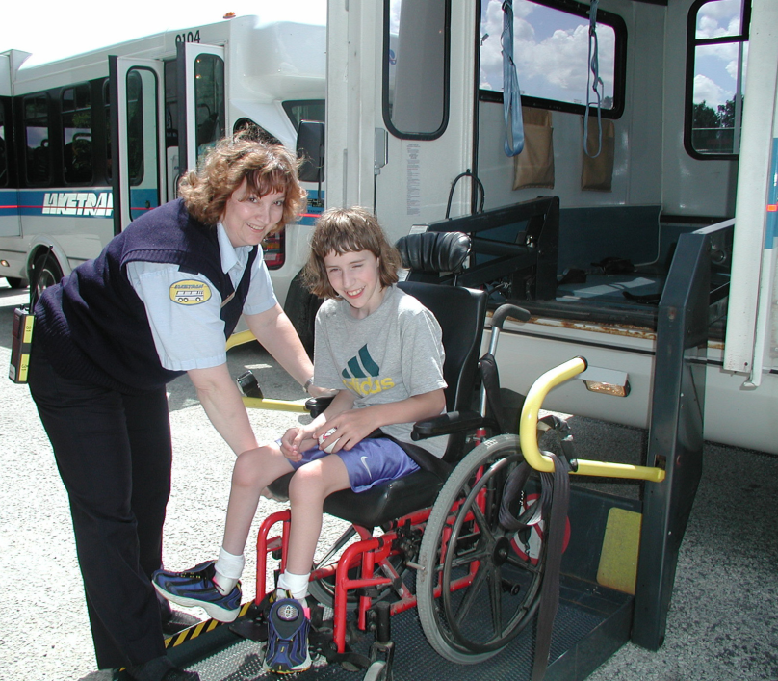
Class Overview
Why this information is important:
You know your passengers
You are in a place to observe them
You are the eyes and ears of your community
/ 6
Notes:
As a transit driver, you often provide transportation to minors and/or vulnerable adults. You see many of your passengers on a regular basis as you provide safe transportation to shopping, doctors, therapy sessions and other appointments or outings. Through this frequent contact, you often become familiar with your passenger's normal routines, moods, behaviors and personal habits such as promptness, cleanliness, etc.
This training class will allow you to use those observations and your customer service skills to identify, report and prevent maltreatment.

Slide 7

Learning Objectives
The Vulnerable Adults Act (VAA) and Maltreatment of Minors Act (MMA)
Determine vulnerability
Recognize maltreatment
/ 7
Notes:
At the end of this training class, you will be able to:
Understand the MN laws pertaining to the Vulnerable Adult Act (VAA) and the Maltreatment of Minors Act (MMA)
Determine vulnerability given a scenario
Recognize maltreatment given a scenario

Slide 8
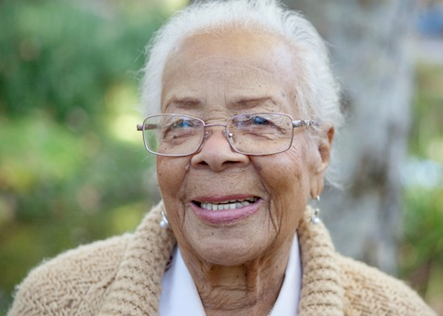
Learning Objectives (continued)
Identify reporting requirements and processes
Potential impacts of reporting
Professional boundaries: avoiding accusations
Defusing emotionally charged situations
/ 8
Notes:
Identify the maltreatment reporting requirements and process
Recognize potential impacts of reporting maltreatment
Identify professional boundaries to avoid accusations of maltreatment
Describe de-escalation techniques that reduce risk of harm in emotionally charged situations
When you have completed all the topics in this lesson, you will complete a short assessment to see how much you have learned.

Slide 9

TOPIC 1: Determining Vulnerability
How do I know if
someone is vulnerable?
/ 9
Notes:
Topic Overview
Identifying a person who is considered vulnerable is not always easy. In this topic you will be introduced to the Minnesota laws that have been established to identify and protect vulnerable individuals. Based on these laws, you will learn how to determine who is vulnerable.
Learning Objectives
Review the MN laws pertaining to the Vulnerable Adult Act (VAA) and Maltreatment of Minors Act (MMA)
Determine vulnerability given a scenario

Slide 10
Meet your Passengers
An exercise in determining vulnerability
/ 10

Slide 11
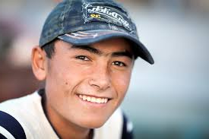
Meet Matt…
25 years-old
Lives in group home
Works at the Opportunity Workshop
/ 11
Notes:
Matt is 25 years-old and rides your bus every day between his group home and his day training program. At the workshop, his job is to shelve and store items. At his group home, his job is to take all of the dishes from the table to the sink after dinner and to make sure that all of the lights are turned off when he goes to bed. He likes to play soccer with his friends at the group home.

Slide 12
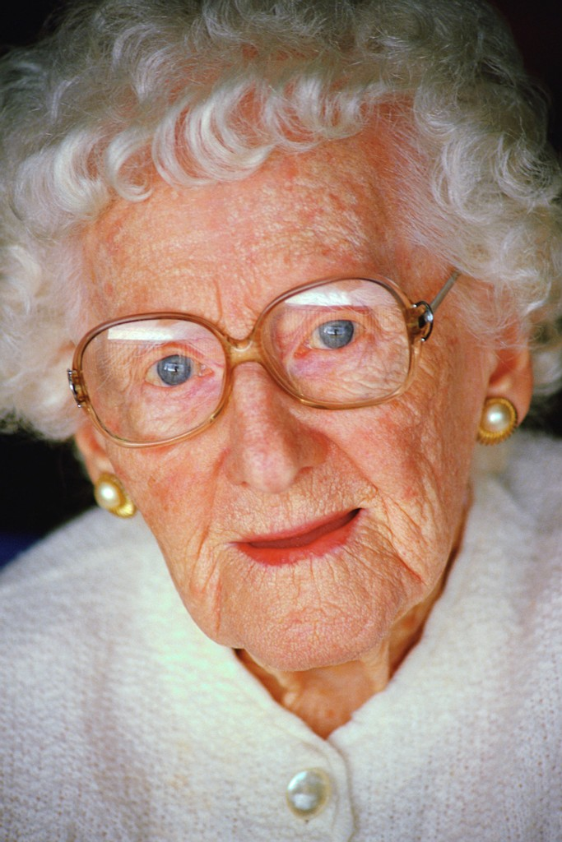
Meet Emma…
80 years-old
Lives in her own home alone
Home health aide visits her each day
Daughter helps her get ready for bed each night
/ 12
Notes:
Emma lives in her own house and is 80 years-old. She receives visits from a home health aide each day, who makes sure she had a good breakfast and checks her blood pressure. The aide also straightens up the house and does the heavy work like laundry and vacuuming. Emma's daughter comes to check on her every night and helps her get ready for bed. Emma rides your bus on Fridays when she gets her hair done and meets her friend Betty for lunch.

Slide 13

Meet George…
78 years-old
Extremely independent
Proud that he is able to get around on his own
Lives in assisted living apartment
/ 13
Notes:
George is an extremely independent 78 year-old and is proud of his ability to get around on his own. He often tells you that he doesn't need assistance getting dressed, but he does live in an assisted living apartment building. George takes his meals in the community dinning room and his son takes him to the bank and to get his medicine. Since his stroke, the assisted living staff now takes care of his laundry and housekeeping. George rides your bus to go to the Senior Center to play cribbage every week.

Slide 14

Meet Ruth…
50 years-old and temporarily living in a nursing home
Recovering from hip and back surgery
Needs help with daily needs
Wheelchair-bound
/ 14
Notes:
Ruth is 50 years-old and is temporarily living in a nursing home while recovering from back and hip surgery. She doesn't have any family in the area, but requires help with daily needs. Ruth has been taking your bus to physical therapy 3 times a week for about 2 months. She tells you that you have been a big help in getting her around with her wheelchair.

Slide 15

Meet Jimmy…
14 years-old
Rides your bus to his trumpet lesson
/ 15
Notes:
Jimmy is a 14 year-old who rides your bus every Monday from his home to his trumpet lesson.

Slide 16
Which of these passengers are considered vulnerable?
/ 16

Slide 17

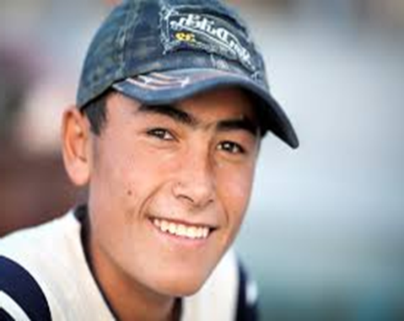


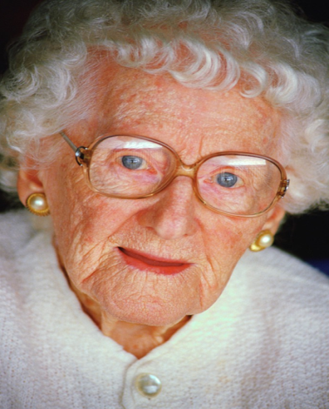
ALL OF THEM
Let’s learn why…
/ 17
Notes:
Answer: ALL of these passengers are considered vulnerable. We will learn why in the remaining discussion during this topic.

Slide 18
Minnesota Laws that Protect Vulnerable People
Maltreatment of Minors Act (MOMA)
Vulnerable Adults Act (VAA)
http://mn.gov/dhs/
/ 18
Notes:
You cannot always tell if people are vulnerable just by looking at them or by where you pick them up. A person's inability to care for him or herself without assistance is not always obvious. Mental and emotional disabilities often have no visible signs. People living in their own homes may be getting personal services from an agency licensed by the State.
Minnesota has established 2 important Acts that define who is vulnerable and the requirements for protecting them.
These Acts are:
Maltreatment of Minors Act (MOMA)
Vulnerable Adult Act (VAA)
► Hand Out / Take Away
Provide students with copies of the Acts at this time.
We will be reviewing each of these acts with you today, but I strongly encourage you to read these acts on your own and to keep these copies with any learning and professional materials or files you have for your job.

Slide 19

How the MOMA Protects Minors…
Under age 18: children are considered vulnerable
Home, school and community must be safe for them
Voluntary and required reporting depending on profession/employer
/ 19
Notes:
How the Maltreatment of Minors Act (MOMA) protects minors:
MOMA was established to protect all children under the age of 18. All minors are considered to be vulnerable to physical abuse, neglect, or sexual abuse. This legislation protects minors by making the home, school and community safe for children. It provides for voluntary and required reporting of neglect and physical or sexual abuse of children that occurs in the home, school and community settings. It also provides for a safe home environment for physically or sexually abused or neglected children when necessary.

Slide 20
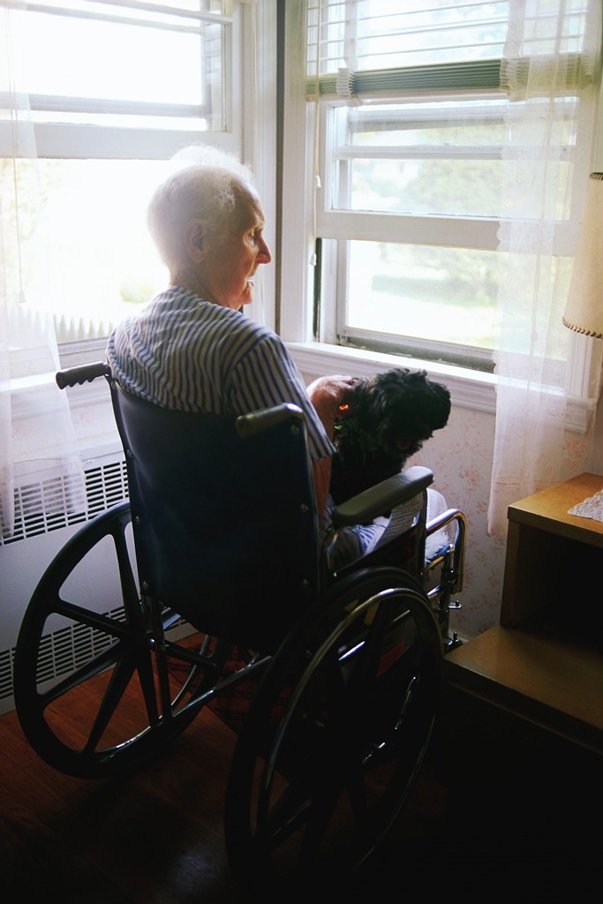
How VAA protects Vulnerable Adults…
Identifies who they are
Voluntary and required reporting
Assistance for providing safe environments for those maltreated
/ 20
Notes:
How Vulnerable Adults Act (VAA) protects vulnerable adults:
The Vulnerable Adult ACT identifies and protects adults who are particularly vulnerable to maltreatment. It also establishes who is required to report suspected maltreatment and requires investigations when reports are made.
In addition, the Vulnerable Adult Act allows for assistance in providing safe environments for vulnerable adults; including safe institutional or residential services, community-based services and living environments for those who have been maltreated.

Slide 21
Check your Understanding
Who is a minor?
Who is considered vulnerable?
/ 21

Slide 22
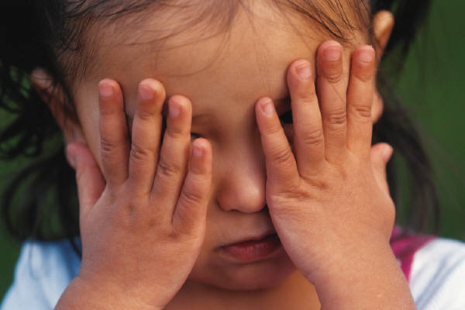
All Children Under Age 18 are…
Considered minors
Protected under the Vulnerable Adults Act
Considered vulnerable
Protected under the Maltreatment of Minors Act
/ 22
Notes:
Answer: A, C & D
All children who are younger than 18 years-old are considered minors, are vulnerable and are protected under the Maltreatment of Minors Act.

Slide 23

Jane: A Vulnerable Adult
Age: 26
Has a brain injury
Lives with her parents
You take her to Adult Day Care every week day while her parents are at work
/ 23
Notes:
Jane is a 26-year-old woman with a brain in jury. Monday through Friday you pick her up from her parent’s home and transport her to the County Adult Day Care Center. Jane is cared for here while her parents are at work.

Slide 24
Why is Jane Considered Vulnerable?
A vulnerable minor because she lives with her parents
A vulnerable adult because she needs the services of an adult day care
Not vulnerable
None of the above
/ 24
Notes:
Answer: B
Jane is considered an adult, because she is not under age 18, and she is vulnerable because she is using the services of adult day care.

Slide 25

Summary
You have learned….
Who is vulnerable
The difference between a minor and vulnerable adult
How Minnesota law protects them
/ 25

Slide 26

TOPIC 2: Recognizing Maltreatment
What is maltreatment?
Is there a difference in maltreatment of minors and vulnerable adults?
/ 26
Notes:
Topic Overview
The topic of maltreatment is complex. There are 3 types of maltreatment that apply to vulnerable adults and 2 types that apply to minors.
Maltreatment can show up in many forms. In this topic, we will review each type of maltreatment and explore some of the ways in which it is exhibited.
Learning Objective
When you have completed this topic you will be able to recognize maltreatment given a scenario.
Defining Maltreatment What is maltreatment?
 Energizer Event
ACTIVITY: Ask the class to define what they believe maltreatment to be. Encourage discussion among the class.

Slide 27




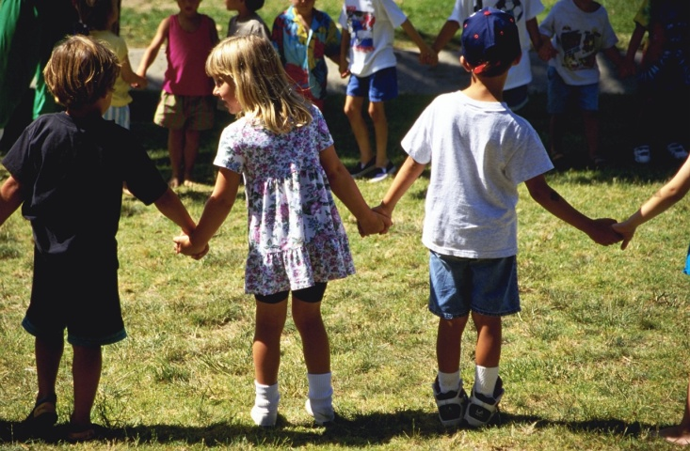
Not Always Able to Defend Themselves…
/ 27
Notes:
When people are providing services to a minor or vulnerable adult, it is not appropriate to inflict harm upon people who may not be able to speak for themselves. Let's take a close look at maltreatment.

Slide 28
Categories of Maltreatment
Type of Maltreatment | Kinds | Examples
Abuse | Criminal Activity Staff Action | Physical assault Sexual abuse
Neglect | Staff Inaction Self | Caretaker fails to supply basic needs Inability to take care of self
Financial Exploitation | Stealing Third party exploitation Harassment, deception or fraud Forcing against will | Taking money or possessions Forcing payment for service not desired Tricking someone into payment Making someone feel obligated
/ 28
Notes:
This chart is a snapshot of the 3 categories of maltreatment that apply to vulnerable adults; abuse, neglect and financial exploitation. Let's look at the definitions and review each category starting with abuse.

Slide 29
ABUSE: Criminal Activity
Against a vulnerable adult…
Assault in 1st-5th degrees
Use of drugs
Solicitation
Criminal sexual conduct in 1st-5th degrees
/ 29
Notes:
Abuse: Criminal Activity Definition
There are two definitions for abuse; one applies to criminal activity and the other to staff action.
Criminal activity is an act against a vulnerable adult that constitutes a violation of, an attempt to violate, or the aiding and abetting of:
Assault in the 1st-5th degrees
Use of drugs to injure or facilitate crime
Solicitation, promotion, or inducement of prostitution
Criminal sexual conduct in the 1st-5th degrees

Slide 30

Staff Action Abuse
Purposeful conduct towards a vulnerable adult which is expected to produce/does produce…
Physical pain
Injury
Emotional Stress
/ 30
Notes:
Abuse: Staff Action
This is purposeful conduct towards a vulnerable adult which could be expected to produce, or does produce: physical pain, injury or emotional stress. Keep in mind that you may or may not actually witness this type of abuse while it is happening. You may suspect that this type of abuse may be occurring only when you see a bruise, notice a change in behavior, or if a passenger tells you that it is happening.

Slide 31
Behaviors Considered Abusive…
Hitting, pinching, biting, kicking, etc.
Humiliating, harassing, derogatory, or threatening treatment
Punishment designed to control a person’s behavior
Sexual contact of any kind
Forcing to perform against their will
/ 31
Notes:
Some behaviors that are considered abusive under this definition are:
Any punishing type of contact such as hitting, pinching, biting, kicking, etc.
Intentionally treating a vulnerable adult in a disparaging, derogatory, humiliating, harassing or threatening manner, whether through gesturing, oral, written or body language.
Use of non-therapeutic punishing procedures specifically to stop or control a person’s behavior.
Any sexual contact between a person providing services and a vulnerable adult or minor.
Forcing, compelling or enticing a vulnerable adult against their will to perform services for the advantage or profit of another.

Slide 32
Check your Understanding
What is maltreatment?
How does the definition of maltreatment differ between vulnerable adults and minors?
/ 32

Slide 33
Which of These Situations is Staff Action Abuse
You witness a nursing attendant grab your passenger’s hands and hold them behind his or her back because the passenger attempted to strike out.
You hear a passenger’s caregiver tell him or her to “shut up!”
You fasten a passenger’s seat belt before going on to the next stop.
All of the above.
/ 33
Notes:
Answers: A & B
You may take a moment to discuss these choices with the class and why they constitute staff/driver action abuse.

Slide 34

Neglect
Failure to supply basic care and services to vulnerable person
Two Types:
Staff inaction
Self-neglect
/ 34
Notes:
Neglect is the failure to supply a vulnerable person with the basic care and services needed to obtain or maintain physical or mental health and safety. Care and services include things like food, clothing, shelter, healthcare and supervision.
Neglect can occur in many different areas of a person's life and may be the result of staff inaction, or self-neglect.
Knowing when a person has been neglected may be nearly impossible if you are unfamiliar with a passenger or have just picked them up for the first time. As you become familiar with your passengers and what is 'normal' for them, you will notice there are changes that may be signs of neglect.
Because drivers do not provide most of the basic needs of their passengers, it is necessary to watch for signs of neglect from their places of residence or work.
Staff inaction neglect occurs when a vulnerable person is not receiving the care or supervision they need from someone who is responsible to care for them.

Slide 35
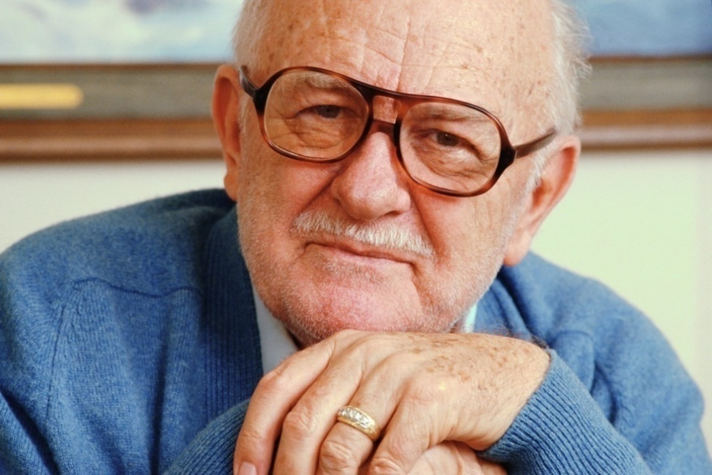
Situation #1: George’s Sore
Weeping sore on hand
2 weeks
Not covered
Not getting better
/ 35
Notes:
Situation 1 - George: You notice that your frequent passenger George has had a weeping sore on his right hand for the past two weeks. The sore is not covered and appears to be getting larger. If the sore continues to be neglected it could become infected and lead to medical problems.

Slide 36
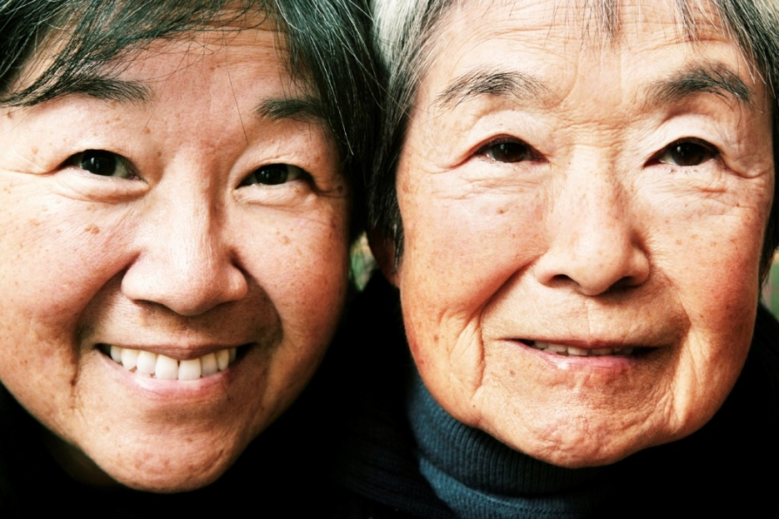
Situation #2: Ruth’s Meals
Complains that she is hungry
Staff has forgotten her lunch for past
2 days
/ 36
Notes:
Situation 2 - Ruth: You have picked Ruth up at the nursing home. She complains she is hungry because the staff at the home has forgotten to get her for lunch two days in a row. If her need for appropriate food and water continues to be neglected, Ruth would be unable to maintain healthy bodily functions and sustain life.

Slide 37
Situation #3: Matt’s Seizure
Experiences a seizure while waiting to board your bus
Staff person sees the seizure happening
Goes into building instead of helping Matt
Assumes that you will take care of him
/ 37
Notes:
Passenger 3 - Matt: Matt is waiting at his usual place outside of his day training program where you pick him up. As you approach the sidewalk, you see Matt fall and go into a seizure. The program staff person, who waits with Matt each day, turns around and goes into the building. This staff person is asked later why she didn’t care for Matt when she saw that he was having a seizure. She replied, “The bus was almost there to pick him up, so I figured the driver would take care of it.”

Slide 38
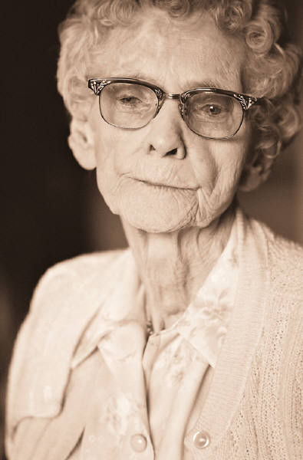
Self-Neglect
Vulnerable person is unable to care for themself
May not be aware that they need help
May be too embarrassed to ask for help
/ 38
Notes:
Self-Neglect: Self-neglect is when one is unable to care for
him or herself without help from others. This is especially relevant for the elderly and others who live on their own and receive infrequent visits from family, friends, nurses or personal care attendants. Identifying self-neglect is similar to identifying neglect by staff. Instead of staff being neglectful, the individual is unable to provide for his or her own basic care or services.
Many times these individuals are not aware that they are neglecting themselves. It is also possible that people aware that they are not able to take care of themselves, but are too embarrassed, or afraid of losing their independence, to request help.

Slide 39
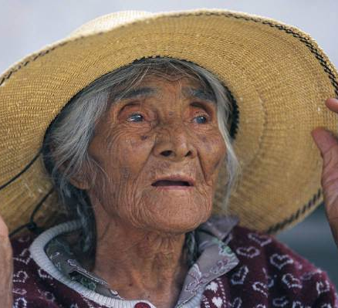
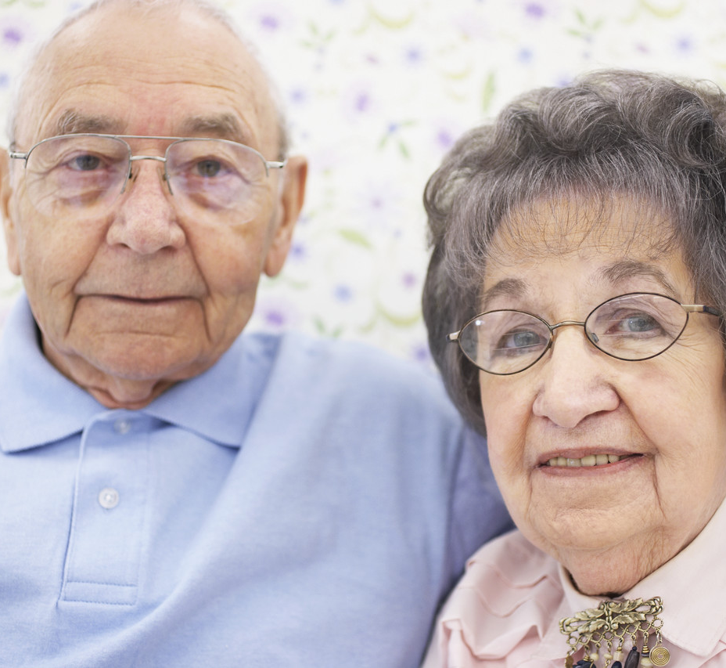
What Could Self-Neglect Look Like on Your Bus?
/ 39
Notes:
ACTIVITY: Discuss with class examples of passengers who may be vulnerable to self-neglect and why. Following are some examples:
An elderly woman who usually takes care regarding her appearance when she is on your bus, begins to come aboard in clothes that are not clean, and seems to not be bathing as often as she usually does. It is learned that she has forgotten to pay her water bill and is no longer able to keep herself bathed or her clothes clean.
A developmentally disabled adult who rides your bus often mentions that he is hungry and not able to get to the store because his mom, who usually takes him grocery shopping, is in the hospital. It is learned that his mother's trip to the hospital was an emergency and other family members were not aware that he was not getting the food he needed.

Slide 40

Financial Exploitation
Stealing
Obtaining 3rd party services to person’s detriment
Acquisition by harassment, deception or fraud
Forcing someone to perform a task against his or her will
/ 40
Notes:
Financial Exploitation: The last category of maltreatment of a vulnerable adult deals only with what a person may do with a vulnerable adult's finances or personal property.
There are 4 definitions of financial exploitation:
Willfully using, withholding or disposing of funds or property of a vulnerable adult without legal authority. This is also known as stealing.
EXAMPLE: A passenger mentions to you that their home health aide is writing themselves checks from their check book.
Obtaining services by a 3rd party for wrongful profit or advantage of the person to the detriment of the vulnerable adult.
EXAMPLE: One of your passengers tells you that their neighbor insists that she allow his son to mow her lawn, and then demands that she pay him for it. Your passenger is distressed because she would prefer to have her grandson do it, but feels pressured to pay the neighbor's son for this service.
Acquiring possession, control or an interest in the funds or property of a vulnerable adult by undue influence, harassment, duress, deception or fraud.
EXAMPLE: A passenger mentions to you that his neighbor often helps him carry their grocery bags into the kitchen. The neighbor suggests that the passenger give her an heirloom ring as an "appreciation" gift for all they has done to help him.
Forcing, compelling, coercing or enticing a vulnerable adult against his or her will to perform services for the profit or advantage of another.
EXAMPLE: A passenger you know makes beautiful hand-made quilts. You suggest that she donate one of them to the school fundraiser your daughter’s class in involved in as a raffle item. You may not realize that the passenger feels pressured to do this because she relies upon your help to go to the doctor each week and she would prefer not to make the donation.

Slide 41
Check Your Understanding
Abuse, neglect and financial exploitation
/ 41

Slide 42
Intentionally Treating a Vulnerable Adult in a Derogatory, Humiliating, or Threatening Manner is Defined as…
Staff action abuse
Criminal assault in the 1st degree
Self neglect
Staff neglect
/ 42
Notes:
Answer: A
Intentionally treating a vulnerable adult in this manner is staff action abuse, because it is an action that is committed by a staff person, or caregiver, towards the vulnerable adult.

Slide 43
Noticing That an Adult Passenger is Losing Weight, is Dirty and/or Disoriented, May Be Evidence of…
Staff action abuse
Financial exploitation
Staff inaction neglect
Self neglect
/ 43
Notes:
Answer: C & D
If a passenger seems to be not eating as well as they should be and/or appears to be disheveled or disoriented, they may be experiencing staff inaction or self neglect, depending upon their living circumstances.

Slide 44
Which Statement Defines Financial Exploitation?
Use of drugs to injure or facilitate crime.
Failure to supply a vulnerable person with the basic care and services needed to obtain or maintain physical or mental health and safety.
Willfully using, withholding or disposing of funds or property of a vulnerable adult without legal authority.
Use of punishing types of procedures to control a vulnerable adult’s behavior.
/ 44
Notes:
Answer: C
Financial exploitation can be intentionally using, withholding or disposing of a vulnerable adult's funds or property without legal authority.

Slide 45
Maltreatment of Minors
Maltreatment of minors deals with 2 categories:
Abuse
Neglect
/ 45

Slide 46

Maltreatment of Minors: Abuse
There are 2 types of abuse:
Physical:
Physical injury
Emotional abuse
Sexual:
Inappropriate touch
Prostitution
/ 46
Notes:
Physical Abuse: Physical, mental or threatened injury to a child inflicted by the person responsible for the child's care (may include parent, babysitter, daycare provider, etc.)
Sexual Abuse: A violation of criminal sexual conduct in the 1st through 5th degrees, including the prostituting of a minor and threat of sexual abuse. (This includes when a child’s caregiver touches them in an inappropriate manner.)

Slide 47
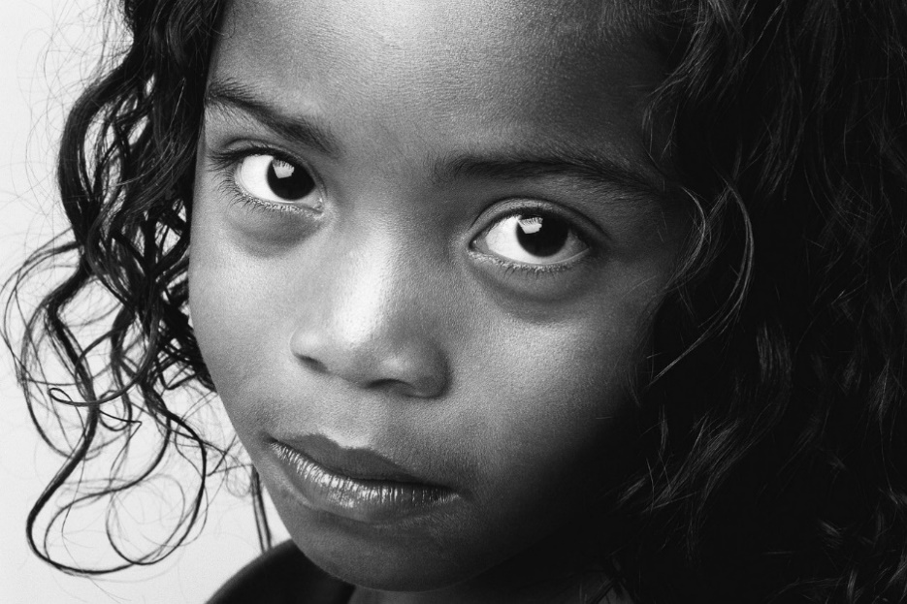
Maltreatment of Minors: Neglect
Failure by
caregiver to…
Provide basic needs
Protect from dangers
Provide supervision
Provide education
/ 47
Notes:
Neglect is defined as the failure by the child’s caregiver to:
Provide items necessary to maintain the physical and mental health of a child. This includes things like food, shelter, clothing and health care.
Protect from situations that endanger the physical or mental health of a child.
Provide supervision as needed based on age, environment and length of absence of the caregiver.
Provide proper education. Every child has a right to education according to state law.

Slide 48
Check Your Understanding
Maltreatment of Minors
/ 48

Slide 49
Which are Acts of Abuse?
A babysitter slaps a child when she won’t listen.
Holding a child by the shoulders to keep him or her from stepping in front of a moving car.
A 21 year-old youth leader asks a
17 year-old group member out on a date.
A teacher yells loudly at a boy who rides your bus almost every day to “get his attention.”
/ 49
Notes:
Answer: A, C & D
A & D: Slapping and yelling at a child is considered physical abuse.
C: Dating is seen as potentially sexual behavior, therefore, an adult seeking to date a minor is considered sexual abuse.

Slide 50
Which Are Acts of Neglect?
Child not given medical treatment for bacterial infection.
Child taken out of day care.
Toddler left alone in the house for 2 hours while parents run errands.
7 year-old not attending school.
13 year-old left alone in the house for 2 hours while parents run errands.
Gambling losses prevent parent from buying groceries.
Mother is aware that her boyfriend sexually abuses her daughter and allows boyfriend to continue to live in the house.
Child skips math class 3 times.
/ 50
Notes:
Answers: A, C, D, F, & G
Each of these situations represent a child whose physical and mental welfare is not being provided for.

Slide 51

Summary
BOTH minors & vulnerable adults can be maltreated
Vulnerable adults can be also be financially exploited
BOTH minors & vulnerable adults can be neglected
Understanding maltreatment and neglect may help you spot it
/ 51

Slide 52

TOPIC 3 : Recognizing and Reporting Maltreatment
How do I know if someone is being maltreated?
What can I do about it?
/ 52
Notes:
Be aware that there are sometimes barriers that prevent you from recognizing maltreatment, and to discuss what can happen when you or your manager, reports it.
In this topic, you will identify signs of maltreatment and learn what to do if you witness or suspect that one of your customers has been maltreated.

Slide 53
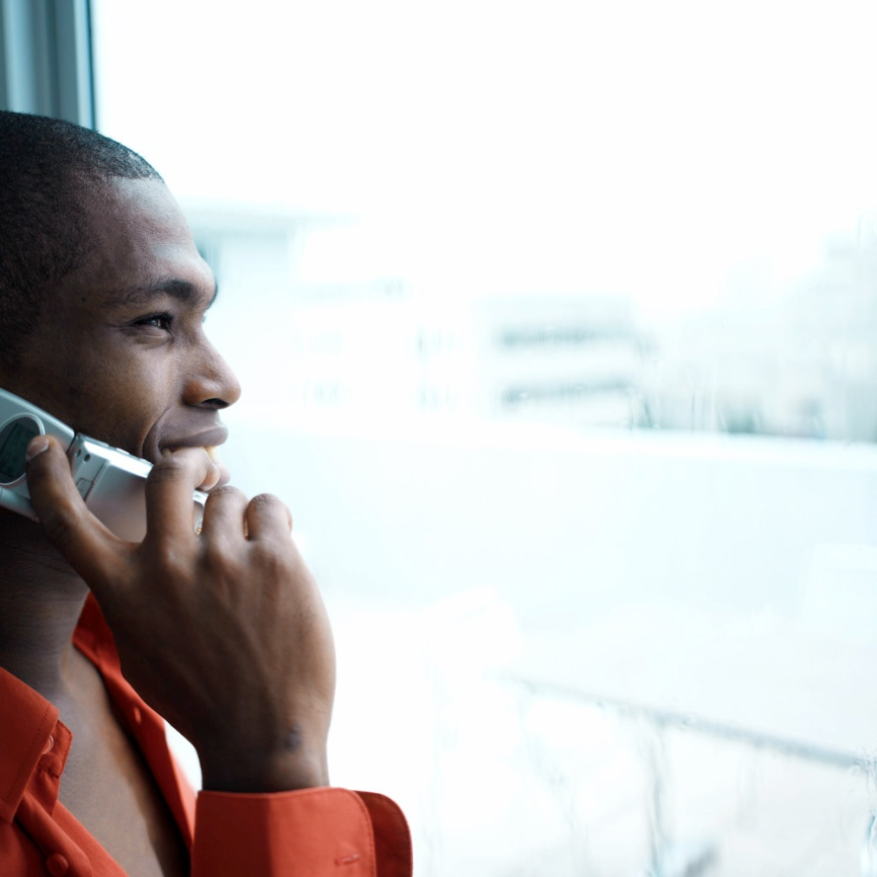
Learning Objectives
Barriers to identifying maltreatment
What to do
Reporting requirements
Discuss potential impacts
/ 53

Slide 54

Barriers to Recognizing Maltreatment
You may not know the passenger well
“Everything is fine”
Physical abuse can be hidden
Maltreatment isn’t always visible
/ 54

Slide 55

Signs of Maltreatment
Conversations
Behavioral Changes
Physical Signs
Appearance and Other
/ 55

Slide 56
Check Your Understanding
Can you identify these signs of maltreatment?
/ 56

Slide 57
Something’s Not Right with Emma…
Usually talkative
Doesn’t speak
Doesn’t answer your questions
Only says “thank you” when she leaves
/ 57
Notes:
Emma boards your bus for her weekly lunch appointment with her friend, Betty. Usually talkative, you notice that Emma is more quiet than usual. When you ask her how she is doing today, she doesn't answer you, but looks away. You note that this is odd, because Emma is usually eager to talk to you about her church activities and grandchildren. The ride continues in silence, with Emma only saying "thank you" as she leaves the bus.
WHY MIGHT YOU SUSPECT THAT SOMETHING IS NOT RIGHT WITH EMMA? (Behavioral Change)

Slide 58
Group Activity
Recognizing Maltreatment Worksheet:
Practice Spotting Maltreatment
/ 58

Slide 59
I’m Worried About Jimmy…
You notice burn marks on his arm
His cheek is bruised
He tells you he was “messing around” with friends
Becomes quiet on the topic
/ 59
Notes:
You pick Jimmy up from his Junior High School and are driving him to the City Arts Center for his weekly trumpet lesson. You notice that Jimmy's left arm appears to have burn marks and there is a bruise on his right cheek. When you ask him how he was injured he becomes quiet, and then answers, "Oh...just messing around with my friends,” but offers no further detail.
WHAT MIGHT LEAD YOU TO THINK THAT JIMMY MAY BE EXPERIENCING MALTREATMENT? (Physical Signs)

Slide 60
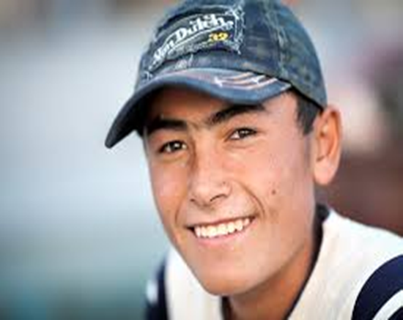
Matt is Always Happy, But Lately…
He’s usually clean and well kept
Clothes are now messy and dirty
Unclean hair
Body odor
He is in a good mood as usual
/ 60
Notes:
You pick up Matt at his group residence to take him to his job at the day training program. Matt's clothes are messy and wrinkled and it does not appear that he has washed his hair. He also smells like he needs a shower. Matt speaks to you about a trip his residence is planning to see an upcoming Vikings game in Minneapolis, and seems excited to be attending. You drop him off at the Workshop. For the next 3 days, Matt enters the bus in the same, disheveled, unclean state, but his spirits seem good.
WHAT MIGHT LEAD YOU TO SUSPECT THAT MATT IS EXPERIENCING MALTREATMENT? (Change in Appearance)

Slide 61

Today, when George got on the bus…
Sits up front and chats with you as usual
Mentions nephew visits him
Tells you nephew is “helping himself” to his coin collection
/ 61
Notes:
George is riding your bus to go to his weekly cribbage game at the Senior Center. As usual, George sits up front so he can discuss sports scores with you and speculate about how well the high school football team will do this season. Midway through the conversation, George begins to talk about his nephew, Bobby. Bobby goes to college out-of-state, but visits George on occasion when he is in town. George tells you that Bobby has been "helping himself" to some of George's valuable collector coins and taking them to the pawn shop. He promises to give George the money, but George has not received any and he speculates that the money is "paying for Bobby's beer parties on the weekends." George concludes that "kids will be kids" and the topic drifts back to sports.
WHAT ABOUT THIS INTERACTION MIGHT LEAD YOU TO THINK THAT GEORGE IS BEING MALTREATED? (Topic of the Conversation)

Slide 62

Responding to Maltreatment
If You See It Happening:
Seek help from facility staff or law enforcement
Move passenger to safety
Seek medical attention if needed
DON’T put yourself in harm’s way!
/ 62

Slide 63

Responding to Maltreatment
If you suspect it:
Reporting requirements
Reporting process
Potential impacts of reporting
/ 63

Slide 64
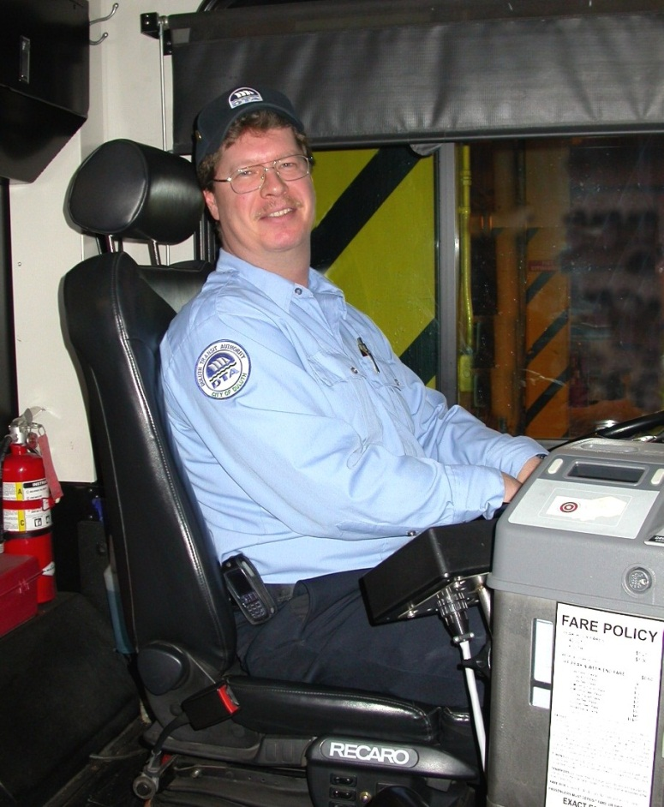
Mandated and Voluntary Reporters
Mandated:
Required by law to report
Voluntary:
Not required by law, but urged to report because it’s the right thing to do
/ 64

Slide 65
Am I a Mandated or Voluntary Reporter?
Ask your manager or supervisor to make sure!
/ 65

Slide 66

Maltreatment Reporting and Impacts
How do I report maltreatment?
What are possible impacts?
/ 66

Slide 67

WHAT Should I Report?
ANY witnessed, verbalized, or suspected maltreatment of:
A minor
A vulnerable adult
/ 67

Slide 68

WHEN Should I report?
IMMEDIATELY after you see or suspect something!
As soon as possible either internally or externally
When in doubt--report!
/ 68
Notes:
A report must be made immediately after witnessing an act of maltreatment or immediately after becoming aware of maltreatment (i.e. a customer tells you about an incident that describes maltreatment.) If you are uncertain whether or not to report, remember: When in doubt, report!

Slide 69

WHERE Do I Report?
Common Entry Point:
By phone
Available for each county
Anonymous
Manager/Supervisor:
Can assist you with reporting
/ 69

Slide 70

HOW Do I report?
What was reported OR what you witnessed
Who is involved
Where it happened
When it happened
MAKE A WRITTEN RECORD
OF SOME KIND
-Driver’s Log -Personal Notebook
/ 70
Notes:
Who is involved
What was said/what you witnessed or noticed (a customer being hit or seeing bruises on the arms)
Where it happened
The date your heard about or noticed it
You may report non-public information if it is relevant to complete the report
Any other related information

Slide 71
What Happens After I Make a Report?
Common Entry Point
Receives report of maltreatment
from individual or organization
Referred to appropriate
agency for investigation
Evidence indicates
Investigation is needed
Evidence indicates NO
Investigation is needed
Initial Disposition Report
is issued
Appropriate agency completes investigation:
proper action is taken to assist
Determines no
maltreatment occurred
No further action
Final Disposition Report is issued
/ 71
Notes:
A driver suspects or has witnessed maltreatment.
Goes to manager/supervisor to discuss it.
Manager/supervisor contacts Common Entry Point with the information OR driver contacts Common Entry Point by him or herself.
Common Entry Point received report of maltreatment from either the driver or the organization.
The report is investigated and it is determined that no maltreatment occurred. No further action is taken OR the report is investigated by the appropriate agency and an "Initial Disposition" report is issued.
If it is determined that maltreatment has occurred and County Protection Services Department of Human Services and Law Enforcement are brought in to help.
A report of findings or "Final Disposition" is issued. The person/organization who reported the maltreatment may request to be notified of the initial and final disposition report.

Slide 72

Initial and Final Disposition Reports
The person you made the report is entitled to know the outcome.
All reports are confidential and should not be shared with others.
/ 72

Slide 73
Check Your Understanding
Maltreatment reporting requirements
/ 73

Slide 74

You Have a Mandatory or Ethical Responsibility To...
Avoid
Discuss
Document
Report
…what you have witnessed or suspect.
/ 74

Slide 75

You Can Report Maltreatment To Either…
Minor’s parents / grandparents
Care facility / home health aide
Your transit manager / Common Entry Point for your county
/ 75
Notes:
Answer: C
You may report maltreatment to either your transit organization manager or your county’s Common Entry Point.

Slide 76

It is Best to Report Maltreatment…
As soon as possible
Within 1 week
After waiting 24 hours
Any of the above
/ 76
Notes:
Answer: A
It is extremely important to report maltreatment as soon as you possibly can. It is advised to do it within 24 hours after witnessing or suspecting maltreatment.

Slide 77
The Impacts of Reporting
Let’s discuss what can happen after you make a report
/ 77

Slide 78
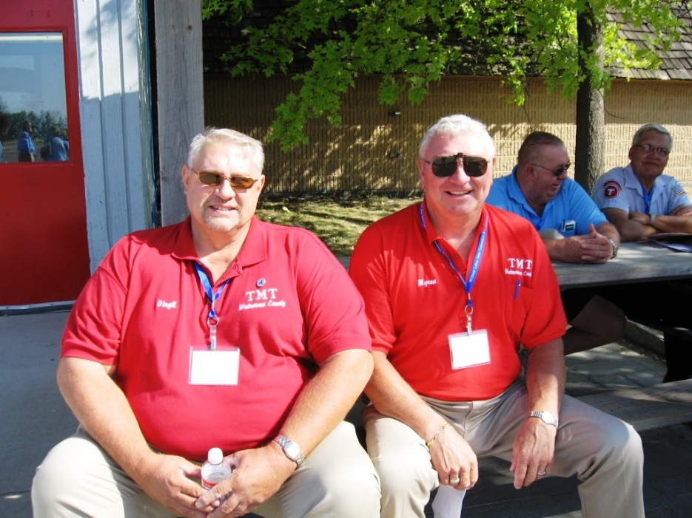
Your Rights As A Reporter
You have the right to remain ANONYMOUS
Minnesota law protects you and your transit organization from:
Prosecution
Retaliation
/ 78
Notes:
Whenever a driver acts on behalf of the passenger in reporting
Maltreatment in good faith, he or she has the right to remain anonymous. In addition, the Vulnerable Adult Act and the Maltreatment of Minors Act both protect reporters and their organizations from prosecution and retaliation. These are outlined in the VVA and MOMA, which were distributed to you earlier in the class.

Slide 79
How Can Reporting Maltreatment Impact My Job?
Let’s talk about what could happen and how to handle it
/ 79
Notes:
Read the case first: Jimmy has you worried. When he got on the bus last week with the strange burn on his arm and a bruise on his cheek, you weren’t so sure that he was just “messing around with his friends.” Though you’re not sure what is going on, you feel that not mentioning the injuries to your manager is just too big of a risk to take for Jimmy’s welfare.

Slide 80

Jimmy Has Me Worried…
Discussed what you saw with manager: reported to CEP
No maltreatment determined
Parents guess who made the report
Insist that “false report” has been made
/ 80
Notes:
After talking it over, you and your manager decide that he should contact your county’s Common Entry Point (CEP) about what you have seen. The CEP takes the report and looks into the issue. Two weeks later, you learn that it has been determined that no maltreatment has occurred and no further investigation is warranted.
In the process of making a determination, the staff of the CEP spoke with Jimmy’s teachers and his parents. Though the CEP staff did not reveal who had reported Jimmy’s injuries, Jimmy told his parents that you had asked about his injuries on the bus a few weeks prior.
Jimmy’s parents no longer allow Jimmy to ride your bus. They then go to your transit organization manager and tell him that they want to file a complaint against you for filing a “false report.” They also state to your manager that they feel strongly that you should be fired and that they intend to hire a lawyer and sue the transit organization.

Slide 81

Questions of Abuse Can Create a Strong Reaction…
What protection does the driver, and transit organization have, in this situation?
How might a driver handle this kind of situation?
If you knew this would happen, would you still make the report?
/ 81
Notes:
Parents, guardians or caregivers may find it embarrassing when they learn that others think that they may have been abusing or neglecting their child or charge. At times, they may wish to find someone to “blame,” even if it is determined that no harm has occurred.
Though the CEP guarantees anonymity when they work with individuals/organizations regarding maltreatment reporting, it may be possible for others to find out who reported an incident or situation from different sources, or by speculation. This may be especially true in small communities where many people know each other and are more aware of each other’s daily routines and personal interactions.

Slide 82

You Report Your Concerns about Ruth…
You notice Ruth is losing weight
Neglect is determined
Ruth’s family moves her to another facility
Ruth isn’t happy about the move
/ 82
Notes:
When you took Ruth to her physical therapy appointment last week, you noticed that she looked like she had lost weight. Ruth mentioned that "the girls" in the nursing home sometimes forgot her meals and that she wasn't sure what to do about it. Ruth tells you that she likes "the girls" who take care of her and doesn't want to make trouble for them by complaining.
You discuss the situation with your manager and you both decide that you need to call the Common Entry Point and request that the situation is looked into. The Department of Human Services, at the request of the Common Entry Point, investigates the nursing home Ruth is staying in and finds that she, and other patients on her floor, is not receiving regular meals. They also learn that the kitchen facility is not being kept clean.

Slide 83
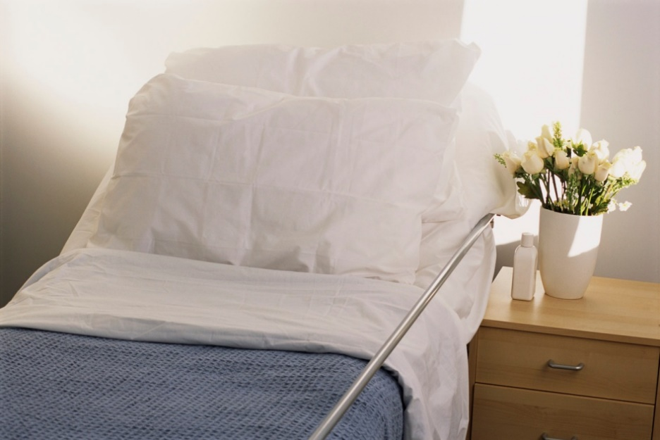
But I Liked Where I Was…
How might Ruth feel if she learns your organization made the report?
What would be the best way to interact with Ruth?
How might this situation impact you?
/ 83

Slide 84
You Begin to Notice Changes in Emma…
Emma becomes withdrawn and loses weight
It is determined that Emma needs more help
She is moved from her home of 50 years to assisted living
/ 84
Notes:
Worried about Emma's silence on the ride to her lunch date, you make a mental note to watch to see if this behavioral change is short-lived or if other signs of potential maltreatment or neglect surface. Over the course of the next few weeks, you notice that Emma begins to lose weight and she seems more withdrawn.
You call the Common Entry Point and tell them what you have seen. It is determined that there is enough concern to issue an investigation. The Department of Human Services visits Emma in her home and learns that her daughter is no longer visiting her to help her prepare for bed. They also learn that Emma will not allow the home health care aide into her house and that she is becoming very wary of her neighbors or anyone who comes to the door.
It is determined that Emma needs to move to an assisted living apartment building from her home of 50 years, so that she can receive consistent help in preparing for bed, and can receive medical treatment to deal with her anxiety.

Slide 85

Moving From a Long-Time Home To a Care Facility…
Have you observed a situation where this has happened?
How might Emma feel about this situation?
How might she feel about you if she learns you reported her situation?
How would you handle it if Emma confronted you?
/ 85

Slide 86
Check Your Understanding
Potential Impacts of Reporting
/ 86

Slide 87
Select Which Are Potential Reporting Impacts…
An upset passenger who feels embarrassed or angry because a report was made
A lawsuit against the driver for reporting the maltreatment
Retaliation against the driver by the facility where maltreatment occurred
Feelings of awkwardness between the driver and passenger after a report of maltreatment has been made
/ 87
Notes:
Answers: A & D
Potential reporting impacts may include a passenger who feels angry or embarrassed because a report was made. This may create a feeling of awkwardness between the passenger and driver.

Slide 88
Summary
Be aware of the signs of maltreatment
Report anything you witness or suspect
Ask your supervisor if you are a mandated or voluntary reporter
Reporters are protected by the law
Reporting can arouse emotions in people
It is possible to work through negative feelings with passengers…
/ 88

Slide 89
TOPIC 4: Preventing Accusations & Defusing Situations
Keeping good professional boundaries
De-escalation techniques to reduce risk
/ 89
Notes:
There are times when a seemingly innocent situation between you and your passenger can lead to maltreatment or accusations of maltreatment. There are simple and effective ways of interacting with your passengers which will ensure that this will not happen.
In this topic, you will discover what can contribute to misunderstandings and how maintaining professional boundaries can help you avoid them. You will also learn techniques that can be used to de-escalate emotionally charged situations.

Slide 90
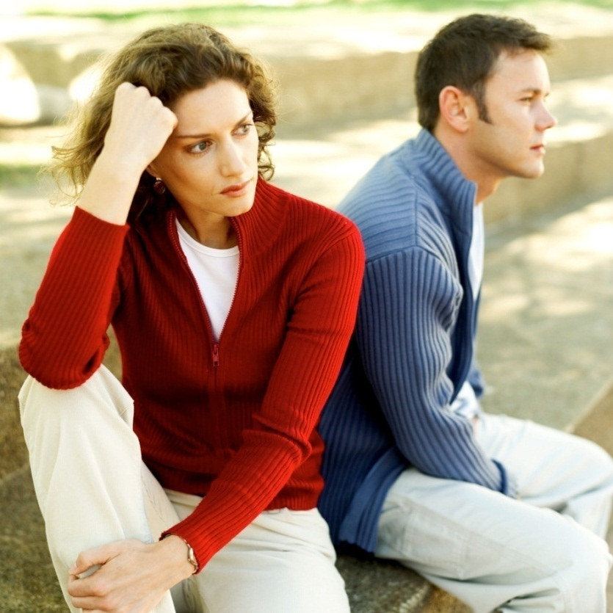
Avoiding Accusations & Defusing Situations
What is a professional boundary?
How can they help me avoid accusations?
How can I keep myself and others safe in a heated situation?
/ 90

Slide 91
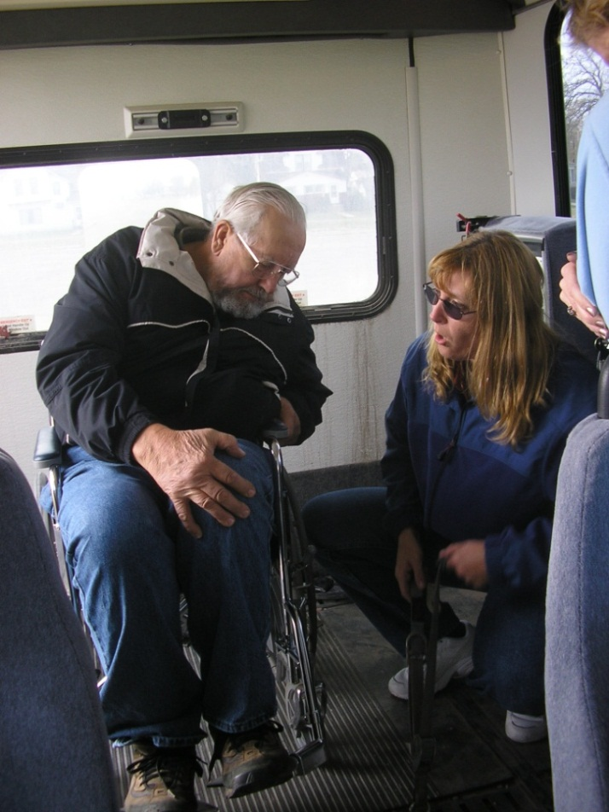
How Your Passengers View You Is Important…
Did a passenger hear you?
Body language and voice tone
Jokes and topics that might offend others
Physical affection can be misunderstood
Teasing can be misunderstood
/ 91

Slide 92


Misunderstandings: GIFTS
DO NOT accept gifts or tips
May be viewed as financial exploitation
Treat every passenger alike
What about cookies and cards?
/ 92
Notes:
When you accept a gift from a passenger, you are at risk for accusations of financial exploitation. Individuals on the outside might assume that you influenced or convinced the passenger to give you the gift. There may be even greater risk of this if the item is valuable. The passenger’s family could think you manipulated the passenger into giving you the item because you knew the value of it. If a passenger offers you a gift or tip, politely refuse it by saying that you are not allowed to accept them. Giving a gift to your passenger blurs the line of the professional relationship between you and your passenger and is inappropriate.
There are times, however, when exchanging a certain type of gift is permissible and may be considered a part of good customer service. Examples of this could be receiving cookies from one of your passengers for a holiday or giving each of your customers a card on their birthdays.
The gift should not be of significant monetary value.
The gift should not arouse suspicion that you may be taking advantage of, or treating one of your passenger’s differently.
When you give a card, or token, to a passenger, you need to treat all your passengers in the same manner.

Slide 93
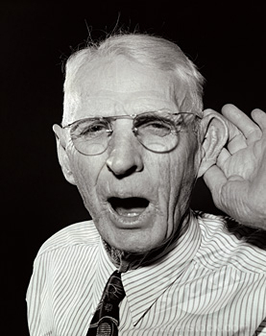


Misunderstandings: COMMUNICATION
Verbal
Body Language/Behavior
Appearance
/ 93
Notes:
Verbal
Speech: quality of speech, talking too fast, mumbling, speaking too softly or too loudly
Hearing: poor hearing, not paying attention, background noises
Conversation content: uncomfortable, sensitive or inappropriate topics, swearing
Body Language
Touching: inappropriate touch, misunderstood touch, not explaining actions
Body language and verbal messages that do not match
Appearance
Avoid clothing that is too tight or revealing.
Poor personal grooming habits, unkempt appearance sends negative message

Slide 94

Professional Boundaries
Conversation
Touching
Attitudes/actions
Personal space
Relationships
Physical/sexual
Legal and social
Moral/ethical
/ 94
Notes:
Professional boundaries allow your passengers to trust that you and your company are acting in their best interest. They protect everyone involved by helping you avoid situations that can lead to accusations of maltreatment.

Slide 95

Personal Space
Comfort zone between two people
Different comfort level for everyone
Let passenger know when you are entering their space and why…
/ 95
Notes:
This is the space between two individuals. Everyone has a comfort zone into which they allow others. When someone moves within that zone, it may cause the other person to become uncomfortable and withdraw or try to recapture that area of personal space.
For some passengers, this could fee very threatening. Be aware that personal space is different for everyone, notice how your passengers react and be respectful of their personal space needs.

Slide 96

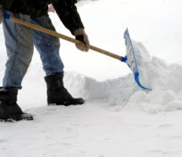
Favors and Requests: Ask Yourself This…
How would others view the favor?
Am I setting up an expectation?
Can I do this for everyone?
/ 96
Notes:
While for some people doing favors is a sign of caring, for other it may be a sign of bribery or a gift with strings attached.
Special favors and requests often lead to a slippery slope. Providing the services you are expected to provide without special favors avoids having your passengers feel disappointed or neglected if you are later unable to fulfill their requests. By treating all passengers equally and with respect, providing only the services directed by your organization, you will lessen the chance for misunderstandings later on.

Slide 97
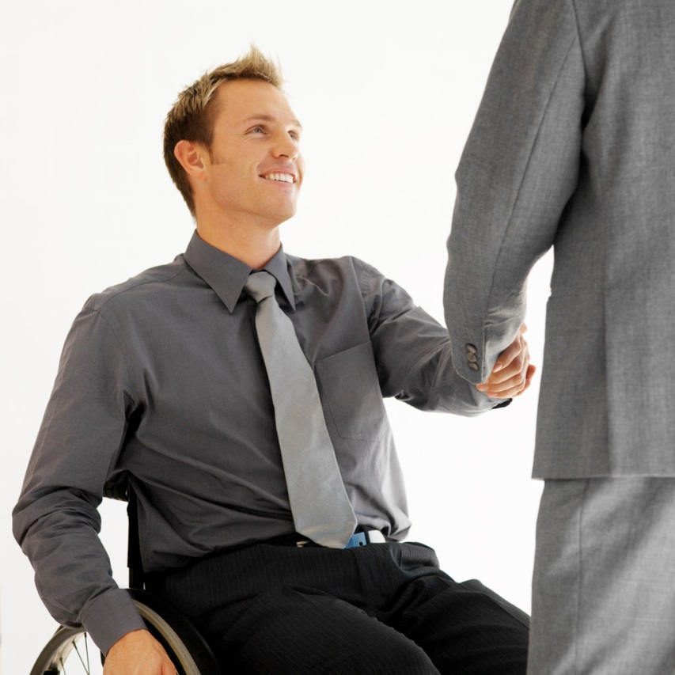
Relationships
Be friendly
Avoid inappropriate physical affection
Do not form personal relationships
Stay professional
If you’re not sure:
how would it look to someone else?
/ 97
Notes:
Although all of the boundaries listed earlier are important for you to maintain, the final one that we will discuss here is the boundary regarding relationships.
Having a personal relationship with a customer is not setting a good professional boundary. There should never be any type of personal relationship between a driver and a passenger, on or off the job. Although maintaining this boundary in a small community may be difficult, it is still necessary. A personal relationship may cause problems for both the driver and the customer.

Slide 98
Which Are Signs of Poor Boundaries?
Giving each passenger a handmade bookmark.
Physical touching not related to transport
Keeping personal information to yourself
Spending free time with the passenger
Bending the rules for a particular passenger
Not accepting gifts or favors
Feeling possessive about the passenger
Making an unscheduled stop for a special passenger
/ 98
Notes:
Answers: B, D, E, G & H
Discuss with class why these situations constitute poor boundaries.

Slide 99
When Am I Crossing a Boundary?
Would this behavior reflect well?
Does it fit our Code of Conduct?
Am I influencing my passenger?
Do I need to “hide” my behavior?
/ 99
Notes:
If the answer is “yes” to the first three questions and “no” to the last, boundaries are probably not being crossed. If your answers differ, take time to examine boundary issues and resolve them immediately.

Slide 100
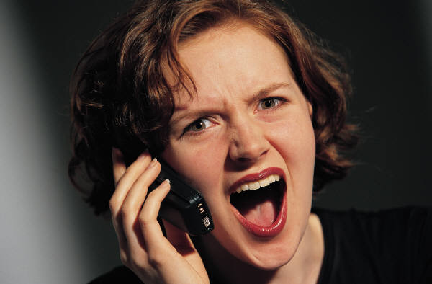
Recognizing an Emotionally Charged Situation
Negative emotions
Change from person’s “normal” behavior
Physical and/or verbal aggression may be present
/ 100
Notes:
Negative emotions, which are often triggered by a stressful event, can escalate to a dangerous level. In these situations, acts of verbal or physical aggressions can occur, putting the individual and others at risk of harm. Understanding your passenger’s “typical” behaviors as much as possible will help you identify when negative emotions are escalating and thus, help avoid allegations of maltreatment.

Slide 101

How to Defuse a Situation
Verbal redirection
Maintain self-control
Keep distance
Avoid touching
Last Resort:
Call 911 or your dispatcher
/ 101
Notes:
Attempt Verbal Redirection: Distract the person from the situation that is upsetting them. Turn their attention to the positives, another event or situation, or politely ask them to relax and explain what is bothering them.
Maintain Self-Control: Control your natural reaction to stress. Avoid displaying frustration and do not yell at the passenger. Losing self-control can lead to allegations of abuse. Remain calm and keep your voice low and quiet, raising the volume only enough for the person to hear you.
Keep Physical Distance between Yourself and Your Passenger: Do not put yourself or others too near the individual whose behavior is escalating. Ensure that the person is safe, but do not approach them unless another passenger is at risk of harm. If necessary, move other passengers out of harm’s way to protect their health and safety, but DO NOT ENDANGER YOURSELF. This may involve stopping the bus. If necessary, ask facility staff or law enforcement for assistance.
Avoid Touching Individual who is Upset: Touching someone who is already upset might cause the situation to escalate further. Your touch may be interpreted by them as aggression to which they may lash out physically.
LAST RESORT: Call your dispatcher or 911: Only when all other methods of de-escalation have failed, call your dispatcher or, if the situation puts yourself or others in immediate danger, 911. It is important that you PROTECT YOURSELF and OTHER PASSENGERS if you cannot control the situation.

Slide 102
Check Your Understanding
Preventing misunderstandings or accusations
Defusing situations
/ 102

Slide 103
Jane’s Home Health Aide
Home health aide stays with Jane
Same age
Knew her in high school
You witness evidence of a personal relationship
/ 103
Notes:
Because they must leave for work early, Jane’s parent hire a home health aide to stay with her until you arrive to pick her up in the morning. They hire Joe, who works for a health agency in town, is the same age as Jane and used to go to high school with her before she was injured.
When you pick her up to take her to adult day care one morning, you notice that Joe and Jane are holding hands. You then witness Joe kissing Jane and over hear him telling her that she is his girlfriend.

Slide 104
Which Describes This Relationship?
Joe is acting in Jane’s best interest. No boundaries have been crossed.
The relationship is not inappropriate because Joe and Jane are the same age and knew each other in high school.
Jane is considered a vulnerable adult . Because he is her home health aide Joe’s behavior can be reported as sexual abuse or misconduct.
There is nothing wrong with their relationship as long as Jane’s parents don’t find out.
/ 104
Notes:
Answer: C
Because Jane is a vulnerable adult and Joe is acting as her home health aide, Joe’s behavior is inappropriate and considered sexual abuse or misconduct.

Slide 105


George’s Gift
Regular sports chats
You are “like a son”
It’s your birthday
Gives you antique gold watch
/ 105
Notes:
George rides your bus often and the two of you chat a good deal about sports. You enjoy your talks with George and he tells you that you are “like a son to him.” On your birthday, he presents you with a beautiful antique gold pocket watch which he tells you
belonged to his grandfather. He stresses that he wishes you to have it because of how fond he is of you.

Slide 106
How Should You handle This Situation?
George is giving you a gift for the good service you have provided him, of his own free will. You should take the watch and thank him.
You thank George for his kindness, but decline the gift, explaining that, as his bus driver, it isn’t right for you to accept gifts from passengers.
You thank George and accept the gift, then donate the watch to your transit organization.
/ 106
Notes:
Answer: B
Many drivers have close relationships with their passengers that can feel more like friendship rather than a professional relationship. This means that you are bringing a level of personal service to your job.
However, it is important to maintain professional boundaries with your passenger. It is extremely important that a passenger, or anyone viewing the situation, feels/thinks that you are in NO WAY taking advantage of someone you are transporting. This can be especially difficult in the area of gift and financial exploitation.

Slide 107
Select the Best Way to Handle an Emotionally Charged Situation:
Pinning a passenger’s arms so he or she can’t hit you.
Getting as close as possible to the upset passenger in an attempt to intimidate.
Immediately calling the police to have the passenger escorted off of the bus.
Attempting to calm the passenger by verbal re-direction, relaxed body language and lowering your voice
/ 107
Notes:
Answer: D
Some good techniques to de-escalate an upset passenger is to remain calm, lower your voice, keep you body relaxed and attempt to re-direct their attention to something less upsetting.

Slide 108

Summary
Be aware
Build professional relationships
Maintain good boundaries
De-escalate emotional situations
/ 108

Slide 109
Applying What You Learned
“What Would You Do?”
A dramatization of situations that could be encountered when working with frail, elderly people
/ 109

Slide 110

You’re Almost Finished!
Take the class assessment
Discuss as a class
Turn in your assessment
Receive your certificate
/ 110

Slide 111
Thank You!
Please let your instructor know
if you have any questions or needs…
/ 111

