Slide 1
Passenger Assistance Safety & Sensitivity (PASS) 6.0
How to properly assist & interact with your passengers

Slide 2
DISCLAIMER
The PASS training manual & PowerPoint presentation is for the use of participants in the Community Transportation Association of America (CTAA)’s & University of Wisconsin-Milwaukee (UWM)’s PASS Certification Program. It is offered only for information purposes. It is not intended to be all inclusive or to address the hazards faced by each participant specifically. The manual specifically does not address issues or duties arising out of any Federal, State or local statutes, ordinance or regulations, except in a direct manner. Users must evaluate their own needs & adapt the information & procedures in this manual to meet those needs. CTAA & UWM assumes no liability for the contents herein or lack thereof.

Slide 3
CTAA Contact Information
Community Transportation Association of America
1341 G. Street N.W., 10th Floor
Washington, DC 20005
Phone: 800.891.0590
Fax: 202.737.9197
E-mail: training@ctaa.org
Web: www.ctaa.org

Slide 4
University of Wisconsin-Milwaukee Contact Information
University of Wisconsin-Milwaukee
Center for Transportation Education & Development
161 W. Wisconsin Ave., Ste. 6000
Milwaukee, WI
Phone: 414.227.3332
Fax: 414.227.3142
Web: www.sce-cted.uwm.edu

Slide 5
Program Objective
To become familiar with & proficient at passenger assistance, disability awareness, & emergency evacuation techniques.
Program Consists of:
    Presentations & Coaching
    Role Play Exercises
    Hands On application

Slide 6
Program Content
Section 1: Distracted Driving
Section 2: Driver Fatigue
Section 3: Transit Employee Safety & Health
Section 4: You as a Professional
Section 5: Customer Service
Section 6: Communication
Section 7: ADA Regulations
  Section 8: Taxi Services & the ADA

Slide 7
Program Content (continued)
  Section 10: Disability Awareness
    Diabetes
  Section 9: Service Animals

Slide 8
Program Content (continued)
  Section 11: Bloodborne Pathogens
  Section 12: Mobility Equipment Features
  Section 13: Vehicle Lift Operation
  Section 14: Wheelchair Securement
  Section 15: Wheelchair Occupant Securement
  Section 16: Transporting an Aging Society
  Section 17: Sexual Harassment
  Section 18: Accidents & emergencies
    Vehicle Evacuation Techniques

Slide 9
Section 1:
Distracted Driving
Passenger Assistance Safety & Sensitivity (PASS)

Slide 10
Compass Maneuvering (video)
By Smith System

Slide 11
Driving Safety
Safety begins with you!
Create a safe work environment for yourself.
Eating, breakfast, lunch & dinner should not be done while driving.

Slide 12
Distracted Driving
You are engaged in potentially distracting behaviors half the time you are behind the wheel.
You are:
  Operating at high speed
  Calculating speeds & distances
  Responding to other drivers & obstacles
  Talking to your passengers, dispatcher.
  Looking for addresses
  Maybe even, singing along to the radio or CD

Slide 13
Distracted Driving
Now add:
  Adjusting seat positions while driving
  Adjusting climate controls
  Using vehicle mirrors for personal grooming
  Eating & or drinking
All of these things may cause you to fail to respond to a dangerous situation.

Slide 14
Distracted Driving
Distraction categories include:
Visual: At 65 mph, if you take your eyes off the road for 2 seconds you will have driven two-thirds the length of a football field before you see the road again.
Manual: When you take your hands off the wheel you are greatly slowing your ability to respond to changing or unexpected conditions.
Cognitive: These distractions take your mind off the task at hand – driving.
Drivers who use hand-held devices are 4 times as likely to get into crashes.

Slide 15
Distracted Driving
Contributors to manual distractions include:
  Using two-way radio, cell phone, MDT
  Mirror, seat, climate control adjustment
  Non secured items in the vehicle
  Eating, drinking

Slide 16
Using a cell phone delays a driver’s reactions as much as having a blood alcohol concentration of .08 percent.

Slide 17
Distracted Driving
Texting involves all three types of distractions:
  Visual
  Manual
  Cognitive

Slide 18
Distracted Driving
Sending or reading a text takes your eyes away from the road on average 4.6 seconds.
At 55 mph you will have driven the length of an entire football field BLIND!

Slide 19
Distracted Driving
You are 23 times more likely to crash while sending or reading a text message.
Turn off your cell phone when driving.
You are more important than that phone call or text message.

Slide 20
Free Online Training
Curbing Transit Employee Distracted Driving
  Course Number: FT 00555
  FTA. dot.gov/training

Slide 21
Section 2:
Driver Fatigue
Passenger Assistance Safety & Sensitivity (PASS)

Slide 22
The best way to prevent driver fatigue is to make certain you have enough sleep before driving regardless of the length of your trip.

Slide 23
Driver Fatigue
Early warning signs of fatigue include:
Yawning
Tired eyes
Boredom
Over steering
Difficulty remembering driving last few miles

Slide 24
Driver Fatigue
“Micro Sleep”
A brief & unintended loss of consciousness.
Characterized by head snapping, nodding, or closing your eyes for more than a couple of seconds.

Slide 25
Driver Fatigue
Who is at risk of driver fatigue?
Adults between 18 – 29 are more likely to drive while drowsy.
Men are more likely than women to drive while drowsy
Night shift workers
You are 4 times more likely to have a fatal fatigue crash if you are driving between 10pm & dawn.

Slide 26
NHTSA estimates falling asleep while driving is responsible for at least 100,000 automobile crashes; 40,00 injuries, & 1,550 fatalities each year.

Slide 27
Driver Fatigue
Tips & responsibilities of drivers:
Recognize the signals; yawning, heavy eyes, blurred vision
Do not skip meals or eat at irregular times often
Take a nap
Avoid medication that may induce drowsiness
Do not rely on “Alertness Tricks” to keep you awake

Slide 28
Driver Fatigue
Remember:
Fatigue may slow reaction time, reduce attention, memory lapses, lack of awareness, mood changes, & reduced judgment ability
DRIVING FATIGUED MAY CAUSE DEATH!

Slide 29
Free Online Training
Fatigue & Sleep Apnea Awareness
Course number: FT00558
FTA.dot.gov/training

Slide 30
Section 3: Transit Employee Occupational Safety & Health
Passenger Assistance Safety & Sensitivity (PASS)

Slide 31
As a professional transit driver/operator you may be exposed to a broad array of biological, physical, & ergonomic hazards, as well as various stressors.

Slide 32
Transit Employee Safety & Health
Musculoskeletal Disorders (MSDs)
MSDs are injuries or pain in the body’s joints, ligaments, muscles, nerves, tendons, & structures that support limbs, neck, & back.

Slide 33
Transit Employee Safety & Health
Work-related Musculoskeletal Disorders (WMSDs)
WMSDs can be associated with work patterns:
  Fixed or constrained body positions
  Force concentrated on small parts of the body

Slide 34
Transit Employee Safety & Health
  A pace of work that does not allow sufficient recovery
  Heat, cold, & vibration

Slide 35
Transit Employee Safety & Health
Things you can do to lessen the risks include:
Adjust your driver seat area properly so that you have full access to all controls, permitting a comfortable arm position
Adjust all mirrors properly

Slide 36
Transit Employee Safety & Health
Adjust & re-adjust lumbar support throughout the day
Take advantage of non-driving time to stretch your back & leg muscles. Stretching enhances circulation & reduces muscle tension.

Slide 37
REMEMBER –
SAFETY BEGINS WITH YOU

Slide 38
Section 4:
You As a Professional
Passenger Assistance Safety & Sensitivity (PASS)

Slide 39
Characteristics of a Professional
Each is…
  …specially trained for a job
  …required to have special skills
  …required to meet licensing standards
  …provides a valuable service

Slide 40
Characteristics of a Professional
The final characteristic of a professional is high level performance at all times.
It’s easy to be positive, feel good, & treat others well when everything is fine. The difficulty comes when things are NOT going well. This is the true test of your skill as a professional.

Slide 41
You as a Professional
When being pleasant to passengers is not easy, try following one or more of these techniques:
Refocus –think about positive things in order to stop thinking about negative things
Talk it out – talk with other operators & supervisors
Understand –If there is a problem, contribute to the solution as best you can

Slide 42
You as a Professional
A professional driver must possess the necessary skills to work with passengers, the family of passengers, agency administrators, etc.
Driving a motor vehicle safely is not enough. You must also:
  Make the passenger feel welcome
  Answer questions

Slide 43
You as a Professional
  Make the ride safe & comfortable
  Handle any problems that occur
  Follow special instructions
  Keep accurate & timely records of your work

Slide 44
You as a Professional
  Passengers rightfully expect safe, efficient, & comfortable transportation service.
  Take time to permit passengers to board & exit comfortably and, be certain to provide assistance to each passenger.

Slide 45
Practically everything done while performing your job & the manner in which you conduct yourself, contributes either favorably or unfavorably to the passenger’s image of you & your agency.

Slide 46
You as a Professional
KEEP IN MIND:
Good performance is taken for granted –poor performance is always recognized.

Slide 47
You as a Professional
Support & explain agency policies when dealing with passengers.
  Speak positively about your agency. Avoid talking about how tough your job is.
  Talk over agency/organization problems with supervisors – NOT passengers.

Slide 48
You as a Professional
Three basic rules or skills that you must know & follow:
  Provide safe, reliable & expert service
      Drive safely & smoothly at all times
      Speak clearly, calmly & with respect
      Offer assistance to every passenger

Slide 49
You as a Professional
2. Be Courteous & Patient
    Use respectful language & tone of voice
    Leave your troubles at home or with dispatch
Avoid Arguments
    Remain polite
    Do not get angry

Slide 50
You as a Professional
When you perform your job as a professional, everyone benefits.
You benefit because your passengers will:
  Treat you more pleasantly
  Willingly follow your directions
  Respect you as a professional

Slide 51
You as a Professional
Your passengers benefit through:
  Safe, comfortable & reliable transportation
Your agency benefits because you help to:
  Increase supportive ridership
  Improve community support & potential funding
  Reduce insured risks

Slide 52
Section 5:
Customer Service
Passenger Assistance Safety & Sensitivity (PASS)

Slide 53
The driver is the most important asset of a transit agency. However, the customer is the most important person of the transit agency. Without the customer, there is no agency.

Slide 54
Who are your Customers?
Who receives the service?
  How does that service impacts that individual or group?
Who provides the service?
  Consider how the perceptions of employees, funders, contributors, & taxpayers have a strong positive or negative effect on your service.

Slide 55
Customer Service
Groups to consider as customers include:
  Existing riders
  Indirect customers
  Former riders
  Funders of service
  Potential riders
  Co-workers

Slide 56
Interaction with Passengers
The way you interact with your passengers will have the most influence on your job & the future of your agency.

Slide 57
Customer Service
Consider:
  As a driver, you represent your employer
  In the course of a day, you have more contact with the public than any other employee of your agency
  A large number of motorists & pedestrians see your vehicle

Slide 58
Customer Service
A person with a disability is more than their disability;
They may have the same interests you have – sports, theater, literature, etc. When speaking to people with disabilities, speak to the person, not the disability.

Slide 59
Customer Service
A passenger should never have to ask for assistance because the driver failed to offer it.
As the driver, you are responsible for passenger safety.
Assistance must be offered to every passenger, every day. You are responsible for assisting passengers in & out of the vehicle.

Slide 60
Customer Service
Some riders may wish to board or exit the vehicle on their own.
Be close by to assist these individuals should it be needed.
If injury occurs as a result of negligence because a driver failed to get out of the driver’s seat, you, the driver, may be found at fault.

Slide 61
Customer Service
In accordance with the ADA, those passengers having difficulty utilizing the steps may stand on the lift.

Slide 62
Customer Service
When providing assistance, it is very important to remember you are dealing with a person.
Ask before taking direct action.

Slide 63
Remember:
Safety is extremely important & must remain a high priority.
If a passenger refuses your offer of assistance, you must be close by & watch for signs of trouble.

Slide 64
Handling Customer (Passenger) Complaints
  Listen non–defensively, no matter how outrageous the complaint may seem. Listen without bias or judgment
  Validate the feelings of the person making the complaint. Acknowledge the frustration & confirm their right to feel upset

Slide 65
Customer Service
Feelings are not always rational, but are real – don’t make promises or try to solve the problem in the heat of the moment
Try to see the problem from their point of view
Do you know what your company policy is concerning complaints?

Slide 66
National RTAP Pre-Trip Inspection
Passenger Safety Issue One: Pre-trip Inspection - Prepare for vehicle walk-around
Start the engine & turn on the fast idle.
Make sure the transmission is in neutral or park & the parking brake is set.
Turn on inside & outside lights & 4-way flashers.
Turn on heater or A/C, depending on weather.
Briefly test horn & windshield washer/wipers.
* It is important to check that the parking brake is working

Slide 67
10 Commandments
(video)

Slide 68
Section 6:
Communication
Passenger Assistance Safety & Sensitivity (PASS)

Slide 69
Communication
Communication is a series of obstacles & openings.
You control whether those obstacles become problems, or whether you can find the opening for effective communication.
  Open communication can help solve problems, making everyone feel better.

Slide 70
Communication
To understand your passenger’s point of view, put yourself in their place.
Treat others as you would want to be treated.
  How you would want a transportation vehicle operator to treat a member of your family?

Slide 71
Three Steps for Better Communication
  Be alert to the person
  Adjust how you communicate
  Check for comprehension

Slide 72
Tips for Communicating with Passengers
Treat adults as adults
Offer assistance — ASK
Speak directly to the passenger
If you do not understand the passenger, do not pretend that you did

Slide 73
Responsibilities of a Vehicle Operator
As a vehicle operator, your job is very important.
You are required to handle many tasks:
Operate the vehicle in a safe manner
Remain aware of all that is happening around you in traffic, on sidewalks, & in your vehicle
Provide assistance to passengers
Be attentive to special needs & potential emergencies
Always perform your duties in a pleasant, courteous manner

Slide 74
Stress
Clearly you face stressors on the job, which can include:
A rapid work pace & lack of control over work conditions
Potential for violence
Lack of bathroom access
Long hours
Split shifts
Traffic
Route scheduling

Slide 75
Remember – you are your agency’s most valuable asset. Perform your job as a professional & you will be successful.

Slide 76
Tips for Dealing with Stress*
  Deal with the cause
  Talk out your troubles
  Learn to pace yourself
  Give in occasionally
  Give yourself a pat on the back for things you do well
  Give the other person a break
  Plan for change
  Develop a positive & outgoing attitude
  Smile & have fun
  *Source: “Serving Passengers with Cognitive Disabilities”

Slide 77
Video
Easter Seals
A.C.C.E.S.S Matters

Slide 78
People-First Language
The words we use in everyday conversation, on the job, at home & with friends are powerful.
The way we refer to other people can either show respect or be a “put-down.”
This is especially true when talking with or about people with disabilities.

Slide 79
Communication
As much as the disability itself may affect a person’s life, being treated as a lesser person prevents a person with a disability from leading a productive life & enjoying the same opportunities as others.

Slide 80
Human beings are not inanimate objects & should not be treated as such when speaking to or describing people with disabilities.

Slide 81
Offensive Terms
Just as some well-known four letter words are offensive, some words used in referring to people with disabilities are equally offensive.
The use of adjectives, such as disabled, blind or deaf, before the noun or instead of the noun is demeaning.

Slide 82
Examples of Offensive “Labels”
  Afflicted
  Cerebral palsied
  Confined to a wheelchair
  Courageous
  Crippled
  Deaf & dumb or deaf-mute
  Disease
  Epileptic
  Gimp
  Normal
  Patient
  Poor
  Retarded, retard
  Spastic
  Suffering
  Unfortunate
  Victim

Slide 83
Use of the Term "Handicap"
The term “handicapped” is not the same as “disabled”
A handicap is a condition, or barrier, imposed by society, the environment, or one’s self.
“Handicap” can be used when describing a situation, as in: “The stairs are a handicap for her,” but the term should not be used to describe a person with a disability.

Slide 84
Section 7:
Americans With Disabilities Act (ADA)
Passenger Assistance Safety & Sensitivity (PASS)

Slide 85
What is the ADA?
The ADA is an extensive civil rights law designed to remove barriers that prevent individuals with disabilities from enjoying the same opportunities that are available to persons without disabilities.

Slide 86
ADA Regulations
A substantial part of the ADA covers:
any public entity that provides designated public transportation or intercity or commuter rail transportation;
any private entity that provides specified public transportation;
any private entity that is not primarily engaged in the business of transporting people but operates a demand responsive or fixed route system.

Slide 87
In general, the law prohibits public entities from denying individuals with disabilities the opportunity to use transportation services, if the individuals are capable of using the system.

Slide 88
ADA Regulations
The law requires that all buses be built with an accessible entrance, lift or ramp, securement areas & securement systems.
The ADA requires operators to assist & be courteous to passengers with disabilities & also to permit service animals on the vehicles.

Slide 89
ADA Regulations
It is not a violation of the ADA, or discrimination, to refuse to provide service to an individual with a disability because that individual engages in violent, seriously disruptive, or illegal conduct.

Slide 90
Service may not be refused solely because the individual’s disability results in appearance or involuntary behavior that may offend, annoy, or inconvenience employees or other passengers of the transit system.
ADA Section (37.5(h))

Slide 91
ADA Regulations
The ADA prohibits operators from passing customers with disabilities at stops & requires drivers to make audible stop an announcements
The entity is not required to enforce a request for non-disabled or non elderly passengers to move from priority seating areas or wheelchair securement locations. (37.167(j)(3))

Slide 92
ADA Regulations
The professional driver/operator must know how to operate all accessible features on the vehicle.
You must ask passengers if they need assistance & specifically what type of assistance they may require.

Slide 93
ADA Regulations
The ADA requires service be provided to a Personal Care Attendant (PCA).
In a Paratransit operation the PCA is not required to pay a fare.
This fare exemption does not apply in a fixed route operation.

Slide 94
Requirements Under the Law
The ADA states that a vehicle operator must use the accessibility related equipment in the vehicle.
Permit passengers with disabilities who do not use wheelchairs or other mobility devices, including standees, to use the lift.

Slide 95
Lift Operations
  Operate the lift, or ramp, at all stops when needed or requested.
  Immediately report lift, or ramp, failures.
  Allow passengers with disabilities to board the lift either forward or backwards.
  Transport any mobility device that fits on the lift, or ramp, & within the “envelope” for securement.

Slide 96
ADA Regulations
  Secure mobility devices using the available securement system. If the mobility device absolutely cannot be secured using the existing securement system, explain to the passenger that he or she is not secured. If the passenger still wants to be transported, you must provide the ride.
  The passenger cannot refuse securement of their mobility device.

Slide 97
ADA Regulations
  Permit passengers with disabilities to travel with respirators or a portable oxygen supply.
  Permit service animals to accompany passengers with disabilities on your vehicle
  Announce all transfer points, major intersections & destination points as well as any stops requested by the passenger.
  Manually assist any passenger having difficulty utilizing the vehicle ramp

Slide 98
ADA Regulations
Under the law, you cannot require passengers with disabilities to:
  Transfer from a mobility device to a regular seat. You MAY recommend they do so.
  Use designated seats if the person does not want to.
  Have a Personal Care Attendant.

Slide 99
ADA Regulations
  You must stop for all customers with disabilities & use the lift, or ramp, & securement equipment as needed. Passing by persons with disabilities is against the ADA.
  If all securement areas are in use – stop & advise the customer of the situation & that another vehicle will be along shortly.

Slide 100
ADA Regulations
  Remember – passengers using assistive devices, such as crutches, canes or walkers, & passengers who have difficulty using stairs are permitted to use the lift & ramp.
  Always instruct the passenger to hold the railing for additional safety.
  Some disabilities are hidden, therefore you may not deny anyone this service if requested.

Slide 101
Section 8: Taxi Services & The ADA
(49CFR part 37; 37.29)
Passenger Assistance Safety & Sensitivity (PASS)

Slide 102
Taxi Services & The ADA
Taxi services must comply with ADA requirements as private companies, primarily engaged in the business of transporting people, which provide demand-response transportation.
The ADA requires training to proficiency so that each employee knows how to provide service the proper way.
Training must be appropriate to the duties of each employee.

Slide 103
Taxi Services & the ADA
When it comes to providing service to people with disabilities, ignorance is no excuse for failure.
A taxi company cannot require that a wheelchair user wait for a lift-equipped van if the person could use an automobile.

Slide 104
Taxi Services & the ADA
Taxi companies must provide service in a manner that does not discriminate against people with disabilities.
Therefore, it would be discrimination to charge a higher fee or fare for a person with a disability.

Slide 105
The fact that it may take more time & effort to serve a person with a disability does not justify discriminatory conduct with respect to passengers with disabilities.

Slide 106
Taxi Services & the ADA
If a taxi company requires, by policy, that luggage be stored in the trunk of the vehicle an exception should be made for a passenger whose wheelchair, or other mobility device, has been placed in the trunk so that luggage may be placed on a seat or the floor of the cab.

Slide 107
Taxi Services & the ADA
The ADA requires that communication & information be available in accessible format such as; braille, large print, audio tapes, TDD devices, etc.

Slide 108
Taxi Services & the ADA
The ADA protects both drivers & customers.
Drivers Must:
Provide transportation to a person with a disability who is capable of using the service.
Offer assistance to passengers if requested (not to include actual lifting of the passenger).

Slide 109
Taxi Services & the ADA
Under the ADA, drivers must (continued):
Serve customers with disabilities who are traveling alone.
Give same reservation services that are available to persons without disabilities.
Not charge extra fees for necessary assistance.
Not deny service because the disability results in appearance or involuntary behavior that may offend, annoy, or inconvenience the driver.
Not deny service to a passenger with a service animal.

Slide 110
Taxi Services & the ADA
Customers with disabilities must:
Know whether or not they can use a typical taxi cab or van.
Be able to transfer from their mobility aid to the passenger compartment without the drivers help.
Tell drivers if they need help & explain what help is needed.
Control their service animal at all times.
Know their destination & be capable of paying the fare.

Slide 111
Additional Resources
More information can be obtained from:
  Taxi, Limousine, & Paratransit Association
  3849 Farragut Ave.
  Kensington, MD 20895
  TLP.org

Slide 112
Additional Resources
  Easterseals
  141 W Jackson Blvd, Suite 1400A,
  Chicago, IL 60604
  800-221-6827
  https://www.easterseals.com/

Slide 113
Section 9: Assisting Passengers with Service Animals
Passenger Assistance Safety & Sensitivity (PASS)

Slide 114
Included in the ADA regulations is the right of a person traveling with a service animal to have equal access to public transportation & accommodations.
Section (35.136)

Slide 115
Service Animals
Effective March 15, 2011, the ADA defines “service animal” in the following way:
  "Any animal that is individually trained to do work or perform tasks for the benefit of an individual with a disability, including a physical, sensory, psychiatric, intellectual, or other mental disability."

Slide 116
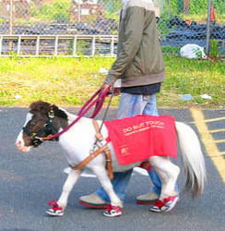
Service Animals
In some cases a miniature horse may be a service animal.

Slide 117
Service Animals
Transit systems may ask two questions to determine whether an animal qualifies as a service animal.
  First – if the animal is required because of a disability.
  Second – what work or task the animal has been trained to perform.

Slide 118
Service Animals
The ADA does not specifically mention requirements for service animal identification, or animals in training.
Therefore, it is illegal to require a person with a service animal to provide proof.

Slide 119
Service Animals
Examples of work or tasks include:
  Guiding individuals who are blind
  Alerting individuals who are deaf
  Pulling a wheelchair
  Assisting during a seizure
  Alerting to the presence of allergens
  Retrieving items
  Providing support & assistance with balance & stability preventing or interrupting impulsive or destructive behaviors

Slide 120
The crime deterrent effects of an animal presence, & the provision of emotional support, well-being, comfort, or companionship do not constitute work or tasks.

Slide 121
Service Animals
Post-Traumatic Stress Disorder & Service Animals
A service animal plays an important role in supporting an individual with PTSD.
The possible tasks the animal can be trained to do is highly individualized around the needs of the person with PTSD.

Slide 122
Service Animals
Safety Issues
Service animals are socialized & trained to interact appropriately with other animals & people.
However, it is possible that a service animal could be provoked & become aggressive.

Slide 123
Service Animals
A transit system may exclude any animal from your vehicle when the animal’s behavior poses a direct threat to the health or safety of others.
You MAY NOT make assumptions about any animal based on past experience with other animals. Each situation must be considered individually.

Slide 124
Service Animals
Tips for providing assistance:
  ASK the passenger what you can do to assist.
  Do not touch or give commands to a service animal unless asked to do so by the handler.
  If necessary, remind passengers that the service animal is working & not to distract it.

Slide 125
Service Animals
When a service animal must ride the lift be extremely alert & safety-conscious.
Service animals should sit or lie on the floor – not on seats.

Slide 126
Section 10:
Disability Awareness
Passenger Assistance Safety & Sensitivity (PASS)

Slide 127
Disability Awareness
According to the ADA, disability means:
  " With respect to an individual, a physical or mental impairment that substantially limits one or more of the major life activities of such individual; a record of such an impairment; or being regarded as having such an impairment."

Slide 128
Disability Awareness
It is important to keep in mind that your passenger with a disability is a person first; a person who has feelings, concerns, & opinions.
They deserve to be treated with the same respect displayed to passengers without disabilities.

Slide 129
Disability Awareness
Assisting People with Visual Impairments
When offering assistance to a passenger who has visual impairments, speak to them in a normal tone using normal terms.
Address the person directly, as it will help the person locate you.
Speak directly to the person, if your gaze wanders your voice follows.

Slide 130
Disability Awareness
Assisting People with Visual Impairments
If you will be guiding a passenger who is blind, ask how you may assist them.
Permit the passenger to grab your arm.
Show the passenger where your arm is by placing his/her hand on your arm.
Stand alongside & slightly ahead of the person you are guiding.

Slide 131
Disability Awareness
Assisting People with Visual Impairments
Walk at a normal pace or a pace comfortable for you & the person you are guiding.
Alert the person to changes in the walking surface & surrounding obstructions.
Hesitate before going up or down steps or curbs & make certain you vocally indicate the need to “step up” or “step down.”

Slide 132
Use the word STOP.
It has only one meaning:
    Cease doing what you are doing

Slide 133
Disability Awareness
Assisting People with Visual Impairments
When showing a person who is blind to a seat, place his/her hand on the back of it.
Do not try to push the person into the seat. In almost all cases the person will use his or her sense of touch to determine the type, height, & width of the seat prior to sitting down.

Slide 134
Disability Awareness
Assisting People with Visual Impairments
General things to remember:
Always announce your entrances & exits
Keep your voice at a normal level
Try to stand directly in front of your passenger when speaking to them
Offer assistance in boarding & exiting your vehicle

Slide 135
Hidden Disabilities
Any one or combination of impairments, such as epilepsy; heart or lung problems; diabetes; cancer; kidney failure; etc., which might affect the function & or endurance of an individual.

Slide 136
Disability Awareness
Hidden Disabilities
Emphysema, bronchial asthma, & some allergies are examples of respiratory disorders.
Make every attempt to keep the air in the vehicle as clean as possible. Closing windows & using air-conditioning helps. Enforce the No Smoking policy of your agency.

Slide 137
Persons with Visual Impairments
Communication Methods

Slide 138
Vision Loss
More than 25 million people in the United States have some vision loss (American Foundation for the Blind)
Vision loss may affect:
  Communication
  Independent Living
  Mobility
Vision loss increases with age

Slide 139
Vision Loss & Aging
6.5 million persons over age 65 have a severe vision impairment.
Vision loss can adversely impact the overall health & well-being of older adults in many ways:
  Increased risk of falls & fractures
  Increased risk of depression
  Difficulty identifying medications
  Difficulty bathing, dressing, & walking around the house

Slide 140
Some Types of Vision Loss
Cataracts
Macular Degeneration
Glaucoma
Diabetic Retinopathy
Retinitis Pigmentosa
Nearsightedness

Slide 141
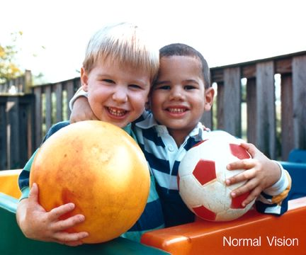

Cataracts
Vision with Cataract

Slide 142

Glaucoma
Vision with Glaucoma

Slide 143

Diabetic Retinopathy
Vision with Diabetic Retinopathy

Slide 144

Retinitis Pigmentosa
Vision with Retinitis Pigmentosa

Slide 145

Nearsightedness
Vision with Nearsightedness

Slide 146
Disability Awareness
Tips for assisting passengers:
Speak clearly & distinctly, do not exaggerate words
Use normal tone & speed of speech unless asked to change either

Slide 147
Communicate
Identify self
Identify customer
Ask how you may help

Slide 148
Techniques
Linking Arms
  Hold your arm relaxed & straight at your side
  After asking if customer has a guide side preference (when appropriate), customer grips arm just above elbow
  Customer stays ½ pace behind your step

Slide 149
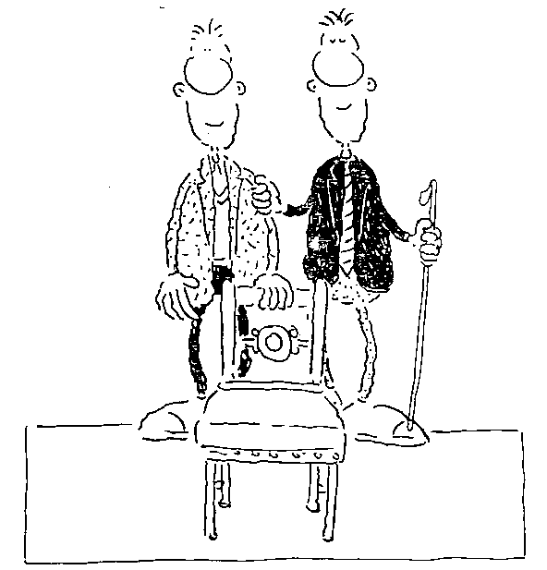
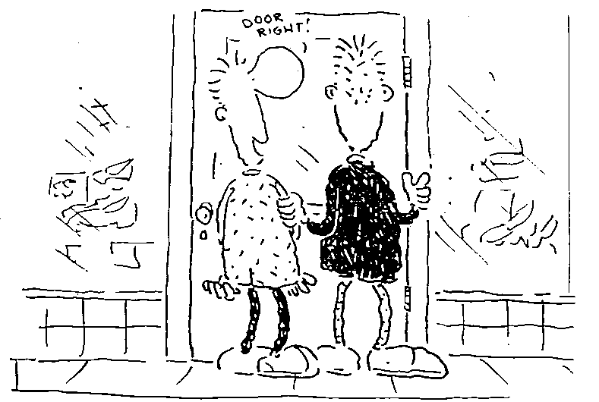
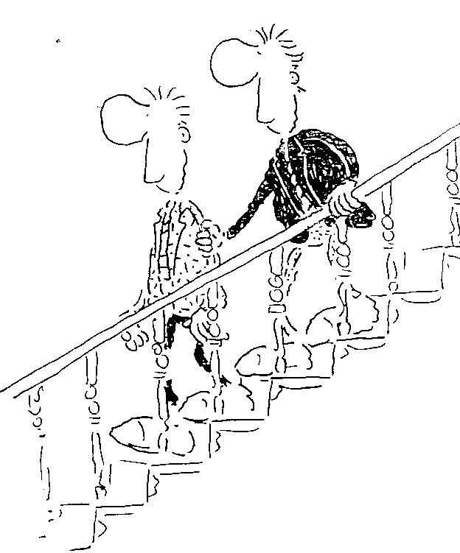
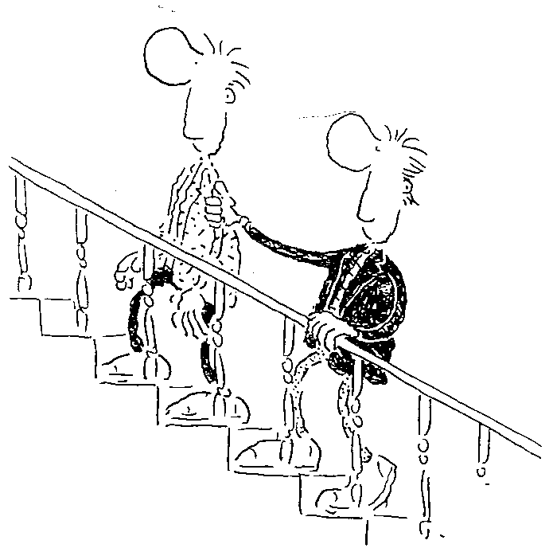
Trust Walk

Slide 150
Techniques
Walking single file
  Move straight arm behind you
Changing sides
  Stop, stay where you are; customer moves along your back to the other side
Doorways
  “Door left” – door hinges on left
  Open the door with your “grip” (assist) arm
Steps & staircase
  Stay one step ahead
  Long stride & pause at top / bottom
  * Square off to step (also used at curb cuts & ramps)
Seating
  Place your grip arm on the back of the chair & allow customer to locate the back & the seat
Cars
  Grip arm on the door handle
  “Car facing left or right”
  Protect head

Slide 151
Hearing Impairments
The major barrier facing a person with a hearing impairment is one of communication.
Unable to benefit from voice communication, persons with severe hearing impairment rely upon their eyes for signals to aid understanding.

Slide 152
Speech Disorders
Be patient, & be careful not to make fun of a passenger with a speech disorder.
If you are not sure of what the passenger said, ask him/her to repeat their statement. Repeat what you think you heard. Ask your passenger to start again where you end.

Slide 153
Cognitive Disabilities
Some passengers may have disabilities that affect their ability to know, think, remember, & learn (cognition).
These disabilities may be mental impairments or physical disabilities that also affect the person’s thinking, memory, awareness, & communication abilities.

Slide 154
Cognitive Disabilities
People who have cognitive disabilities may have difficulties with some or all of the following skills:
Thinking
Awareness
Orientation
Judgment
Memory
Learning
Communication/language
Processing Information
Decision-making
Emotional control

Slide 155
Alzheimer's Disease
Alzheimer’s Disease affects memory, speech, & other intellectual skills.
People with this disease experience changes in their mood, personality, & behavior.
They may become violent or display some other inappropriate behavior.

Slide 156
Because of memory loss, it is often necessary to repeat information, even telling the individual their address, where they are going, & who they are meeting.

Slide 157
Alzheimer's Disease
Sometimes people with this disease have a tendency to wander. Therefore, it may be necessary to complete a person-to-person drop off
Alzheimer’s Disease is not a natural part of aging; is not mental illness; is not curable or contagious

Slide 158
Alzheimer's Disease
Tips for assisting passengers with Alzheimer's Disease
  Be patient
  Use short, clear sentences
  Do not give too much information
  Encourage the person to sit in the front of the vehicle

Slide 159
Stroke
A stroke is caused by an interruption in the blood supply to the brain which may cause:
paralysis & a loss of feeling on one side of the body
memory loss & confusion
difficulty speaking & understanding

Slide 160
Five Symptoms of Stroke
Sudden weakness or numbness of the face, arm, or leg especially on one side of the body
Slurred words or trouble talking or understanding speech
Blurring or dimness of vision, in one or both eyes
Unexpected dizziness, loss of balance, or sudden fall
Sudden severe headache with no apparent cause

Slide 161
Stroke
If you believe a person is having a stroke:
  Ask the individual to smile
  Ask him or her to raise both arms
  Ask the person to speak a simple sentence
If he or she has trouble with any of these tasks, call 911 immediately & describe the symptoms to the dispatcher.

Slide 162
Cerebral Palsy
A group of conditions, not a disease, caused by damage to the brain before, during or just after birth.
Referred to as a developmental disability which can affect posture, muscle control, & in some cases senses.

Slide 163
Cerebral Palsy
Individual may have a balance problem, difficulty walking, difficulty using his/her arms & hands.
Individual may have great difficulty speaking clearly therefore, ask yes or no questions.

Slide 164
Cerebral Palsy
Tips for assisting passengers with cerebral palsy
  Speak as you would to any passenger
  Speak directly to the individual not a friend or companion
  Be patient; allow time for the passenger to speak
  Don’t pretend you understood something that was said if you did not

Slide 165
Amputation
Amputation causes problems with mobility & a real, or perceived loss of self-sufficiency that can cause depression or anxiety.
Becoming an amputee brings with it a host of lifestyle changes.

Slide 166
Amputation
Keep in mind that the human body loses body heat mostly through the skin. The human air conditioning system is sweat.
The loss of a limb reduces the ability of the amputee passenger to lose body heat. Therefore, an amputee can readily overheat on a hot vehicle or when sitting in the sun.
Make certain your passenger is comfortable.

Slide 167
Learning Disabilities
A disorder that makes it hard for a person to store, process or express information. Individuals with a learning disability may have:
  Short attention span
  Poor memory
  Difficulty with reasoning & communicating
  Some difficulty with social behavior, skill problems, as well as understanding & following verbal directions

Slide 168
Learning Disabilities
Tips on assisting passengers with learning disabilities
  Be direct, say what you mean
  Don’t use sarcasm & don’t exaggerate
  Give the passenger time to put his/her thoughts into words
  Have patience, the passenger may ask the same question over & over

Slide 169
Intellectual Disabilities
An individual with intellectual disabilities has a very below average intellectual functioning (IQ below 70 to 75), & significant limitations in 2 or more daily living skills such as communication, self-care, social skills, or health & safety, which show up in a person before the age of 18.

Slide 170
Intellectual disability is not the same as mental illness, although some people may have both.

Slide 171
Intellectual Disabilities
Individuals with an intellectual disability may:
  be slower in doing things like boarding the vehicle, paying a fare, taking a seat
  not be able to read well or at all
  have difficulty expressing themselves & may have some degree of speech impairment
  watch what other people do to know what to do
  be very affectionate
  function differently day to day

Slide 172
Intellectual Disabilities
Tips on assisting passengers with intellectual disabilities:
  Treat adults as adults
  Use eye contact
  Use simple words & short sentences
  Repeat information
  Show how to do what you are telling them to do
  Check for comprehension, ask what they are going to do now

Slide 173
Mental Illnesses
Mental illnesses are defined as; brain diseases, which affect an individuals ability to think, feel, & relate to other people & the environment.
Mental illness is not the same as being intellectually disabled & can occur at any time during life.
Mental illnesses include schizophrenia, major depression, manic-depressive disorder, phobias, anxiety, personality disorders, & stress-related illnesses & disorders.

Slide 174
Mental Illnesses
  Symptoms may include:
  Excessive anxiety, fear or suspicion, anger or hostility
  Hallucinations – may hear, feel or see things that are not really there
  Repetitive behavior
  Difficulty with over stimulating high stress environments

Slide 175
Autism
At this time, there is no known unique cause of Autism.
There is also no adjective which can be used to describe every type of person with Autism.

Slide 176
Autism is a lifelong disability that usually affects a person’s social interaction, learning, communication, & behavior due to interference with the way the person’s brain collects & organizes information.

Slide 177
Autism
One characteristic which is quite common is the individuals ‘insistence on sameness’, i.e., following the same routine. If a transit route is changed, even slightly, the individual may become upset & even tantrum.
Many individuals with Autism do not realize that others may have different thoughts, plans, & perspectives than their own.
As an example, the individual may show the back of a ride pass to a driver while they are looking at the front, not realizing that the driver has a different view.

Slide 178
Autism
Passengers with Autism may:
  Have severe language difficulties
  Understand but not respond
  May seem disinterested in other people, keep to themselves
  Rock or have other repetitive behaviors

Slide 179
Autism is a very complex disorder, & the needs of these individuals vary greatly.

Slide 180
Autism
Tips on assisting passengers with autism:
  Speak directly to the passenger, use simple short sentences
  Tell the passenger in advance of changes in the routine such as a different driver while you are on vacation, or a schedule change
  Be a professional & practice professional customer service skills

Slide 181
Traumatic Brain Injury
Individuals with a traumatic brain injury may:
  have difficulty paying attention or concentrating
  have difficulty remembering, understanding complex topics or issues
  have difficulty thinking through the steps needed to do something
  not move, think, or react quickly
  have difficulty putting thoughts into words
  take a long time to respond to a question

Slide 182
Traumatic Brain Injury
Tips on assisting passengers with a Traumatic Brain Injury
  Use good eye contact
  Use simple words & sentences
  Show how to do what you are telling to do
  Be patient

Slide 183
Spinal Cord Injury
Approximately 450,000 people in the United States have experienced a spinal cord injury; of these, over 250,000 currently live with some degree of paralysis.

Slide 184
Spinal Cord Injury
Two types of spinal cord injury:
1. Complete – individual is unable to function below the level of the injury.
2. Incomplete – Individual has some functioning below the primary injury level.

Slide 185
Spinal Cord Injury
The individual may experience bowel &/or bladder control issues.
The individual may also experience loss of involuntary functions such as the ability to breathe, to regulate blood pressure effectively, to control body temperature, to sweat below the injury level, & to control pain.

Slide 186
Diabetes
Diabetes is a disease in which the body does not produce or properly use insulin, a hormone that is needed to convert sugar, starches, & other food into energy needed for daily life.

Slide 187
Diabetes
Type I Diabetes
  results from the body’s failure to produce insulin. It is usually diagnosed in children & young adults
Type II Diabetes
  the most common form – occurs in people of all ages & ethnic groups

Slide 188
Epilepsy or Seizure Disorders
Epilepsy or seizures disorders are symptoms of brain disorders. These disorders can start before birth, or may be the result of a brain injury. Medication controls seizures, although a seizure may take place at any time, even under medication.

Slide 189
Epilepsy or Seizure Disorders
Convulsive seizure (Grand Mal)
  The body becomes stiff, followed by rapid, jerking motions
  Person may have frothing or saliva at the mouth
  Person may go into deep unconsciousness & may lose bowel & bladder control
  Usually lasts only 2-5 minutes, but can last longer

Slide 190
Epilepsy or Seizure Disorders
Grand Mal seizures usually last 2-5 minutes & include extensive shaking of the entire body, accompanied by temporary loss of consciousness.
Do not attempt to restrain the person during a seizure. It is impossible to swallow the tongue. Therefore, do not attempt prevention by putting something in the person’s mouth.

Slide 191
Epilepsy or Seizure Disorders
If a passenger goes from one seizure to another or if a seizure lasts more than 10 minutes, call for emergency assistance. Regardless of how long the seizure may last, inform your dispatcher as soon as possible.
Do not continue without a determination as to whether additional medical assistance is required.

Slide 192
Epilepsy can usually be controlled with medication. However, it is dangerous to assume that because the person’s condition was under control one day, he or she cannot have a seizure on the next.

Slide 193
Epilepsy or Seizure Disorders
Tips on assisting:
  Remain calm
  Pull your vehicle safely to the curb or side of the road & stop
  Fold a jacket or other soft material & gently slide it under the head of the passenger
  Allow the seizure to run its course
  Avoid prolonged physical contact with the person as this can prolong the seizure
  Know your agency’s policy on safety & reporting

Slide 194
Section 11:
Bloodborne Pathogens
Passenger Assistance Safety & Sensitivity (PASS)

Slide 195
National RTAP: Bloodborne Pathogens
Issue One: Bloodborne Pathogens & the Workplace
Bloodborne pathogens are microorganisms that can cause disease when transmitted from one person with an infectious or contagious condition to another.
They are capable of causing serious illness & even death. To protect yourself in the workplace, assume all blood & bodily fluids are infectious.

Slide 196
Bloodborne Pathogens
Bloodborne Pathogens are viruses or other infectious agents carried by the blood.
These pathogens include, but are not limited to, Hepatitis B Virus (HBV) & Human Immunodeficiency Virus (HIV)

Slide 197
Bloodborne Pathogens
OSHA regulation 1910.1030 deals specifically with Bloodborne Pathogens.
Although this regulation was written with medical facilities in mind, it applies to all organizations that have employees who may come in contact with potentially infectious bodily fluids.

Slide 198
Knowledge of & compliance with the bloodborne pathogen regulations is the best way to protect yourself, your family, employer, & passengers from infection.

Slide 199
Bloodborne Pathogens
Universal Precautions
Treat all blood & body fluids as potentially infectious for HIV, HBV, HCV & other pathogens.
It is highly recommended that you wash your hand thoroughly before hand to mouth, nose or eye contact.

Slide 200
Bloodborne Pathogens
Unbroken skin is a barrier against bloodborne pathogens.
However, any break in the skin may provide a pathway for infected blood or other potentially infected materials to enter your body.

Slide 201
Bloodborne Pathogens
Infected blood or other material can enter through:
Open sores, cuts, abrasions
Damaged or broken skin such as sunburn or blisters
Acne
Hang nails
Paper cuts

Slide 202
Bloodborne Pathogens
Bio-hazard clean-up kit (Spill Kit)
Each vehicle should be equipped with a biohazard kit. Make it a regular part of your pre-trip inspection.
Knowing how to use the spill kit, which is your primary source of personal protective equipment, is of extreme importance.

Slide 203
Bloodborne Pathogens
As part of your pre-trip inspection routine it is a good idea to open the kit & verify the presence of required materials.
If the kit is sealed do not open it. However, verify that the seal is intact & make a notation on your inspection form.

Slide 204
Bloodborne Pathogens
Hepatitis: A general term that refers to inflammation of the liver. Viruses, alcohol, or chemicals can cause it.
Cirrhosis of the liver is the term that describes scarring or permanent damage to the liver. Severe or chronic hepatitis can lead to cirrhosis as well as liver cancer.
A damaged liver can lead to terminal illness.

Slide 205
Hepatitis is not spread to another person through casual contact such as helping passengers onto or off your vehicle. It is a blood-to-blood transmission.

Slide 206
Bloodborne Pathogens
Hepatitis A (HAV): A virus spread by infected feces that contaminate food or drinking water & infects approximately 35,000 people in the US each year.

Slide 207
Bloodborne Pathogens
Hepatitis B (HBV): A virus that causes serious liver disease & is sometimes fatal. It causes inflammation of the liver & can lead to cirrhosis of the liver & liver cancer.
HBV is 50 to 100 times more infectious than Human Immunodeficiency Virus (HIV) & can survive in dried blood up to seven days.

Slide 208
Bloodborne Pathogens
Hepatitis C (HCV): A viral infection of the liver which causes inflammation of the liver & is the leading reason for liver transplants in the United States.

Slide 209
Bloodborne Pathogens
REMEMBER
Should someone get sick or injured on your vehicle:
Remain calm
Comfort the injured or sick person
Use universal precautions & put on disposable gloves
Call 911
Use a bio-hazard spill kit for cleanup

Slide 210
Bloodborne Pathogens
Human Immunodeficiency Virus (HIV):
Human Immunodeficiency Virus is the virus that leads to AIDS. It is an infectious disease that currently has no cure.
When HIV develops into AIDS, symptoms become more severe. The body is unable to resist common viruses, or the complications associated with them. Virtually every system of the body is attacked.
Eventually the body is no longer capable of withstanding the various infections & ailments, & organ systems collapse, which ultimately leads to death.

Slide 211
Bloodborne Pathogens
Acquired Immuno-Deficiency Syndrome (AIDS)
The AIDS disease renders the body’s immune system unable to resist invasion by several microorganisms that cause serious infection.
The virus usually remains dormant for some time & it may take up to 10 years for symptoms to develop.

Slide 212
Bloodborne Pathogens
HIV/AIDS
Casual contact in general is not a risk factor for infection.
The virus is transmitted by blood. Therefore, any time you provide first aid, or assistance to an injured passenger, be certain to practice universal precautions.

Slide 213
Bloodborne Pathogens
Special needs of persons with AIDS
  Many individuals with AIDS do not need special attention
  Maintain client confidentiality
  Be careful not to rush these passengers & use the same courtesy & common sense you would with other passengers

Slide 214
Bloodborne Pathogens
Kidney Dialysis
Your kidneys maintain body fluid levels by excreting fluids when the body has excess & conserving fluids when the body fluid is low.
The kidneys assist in regulating blood pressure by excreting excess fluids & a chemical called rennin.

Slide 215
Bloodborne Pathogens
The kidneys filter the entire blood supply every 2 minutes in order to perform their major job of removing waste from the blood & discharging it as urine.
If, for some reason, 1 kidney stops functioning, the other can perform the job of both.

Slide 216
Bloodborne Pathogens
Hemodialysis
An artificial process of removing waste & excess fluid from the blood.
Treatments are generally required 2 to 3 days per week, with each treatment lasting 4 to 6 hours.

Slide 217
Bloodborne Pathogens
Hemodialysis
Individuals who go through this treatment are usually extremely weak & feel ill upon completion of treatment.
Many may be carrying up to 15 pounds of excess body fluid prior to treatment.
Make absolutely certain that these passengers receive assistance in moving.

Slide 218
Bloodborne Pathogens
The Passenger:
May scratch a lot from dry skin caused by blood chemistry
May have poor vision
May require assistance standing, walking, & entering or exiting your vehicle.
May bleed from the access point to their blood supply. Should this occur seek medical attention immediately.

Slide 219
National RTAP
Transporting Non-Ambulatory Passengers Issue One: Your Responsibility
As a driver, you are responsible for the safe boarding, securement, transport, & deboarding of people who use wheelchairs & other mobility devices.
To a person who uses a wheelchair or other mobility device, a trained & empathetic driver makes a particularly large difference in their quality of life.

Slide 220
National RTAP
Transporting Non-Ambulatory Passengers Issue One: Your Responsibility
Regardless of the service you provide, you are expected to completely facilitate boarding & deboarding of people who use wheelchairs or other mobility devices.
Understanding your agency’s policies is essential to fulfilling your responsibility to comply with the Americans with Disabilities Act (ADA) requirements & your responsibility to the safety of your passengers.

Slide 221
Section 12:
Mobility Equipment & Features
Passenger Assistance Safety & Sensitivity (PASS)

Slide 222
MOBILITY EQUIPMENT & FEATURES

Slide 223
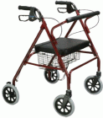
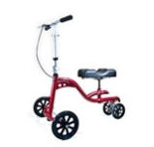
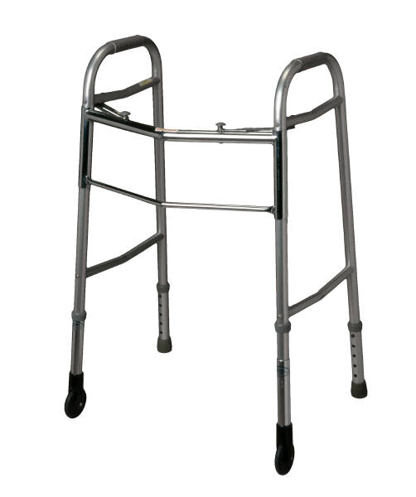
Mobility Equipment & Features
Walkers
Passengers using this device will lean fairly heavily on it. This device is particularly common among the elderly & may have a “seat” attached so the user may rest.
knee walker

Slide 224
Mobility Equipment & Features
Passengers using walkers will be moving quite slowly since balance is a problem. Do not rush your passengers.
It will be extremely difficult, if not impossible, for the passenger to utilize the steps in your vehicle. Therefore, the ADA requires that this individual be permitted to use the accessible entrance for entry & exit of the vehicle.

Slide 225
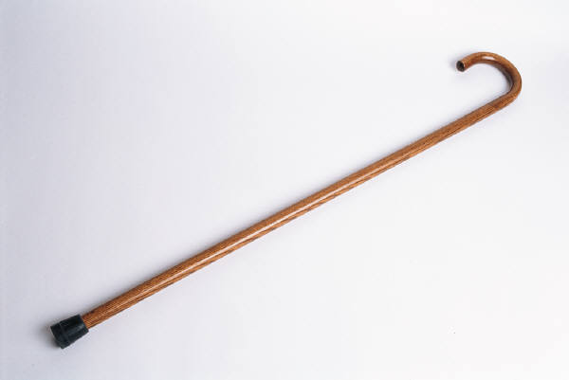
Mobility Equipment & Features
Canes
The primary function of a cane is to maintain balance when walking or standing.

Slide 226

Mobility Equipment & Features
The “white cane” is not used for support.
Only those individuals who are legally blind are entitled to use a “white cane”.

Slide 227
Mobility Equipment & Features
When providing assistance to a passenger using any type of cane, do so on the side of the passenger opposite the cane.
Be certain to ask your passenger if they would like assistance, & if so, how you may help.

Slide 228

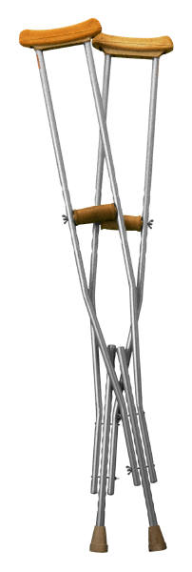
Mobility Equipment & Features
Crutches
There are two basic types of crutches; underarm, & forearm. Crutches assist with balance & body weight support.

Slide 229
Mobility Equipment & Features
All passengers using crutches may have a balance problem. Ask if they require assistance & how you may provide it.
Remember, it may be easier & safer for your passenger to use the lift for boarding & exiting the vehicle.

Slide 230
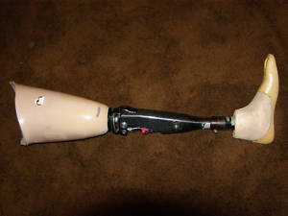
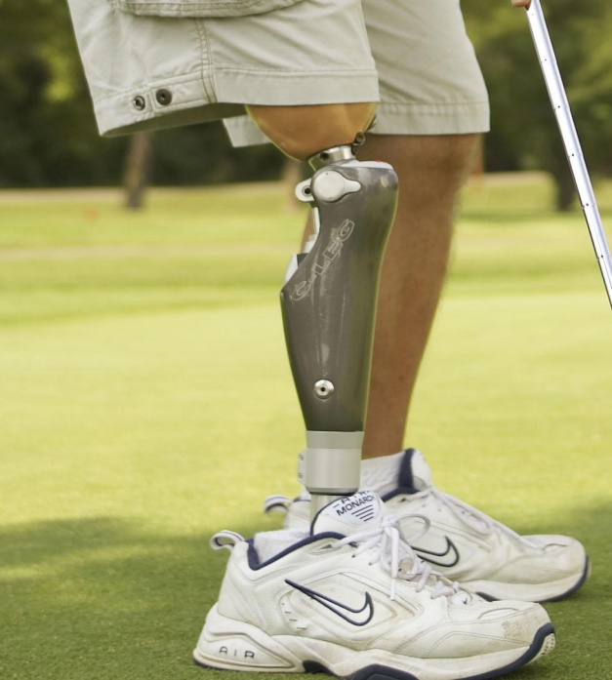
Mobility Equipment & Features
Prosthesis
An artificial device that replaces a missing body part such as an arm or leg.

Slide 231
Mobility Equipment & Features
A passenger using a prosthetic leg may walk slowly & have difficulty walking up or down steps of your vehicle.
Be patient & do not make your passenger feel pressured to move faster.

Slide 232
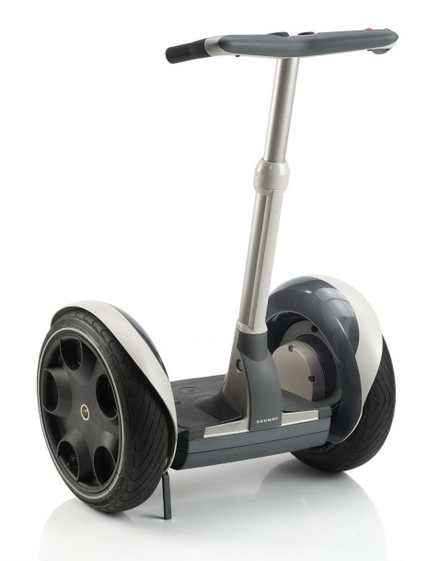
Mobility Equipment & Features
Segway
A Segway is a two-wheeled, gyroscopically stabilized, battery-powered personal transportation device. Some individuals with disabilities may use a Segway as a personal mobility aid, in lieu of more traditional devices like a wheelchair or scooter.

Slide 233
Mobility Equipment & Features
A Segway is not a wheelchair. However, a Segway, when used by a person with a disability as a mobility device, is part of the broad class of mobility aids that the ADA intends will be accommodated. In this way, a Segway occupies a legal position analogous to canes, walkers, etc.

Slide 234
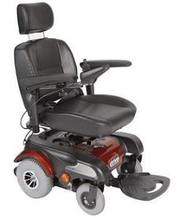
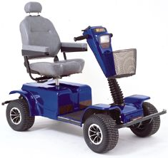
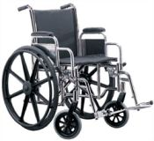
Mobility Equipment & Features
Wheelchairs
A mobility aid belonging to any class of three-or-more wheeled devices, usable indoors, designed or modified for & used by individuals with mobility impairments whether operated manually or powered.

Slide 235
Mobility Equipment & Features
The ADA no longer uses the term “Common Wheelchair” because the requirements for lift platforms, & wheelchair spaces specify the appropriate dimensions for wheelchairs. Therefore, a device used by individuals with disabilities for mobility must fit an “envelope” which is 30 inches wide by 48 inches long.

Slide 236
Mobility Equipment & Features
The DOT rules do not require a transit system to accommodate devices that are not primarily designed or intended to assist persons with mobility disabilities.

Slide 237
Mobility Equipment & Features
The chair is as valuable to the user as the body part or function it has replaced. Wheelchair users consider their wheelchair to be a part, or extension, of their own body.
Unnecessary leaning on or touching the chair is similar to doing the same to the person.

Slide 238
Mobility Equipment & Features
Proper assisting techniques insure safety & comfort for the occupant. Just as you would for an ambulatory person, slowly & carefully, move a person in a wheelchair by making your movements smooth & gentle.
Do not jerk or jolt, which can be very uncomfortable, or even painful for the person in the wheelchair.

Slide 239
Mobility Equipment & Features
The person is putting you in control when you are guiding the chair – move with confidence.
Prepare your passenger for movement by giving simple verbal cues when you are going to start.

Slide 240
Mobility Equipment & Features
Because of the wheelchair’s value to the occupant, it is important to treat it carefully. Take care not to scratch the tubing on corners of lifts or vehicle seats. The securement straps should not gouge or scar the frame of the chair.
Always report safety defects to the owner such as wheels coming off, spokes loose, underinflated tires, etc.

Slide 241
Mobility Equipment & Features
The center of gravity of an unoccupied chair is just above & forward of the rear axle. When occupied, this changes to about the top of the armrests
Therefore, even though weight is well distributed, the short wheelbase & high center of gravity make it possible to spill a person forward.

Slide 242
Mobility Equipment & Features
Driving Techniques
Centrifugal force (outward) is exerted on wheelchairs when your vehicle turns a corner or takes a curve in the road. Regardless of the direction of the turn or curve, the passenger may feel as if they are being pulled forward out of the chair, or that the chair may tip over. Therefore, slow steady turns & curves must be made.

Slide 243
Mobility Equipment & Features
Wheelchairs pick up road shock each time the vehicle hits a bump. Care & judgment are needed to avoid unnecessary bumps or potholes. If the road is unavoidably bumpy, slow down & ease your way through.

Slide 244
Frequently Asked Questions About Wheelchairs
Does a wheelchair need brakes to use the transit service?
No.
A transit provider may not deny transportation to a wheelchair user because the wheelchair does not have brakes /wheel locks or the user does not choose to set the brakes/wheel locks.

Slide 245
Frequently Asked Questions About Wheelchairs
Can the provider require a person to transfer from a wheelchair into a seat?
No.
Regulations allow the person to transfer if a seat is available. Such a move is the rider’s decision. The driver may suggest a transfer in a non-coercive manner.

Slide 246
Mobility Equipment & Features
Tips for drivers:
Talk directly to the person in the wheelchair, rather than to the person pushing it. In an extended conversation, bring yourself to eye level of the seated person.
ASK if assistance is needed before you assist, including pushing a wheelchair.

Slide 247
Mobility Equipment & Features
Whenever possible, place yourself on the low side of the person you are assisting. When going up an incline ramp or curb, you should be behind the chair facing & walking forward; when coming down, you should be behind the chair holding onto the handgrips, facing the direction you are coming from. Make sure you are checking behind you for obstacles, slippery spots, etc.

Slide 248
Mobility Equipment & Features
Always call your supervisor or dispatch when things are not as usual or if your agency policy is being broken

Slide 249
Section 13:
Lift Operating Procedures
Passenger Assistance Safety & Sensitivity (PASS)

Slide 250
Lift Operating Procedures
The information in this section covers general procedures that will apply to all lifts. Your agency may have specific policies pertaining to vehicle lift operations. It is recommended that you check with your supervisor concerning those policies.

Slide 251
Lift Operating Procedures
These procedures are in place for safety reasons. They have not been developed to hassle a driver or passenger.

Slide 252
Lift Operating Procedures
Lifts are potentially hazardous equipment. They must be maintained & operated properly. Considerable caution & awareness is needed when operating a lift.
Only the vehicle driver should operate the lift.

Slide 253
Lift Operating Procedures
These are general guidelines for lift operation – adhere to YOUR agency’s policies.
  At your destination, stop on level ground, put the vehicle in “park”, set the emergency brake.
  Make sure there is enough room for the lift platform to open without hitting obstacles.
  Activate emergency flashers.

Slide 254
Lift Operating Procedures
It is the responsibility of the vehicle operator to:
  properly open, secure & close the lift doors,
  to load & unload the passenger on & off the lift platform
  & to properly use all lift functions.
Open the lift from the outside of the vehicle. Securely lock doors in open position.
Greet your passengers. Talk to them, not around them.

Slide 255
Lift Operating Procedures
Ask your passenger if they would like assistance getting onto the platform.
The passenger may want to ride the lift facing the vehicle. Explain the hazard involved & request that the passenger ride on the lift with their back to the vehicle. Remember, however, under ADA, it is their choice.
Set the wheel locks on the wheelchair and, if the passenger is capable, ask them to hold the handrails on the lift.

Slide 256
Lift Operating Procedures
If the passenger is using a motorized device ask them to turn the power off once on the lift.
If your lift is equipped with a passenger safety belt it must be utilized each time the lift is operated.

Slide 257
Lift Operating Procedures
The lift must always be operated from the ground. Do not remain in the vehicle while raising or lowering the lift platform. Do not ride on the lift with passengers who are using a mobility device.

Slide 258
Lift Operating Procedures
Stand on the ground with one hand holding the wheelchair & one hand operating the controls.
Raise the platform only a couple inches.
Check the front safety barrier to be certain it is locked.
Only after you are certain the barrier is locked, continue raising the lift platform to the vehicle floor level.

Slide 259
Lift Operating Procedures
Put the lift controls in a secure location with one hand while holding the wheelchair with the other.
Release the wheel locks & push the chair into the vehicle.
Reach in & lock one wheel. Never leave a wheelchair on the platform unattended.
When boarding, push it in.
When exiting, pull it out.

Slide 260
Lift Operating Procedures
This 3 step procedure may be difficult for some drivers. Therefore, ask the passenger if they can assist moving their wheelchair in & out of the vehicle.

Slide 261
Lift Operating Procedures
Caution is needed when loading a power wheelchair into & out of your vehicle.
When boarding this passenger, ask them to turn off the power to the device after they have gotten onto the lift. When the lift comes up to floor level, ask the passenger to turn the power on again & only tap their controls for the direction you want them to travel. This may require two or three taps, but you want to be certain they are going in the correct direction.

Slide 262
Lift Operating Procedures
When exiting the vehicle, again ask the passenger to tap their controls one, two, or three times to get them onto the lift platform. Once on the platform, ask them to turn off the power.
Make certain you are clear in your directions & that the passenger understands what you are saying.

Slide 263
Lift Operating Procedures
Standees should stand in the center of the platform facing the direction they will travel.
If capable, the passenger should hold both handrails when on the platform.
The driver must determine if it is safe to ride the lift with the passenger, or safer to operate the lift from the ground.
How you can best protect the passenger must be assessed with each standee use of the lift.

Slide 264
Lift Operating Procedures
Manual operation of the lift
All Braun, RICON, & Maxon Mobility lifts are equipped with a hydraulic manual pump located within the plastic motor housing on the side of the lift. A steel pump arm may be mounted on the inside or outside of this plastic housing.

Slide 265
Lift Operating Procedures
NOTE:
During manual operation of a paratransit/community transportation lift, the driver must be inside the vehicle. This is the only time under normal conditions that it is acceptable for the driver to operate the lift from inside the vehicle.

Slide 266
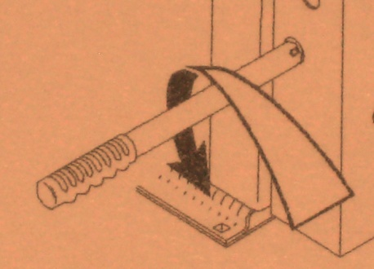
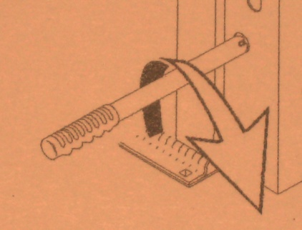
Lift Operating Procedures
Manual Lowering - To lower the platform manually, insert the pump handle onto the bleeder valve. Turn the pump handle counterclockwise just enough to allow the platform to drop slowly.
When the platform has reached the ground,
tighten the valve by turning it clockwise.

Slide 267
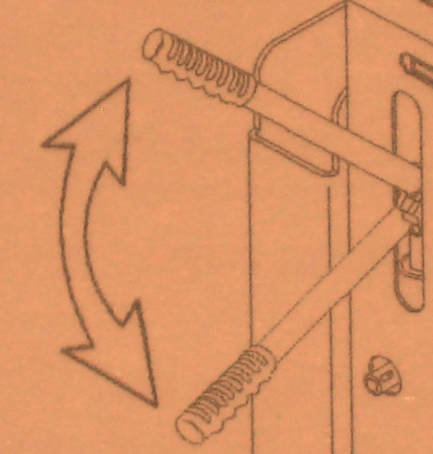
Lift Operating Procedures
Manual Raising – Insert the pump handle into the pump opening. Pump the handle by raising & lowering it a full stroke. The platform will rise very slowly to floor level.

Slide 268
Lift Operating Procedures
If your lift is fully automatic after moving your passenger off the lift, continue to pump the handle to fold the lift into the vehicle.
If your lift is not fully automatic, refer to the lift operating instructions which should be mounted directly on the lift.

Slide 269
Lift Operating Procedures
403-compliant lifts
The 403 lift must be classified by the National Highway Traffic Safety Administration (NHTSA) as a Public Use Lift with a continuous lifting capacity of 800 pounds.

Slide 270
Lift Operating Procedures
The driver should not ride on the lift with the passenger. The lift is intended for one wheelchair & its occupant.

Slide 271
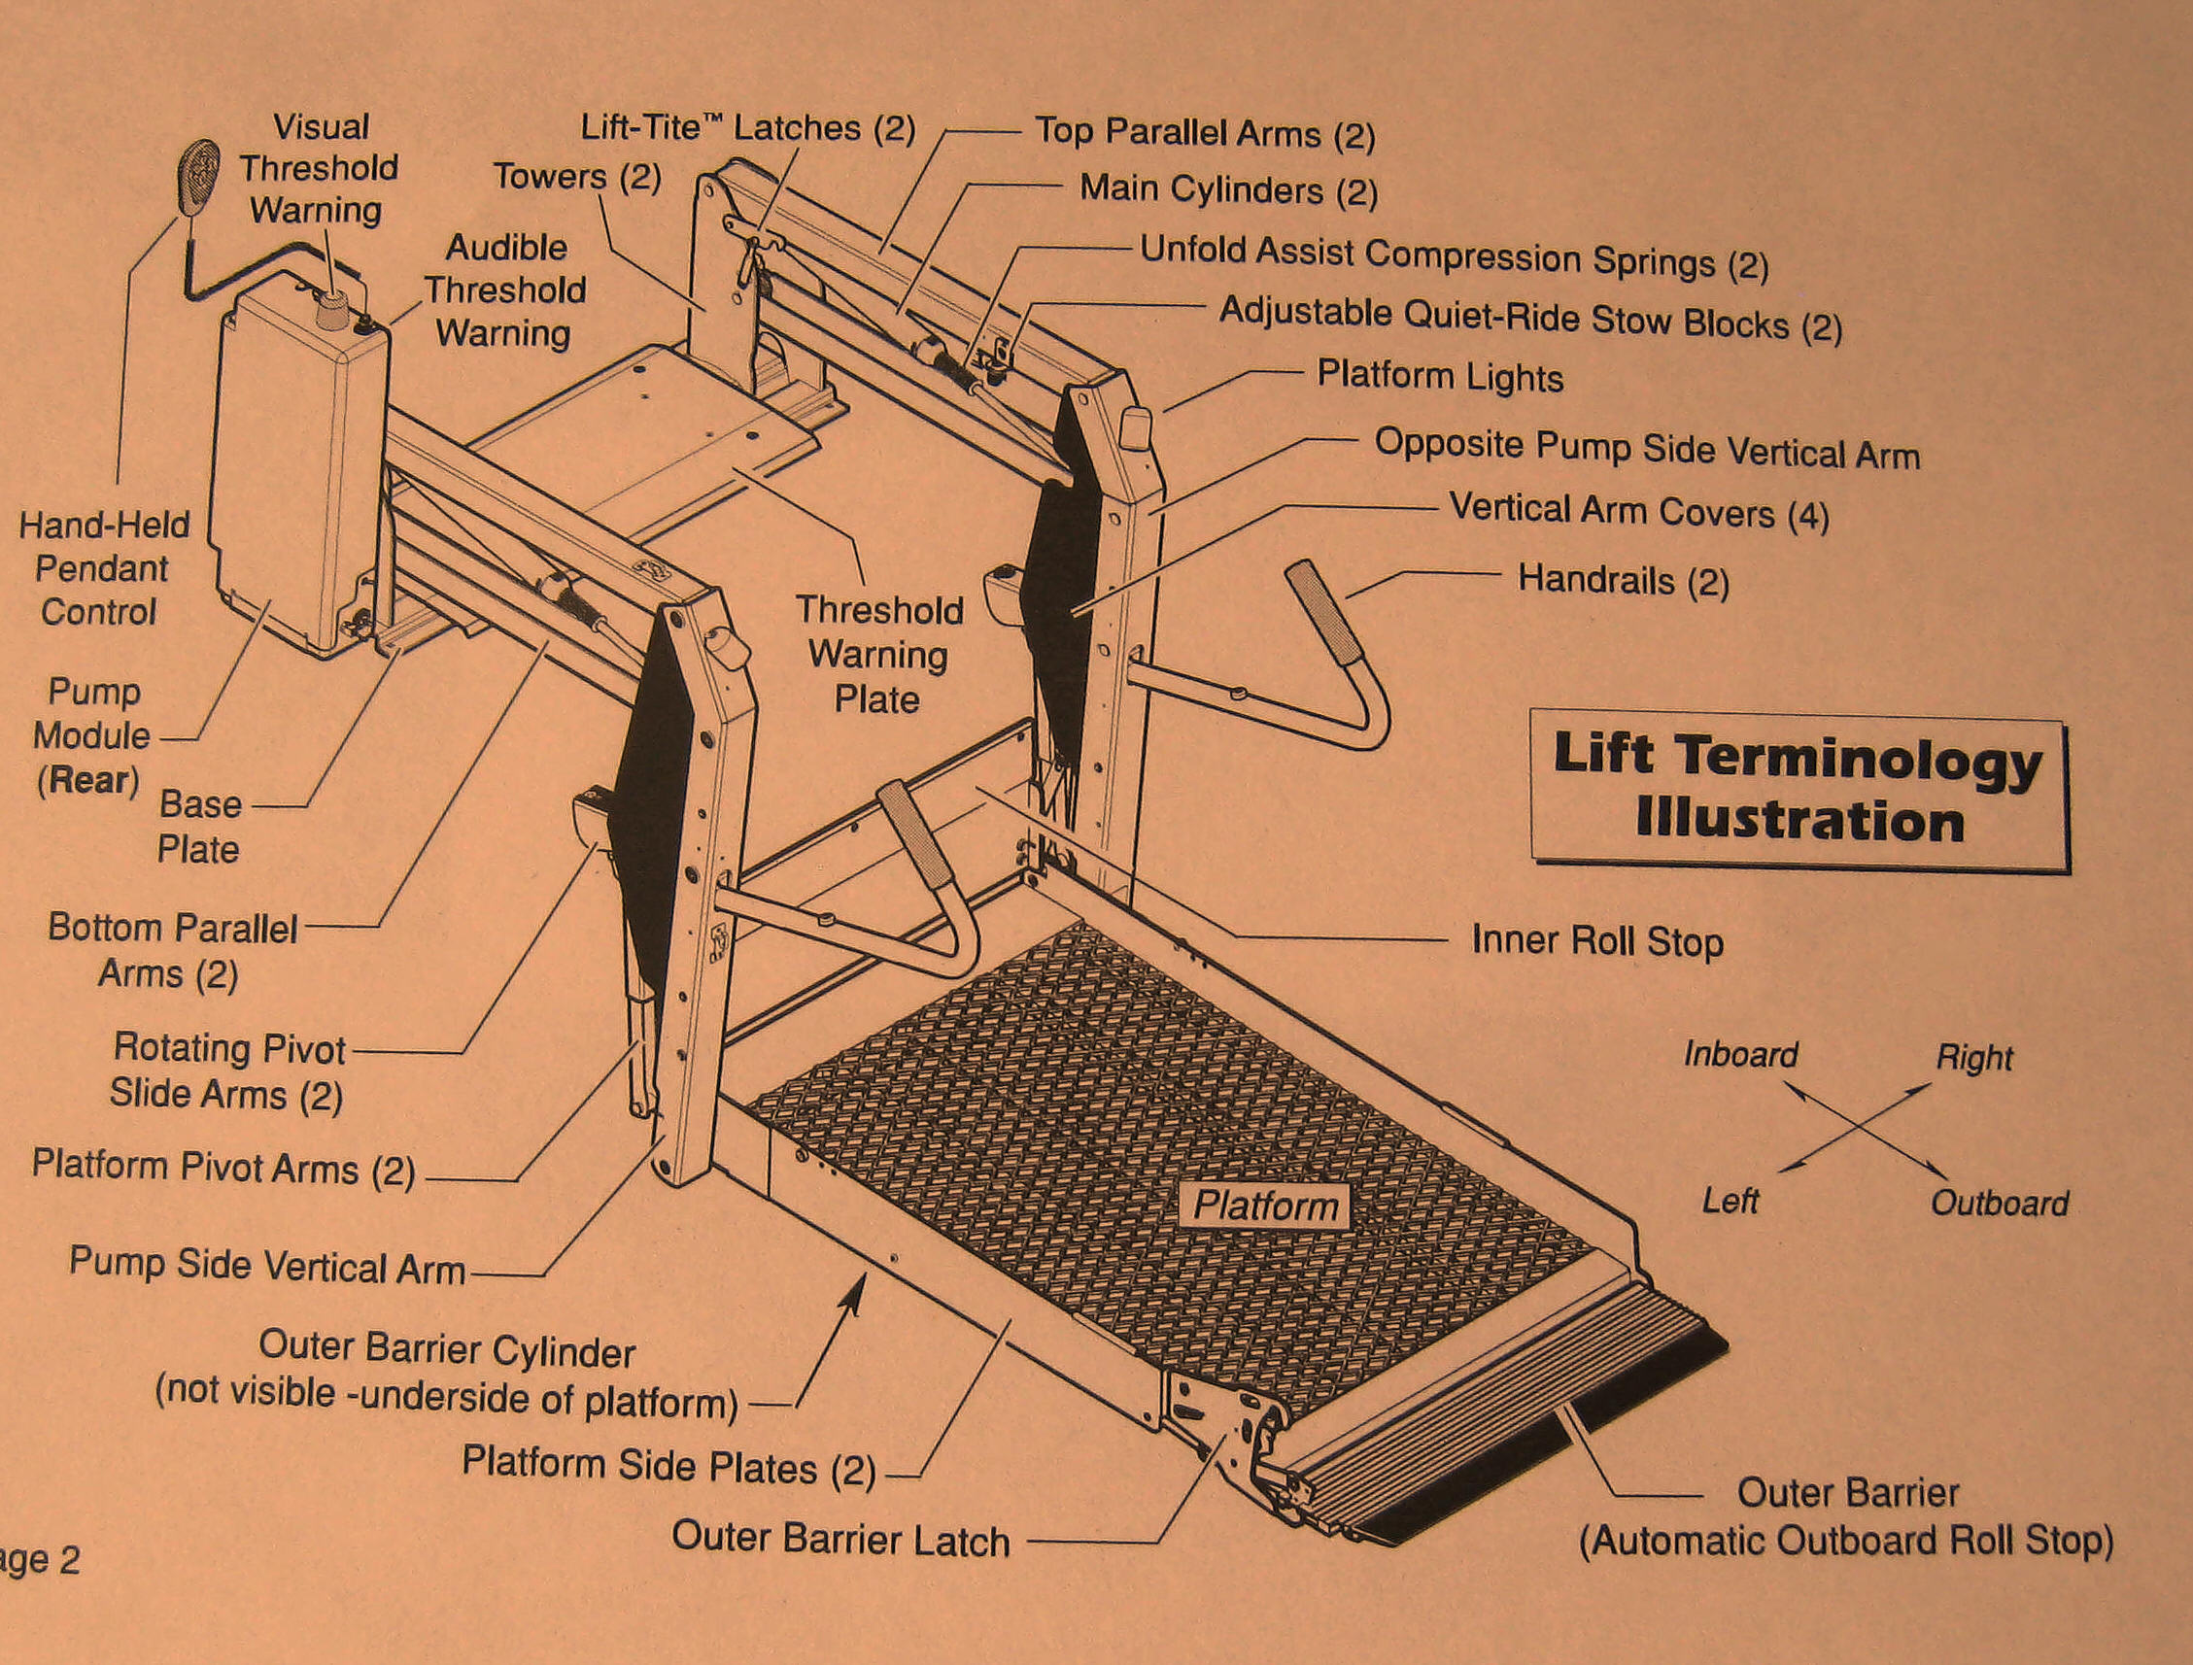
BRAUN LIFT

Slide 272
Lift Operating Procedures
Braun
Vehicle movement is prohibited unless the lift is fully stowed & the lift will not function unless the vehicle is parked & secured.
A visible & audible threshold warning system will activate if 25 pounds or more are on the threshold warning plate when the platform is 1 inch or more below the floor level.

Slide 273
Lift Operating Procedures
The inner roll stop & outer barrier sense weight to prohibit lift operation. The lift will not function if 25 pounds or more are on the inner or outer roll stop. The lift platform cannot be folded if 50 pounds or more are on the platform.
Two light beams detect if someone passes through either one when the platform is 1 inch below the floor level. An audible & visual signal are activated.

Slide 274
Lift Operating Procedures
The lift cannot be raised more than 3 inches unless the outer barrier is vertical & the outer barrier latch is positively engaged.
A power switch is located on the power box to the lift itself & is accessible from outside the vehicle when the lift doors are open.

Slide 275
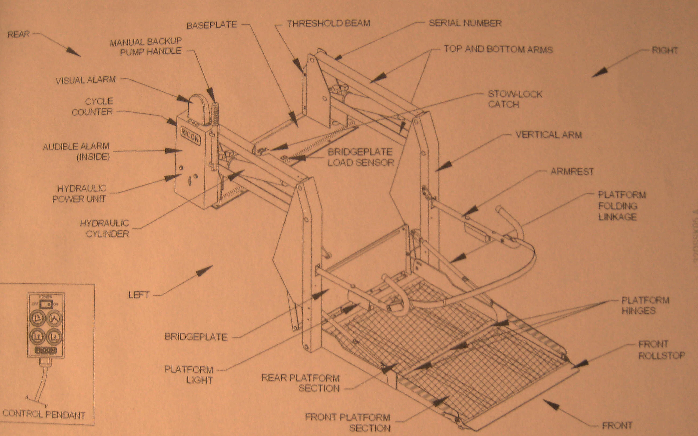
RICON LIFT

Slide 276
Lift Operating Procedures
Ricon
Two light beams detect if someone passes through either one when the platform is 1 inch below the floor level. An audible & visual signal are activated.
The RICON lift bridge plate is equipped with a load sensor which will prevent lowering of the lift platform if an object is on the bridge plate.

Slide 277
Lift Operating Procedures
The RICON lift will not operate unless the occupant restraint belt is properly fastened.
A power switch is located on the hand control for the lift.

Slide 278
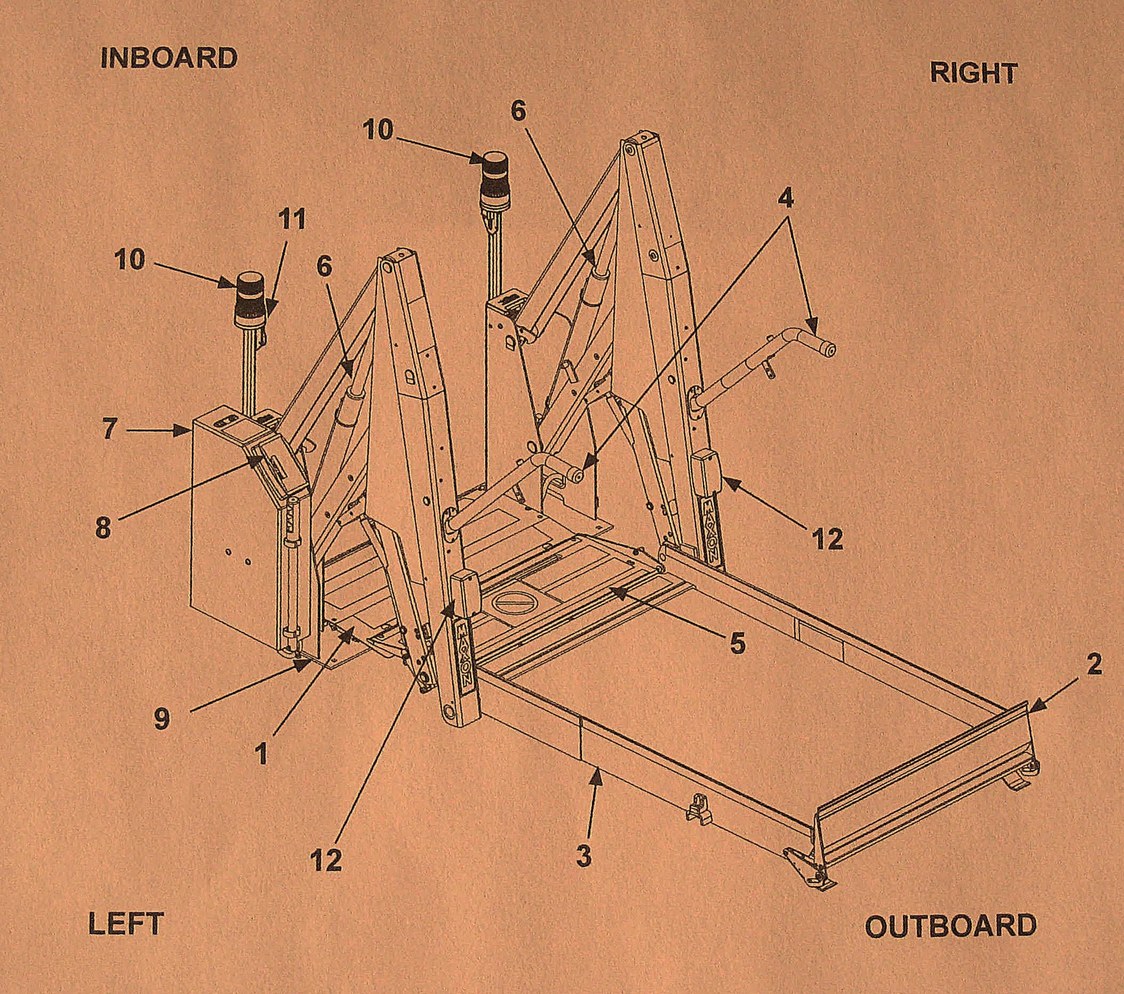
MAXON MOBILITY LIFT

Slide 279
Lift Operating Procedures
1. Threshold Plate 7. Hydraulic Power Unit
2. Outboard Roll Stop 8. Lift Controller (Brain Box)
3. Platform 9. Base
4. Handrails 10. Threshold Warning Beacon
5. Inboard Roll Stop 11. Threshold Warning Alarm
6. Hydraulic Cylinder 12. Platform Lights

Slide 280
Lift Operating Procedures
Maxon
A visible & audible threshold warning system will activate if 25 pounds or more are on the threshold warning plate when the platform is one inch or more below floor level.
A power switch is located on the power box to the lift itself.

Slide 281
Lift Operating Procedures
Cycle Counter
The Braun & RICON 403 lifts have a lift cycle counter located on the hydraulic pump housing, visible through a slot on the aisle side of the housing.
The counter advances each time the platform moves through a complete cycle. The number of cycles displayed is used to schedule preventive maintenance services.

Slide 282
Lift Operating Procedures
The counter on the Maxon lift is located within the Lift Controller (brain box display). One cycle is counted each time the lift is unfolded, lowered to the ground & raised to floor level, & stowed.
One lift is counted each time the lift is lowered from floor level to the ground, & raised back to floor level.

Slide 283
Section 14:
Wheelchair Securement
Passenger Assistance Safety & Sensitivity (PASS)

Slide 284
Wheelchair Securement
ADA Requirements:
Sec. 38.23 (d) of the DOT ADA regulations requires all ADA-compliant vehicles to have a two-part securement system: one to secure the common wheelchair & a separate system to secure the wheelchair user.
(such seat belts & shoulder harnesses shall not be used in lieu of a device which secures the wheelchair or mobility aid itself).

Slide 285
Wheelchair Securement
All vehicles over 22 feet in length must have two securement locations, while vehicles 22 feet & under must accommodate a minimum of one wheelchair

Slide 286
Wheelchair Securement
According to the ADA, securement locations shall be placed as near the accessible entrance as practical & have a floor clearance area of at least 30” X 48”.
Note: The US ACCESS-Board is in the process of revising the vehicle guidelines making this space 30” X 54”. The device itself must fit in an area 30” X 48”.

Slide 287
Wheelchair Securement
Such space shall adjoin, & may overlap, an access path. Securement areas may have fold-down seats. Provided the seats when folded up, do not obstruct the clear floor space required.

Slide 288
Wheelchair Securement
The securement system shall limit the movement of an occupied mobility aid to no more than 2 inches in any direction under normal vehicle operating conditions.
Since 1991 all vehicles must have securement locations for wheelchairs & other mobility aids that face rearward or forward.

Slide 289
Wheelchair Securement
Rearward facing is only permitted when a specific barrier is in place.
Side facing is never permitted.

Slide 290
Wheelchair Securement
Each system includes a minimum of 4 floor-mounted belts & a lap & shoulder belt. The manufacturer of each system states that all belts must be utilized each time the system is used.

Slide 291
Wheelchair Securement
Regardless of the type of securement system in the vehicle, the securement of the wheelchair is basically the same for each.
DO NOT TAKE SHORTCUTS – REMEMBER, THE PASSENGER’S SENSE OF SECURITY IS OF EXTREME IMPORTANCE

Slide 292
Wheelchair Securement
Placement of the Wheelchair
The wheelchair & occupant must face toward the front or rear of the vehicle.
Center the chair between the floor tracks or plates.
Apply the wheel locks on a manual wheelchair – turn off the power on motorized chairs.

Slide 293
Wheelchair Securement
Front Strap Procedure:
The track/pocket fitting on the belt must be attached to the floor track/pocket from 3 inches to 8 inches outside the front wheels, providing side-to-side stability.
Do not permit the strap to interfere or to conform around any part of the wheelchair. Make certain to maintain a clear load path from floor to wheelchair.

Slide 294
Wheelchair Securement
When inserting the track/pocket fitting into the floor, pull on it to make certain it’s secure. The chair end of the belt should be secured to a permanent, unmovable part of the chair as close to the seat cushion as possible.
Try to provide as close to a 45-degree angle from the floor to the wheelchair as possible for maximum stability.

Slide 295
Wheelchair Securement
When using a retractor type system, retract the belts until tight. If not, pull the loose end of the strap toward the point the belt is attached to the wheelchair & tension through the buckle. Lock the buckle while holding tension as needed.

Slide 296
Wheelchair Securement
Rear Strap Procedure:
Release the wheel locks & pull the chair rearward. Re-apply the locks. For a motorized chair, ask the person to move the chair rearward & turn off power. This removes front slack in the front straps.

Slide 297
Wheelchair Securement
Attach the straps to the floor track/pocket just inside the rear wheels. Pull upwards on the strap to make sure it is secure.
Attach the chair end to a permanent part of the chair as close to the seat cushion as possible. A 45-degree angle is ideal.

Slide 298
Wheelchair Securement
When using a retractor type system, retract the belts until tight. If not, pull the loose end of the strap toward the point the belt is attached to the wheelchair & tension though the buckle. Lock the buckle while holding tension as needed.

Slide 299
Wheelchair Securement
Check for proper securement of all belts.
Check for movement front-back & side to side of the chair – under ADA, no more than 2” in any direction is permitted.

Slide 300
Wheelchair Securement
Web Loops/Quick Strap
In an attempt to assist in safe securement of almost all wheelchairs, Q’Straint/Sure-Lok has developed a Webbing Loop/Quick Strap which come in various lengths.
If these loops are going to be used, explain to the occupant of the wheelchair the difficulty in proper securement, & ask if the loop may be attached to the chair to assist with proper, safe securement.

Slide 301
Wheelchair Securement
Cautions:
Do not attach straps or loops to the wheels or any detachable portion of the chair.
Do not allow straps or loops to bend around wheels, footrests or any other object on the chair.

Slide 302
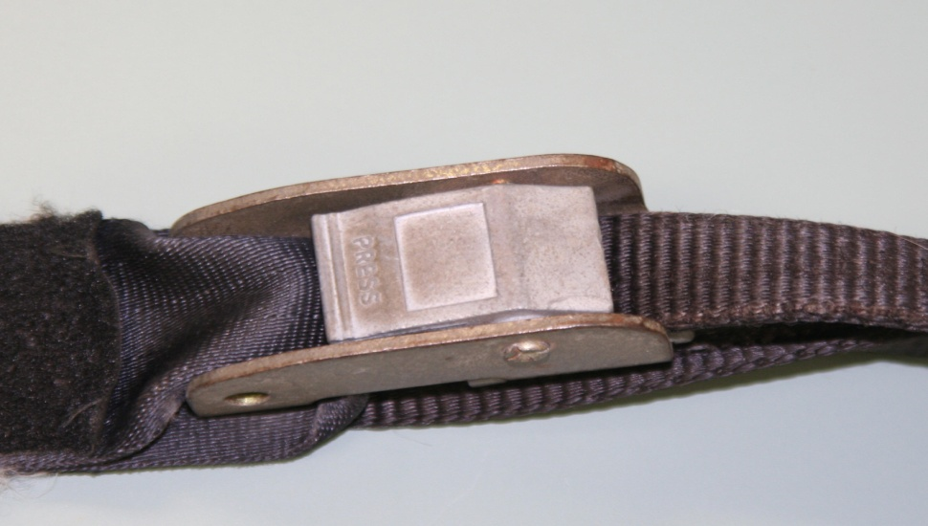
Wheelchair Securement
Never use only the cam buckle straps on all 4 points of attachment to the wheelchair frame. The cam buckle is a slack-removing device & can only tension to the extent of the operator’s strength & angle of pull. At least 2 of the securement straps must have full tensioning capability.

Slide 303
Wheelchair Securement
Use the same style of buckle device at each end of the wheelchair.
Do not cross the securement straps or attach to the cross piece under the seat. This may place added stress or unequal load forces on the wheelchair frame & may contribute to collapsing or tipping of the wheelchair.

Slide 304
Section 15:
Securing the Wheelchair Occupant
Passenger Assistance Safety & Sensitivity (PASS)

Slide 305
Securing the Wheelchair Occupant
Requirements under the ADA
Under the broad, non-discrimination provisions in Sec. 37.5 of the DOT’s ADA regulations, a transit operator is not permitted to require a wheelchair user to use the seatbelt & shoulder harness, unless the system requires the use of these devices by all passengers.

Slide 306
Securing the Wheelchair Occupant
On a fixed route bus, if none of the passengers are required to wear seat or shoulder belts, then neither can the person using a wheelchair be required to do so.

Slide 307
Securing the Wheelchair Occupant
If a seat belt is provided at each passenger seat location & the transit provider has a written policy requiring seat belts be worn, all passengers must wear belts.
Vehicles should be equipped with a notice that local law or agency policy requires the use of lap & shoulder belts, if applicable.

Slide 308
Securing the Wheelchair Occupant
Know the safety belt use law in your state along with the policies of your agency. Then enforce them.

Slide 309
Securing the Wheelchair Occupant
WC 19 Wheelchairs & Securement Systems
Many wheelchairs are equipped with a “seatbelt” permanently attached to the seat portion of the device.
The vast majority of these belts are for postural support.

Slide 310
Securing the Wheelchair Occupant
This belt is not a certified lap belt that is designed & tested for use in conjunction with the wheelchair & occupant securement system.
NEVER USE A POSTURAL SUPPORT BELT IN PLACE OF A PROPERLY CERTIFIED SEAT BELT & SHOULDER HARNESS.

Slide 311
Securing the Wheelchair Occupant
Since late 2015 wheelchairs are being manufactured compliant with WC 19 securement standards.
These devices permit safe securement of the occupant shoulder harness directly to the lap belt permanently attached to the wheelchair.

Slide 312

Securing the Wheelchair Occupant
Caution:
If the device does not have a permanent label identifying it as WC 19 certified do not allow the postural belt to substitute for the required lap & shoulder belt.

Slide 313
Securing the Wheelchair Occupant
Lap Belt
The lap belt must be worn low & tight across the front of the occupant’s pelvic area with the junction between the lap & shoulder belt located near the wearer’s hip.
In the event of a sudden stop, this can assist in preventing the occupant from sliding out of the wheelchair under the belt.

Slide 314
Securing the Wheelchair Occupant
Make certain not to position the lap belt over the abdominal area. Pull the loose ends of the lap belt to provide firm & comfortable tension.
Do not use a postural belt in lieu of a certified lap belt. These are meant only to keep the occupant upright in the chair. It is not a certified lap belt that is designed & tested for use in conjunction with the securement system.

Slide 315
Securing the Wheelchair Occupant
Shoulder Belts
Place the shoulder belt across the collarbone & diagonally across the occupant’s chest.
Connect to lap belt with appropriate attachment.
Ensure a snug fit by pulling on the adjusters to provide a firm, but comfortable fit.

Slide 316
Section 16:
Transporting an Aging Society
Passenger Assistance Safety & Sensitivity (PASS)

Slide 317
Securing the Wheelchair Occupant
NOTE: The actual procedures for securing the shoulder belt is gong to vary from wheelchair to wheelchair & model to model.
There may be a diagram on the vehicle wall. Be familiar with this information.

Slide 318
Transporting an Aging Society
People are living longer today. Having the freedom to get around is equally important to old age as it is to youth.
Driving the elderly is a very personal service. Drivers may see the same people day after day, month after month.

Slide 319
Transporting an Aging Society
Older people depend on you – their driver. You may see more of this person than any other member of the public.
For someone who lives alone, a long ride in a van may be considered a social event.

Slide 320
Transporting an Aging Society
Often a driver sees people at their home & the condition of the house, the yard & the individual over time. A driver is likely to observe a sudden change or serious problem.

Slide 321
Transporting an Aging Society
The driver is not expected to make judgments on an older person’s needs. However, you play a critical role in noticing that this person needs help. Informing your supervisor of your observations can mean the difference between a rider’s life & death.

Slide 322
Transporting an Aging Society
Never ignore something out of the ordinary. When dropping people at the senior centers or at a doctor’s office, do not assume others will notice what you have observed. Alert staff, as well as your supervisor, immediately.

Slide 323
Transporting an Aging Society
Tips for drivers:
  Allow extra time for getting up & down, in or out. Be supportive. Don’t make the older person feel pressured if you are behind schedule.
  As a driver, you are not required to be a counselor, but listening & talking about current events or television programs are appropriate if it does not distract you from your driving.

Slide 324
Transporting an Aging Society
  When a passenger’s words are angry & blaming, it is helpful to think about how that person might be feeling & not respond to the words. Keep your emotions calm, so your driving is not affected.
  Use your sense of humor & make your passengers laugh.

Slide 325
Section 17:
Sexual Harassment
Passenger Assistance Safety & Sensitivity (PASS)

Slide 326
Sexual Harassment
Defined as: Unwelcome sexual advances, requests for sexual favors & other verbal & physical conduct

Slide 327
Sexual Harassment
    Gender harassment: Generalized gender-based remarks & behavior.
    Seductive behavior: Inappropriate unwanted, offensive physical or verbal sexual advances, sexual bribery:
    Solicitation of sexual activity or other sex-linked behavior by promise of reward.

Slide 328
Sexual Harassment
  Sexual Coercion: Coercion of sexual activity by threat of punishment.
  Sexual assault: Gross sexual imposition like touching, fondling, grabbing, or assault.

Slide 329
Sexual Harassment
Sexual harassment can occur in a variety of circumstances including, but not limited to:
  The victim or harasser can be man or woman
  Victim does not have to be a person of the opposite sex
  The victim does not have to be the person harassed, but could be anyone affected by the offensive conduct.
  The harasser’s conduct must be unwelcome

Slide 330
Sexual Harassment
Appropriate vs. Inappropriate Behavior
Your passenger may be friendly & anxious to meet you or they may be shy & withdrawn. In either case, how you act or do not act, will be interpreted by your passengers in ways you may not have intended.

Slide 331
Sexual Harassment
Do not become socially involved with your passengers.
Remember:
  Call passengers by name
  Ignore sexual overtures

Slide 332
Sexual Harassment
  Report instances of inappropriate passenger behavior to your supervisor
  Avoid conversations about religion, politics, sex, or morals
  Do not offer advice outside of that related to the vehicle & the safety of the passengers

Slide 333
Section 18:
Accidents, Incidents, & Emergencies
Passenger Assistance Safety & Sensitivity (PASS)

Slide 334
Your passengers literally place their lives in your hands when they board your vehicle.

Slide 335
Accidents, Incidents, & Emergencies
In an accident or emergency, your responsibilities range from having the ability to protect yourself & your passengers from injury or death, to protecting yourself & your agency afterwards from fraudulent or excessive liability claims.

Slide 336
Accidents, Incidents, & Emergencies
When there is an accident or emergency involving your vehicle or passengers, you are responsible for handling the situation in a way that lessens the risk of injury or death to your passengers & to yourself.

Slide 337
Accidents, Incidents, & Emergencies
You must have thorough knowledge & understanding of the basic accident & emergency handling procedures in order to maintain that trust.

Slide 338
Accidents, Incidents, & Emergencies
The 4 Basic Accident & Emergency Handling Procedures:
  Keep calm
  Protect your passengers, yourself, your vehicle
  Contact your dispatcher
  Complete the required reports
Each situation is going to be different. Therefore, 2 & 3 may be reversed while 1 & 4 remain constant.

Slide 339
Accidents, Incidents, & Emergencies
These four steps are basic – your agency should have a very detailed & in-depth policy/guideline to follow in the event of an accident or incident.
Become familiar with these policies.

Slide 340
Accidents, Incidents, & Emergencies
Evacuation
As a driver, you have an important responsibility for the welfare & safety of your passengers. You must be prepared to provide evacuation assistance to all passengers.

Slide 341
Accidents, Incidents, & Emergencies
The Evacuation Decision
If you smell smoke, see smoke or smell gasoline or diesel fumes, evacuate the vehicle immediately.
Do not assume it is NOT an emergency.

Slide 342
Accidents, Incidents, & Emergencies
Passengers in wheelchairs present two elements for assessment:
  whether or not conditions permit operation of the lift.
  whether or not to evacuate the passenger in their mobility device.

Slide 343
Accidents, Incidents, & Emergencies
Passengers may be reluctant to leave their wheelchair behind because without it they become totally immobile. However, saving the passenger’s life is first priority. If time & conditions permit, the wheelchair can be recovered later.

Slide 344
Accidents, Incidents, & Emergencies
Be sure to identify portable oxygen devices & remove them from the vehicle.
Alert fire fighters to their presence & location.

Slide 345
Accidents, Incidents, & Emergencies
Communicating with passengers & helpers
In an emergency, most passengers will look to you, the driver, for direction. You represent authority & must take initial control & take the lead.
Passengers should be advised that help is on the way, but for their safety, it is best that they leave or be assisted from the vehicle.

Slide 346
Accidents, Incidents, & Emergencies
The use of able-bodied passengers or passers-by, must be done with great care. The ability to remain calm & give clear & concise instructions to helpers will prevent unnecessary injuries.
Make it clear what commands will be used to start whatever you will be doing.

Slide 347
Accidents, Incidents, & Emergencies
Remember – as the driver of your vehicle, you are responsible for directing passengers & passers-by in giving assistance.
However, once public safety personnel arrive on the scene, they will assume command & control of the emergency. At that point, your responsibility is seeing to the needs of your passengers.

Slide 348
Fire Extinguishers
An essential piece of emergency equipment & all vehicles should have one.
A typical fire extinguisher has only 15-20 seconds of retardant.
In order for a fire extinguisher to be effective it must be used properly.

Slide 349
Fire Extinguisher Operation
  P. A. S. S.
      Pull the pin
      Aim toward fire
      Squeeze the handle
      Sweep at the base of the fire

Slide 350
Special Considerations for Fires
Fire extinguishers are an extremely valuable tool, but you must always remember that they are small & have a limited capacity.
When confronted with a fire, your first concern should be in protecting the safety of your passengers & yourself.
The fire extinguisher should be used to protect your exits while you evacuate the vehicle.

Slide 351
National RTAP
Emergency Evacuations
(video)

Slide 352
Vehicle Evacuation
(video)

Slide 353
Thank You!!

