Slide 1

Entry-Level Driver Training (ELDT) Theory Curriculum
Prepared for Minnesota Transit Agencies by Minnesota RTAP
PASSENGER ENDORSEMENT ONLY
Last Updated February 3, 2022

Slide 2
Symbols Guide
B
Class B
P
Passenger Endorsement
A
Class A
B→A
Class B to A
Not relevant to public transit, but you must still train on this for ELDT
Not Relevant for Transit, Still Must Learn

Slide 3
Introduction
This training was developed by the Minnesota Rural Transit Assistance Program (RTAP) in collaboration with transit professionals and trainers throughout the state.
Some of the content may not apply to your role as a public transit operator; however, all of it must be covered to meet the ELDT requirement for your CDL.
Please consult your instructor with any questions about what content applies to your role as a transit operator.

Slide 4
Section 1: Basic Operation
P
B
A
B→A

Slide 5
Unit 1.1 Orientation
P
B
A
B→A
This unit satisfies FMCSA’s ELDT requirements for units A1.1.1, BA1.1.1, and B1.1.1, and C1.3.

Slide 6
P
B
A
B→A
Orientation
This training is for new drivers pursuing a CDL.
Many subjects will be reviewed to ensure that you understand safety fundamentals and essential regulatory requirements for driving.
In this curriculum, you will also be taught your responsibilities not directly related to CMV driving, such as proper cargo securement.

Slide 7
P
B
A
B→A
Orientation
The training will also cover the ramifications, including driver disqualification provisions and fines for non-compliance along with an overview of the applicability of state and local laws relating to the safe operation of the CMV, stopping at weigh stations/scales, hazard awareness of vehicle size and weight limitations, low clearance areas. and bridge formulas.
Consequences for non-compliance may include loss of CDL driving privileges and fines for you and the carrier/employer.

Slide 8
P
B
A
B→A
Orientation
Knowing the weight of your vehicle is important to safety. Roads and other road structures (such as parking lots) are built to handle maximum weights. There is a significant weight difference between large trucks and buses and other vehicles on the road, which means there are greater consequences with there is an accident.
GVW - Gross vehicle weight. The greater of the unloaded weight of a vehicle plus the weight of the load; or the value specified by the manufacturer as the maximum gross weight or gross vehicle weight rating (GVWR).
GVWR - Gross vehicle weight rating. Means the value specified by the vehicle manufacturer as the loaded weight of a single motor vehicle.
Axle Weight = The weight transmitted to the ground by one axle or one set of axles.
Sources: Minnesota Commercial Driver's License Manual and Minnesota Commercial Truck and Passenger Regulations, 2021

Slide 9
P
B
A
B→A
Orientation
The size and design of your vehicle impacts how it maneuvers and where you can travel.
Height is measured from level road surface to top of load or vehicle. CMVs can be too tall for some of the clearances of bridges and other fixed objects such as canopies at hotels, clinics, etc. Tall vehicles also have a higher center of gravity and have a higher risk of roll overs than smaller vehicles.
Ground Clearance (also known as ride height) is the minimum distance between the lower end of the vehicle body and the road. When you load a vehicle with passengers or cargo, the available height is lowered. Low ground clearance is difficult on rough roads. The underbelly of the vehicle can get scratched, or it can get hung up on the tracks at a railroad crossing. Vehicles with higher ground clearance are more likely to turn over.
Sources: Minnesota Commercial Driver's License Manual ; Minnesota Commercial Truck and Passenger Regulations, 2021 and www.fmcsa.dot.gov/ourroads/limited-maneuverability

Slide 10
P
B
A
B→A
Orientation
The vehicle’s width, length, rear overhang impact it’s tail swing. The rear overhang impacts tail swing the most. Tail swing occurs when the movement of the rear portion of the vehicle swings in the opposite direction of the front end, while the front end turns. You must account for these factors to avoid hitting objects with the rear of your vehicle.
Rear Overhang is the distance between the center of the rear axle to the bumper/bed of the vehicle. The greater the distance, the larger the swing when turning.
Length is a bumper-to-bumper measurement. Maximum length in Minnesota for a single motor vehicle without requiring a special permit is 45 feet.
Width is measuring from the widest points on each side of the vehicle or load, exclusive of side rear view mirrors or load securement devices, which may extend an additional 3 inches on each side of vehicle. Maximum width allowed without requiring a special permit is 8 feet, 6 inches.
Sources: Minnesota Commercial Driver's License Manual ; Minnesota Commercial Truck and Passenger Regulations, 2021 and www.fmcsa.dot.gov/ourroads/limited-maneuverability

Slide 11
P
B
A
B→A
Not Relevant for Transit, Still Must Learn
Orientation
Wheels, rims and tires
The wheel is the metal part the tire is fit into. The rim is the other edge of the wheel. Tires are the rubber portion of the wheel that grips the road.
Tire rating: Tires are rated on treadwear, traction performance, temperature resistance and tire load. These ratings are marked on the sidewall of the tire.
Tire Load is the maximum safe weight a tire can carry at a specified pressure. This rating is stated on the side of each tire.
The steering wheels (the wheels that determine the direction your vehicle moves) are the front axle tires and wheels.
Sources: Minnesota Commercial Driver's License Manual and www.nhtsa.gov/equipment/tires

Slide 12
P
B
A
B→A
Not Relevant for Transit, Still Must Learn
Orientation
You will notice that the steering wheel on a CMV is a lot larger than a car’s steering wheel. It is lower, and oriented in the horizontal plane. It is just as easy to turn as a car’s wheel, but it takes many turns to go from a full right turn to a full left turn.
Mirrors: You have a side mirror on each side of the vehicle.
Headlights, parking lights, & turn signals are seen just above the bumper. Clearance lights are present across the very top of the motor coach.
Note the large windshields, which may be one or multiple pieces of glass.
Source: FMCSA Model Training Curriculum for Motorcoach Drivers

Slide 13
P
B
A
B→A
Not Relevant for Transit, Still Must Learn
Orientation
Brakes systems can be hydraulic or air. All CMVs have service brakes, parking brakes and emergency breaks. Most large CMVs are equipped with air brakes.
Engine Compartment: Often located in the front of smaller buses and in the back on large buses.
Electrical system basic components are the starter motor, battery and alternator.
Sources: FMCSA Model Training Curriculum for Motorcoach Drivers and fleetnetamerica.com/blog/post/electrical-systems-in-heavy-duty-vehicles

Slide 14
P
B
A
B→A
Not Relevant for Transit, Still Must Learn
Orientation
Proper Cargo Securement
Blocking is used in the front, back, and/or sides of a piece of cargo to keep it from sliding. Blocking is shaped to fit snugly against cargo and secured to the cargo deck to prevent cargo movement.
Bracing goes from the upper part of the cargo to the floor and/or walls of the cargo compartment.
Cargo Tie-down
  On flatbed trailers or trailers without sides, cargo must be secured to keep it from shifting or falling off. In closed vans, tie-downs can also be important to prevent cargo shifting that may affect the handling of the vehicle. Tie-downs must be of the proper type and proper strength.
  The aggregate working load limit of any securement system used to secure an article or group of articles against movement must be at least one-half times the weight of the article or group of articles. Proper tie-down equipment must be used, including ropes, straps, chains, and tensioning devices (winches, ratchets, clinching components). Tie-downs must be attached to the vehicle correctly (hooks, bolts, rails, rings).
Source: Minnesota Commercial Driver's License Manual

Slide 15
P
B
A
B→A
Not Relevant for Transit, Still Must Learn
Orientation
Proper Cargo Securement, continued
Header Boards
  Front-end header boards (“headache racks”) protect you from your cargo in case of a crash or emergency stop. Make sure the front-end structure is in good condition. The front-end structure should block the forward movement of any cargo you carry.
Source: Minnesota Commercial Driver's License Manual

Slide 16
P
B
A
B→A
Orientation
What is a commercial motor vehicle?
A vehicle having
a gross vehicle weight rating (GVWR) of 10,001 pounds or more;
designed to transport >15 passengers, including the driver;
or transporting hazardous materials in quantities requiring the vehicle to be placarded.
Reference: Section 204 of the Motor Carrier Safety Act of 1984 (MCSA) (Pub. L. 98-554, Title II, 98 Stat. 2832, at 2833)

Slide 17
P
B
A
B→A
Not Relevant for Transit, Still Must Learn
Orientation
What is a combination vehicle?
A combination vehicle is formed when a truck tractor or straight truck has a trailer added to it.

Slide 18
Orientation
P
Not Relevant for Transit, Still Must Learn
Weigh Stations
What to check at a weigh station:
Inspecting weight (total and per axle)
Equipment – ensure it is in working order, headlights, tires, etc.
Proper names on doors
DOT number
Proof of annual inspection
Paperwork and permits are in order

Slide 19
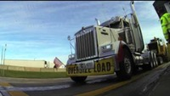
Orientation
P
Not Relevant for Transit, Still Must Learn
Video: How a MN Weigh Station Operates 2016. MnDOT —10:22 minutes

Slide 20
Orientation
P
Not Relevant for Transit, Still Must Learn
ALL vehicles rated 10,000 GVW or more are required to stop at open weigh stations for inspections. They may wave you through or they may inspect your vehicle.
There are only a handful of weigh stations in MN, so this will not affect many buses. At the weigh station you could be subject to an inspection similar to DOT roadside inspections.
DOT inspections — what to expect:
They may pull you over for something as simple as a headlight out, or just a random stop.
This is a roadside inspection, they will look for basics like lights, Q’Straint placement, tires, etc.
They will also interview the driver looking for signs of intoxication etc. They can also show up at your shop at any time to inspect any buses you have in house.

Slide 21
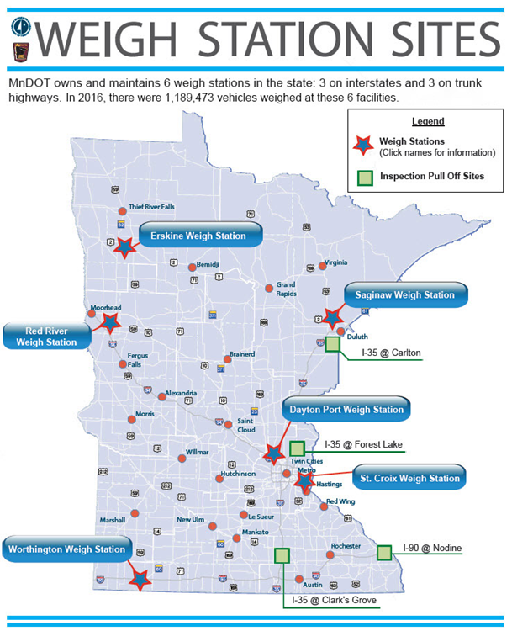
Orientation
P
Not Relevant for Transit, Still Must Learn

Slide 22
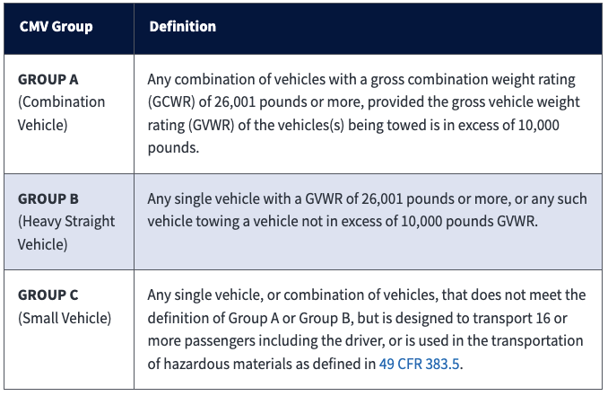
P
B
A
B→A
Orientation
What are the 3 commercial motor vehicle groups according to FMCSA?

Slide 23
P
B
A
B→A
Orientation
What vehicles require a CDL in Minnesota?
A combination of vehicles in which
  the gross combination weight (GCW) >26,000 pounds
  the towed unit has a gross vehicle weight (GVW)* >10,000 pounds
A single vehicle with a GVW >26,000 pounds
A vehicle designed to transport >15 passengers, including the driver
Any size vehicle that requires hazardous materials placards
Any size vehicle outwardly equipped and identified as a school bus

Slide 24
P
B
A
B→A
Orientation
What are Federal Motor Carrier Safety Regulations (FMCSRs) and Hazardous Materials Regulations (HMRs) and Where are They Published?
What: Set minimum safety standards for motor carriers and drivers.
Where: Title 49 of the U.S. Code of Federal Regulations (CFR)
Organized into Sections and Parts, designated by a numbered entry. Citations appear as follows: 49 CFR 390 or 49 CFR 390.15, where:
  Title: 49
  Part: 390
  Section: 15
  Title 49 governs transportation

Slide 25
P
B
A
B→A
Orientation
What are the characteristics of passenger-carrying CMVs?
Per the FMCSA, “a bus is a motor vehicle designed, constructed and/or used to transport passengers. A motorcoach is a bus designed with an elevated passenger deck located over a baggage compartment. A minibus is designed to transport 16 or more passengers (including the driver) and is typically built on a small truck chassis.”

Slide 26
P
B
A
B→A
Orientation
Safety fundamentals
Understanding potential hazards
Scanning the roadway for present or developing hazards
Allowing yourself time to react to hazards
Understanding your options in reacting to hazards present
When you consistently apply these fundamental concepts, your risk of being involved in preventable collisions will decrease.
Source: FMCSA Model Training Curriculum for Motorcoach Drivers

Slide 27
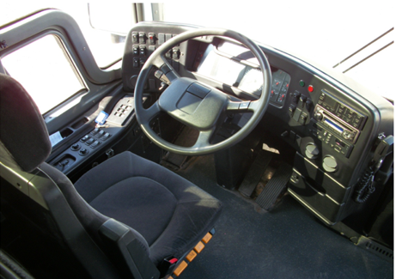
P
B
A
B→A
Orientation
Seat Adjustment
The seat is adjusted in two major ways:
up and down (height) and forward and back.
Both adjustments should permit you to reach
and operate the accelerator, brake, and any other
foot controls easily; the seat position should
allow you to depress the brake pedal all the way
to the floor.
The height adjustment should eliminate pressure to the bottom of your thigh when your foot is on the accelerator. A seat that is too high can affect circulation to your legs and feet.
The forward and back adjustment should let you easily touch the top of the steering wheel. When this is set properly, your elbows will be slightly bent when your hands are at the 8 and 4 o’clock positions on the steering wheel.
Source: FMCSA Model Training Curriculum for Motorcoach Drivers
Notes:
What are Federal Motor Carrier Safety Regulations (FMCSRs) and Hazardous Materials Regulations (HMRs) and Where are They Published?
The Federal Motor Carrier Safety Regulations (FMCSRs) and Hazardous Material Regulations (HMRs) set forth minimum safety standards for motor carriers and drivers. They are published in Title 49 of the U.S. Code of Federal Regulations (CFR) and organized into Sections and Parts, designated by a numbered entry. Citations appear as follows: 49 CFR 390 or 49 CFR 390.15, where:
Title: 49
Part: 390
Section: 15
Title 49 governs transportation.

Slide 28
P
B
A
B→A
Orientation
Mirror Adjustment – Flat Mirrors
If necessary, move the arm holding each mirror so that you have an unobstructed view of the entire mirror.
Rotate both flat mirrors horizontally until the inside edges pick up the rear corners of the coach body. This is just to permit you to see what is happening right next to the coach. Rotating them inward any further is a common mistake and will limit their benefit — you don’t need to see the side of the coach — you need to see what is along the outside of the coach.
Rotate the left (driver side) flat mirror vertically until the bottom one­-third of the mirror shows the roadway. That is, the horizon is about one-third of the way from the bottom of the mirror.
Rotate the right flat mirror vertically until the bottom two-thirds of the mirror shows the roadway. The horizon should be about one-third of the way from the top of the mirror. You should be able to see the right rear wheel(s) of the coach.
Source: FMCSA Model Training Curriculum for Motorcoach Drivers

Slide 29
P
B
A
B→A
Orientation
Mirror Adjustment
Source: FMCSA Model Training Curriculum for Motorcoach Drivers

Slide 30
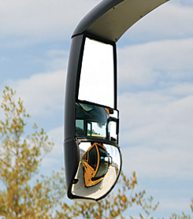
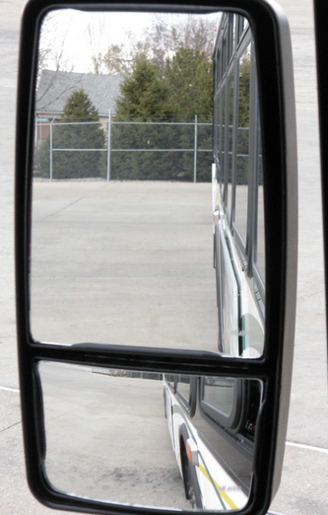
P
B
A
B→A
Orientation
Mirror Adjustment – Convex Mirrors
Because of their curvature, convex mirrors can show you areas that the flat mirrors do not. They help you see further out to the left and right and they allow you to see the roadway closer to the front of the coach, minimizing, but not eliminating, the left and right blind spots. They are very common, though not all buses may have them, so be sure you always set your flat mirrors properly even if you have convex mirrors on most coaches you operate.
Source: FMCSA Model Training Curriculum for Motorcoach Drivers
Notes:
The Federal Motor Carrier Safety Regulations (FMCSRs) and Hazardous Material Regulations (HMRs) set forth minimum safety standards for motor carriers and drivers. They are published in Title 49 of the U.S. Code of Federal Regulations (CFR) and organized into Sections and Parts, designated by a numbered entry. Citations appear as follows: 49 CFR 390 or 49 CFR 390.15, where:
Title: 49
Part: 390
Section: 15
Title 49 governs transportation.

Slide 31
P
B
A
B→A
Orientation
Mirror Adjustment – Convex Mirrors
Some convex mirrors are mounted on flat mirrors and are not adjustable. If your convex mirrors can be adjusted independently of your flat mirrors, follow this procedure to set them:
  Rotate each convex mirror horizontally until the inside edge of its field of view overlaps with the outside edge of the flat mirror’s field of view. Drivers with separately adjustable convex mirrors frequently set them in such a way that the views in the convex mirrors overlap a lot with the views in the flat mirrors. There should always be some overlap, but there should not be much.
  Tilt the left (driver’s side) convex mirror vertically until a point 40 feet from the mirror can be seen in the top edge of the mirror. (The end of the coach is about 40 feet away.)
  Tilt the right convex mirror vertically until the bottom edge of its field shows the roadway just behind the door.

Slide 32
P
B
A
B→A
Orientation
Mirror Adjustment – Convex Mirrors
The convex mirrors should supplement the information provided by the flat mirrors.
When set this way, they will let you see areas that the flat mirrors cannot show you. If you can see a vehicle in your convex mirror but not in your flat mirror, you can be sure it is beside the vehicle, not in back of the vehicle.
Source: FMCSA Model Training Curriculum for Motorcoach Drivers

Slide 33
P
B
A
B→A
Orientation
Spare Tire Storage
If your bus is equipped with a spare tire, please review the location of the spare tire(s) with your supervisor and how to access it.

Slide 34
P
B
A
B→A
Orientation
Bridge Formulas
You must keep weights within legal limits. States have maximums for GVWRs, GCWRs, and axle weights.
Often, maximum axle weights are set by a bridge formula. A bridge formula permits less maximum axle weight for axles that are closer together. This is to prevent overloading bridges and roadways.
Overloading can have negative effects on steering, braking, and speed control.
Overloaded trucks have to go very slowly on upgrades and gain too much speed on downgrades. Stopping distance increases. Brakes can fail when forced to work too hard. During bad weather or in mountains, it may not be safe to operate at legal maximum weights. Take this into account before driving.

Slide 35
P
B
A
B→A
Orientation
Bridge Formulas
You must keep weights within legal limits. States have maximums for GVWRs, GCWRs, and axle weights.
Often, maximum axle weights are set by a bridge formula. A bridge formula permits less maximum axle weight for axles that are closer together. This is to prevent overloading bridges and roadways.
Overloading can have negative effects on steering, braking, and speed control.
Overloaded trucks have to go very slowly on upgrades and gain too much speed on downgrades. Stopping distance increases. Brakes can fail when forced to work too hard. During bad weather or in mountains, it may not be safe to operate at legal maximum weights. Take this into account before driving.
You can find information on Minnesota’s bridge formulas on this website

Slide 36
P
B
A
B→A
Orientation
Height Limitations and Clearances
No vehicles in Minnesota may exceed a height of 13 feet, 6 inches without a special permit
When overpasses are lower than 14-feet, 6-inches (a foot above regulation height) MnDOT posts either a bridge height to notify drivers or a low clearance’ sign.
You also may be able to search for low clearance bridges and overpasses in your state/region, so you are prepared when trip planning.

Slide 37

P
B
A
B→A
Orientation
Hazard Awareness of Vehicle Size and Weight Limitations
Size differences greatly affect how truck and bus drivers operate – and all road users should be aware of their unique safety challenges to help keep everyone on our roads safe.
Trucks are often 20 to 30 times heavier than passenger vehicles.
The huge mass of a truck or bus increases the risk of more severe crash damage, injuries and fatalities.

Slide 38
P
B
A
B→A
Orientation
Hazard Awareness of Vehicle Size and Weight Limitations
Tall vehicles have a higher center of gravity, roll over more easily than smaller vehicles and must go much slower on curves and ramps.
Large vehicles generate wind gusts that can push smaller vehicles into other lanes.
Smaller vehicles can be pushed or pulled under a commercial vehicle with high ground clearance.
Drivers must obey all posted signs regarding maximum truck width, length, height and weight limits.

Slide 39
Unit 1.2 Control Systems/Dashboard
B
A
B→A
This unit satisfies FMCSA’s ELDT requirements for units A1.1.2, BA.1.1.2, and B1.1.2

Slide 40
Control Systems/Dashboard
B
A
B→A
Dashboard Gauges:
Oil Pressure
Ammeter and/or Voltmeter
Coolant Temperature
Engine Oil Temperature
Warning Lights & Buzzers (Oil, coolant, charging circuit warning lights should go out right away)
Lights:
Headlights
Dimmer Switch
Turn Signal
Four-Way Flashers
Clearance, Identification, Marker Light Switch(es)

Slide 41
Control Systems/Dashboard
B
A
B→A
Vehicle Controls:
Steering Wheel
Clutch
Accelerator (Gas Pedal)
Brake Controls:
  Foot Brake
  Trailer Brake (if equipped)
  Parking Brake
  Retarder Controls (if equipped)
Transmission Controls
Interaxle Differential Lock (if equipped)
Horn(s)
Windshield Wiper/Washer
Mirrors & Windshield

Slide 42
Control Systems/Dashboard
B
A
B→A
Emergency Equipment:
Spare Electrical Fuses (unless vehicle as circuit breakers)
Three Red Reflective Triangles
Properly Charged & Rated Fire Extinguisher
Tire Chains
Tire-Changing Equipment
Accident-Reporting Kit (Packet)
List of Emergency Phone Numbers

Slide 43
Control Systems/Dashboard
B
A
B→A
How to read the instrument panel
Start engine.
Engage parking brake.
Put gearshift in neutral (or “park” if automatic).
Start engine and listen for unusual noises
If equipped, check the ABS indicator lights. Light on dash should come on and then turn off. If it stays on the ABS is not working properly.

Slide 44
Control Systems/Dashboard
B
A
B→A
Gauges should look like this:
Oil pressure: Moves to normal within seconds after engine starts.
Air pressure:
  Builds from 50 to 90 psi within 3 minutes.
  Build air pressure to governor cut-out (usually around 120 – 140 psi). Know your vehicles requirements.
Ammeter and/or voltmeter: Fall within normal range(s).
Coolant temperature: Gradual rise to normal operating range.
Engine oil temperature: Gradual rise to normal operating range
Notes:
Gauges should look like this:
Oil pressure: Moves to normal within seconds after engine starts.
Air pressure:
Builds from 50 to 90 psi within 3 minutes.
Build air pressure to governor cut-out (usually around 120 – 140 psi). Know your vehicles requirements.
Ammeter and/or voltmeter: Fall within normal range(s).
Coolant temperature: Gradual rise to normal operating range.
Engine oil temperature: Gradual rise to normal operating range

Slide 45
Control Systems/Dashboard
B
A
B→A
Seatbelts
Make sure your seatbelt is secured and pulled tight before driving
The driver’s seat should have a seat belt. Always use it for safety.
Notes:
Gauges should look like this:
Oil pressure: Moves to normal within seconds after engine starts.
Air pressure:
Builds from 50 to 90 psi within 3 minutes.
Build air pressure to governor cut-out (usually around 120 – 140 psi). Know your vehicles requirements.
Ammeter and/or voltmeter: Fall within normal range(s).
Coolant temperature: Gradual rise to normal operating range.
Engine oil temperature: Gradual rise to normal operating range

Slide 46
Control Systems/Dashboard
B
A
B→A
Before driving, make sure your mirrors are in their correct position
360º Awareness
Check your mirrors
every 3-5 Seconds

Slide 47
Control Systems/Dashboard
B
A
B→A
Mirrors and Blind Spots
To maximize your vision in your rearview and side mirrors:
  Adjust the driver’s side mirror by resting your head against the driver’s side window and moving the mirror so that you barely see the side of your own vehicle
  Move your head the same distance to the right and repeat with the outside mirror. Now when a vehicle leaves your field of vision from the inside mirror it is picked up by the outside mirrors. This adjustment also helps reduce nighttime headlight glare from behind
All vehicles have blind spots. You need to know your vehicle’s blind spots and be aware of other vehicles’ blinds pots. As signs on large vehicles often warn, “if you can’t see my mirror, I can’t see you”
Regularly checking your mirrors and the road ahead will increase your awareness, improve your recognition time and may speed reaction time
Source: National RTAP. Safety Training and Rural Transit Training Module

Slide 48
Control Systems/Dashboard
B
A
B→A
Brakes
Many buses are equipped with air brake systems that rely on an air supply and release system to actuate the service or parking brake.
Air storage tanks are filled with compressed air by the compressor, which is powered by the engine.
When the driver steps on the brake pedal, airs flows from the storage tanks into the brake chambers, causing the brake to engage.
For parking brakes, air is depleted from the system, allowing decompression of springs that cause the parking brake to engage.
An air pressure gauge located on the dashboard indicates the availability of air pressure for safe vehicle operation, and the system includes warning tones and/or lights to warn of low air pressure.

Slide 49
Control Systems/Dashboard
B
A
B→A
Steering, Accelerating, Shifting, and Parking
To drive a vehicle safely, you must be able to control its speed and direction. Safe operation of a commercial vehicle requires skills in:
  Accelerating
  Steering
  Shifting gears
  Braking
Fasten your safety belt when on the road. Apply the parking brake when you leave your vehicle.
Do not roll back when you start. You may hit someone behind you. Partly engage the clutch before you take your right foot off the brake. Put on the parking brake whenever necessary to keep from rolling back. Release the parking brake only when you have applied enough engine power to keep from rolling back. On a tractor-trailer equipped with a trailer brake hand valve, the hand valve can be applied to keep from rolling back.
Review your vehicle’s dashboard with your instructor.

Slide 50
Unit 1.3 Pre-Trip, Enroute, and Post-Trip Inspections
P
B
A
B→A
This unit satisfies FMCSA’s ELDT requirements for units A1.1.3, BA.1.1.3, B1.1.3, and C1.4

Slide 51
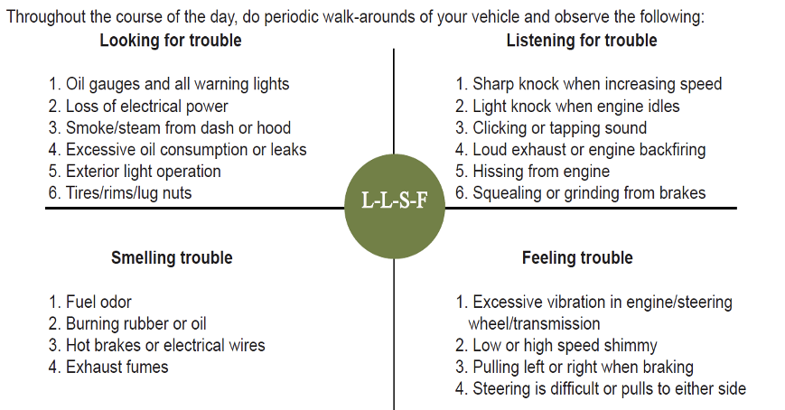
Pre-Trip, Enroute, & Post-Trip Inspections
P
B
A
B→A
Enroute Inspections
Source: National RTAP. Emergency Procedures for Rural Transit Drivers Training Module

Slide 52
Pre-Trip, Enroute, & Post-Trip Inspections
P
B
A
B→A
Pre-trip, enroute, and post-trip inspections are essential to a safe trip
What is your organization’s policy regarding inspecting your vehicle?
Where are the blind spots on the vehicle you drive?
Proper mirror adjustment: will it eliminate all your blind spots?
How should you adjust your mirrors?

Slide 53
Pre-Trip, Enroute, & Post-Trip Inspections
P
B
A
B→A
Passenger Safety Issue One: Pre-trip Inspection - Prepare for vehicle walk-around
Start the engine & turn on the fast idle.
Make sure the transmission is in neutral or park & the parking brake is set.
Turn on inside & outside lights & 4-way flashers.
Turn on heater or A/C, depending on weather.
Briefly test horn & windshield washer/wipers.
* It is important to check that the parking brake is working

Slide 54
Pre-Trip, Enroute, & Post-Trip Inspections
P
B
A
B→A
FMCSA § 392.7 and § 396.11
This law states that no CMV shall be driven unless the driver is satisfied that the following parts and accessories are in good working order or fail to use these parts when needed
Service brakes, including trailer brake connections
Parking (hand) brake
Steering mechanism
Lighting devices and reflectors
Wheels and rims
Emergency equipment
Tires
Horn
Windshield wiper or wipers
Rear-vision mirror or mirrors
Coupling devices

Slide 55
Pre-Trip, Enroute, & Post-Trip Inspections
P
B
A
B→A
FMCSA § 392.7 and § 396.11
Drivers transporting intermodal equipment (like trailers) must additionally inspect the following:
Lighting devices, lamps, markers, and conspicuity marking material
Wheels, rims, lugs, tires
Air line connections, hoses, and couplers
King pin upper coupling device
Rails or support frames
Tie down bolsters
Locking pins, clevises, clamps, or hooks
Sliders or sliding frame lock

Slide 56
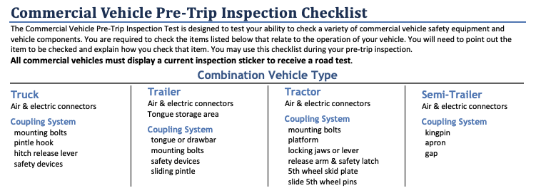
Pre-Trip, Enroute, and Post-Trip Inspections
P
B
A
B→A

Slide 57
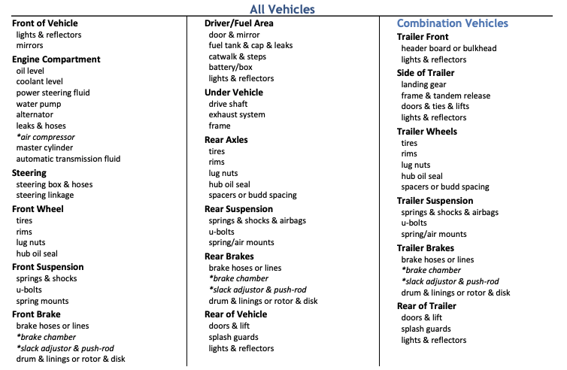
Pre-Trip, Enroute, & Post-Trip Inspections
P
B
A
B→A

Slide 58
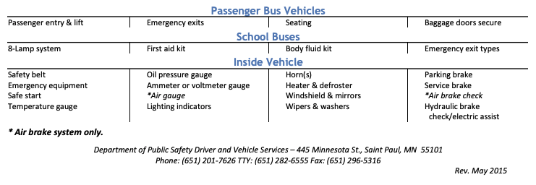
Pre-Trip, Enroute, & Post-Trip Inspections
P
B
A
B→A

Slide 59
Pre-Trip, Enroute, & Post-Trip Inspections
P
B
A
B→A
Basic Pre-trip Inspection
Check the overall appearance of the coach when approaching
Review the previous trip vehicle inspection report
Conduct a walk-around inspection
Check the headlights, auxiliary lights, and four-way flashers
Check the stop lights and turn signals
Check the engine compartment
Adjust the seat/mirrors and inspect the interior compartment
Air-brake system check

Slide 60
Pre-Trip, Enroute, and Post-Trip Inspections
P
B
A
B→A
Check the Overall Appearance
As you approach the bus, note its general condition.
Do you notice any damage?
Is it leaning to one side?
Is there anything hanging from underneath?
Look under the bus for any fresh fluids. If fresh fluid is observed under the engine area, a leak can be further investigated/confirmed by inspecting the engine compartment. If you see any confirmed leaks or suspicious fresh fluid puddles, try to determine the fluid type and have the leak evaluated by a mechanic or supervisor.

Slide 61
Pre-Trip Inspection
P
B
A
B→A
Review the Previous Trip Vehicle Inspection Report (VIR)
Check the previous VIR and make a mental note of any reported defects or issues – you will be checking the status of these during the rest of your inspection. Any safety-related defects must be corrected before the vehicle is used again and any repairs performed should be accompanied by the mechanic’s signature.
After verifying that any safety deficiencies have been repaired, you must sign the appropriate area at the bottom of the VIR (Driver’s Signature).

Slide 62
Pre-Trip Inspection
P
B
A
B→A
Conduct a Walk-Around Inspection
Enter the vehicle and unlock all luggage bays (if applicable). Exit the coach, checking to see that the stairwell is clear of debris. Once outside, check to see that the door(s) opens and closes properly.
Check to make sure the mirror support brackets are firmly fixed.

Slide 63
Pre-Trip Inspection
P
B
A
B→A
As you walk around the bus, check:
The condition of each tire and wheel.
Each tire to ensure it is not flat.
Loose or missing lug nuts, rust marks, and cracked wheels
For oil on tires or wheels
Cuts, bulges, cracks, not enough tread, or uneven tread wear on the tires
Loose or separated treads
All auxiliary lights and reflectors are clean and not broken.

Slide 64
Pre-Trip Inspection
P
B
A
B→A
Check the windshield for cleanliness and damage. Allowable conditions:
  Any crack not over 1-inch wide, as long as it’s not intersected by any other crack.
  Any damaged area that can be covered by a quarter, as long as it’s more than three inches from any other damaged area.
Check the spring tension on the wiper arms and check the wiper blades for damage and signs of age (stiff rubber).
Check each luggage and service access bay for unusual objects or packages, utilizing door pins or other locking mechanisms when present to ensure the bay doors remain open. Check door operation in the process.

Slide 65
Pre-Trip Inspection
P
B
A
B→A
Check the exterior safety equipment:
Spare tire
Tire chains or similar traction aides (if needed)
Reflective triangles (three) and spare fuses (if not kept inside passenger compartment)
As you walk around the bus, check for damages or missing parts.
If you find a problem during any of the above checks, have the condition checked/fixed if it would affect the safe operation of the bus. You should not use a bus that is not in safe operating condition.

Slide 66
Pre-Trip Inspection
P
B
A
B→A
Check Headlights, Auxiliary Lights and Four-way Flashers
With the engine off and the parking brake on, turn on your four-way flashers, headlights, and all auxiliary lights (parking, clearance and identification lights).
Exit the coach, checking the operation of the stairwell and landing lights. Walk around the coach and check to see operation of all the headlights, tail lamps, four-ways and auxiliary lights. Go back inside and, watching the light patterns in front of the coach, toggle your high beams to ensure they are operational.

Slide 67
Pre-Trip Inspection
P
B
A
B→A
Check the Engine Compartment
Check the overall condition of the belts and hoses. Are any of the belts loose or frayed? Are any of the hoses cracked, loose, or rotting?
Look for signs of leaking fluids in engine compartment and underneath the coach.
Check the engine bay for unnecessary or unusual buildup of grease, oil, dirt or other materials that could fuel a potential fire. If the engine is equipped with a fire suppression system, check disbursement nozzles for cleanliness and potential obstruction.
Locate the alternator. Ensure that all battery cables leading to/from the alternator are secured and not chaffed or free to rub against another component.

Slide 68
Pre-Trip Inspection
P
B
A
B→A
Check the Engine Compartment (continued)
With the engine off, check the oil level by taking the dipstick out, wiping it with a paper towel, re-inserting it all the way, and examining the dipstick. If the level is low, oil should be added and a close inspection for leaks should be performed before the trip.
With the engine turned off, check the coolant level using the sight glass or alternate method. If it is low on a pre-trip inspection, have it serviced and inspect closely for any evidence of leaks.
Turn the engine on. Check the transmission fluid level after letting the engine idle for at least two minutes.
CAUTION: Never remove the radiator cap when the engine is hot or has recently been running. Severe steam burns could result.

Slide 69
Pre-Trip Inspection
P
B
A
B→A
Adjust seat/mirrors and inspect the interior.
Adjust the seat for yourself and check the seat belt for proper operation.
After you have adjusted your seat, adjust your mirrors for optimal vision.
Make sure that the parking brake is on and the gearshift is in “neutral.”
Turn on the master control switch and ensure the engine is running.
Operate the windshield wipers and washer. Inspect the windshield for damage.

Slide 70
Pre-Trip Inspection
P
B
A
B→A
Check the oil pressure. If you have a gauge, you should have pressure immediately; if you have a warning light only, the warning light should go off. If not, shut the engine off; otherwise, leave the engine running. If you have an oil gauge, the oil pressure may not reach its normal level until the engine warms up. Listen for any unusual noises.
Check the coolant temperature gauge: temperature should begin to climb to the normal operating range. If you only have a coolant temperature warning light, the light should go off.
Check the voltmeter/battery gauge to see that alternator is charging. If you only have a battery/alternator warning light, the light should go off.

Slide 71
Pre-Trip Inspection
P
B
A
B→A
Check that the air pressure gauge indicates that air pressure is building
Check that the coach’s heating, air conditioning, defroster and ventilation system is working properly.
Check the public-address system and adjust as necessary.
Test your horn.
Check the play in your steering wheel. As you turn the wheel left and right, you should feel tension after turning the wheel 1 to 2 inches. Listen for unusual noises.
Check the instrument and other panels for any warning lights, such as anti-lock braking system (ABS), tire pressure monitor, etc.
Release and re-apply the parking brake.

Slide 72
Pre-Trip Inspection
P
B
A
B→A
Check Emergency Equipment
Check the fire extinguisher for proper mounting and charge.
Locate emergency triangles and spare fuses (if these are kept in a storage area outside/under the coach, they should be checked during the exterior walk-around).
Check the passenger seats and seat belts (if equipped) for damage.
Check that emergency exit windows and roof hatches are marked and releases are functional. Re-secure any unlatched emergency exit windows and hatches.
Check each overhead rack (if so equipped) and areas under seats for any suspicious objects or packages.
Check the restroom for damage, cleanliness and supplies, such as toilet tissue and paper towels. Check the restroom door lock and “occupied” sign.

Slide 73
Pre-Trip Inspection
P
B
A
B→A
Check the Air Brake System
Brakes are a critical safety component. If any of the following tests are not passed, be sure the condition is corrected before starting your trip.
When conducting brake system checks, be sure the coach is on a flat surface, as there will be times when no brakes are engaged. If the coach is not or cannot be located on a flat surface, wheel chocks should be used from the beginning of the system check until just prior to the “parking brake test”.

Slide 74
Pre-Trip Inspection
P
B
A
B→A
Static Leakage Test
Place the transmission in neutral, apply the parking brake (if not already applied) and stop the engine. Take note of the air pressure reading and wait for one minute - the air pressure must not drop more than 2 psi during this minute. Now release the parking brake and wait another minute. The air pressure gauge must not drop more than 2 psi in this second minute. Reapply the parking brake.
Applied Leakage Test
With the engine still off and the parking brake released, apply the service brake firmly and hold. The initial drop in air pressure must not be more than 10 psi. After the system settles (needle stops moving) continue to hold the pedal down for one full minute. The pressure should not drop by more than 3 psi in this minute. Re-apply the parking brake.

Slide 75
Pre-Trip Inspection
P
B
A
B→A
Low Air Warning System Test
The purpose of this test is to be sure that the low-air pressure warning system is functioning properly.
With the engine still off, release the parking brake, apply and release the service brake repeatedly to reduce the air pressure. When the air pressure gauge reaches 80 psi, turn on the master control switch, but do not turn on the engine. Continue reducing the air pressure until the low air pressure warning light and buzzer come on. This should occur between 75 psi and 55 psi.

Slide 76
Pre-Trip Inspection
P
B
A
B→A
Emergency Brake Test
Next, continue reducing the air pressure. When the system air pressure reaches about 20 psi, the parking brake knob should “pop out” to indicate that the emergency brake system has activated the spring/parking brake.
Air Pressure Build-Up Test
Start the engine - the air pressure should begin building. Let the air pressure build up until the low air pressure warning buzzer stops. Continue to let the air pressure build. It should not require more than about one minute for the air pressure to go from discharged (5-20 psi) up to between 120 and 130 psi.

Slide 77
Pre-Trip Inspection
P
B
A
B→A
Governor Cut-Out Test
When the pressure has climbed to between 120 and 130 psi, the governor should cause the air compressor to cut out. When it cuts out, the compressor sound will stop, and the gauge needle will stop moving.
Governor Cut-In Test
Reduce the air pressure by making applications of the service brake. Before the pressure drops below 85 psi, the compressor should cut-in and begin to build air into the system.

Slide 78
Pre-Trip Inspection
P
B
A
B→A
Parking Brake Test
With the parking brake still engaged, place the bus into gear and try to move the coach – applied parking brakes should keep the coach from moving.
Service Brake Test
Release the parking brake and drive forward slowly – the coach should move freely with no brake drag.
Apply the service brake while holding the steering wheel lightly to determine whether the brakes apply without pulling to either side. Drive forward slowly a third time and apply the service brake gradually to check for smoothness (make sure there is no unusual jerkiness when stopping).

Slide 79
Enroute Inspection
P
B
A
B→A
If you have interim stops on the way to your final destination check for:
Tires/wheels: are there any flats or tires leaking air? Look for signs of hub oil on wheels and check tires/wheels for excessive heat.
Lights
Leaks (oil, coolant, etc.)
Verify all compartments are closed
Check for damage
Note obstacles to pulling out/backing out

Slide 80
Post-Trip Inspection
P
B
A
B→A
At the end of your trip, you may need to document your trip and any defects discovered during your pre-trip, enroute or post-trip inspection on a Driver Vehicle Inspection Report (DVIR). This varies by industry and agency.
At a minimum you would note the condition of the following on your report:
  Service Brake
  Parking Brake
  Steering Mechanism
  Lighting Devices & Reflectors
  Tires
  Wheels & Rims
  Mirrors
  Horn
  Windshield Wipers
  Emergency Equipment

Slide 81
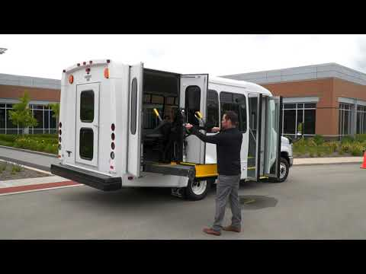
Cycling Accessible Lifts
P
Video: How to Operate a Wheelchair Lift. Braun—6:26 minutes

Slide 82
Cycling Accessible Lifts
P
B→A
Cycle the lift or ramp, checking for smooth operation
Inspect the securement system, including floor tracks, anchorages, straps/tie-downs, seat belts and folding seats to ensure necessary components are present and functional
* If lift is not operational, check with dispatch to determine
if you must change buses

Slide 83
Unit 2.3 Distracted Driving
P
B
A
B→A
This unit satisfies FMCSA’s ELDT requirements for units A1.2.3, BA1.2.3, B1.2.3, and C1.13

Slide 84
Distracted Driving
P
B
A
B→A
FMCSRs prohibit the use of cellphones and texting while driving
The rule applies to interstate truck and bus drivers and drivers who transport placardable quantities of hazardous materials.
What’s prohibited:
Texting, defined as entering alphanumeric text into, or reading text from, an electronic device. This includes, but is not limited to, short message service, e-mailing, instant messaging, a command or request to access a Web page, or pressing more than a single button to initiate or terminate a voice communication using a mobile phone or engaging in any other form of electronic text retrieval or entry, for present or future communication.

Slide 85
Distracted Driving
P
B
A
B→A
FMCSRs prohibit the use of cellphones and texting while driving
This rule restricts a CMV driver from reaching for or holding a mobile phone to conduct a voice communication, as well as dialing by pressing more than a single button. CMV drivers who use a mobile phone while driving can only operate a hands-free phone located in close proximity.

Slide 86
Distracted Driving
P
B
A
B→A
What happens if a driver is caught using a hand-held phone or texting while driving?
The rule imposes sanctions for driver offenses, including civil penalties up to $2,750 and driver disqualification for multiple offenses. Motor carriers are also prohibited from requiring or allowing their drivers to text or use a hand-held mobile phone while driving and may be subject to civil penalties up to $11,000. Violations will impact SMS results. Texting and calling on a hand-held phone carry the maximum violation severity weighting.

Slide 87
Distracted Driving
P
B
A
B→A
Types of Distractions
Visual Distractions: Takes eyes off the road
Manual Distractions: Takes hands off the wheel
Cognitive Distractions: Takes mind away from safe operation
Simply put…
Anything that takes your eyes off the road is a distraction.

Slide 88
Distracted Driving
P
B
A
B→A
Self-Created Distractions
Texting
Speaking on your cell phone
Adjusting seat positions while driving
Adjusting climate controls
Adjusting interior mirrors
Using vehicle mirrors for personal grooming
Eating and/or drinking
Singing with the radio, CD, or other audio

Slide 89
Distracted Driving
P
B
A
B→A
Company Created Distractions:
Communication radios
  Does your company require you to respond to dispatch while you are driving?
Cell phones, if your company uses them in place of standard communications equipment
Fare boxes
Destination signs

Slide 90
Distracted Driving
P
B
A
B→A
Distractions created outside of your vehicle:
Operating at high speed
Calculating speeds and distances
Responding to other drivers and obstacles
Pedestrians
Bicyclists
Looking for addresses

Slide 91
P
B
A
B→A
Why is this important?

Slide 92
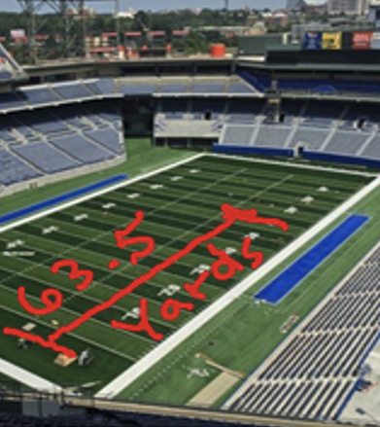
Distracted Driving
P
B
A
B→A
If you take your eyes off the road for 2 seconds at 65 mph
Traveling at 95.33 feet per second for two seconds means you travelled
  190.66 feet
  63.5 yards
  Nearly two-thirds length of a football field

Slide 93
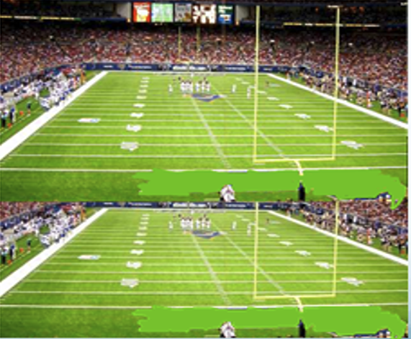
Distracted Driving
P
B
A
B→A
Sending or reading a text takes your eyes away from the road on average 4.6 seconds’
At 65 mph you will have driven the length of 1.2 football fields, BLIND!

Slide 94
Distracted Driving
P
B
A
B→A
When you take one hand off the wheel to:
  Use the two-way radio, cell phone or other on-board equipment (GPS, farebox)
  Adjust the mirror, seat, or climate control
  Secure items in the vehicle
  Eat or drink
You have GREATLY reduced your response time to anything that happens outside of your vehicle.

Slide 95
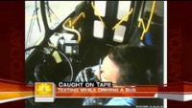
Distracted Driving
P
B
A
B→A
Let’s see what can happen in 5 seconds
Video: Texting While Driving Caught on Tape. Today Show—2:27 minutes

Slide 96
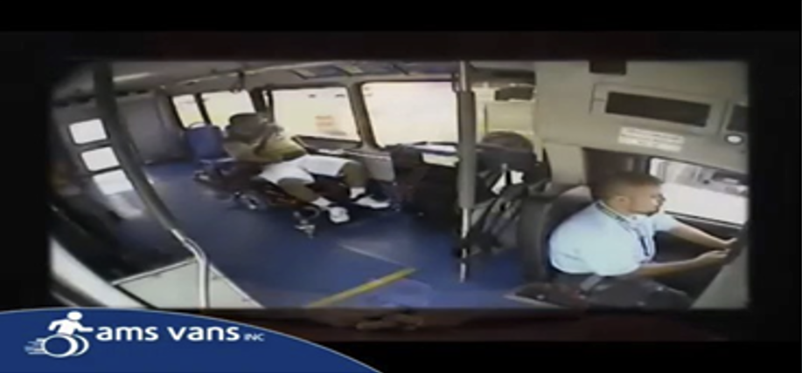
Distracted Driving
P
B
A
B→A
Here’s what the driver was doing:

Slide 97
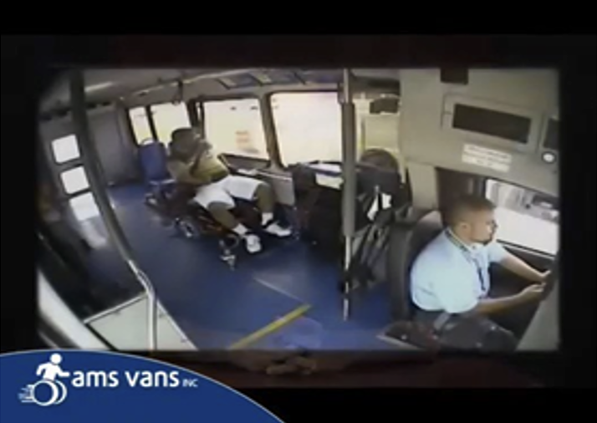
Distracted Driving
P
B
A
B→A
Look closely, notice the driver has
  One hand on the wheel
  And the other hand
  and his eyes on his cell phone

Slide 98
Defensive Driving
P
B
A
B→A
Defensive Driving is driving to save lives, time, and money despite the conditions around you and the actions of others

Slide 99
Defensive Driving
P
B
A
B→A
Making safe and legal driving decisions
Creating a safe, stress-free environment around your vehicle
Driving to your destination safely without a ticket, crash, or affecting others’ safety
Practicing common sense, courtesy, and cooperation
Recognizing the risks of hazardous driving behaviors and conditions

Slide 100
The Five Keys
P
B
A
B→A
Aim high in steering.
Get the big picture.
Keep your eyes moving.
Leave yourself and out.
Make sure they see you.

Slide 101
Distracted Driving
P
B
A
B→A
What is distracted driving?
Any activity that could divert a person’s attention away from the primary task of driving. The three types of distractions are manual (taking your hands off the wheel), visual (taking your eyes off the road), and cognitive (taking your mind off driving). All distractions endanger passenger, driver, and bystander safety.
Distractions include:
  Texting, using a cell phone or smart phone
  Eating or drinking
  Talking to passengers
  Grooming
  Reading, including maps
  Using a navigation system
  Watching a video
  Adjusting music or audio, on the radio or another device
Make sure you are aware of your company’s policies regarding communication devices.
Source: US DOT National Highway Safety Administration Distraction Website

Slide 102
Defensive Driving
P
B
A
B→A
  Act in time
  Always stay alert, focus on the driving task so you don’t lose response time.
  Choose the safest driving maneuver to avoid a crash.
  Remember: other drivers may act in time, but they may act incorrectly.
Notes:
102
Act in Time.
Always stay alert, focus on the driving task so you don’t lose response time.
Choose the safest driving maneuver to avoid a crash.
Remember other drivers may act in time, but they may act incorrectly.

Slide 103
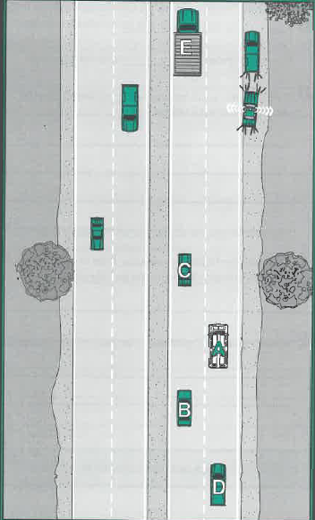
Defensive Driving
P
B
A
B→A
If you were the driver of “A” in this situation, how would you handle this situation?

Slide 104
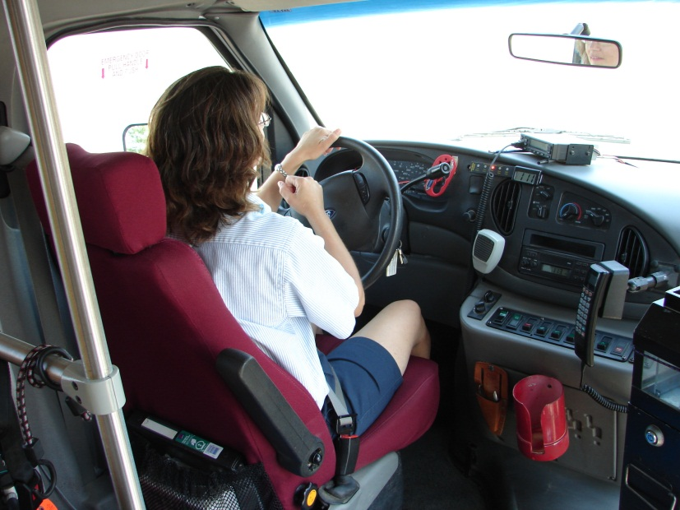
Defensive Driving
P
B
A
B→A
Avoid backing your vehicle
4-second following distance
Don’t rush
Maintain a “cushion of safety”
Be aware of your surroundings

Slide 105
Distracted Driving
P
B
A
B→A
It is a MYTH that we can multi-task
All brains focus in the same way
We can shift our attention quickly, but we cannot pay attention to more than one thing at a time
More than divided, our attention is diverted.

Slide 106
Unit 3.3 Railroad (RR)-Highway Grade Crossings and Drawbridges
P
B
A
B→A
This unit satisfies FMCSA’s ELDT requirements for units A1.3.3, BA1.3.3, B1.3.3, and C1.14

Slide 107
Railroad (RR)-Highway Grade Crossings & Drawbridges
P
B
A
B→A
Drawbridges
Stop at drawbridges that do not have a signal light or traffic control attendant
Stop at least 50 feet before the draw of the bridge. Look to make sure the draw is completely closed before crossing. You do not need to stop, but must slow down and make sure it’s safe, when:
  There is a traffic light showing green.
  The bridge has an attendant or traffic officer who controls traffic whenever the bridge opens.

Slide 108
Railroad (RR)-Highway Grade Crossings & Drawbridges
P
B
A
B→A
Railroad Grade Crossing Environments Overview
Highway-railroad grade crossings are intersections where a highway crosses a railroad at-grade. They are also called level crossings in Canada & other countries.
To avoid collisions, warning/control devices are required at grade crossings
Active Grade Crossings have:
  Active warning and control devices such as bells, flashing lights, & gates
  Passive warning devices such as crossbucks (x-shaped signs that mean yield to the train), yield, or stop signs and pavement markings.
Passive Grade Crossings have only passive warning devices. These warning/control devices are specified in the Manual of Uniform Traffic Control Devices (MUTCD).

Slide 109
Railroad (RR)-Highway Grade Crossings & Drawbridges
P
B
A
B→A
Grade crossings may be public or private:
  Public grade crossings are roadways that are under the jurisdiction of, and maintained by, a public authority.
  Private grade crossings are on privately owned roadways, such as on a farm or industrial area, and are intended for use by the owner or by the owner’s licensees & invitees. A private crossing is not intended for public use and is not maintained by a public highway authority.

Slide 110
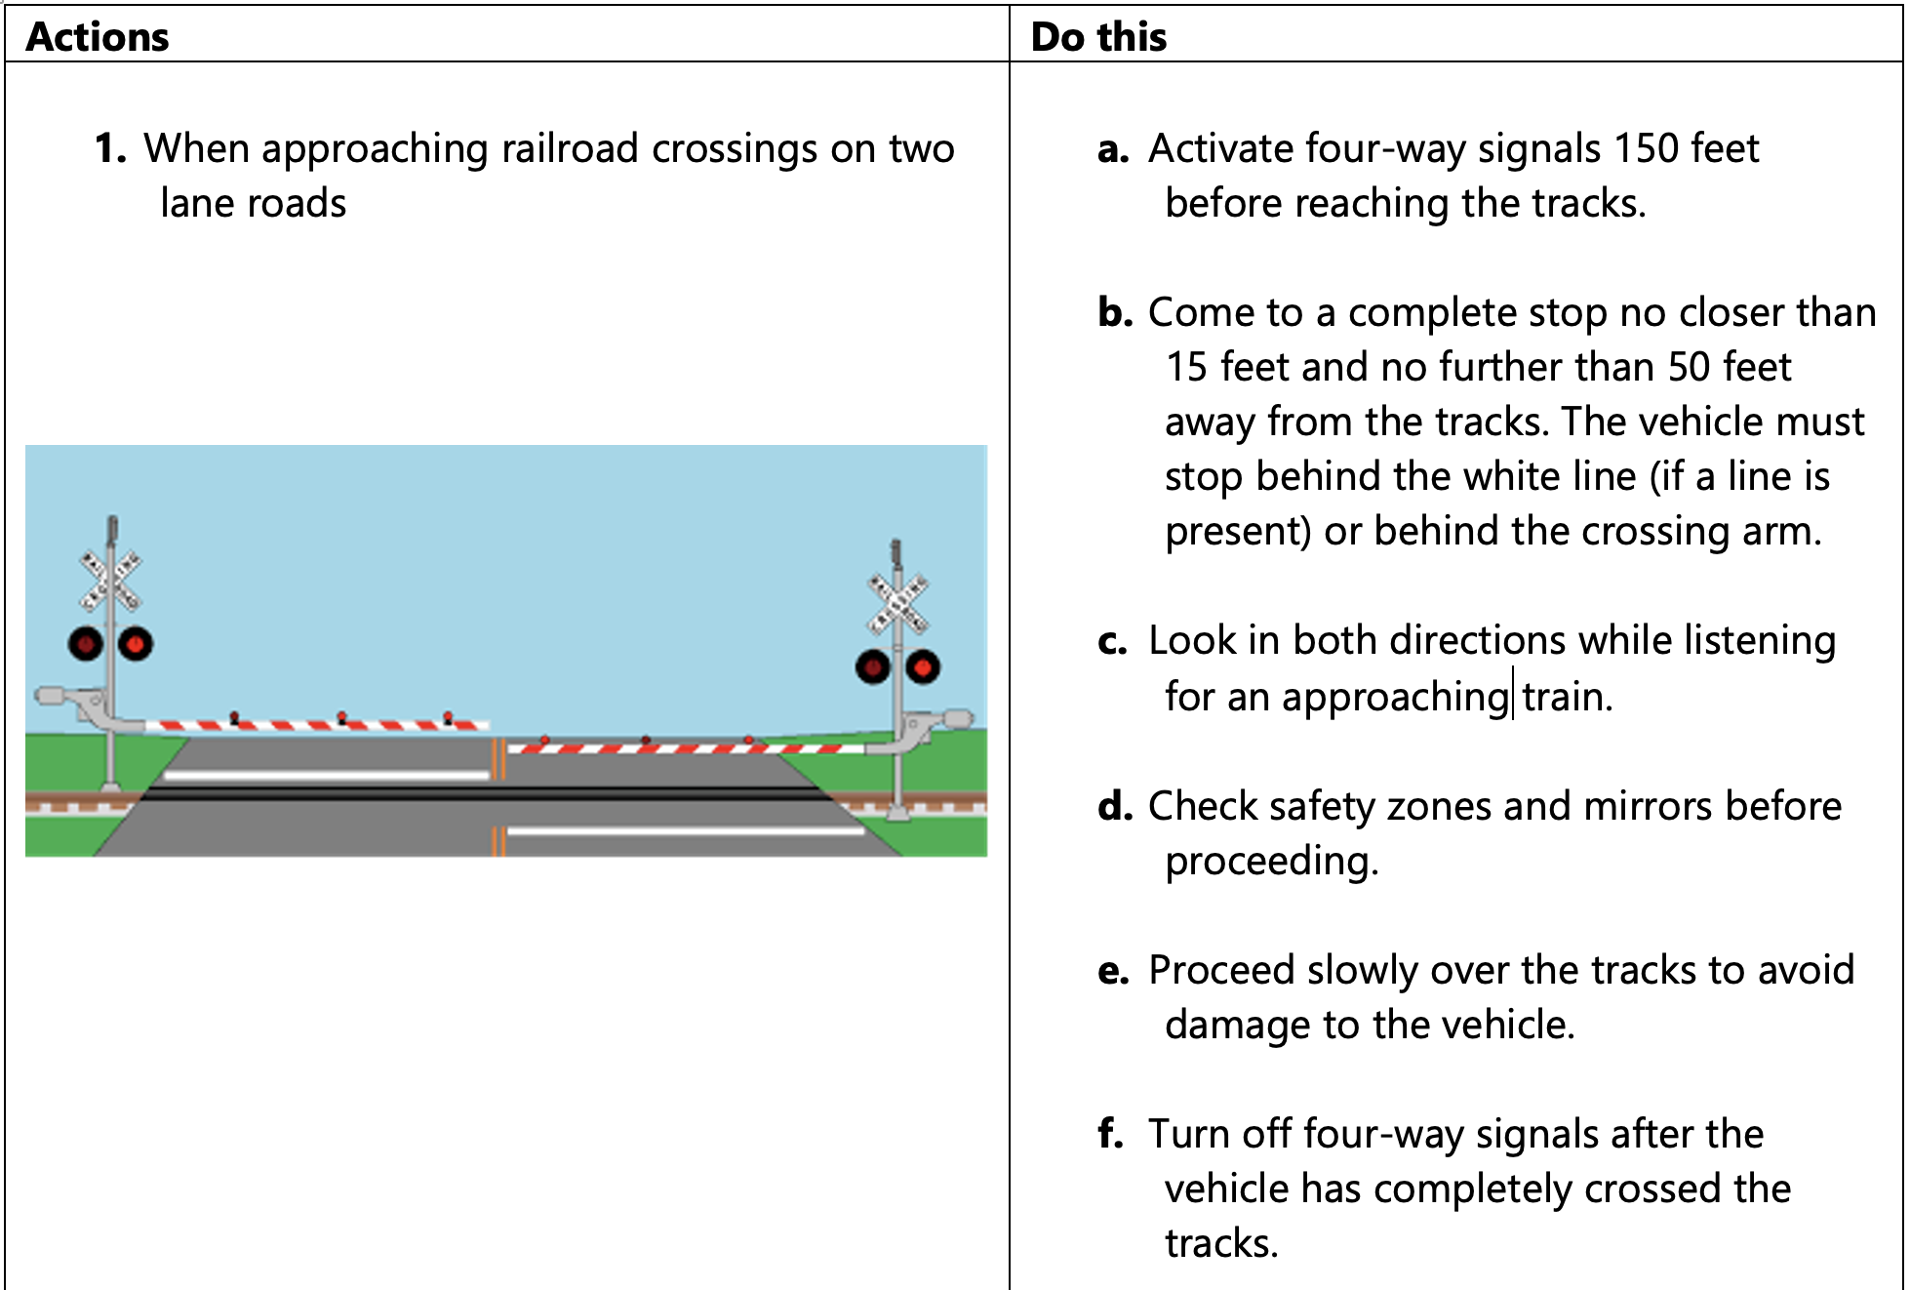
Railroad (RR)-Highway Grade Crossings & Drawbridges
P
B
A
B→A

Slide 111
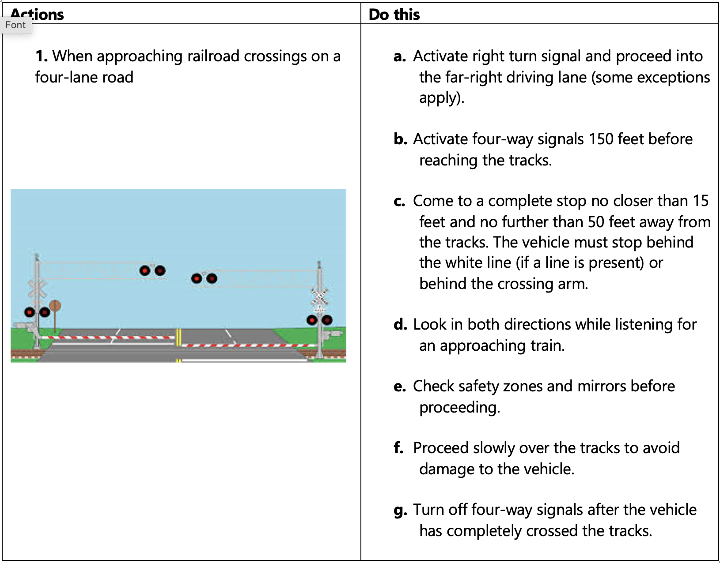
Railroad (RR)-Highway Grade Crossings & Drawbridges
P
B
A
B→A

Slide 112
Railroad (RR)-Highway Grade Crossings & Drawbridges
P
B
A
B→A
These vehicles are required to stop at all railroad grade crossings:
Buses carrying passengers
School buses (whether carrying passengers or not)
Placarded vehicles
Railroad Grade Crossing Violation
You will be disqualified from operating a commercial motor vehicle for:
60 days if you are convicted of a railroad grade crossing violation.
120 days if, during any three-year period, you are convicted of two railroad grade crossing violations arising from separate incidents.
One year if, during any three-year period, you are convicted of three or more railroad grade crossing violations arising from separate incidents.

Slide 113
Railroad (RR)-Highway Grade Crossings & Drawbridges
P
B
A
B→A
11 times more likely to be fatal
Do not shift gears while crossing tracks
Don’t rely on RR crossing warning lights or gates
Watch for vehicles that are required to stop at crossings
Never race a train to the crossing
Look for a second train
  Eliminate all distractions & noises to listen for trains

Slide 114
Railroad (RR)-Highway Grade Crossings & Drawbridges
P
B
A
B→A
Stalling on Railroad Tracks
Once you begin crossing the tracks, do not hesitate. Cross without stopping.
If your vehicle becomes stalled on railroad tracks and a train is approaching, leave the vehicle.
To avoid being struck by debris from the collision keep a safe distance from the tracks.
Walk quickly in a 45-degree angle away from the tracks in the direction from which the train is approaching.

Slide 115
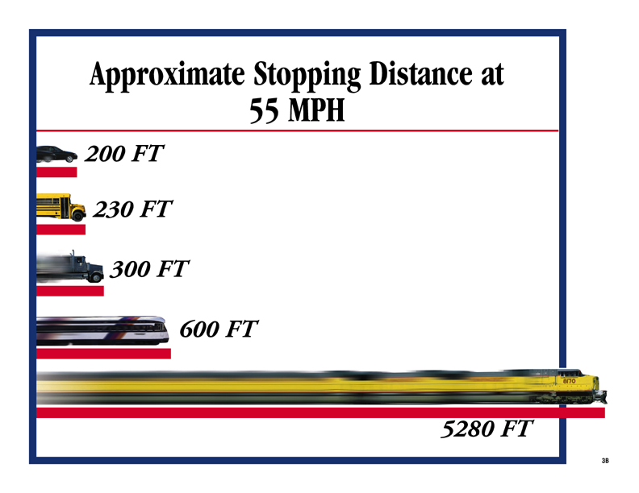
Railroad (RR)-Highway Grade Crossings & Drawbridges
P
B
A
B→A

Slide 116
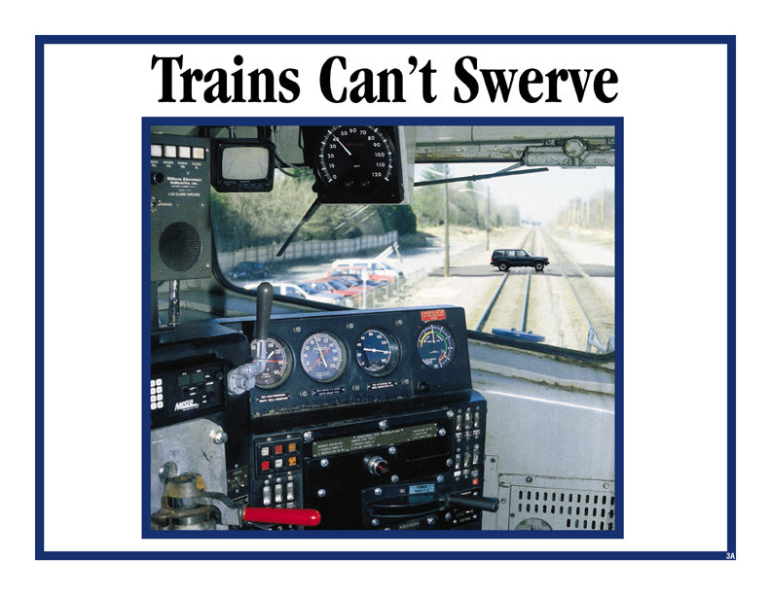
Railroad (RR)-Highway Grade Crossings & Drawbridges
P
B
A
B→A

Slide 117
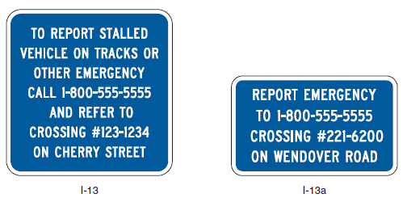
Railroad (RR)-Highway Grade Crossings & Drawbridges
P
B
A
B→A
Emergency Notification System (ENS) for Highway-Rail Grade Crossings
Every highway-rail crossing has an Emergency Notification System (ENS) sign that provides a 24/7/365 phone number to call to report problems or emergencies at the railroad location.
The blue colored ENS sign is located on the railroad crossing posts or the metal control box near the tracks. The ENS is for those emergencies that would require stopping train traffic due to an obstruction, disabled vehicle, or any other problem at the crossing.
By providing the DOT number on the sign, the dispatchers know exactly where the grade crossing is and can notify trains moving in that direction to either come to a stop or be placed on a speed restriction.

Slide 118
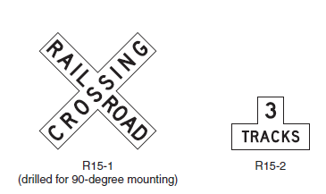
Railroad (RR)-Highway Grade Crossings & Drawbridges
P
B
A
B→A
Grade Crossing Signs
As a minimum, one Crossbuck sign shall be used on the right side of each highway approach to every highway-rail grade crossing, alone or in combination with other traffic control devices.
If automatic gates are not present & if there are two or more tracks at the highway-rail grade crossing, the number of tracks shall be indicated on a supplemental Number of Tracks (R15-2) sign of inverted T shape mounted below the Crossbuck sign

Slide 119
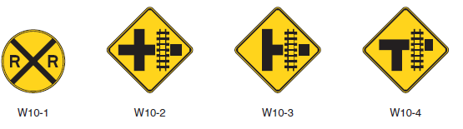
Railroad (RR)-Highway Grade Crossings & Drawbridges
P
B
A
B→A
Advance Warning Signs
If the distance between the railroad tracks and the parallel highway, from the edge of the tracks to the edge of the parallel roadway, is 100 ft or more, a W10-1 sign will exist in advance of the highway rail grade crossing
If the distance between the railroad tracks & a parallel highway, from the edge of the tracks to the edge of the parallel roadway, is less than 100 ft, W10-2, W10-3, or W10-4 signs exist on each approach of the parallel highway to warn road users making a turn that they will encounter a highway-rail grade crossing soon after making a turn

Slide 120
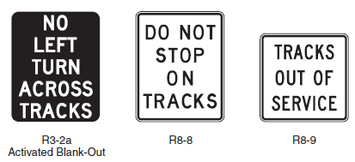

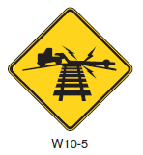
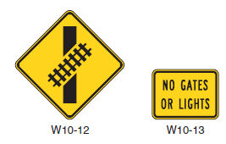
Railroad (RR)-Highway Grade Crossings & Drawbridges
P
B
A
B→A
Other Rail Grade Signs Examples
If the highway profile conditions are sufficiently abrupt to create a hang-up situation for long wheelbase vehicles or for trailers with low ground clearance, the Low Ground Clearance Highway-Rail Grade Crossing Sign (W10-5) is present
Turn prohibition signs (R3-2a) that are associated with preemption shall be visible only when the highway-rail grade crossing restriction is in effect.

Slide 121
Railroad (RR)-Highway Grade Crossings & Drawbridges
P
B
A
B→A
Clearance around tracks
Minnesota Administrative Rules, Transportation Department Chapter 8830, Part 8830.9951 – Required clearance:
  8 feet, 6 inches from the center of the track
  Vertical clearance of 22 feet
Per MnDOT’s Railroad-Highway Grade Crossing Safety Improvement Program, crossings that have a sight distance obstruction or an alignment, which creates unsafe conditions at that grade crossing, may be identified for possible closure.
Per Chapter 2 of the Federal Highway Administration’s Highway-Rail Crossing Handbook, crossings with sight distance deficiencies which cannot be corrected should consider use of active devices at the stop.
Stop your vehicle within 50 feet, but no less than 15 feet from the nearest rail. Listen and look in both directions along the track.

Slide 122
Unit 4.2 Roadside Inspections
P
B
A
B→A
Not Relevant for Transit, Still Must Learn
This unit satisfies FMCSA’s ELDT requirements for units A1.4.2, BA1.4.2, B1.4.2, and C1.17.

Slide 123
Roadside Inspections
P
B
A
B→A
Not Relevant for Transit, Still Must Learn
What to expect during a roadside inspection:
Vehicles and drivers are examined to ensure compliance with state statutes and federal regulations pertaining to vehicle equipment, load securement, driver qualifications, hours of service, and a host of other requirements.
There are 8 levels of inspection that could be performed.
Here’s what to expect during a standard inspection:
CDL
Alcohol and Drug use
Medical Examiner’s and Skill Performance Evaluation (SKE)
Certificates
Hours of Service Compliance

Slide 124
Roadside Inspections
P
B
A
B→A
Not Relevant for Transit, Still Must Learn
What to expect during a standard inspection (continued)
Record of duty status
Seatbelt usage
Vehicle inspection reports
Brake, electrical, exhaust, and fuel systems
Cargo securement
Coupling devices
Driveline/driveshaft mechanisms
Frames
Hazardous materials compliance

Slide 125
Roadside Inspections
P
B
A
B→A
Not Relevant for Transit, Still Must Learn
What to expect during a standard inspection (continued)
Lighting devices (headlamps, taillamps, turn signals, etc.)
Steering mechanisms
Suspensions
Tires (including hubs, rims, wheels)
Van and open-top trailer bodies
Windshield wipers

Slide 126
Roadside Inspections
P
B
A
B→A
Not Relevant for Transit, Still Must Learn
What is Out-of-Service (OOS)?
A driver is not permitted to drive after being on duty in excess of the maximum periods permitted, as detailed in 49 CFR 395.13. Motor carriers cannot require or permit a driver who has been declared out-of-service to operate a CMV until the driver may lawfully do so.
Out-of-Service (OOS) order means a declaration by an authorized enforcement officer of a Federal, State, Canadian, Mexican, or local jurisdiction that a driver, a commercial motor vehicle, or a motor carrier operation is out of service pursuant to 49 CFR 386.72, 392.5, 392.9a, 395.13, or 396.9, or compatible laws, or the North American Standard Out-of-Service Criteria.

Slide 127
Roadside Inspections
P
B
A
B→A
Out-of-Service (OOS) criteria:
No driver shall drive after being on duty in excess of the maximum periods permitted by this part.
No driver required to maintain a record of duty status under § 395.8 or § 395.15 of this part shall fail to have a record of duty status current on the day of examination and for the prior seven consecutive days.
You will be put out-of-service for 24 hours if you have any detectable amount of alcohol under .04%. If your blood alcohol concentration (BAC) is .04% or more, you will lose your CDL for at least 1 year for a first offense.
Federal and state inspectors also may inspect your vehicles. If they judge the vehicle to be unsafe, they will put it “out of service” until it is fixed.

Slide 128
Roadside Inspections
P
B
A
B→A
Ramifications and penalties for operating a CMV when subject to an OOS order as defined in § 390.5.
You will lose your CDL:
For at least 90 days if you have committed your first violation
of an OOS order.
For at least one year if you have committed two violations
of an OOS order in a 10-year period.
For at least three years if you have committed three or more violations of an out-of-service order in a 10-year period.

Slide 129
P
B
A
Not Relevant for Transit, Still Must Learn
Handling & Documenting of Cargo
Use loading process as an opportunity to screen baggage. In addition to the physical task at hand, drivers must be able to recognize potential suspicious packages and baggage. Look for
  Packages that appear to be unusually heavy in size, emit unusual odors or wet, or contain significant amounts of liquid or contain unusual objects such as wire, metal pipe, many bottles/thermoses, nails and ball-bearings.
  Passengers who appear overly possessive or concerned about their luggage
  Passenger carry-ons that are larger and could have been stowed in the luggage bay
Secure baggage bay doors with a lock pin (if equipped)
Source: FMCSA Model Training Curriculum for Motorcoach Drivers

Slide 130
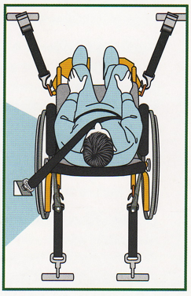
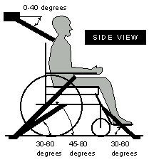
P
B
A
Handling & Documenting of Cargo
Proper handling and securement of devices
associated with ADA compliance: Wheelchair/Aid securement
Set brakes (manual) or power chair off (powered)
4-point tie-down
Do not attach tie-downs to wheels or any removable parts
Do not attach tie-downs to the folding cross brace of a wheelchair
Attach the straps as high as possible on the chair
Route each tie-down strap in a straight line; do not bend
around a wheel or other object
Tighten all straps, but do not over-tighten
Test the chair to be sure you cannot move it in any direction
Secure passenger to chair
Source: FMCSA Model Training Curriculum for Motorcoach Drivers

Slide 131
P
B
A
Handling & Documenting of Cargo
Proper handling and securement of devices associated with ADA compliance:
Transporting oxygen
Oxygen concentrators are portable devices that concentrate the oxygen from the atmosphere to deliver higher concentrations of oxygen to the user. They do not pose any threats to safety.
Oxygen tanks/cylinders contain pure oxygen gas. These tanks are pressurized metal cylinders and will have some type of valve system at the top of the cylinder where the oxygen dispenses. Pure oxygen gas is a classified as a hazardous material.
Limit cylinders in passenger compartment to what’s practical (currently in use or will be needed before next scheduled stop)
Extra cylinders must be secured in the luggage bays with valves protected from contact with other stowed items
Total amount of oxygen stowed in cargo bays should be < 99 lbs.
Source: FMCSA Model Training Curriculum for Motorcoach Drivers

Slide 132
P
B
A
Not Relevant for Transit, Still Must Learn
Handling & Documenting of Cargo
Proper Cargo Securement
Blocking is used in the front, back, and/or sides of a piece of cargo to keep it from sliding. Blocking is shaped to fit snugly against cargo. It is secured to the cargo deck to prevent cargo movement.
Bracing is also used to prevent movement of cargo. Bracing goes from the upper part of the cargo to the floor and/or walls of the cargo compartment.
Cargo Tie-down
  On flatbed trailers or trailers without sides, cargo must be secured to keep it from shifting or falling off. In closed vans, tie-downs can also be important to prevent cargo shifting that may affect the handling of the vehicle. Tie-downs must be of the proper type and proper strength.
  The aggregate working load limit of any securement system used to secure an article or group of articles against movement must be at least one-half times the weight of the article or group of articles. Proper tie-down equipment must be used, including ropes, straps, chains, and tensioning devices (winches, ratchets, clinching components). Tie-downs must be attached to the vehicle correctly (hooks, bolts, rails, rings).
Source: Minnesota Commercial Driver’s License Manual Also featured in Orientation

Slide 133
P
B
A
Not Relevant for Transit, Still Must Learn
Handling & Documenting of Cargo
Proper Cargo Securement, continued
Header Boards
  Front-end header boards (“headache racks”) protect you from your cargo in case of a crash or emergency stop. Make sure the front-end structure is in good condition. The front-end structure should block the forward movement of any cargo you carry.
Source: Minnesota Commercial Driver’s License Manual Also featured in Orientation

Slide 134
P
B
A
Not Relevant for Transit, Still Must Learn
Handling & Documenting of Cargo
Safe and Efficient loading/unloading tips
Load heavy items first
Create a wall
Use efficient clips for strapping
Label everything
Create a template for inventory
Use moving equipment, such as forklifts
Source: www.stokesquipment.com

Slide 135
P
B
A
Not Relevant for Transit, Still Must Learn
Handling & Documenting of Cargo
Tips to Prevent Cargo Theft
No unattended, loaded trailers, whenever possible; especially in high cargo theft areas.
Use high security rear door locks and air cuff locks.
If it is unavoidable to stage/drop a load, consider installing landing gear locks as well.
Usage of hard security devices, such as locks and seals,
Leveraging appropriate technology,
Reinforcing cyber-security to prevent access to key information.﻿﻿
Source: www.travelers.com

Slide 136
P
B
A
Not Relevant for Transit, Still Must Learn
Handling & Documenting of Cargo
Tips to Prevent Cargo Theft
No unattended, loaded trailers, whenever possible; especially in high cargo theft areas.
Use high security rear door locks and air cuff locks.
If it is unavoidable to stage/drop a load, consider installing landing gear locks as well.
Usage of hard security devices, such as locks and seals,
Leveraging appropriate technology,
Reinforcing cyber-security to prevent access to key information.﻿﻿
Source: www.travelers.com

Slide 137
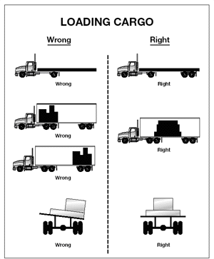
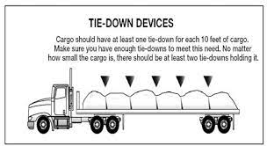
Handling & Documenting of Cargo
P
B
A
Not Relevant for Transit, Still Must Learn
Source: Minnesota Commercial Driver’s License Manual

Slide 138
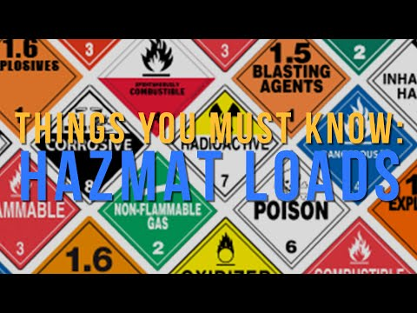
Handling & Documenting of Cargo
P
B
A
Not Relevant for Transit, Still Must Learn
Video: Avoid Violations!! Must know information on HAZMAT LOADS. ET Transport—5 minutes

Slide 139
Unit 5.3 Hours of Service Requirements
P
B
A
B→A
Not Relevant for Transit, Still Must Learn
This unit satisfies FMCSA’s ELDT requirements for units A1.5.3, BA1.5.3, B1.5.3, and C1.11.

Slide 140
Hours of Service (HOS) Requirements
P
B
A
B→A
Not Relevant for Transit, Still Must Learn
The hours of service (HOS) regulations are designed to improve safety for the motoring public by reducing Commercial Motor Vehicle (CMV) driver fatigue.
There are different HOS regulations for Property-Carrying Drivers and Passenger-Carrying Drivers. This training covers Passenger-Carrying Drivers HOS regulations. Drivers
Source: FMCSA

Slide 141
Hours of Service (HOS) Requirements
P
B
A
B→A
Not Relevant for Transit, Still Must Learn
Hours-of-service rules as they apply to intrastate transportation in Minnesota
Who is Subject to the Hours of Service Rules?
A For-Hire Motor Carrier
A Private Carrier when operating vehicles over 10,000 pounds Gross Vehicle Weight (GVW)
A Person transporting solid waste...including recyclable materials and waste tires, as described in 221.025(b), when operating a vehicle(s) with a GVW over 10,000 pounds or more
A Person transporting hazardous material (HM) of a type or quantity that requires the vehicle to be marked or placarded
A Transit Service receiving operating assistance from either MnDOT or the Metropolitan Council (MCTO, St. Cloud, and Duluth transit systems excepted).

Slide 142
Hours of Service (HOS) Requirements
P
B
A
B→A
Not Relevant for Transit, Still Must Learn
Passenger-Carrying Drivers HOS Regulations
10-Hour Driving Limit: May drive a maximum of 10 hours after 8 consecutive hours off duty.
15-Hour Limit: May not drive after having been on duty for 15 hours, following 8 consecutive hours off duty. Off-duty time is not included in the 15-hour period.
60/70-Hour Limit: May not drive after 60/70 hours on duty in 7/8 consecutive days.
Sleeper Berth Provision: Drivers using a sleeper berth must take at least 8 hours in the sleeper berth and may split the sleeper berth time into two periods provided neither is less than 2 hours. All sleeper berth pairings MUST add up to at least 10 hours.
Adverse Driving Conditions: Drivers are allowed to extend the 10-hour maximum driving time and 15-hour on-duty limit by up to 2 hours when adverse driving conditions are encountered.
Short-Haul Exception: A driver is exempt from the requirements if the driver operates within a 150 air-mile radius of the normal work reporting location, and the driver does not exceed a maximum duty period of 14 hours. Drivers using the short-haul exception in §395.1(e)(1) must report and return to the normal work reporting location within 14 consecutive hours and stay within a 150 air-mile radius of the work reporting location.

Slide 143
Hours of Service (HOS) Requirements
P
B
A
B→A
Not Relevant for Transit, Still Must Learn
Definitions of time
On-duty: All time a driver spends performing work or being ready to work, until being relieved by the carrier of all responsibility. “On-duty” time also includes any compensated work performed by the driver for a carrier or non-motor carrier entity.
Driving: All time spent at the driving controls of a commercial motor vehicle in operation.
Off-duty: The driver has been relieved of all responsibilities for the vehicle and its cargo or passengers and the driver is free to pursue activities of his/her own choosing.
Sleeper Berth: All time spent resting in a sleeper berth as defined in 49 CFR Section 393.76.
Carriers must maintain true and accurate records of a driver’s HOS. Drivers must record their daily activities on a Record of Duty Status (RODS), unless they meet all the conditions for the short haul provision or are otherwise excepted/exempted.

Slide 144
Hours of Service (HOS) Requirements
P
B
A
B→A
Not Relevant for Transit, Still Must Learn
Electronic Logging Device (ELD)
Technology that automatically records a driver’s driving time and other HOS data. It monitors the engine run time, moving, miles and engine hours.
All carriers and drivers subject to the HOS regulations must use ELDs unless exempted or excepted.
Motor carriers and drivers may only use ELDs that are self-certified and registered on FMCSA’s website: https://eld. fmcsa.dot.gov/list.

Slide 145
Hours of Service (HOS) Requirements
P
B
A
B→A
Not Relevant for Transit, Still Must Learn
Exceptions to the ELD Rule:
Drivers who operate under the Short-Haul Provision.
Drivers who use paper RODS for not more than 8 days in
any 30-day period.
Drivers who conduct driveaway-towaway operations
in which the vehicle being driven is the commodity being delivered.
Drivers of vehicles manufactured before model year 2000.
Record Retention: At least six months.

Slide 146
Hours of Service (HOS) Requirements
P
B
A
B→A
Not Relevant for Transit, Still Must Learn
What happens to drivers/carriers who violate the HOS rules?
Drivers will be placed Out of Service (OOS) if they
  Exceed maximum hours permitted at the time of the stop/inspection, or
  Fail to keep proper record of duty status for current day and 7 prior consecutive days.
An OOS driver shall not be required or permitted to drive, and a driver may not drive until they have hours available. Drivers may be issued citations when found to be in violation of the HOS rules.
Carriers who require or permit drivers to violate the HOS rules may fined.
Driving (or allowing a driver to drive) more than 3 hours beyond the 11-hour driving-time limit may be considered an “egregious” violation and make the carrier and/or driver subject to the maximum civil penalties. Fines to drivers can range from around $1,000-$19,000 depending on the severity. The carrier may also pay a fee. If the violation involves hazardous material, the fine can exceed $75,000.

Slide 147
Hours of Service (HOS) Requirements
P
B
A
B→A
Not Relevant for Transit, Still Must Learn
Tips to avoid and recognize fatigue
Get enough sleep before getting behind the wheel. If you become drowsy while driving, be sure to choose a safe place to pull over and rest.
Maintain a healthy diet. Skipping meals or eating at irregular times may lead to fatigue.
Take a nap. Naps should last at least 10 minutes. An ideal nap is 45 minutes. Allow at least 15 minutes after waking to fully recover before starting to drive.
Avoid medication that may induce drowsiness. Cold pills are one of the most common medications that make you drowsy. If you must drive with a cold, it is safer to suffer a cold than drive under the effects of the medicine.
Recognize the signals and dangers of drowsiness. Frequent yawning, heavy eyes and blurred vision may indicate drowsy.
Do not rely on “alertness tricks” to keep you awake. Behaviors such as smoking, turning up the radio, drinking coffee, opening the window, and other “alertness tricks” are not real cures for drowsiness and may give you a false sense of security.

Slide 148
Unit 5.4 Fatigue and Wellness Awareness
P
B
A
B→A
This unit satisfies FMCSA’s ELDT requirements for units A1.5.4, BA1.5.4, B1.5.4, and C1.11.

Slide 149
Driver Fatigue
P
B
A
B→A
No driver shall operate a commercial motor vehicle,
and a motor carrier shall not require or permit a driver
to operate a commercial motor vehicle , while the driver’s ability or alertness is so impaired, or so likely to become impaired, through fatigue, illness, or any other cause,
as to make it unsafe for him/her to begin or continue
to operate the commercial motor vehicle.

Slide 150
Fatigue & Wellness Awareness
P
B
A
B→A
According to FMCSA, these are the core risk factors for professional drivers
Smoking: increases heart disease, lung disease, and chance of contracting cancer
Obesity: increases risk for cardiovascular diseases, hypertension and diabetes, can increase problems with arthritis, back, and joint pain.
Hypertension (high blood pressure): increases risk of heart disease, kidney failure and stroke, symptoms may include fatigue, severe headache, chest pain, breathing difficulty, irregular heartbeat
Source: National RTAP: Emergency Procedures for Rural Transit Drivers Training Module

Slide 151
Fatigue & Wellness Awareness
P
B
A
B→A
Core risk factors for professional drivers:
Stress: increases the incidence of hypertension and cardiovascular, gastrointestinal and immune deficiencies, risk factor in other diseases like depression and obesity.
Poor eating habits: can be one of the most decisive factors in individual health.
Lack of physical activity: Can increase the risk of physiological illness such as depression, anxiety, and stress, as well as physical illnesses like obesity, hearth disease, hypertension and some cancers.
Source: National RTAP: Emergency Procedures for Rural Transit Drivers Training Module

Slide 152
Driver Fatigue
P
B
A
B→A
In today’s economy, many people have more than one job.
You have many bills to pay, mouths to feed; and one job does not quite make it.
So you pick-up a “part-time” job to make ends meet.
Since there are only 24 hours in one day
  You catch a nap here and there
  Sleep 3 or 4 hours
  Then start the day over

Slide 153
Driver Fatigue
P
B
A
B→A
After a few days of this routine, you think you can do this
But then you notice that while you are driving,
  You feel a little drowsy
  You start shifting around in your seat
  You stare blankly at the road
  You do not remember the past few miles
  You start yawning and your eyes close

Slide 154
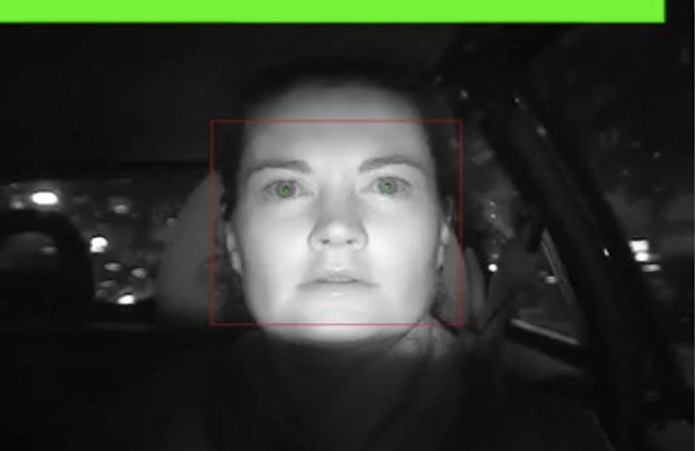
Driver Fatigue
P
B
A
B→A
In other words, you start looking like this

Slide 155
Driver Fatigue
P
B
A
B→A
According to a Sleep in America poll:
  1% or as many as 1.9 million drivers have had a car crash or a near miss
  due to drowsiness in the past year
  54% or 105 million drivers have driven while drowsy at least once
  in the past year
  28% or 54 million drivers do so at least once per month
Chronic and acute driver fatigue decreases your ability to recognize and respond to oncoming hazards. Fatigue impairs your driving, like alcohol impairment. Remember, you a driving a larger vehicle and larger vehicles can do more damage.
Staying alert to be able to think clearly and quickly respond to potential hazards is important factor to driver safety.

Slide 156
Driver Fatigue
P
B
A
B→A
As a professional transit driver/operator you may be exposed to a broad array of biological, physical, & ergonomic hazards, as well as various stressors.
/ 156

Slide 157
Wellness Awareness
P
B
A
B→A
Musculoskeletal Disorders (MSDs)
MSDs are injuries or pain in the body’s joints, ligaments, muscles, nerves, tendons, & structures that support limbs, neck, & back.

Slide 158
Wellness Awareness
P
B
A
B→A
Work-related Musculoskeletal Disorders (WMSDs)
WMSDs can be associated with work patterns:
  Fixed or constrained body positions
  Force concentrated on small parts of the body

Slide 159
Wellness Awareness
P
B
A
B→A
  A pace of work that does not allow sufficient recovery
  Heat, cold, & vibration

Slide 160
Wellness Awareness
P
B
A
B→A
Things you can do to lessen the risks include:
Adjust your driver seat area properly so that you have full access to all controls, permitting a comfortable arm position
Adjust all mirrors properly

Slide 161
Wellness Awareness
P
B
A
B→A
Adjust & re-adjust lumbar support throughout the day
Take advantage of non-driving time to stretch your back & leg muscles. Stretching enhances circulation & reduces muscle tension.

Slide 162
Unit 5.5 Post-Crash Procedures
P
B
A
This unit satisfies FMCSA’s ELDT requirements for units A1.5.5, B1.5.5, and C1.1.

Slide 163
Accident & Emergency Handling Procedures
P
B
A
In an accident or emergency, your responsibilities range from having the ability to protect yourself and your passengers from injury or death, to protecting yourself and your agency afterwards from fraudulent or excessive liability claims.

Slide 164
Accident & Emergency Handling Procedures
P
B
A
When there is an accident or emergency involving your vehicle or passengers, you are responsible for handling the situation in a way that lessens the risk of injury or death to your passengers and to yourself.

Slide 165
Accident & Emergency Handling Procedures
P
B
A
You must have thorough knowledge, and understanding, of the basic accident and emergency handling procedures in order to maintain that trust.

Slide 166
Accident & Emergency Handling Procedures
P
B
A
The four basic accident and emergency handling procedures are:
    Keep calm
    Protect your passengers, yourself, your vehicle
    Contact your dispatcher
    Complete the required reports
Each situation is going to be different. Therefore, 2 and 3 may be reversed while 1 and 4 remain constant.

Slide 167
Accident & Emergency Handling Procedures
P
B
A
These four steps are basic – your agency should have a very detailed and in-depth policy/guideline to follow in the event of an accident or incident.
Become familiar with these policies.

Slide 168
Post-Accident Procedures
P
B
A
The first thing to do at an accident scene is to keep another accident from happening in the same spot.
To protect the area:
Try to get it to the side of the road. This will help prevent another accident and allow traffic to move.
Put on your flashers.
Set out reflective triangles to warn other traffic.
Make sure other drivers can see them in time
to avoid the accident.

Slide 169
Post-Accident Procedures
P
B
A
Assess your own physical condition post-accident
Are you capable of assisting passengers to safety?
If you are incapacitated, attempt to notify authorities of the accident or assign another person responsibility to notify the authorities.

Slide 170
Post-Accident Procedures
P
B
A
If you have a cell phone or CB radio, call for assistance before you get out of your vehicle. If not, wait until after the accident scene has been properly protected, then call or send someone to call the police. Try to determine where you are so you can give the exact location.

Slide 171
Evacuation
P
B
A
As a driver, you have an important responsibility
for the welfare and safety of your passengers.
You must be prepared to provide evacuation assistance to all passengers.

Slide 172
The Evacuation Decision
P
B
A
If you smell smoke, see smoke, or smell gasoline or diesel fumes, evacuate the vehicle immediately.
Do not assume it is NOT an emergency.

Slide 173
Evacuation
P
B
A
Passengers in wheelchairs present two elements for assessment:
The first is whether or not conditions permit operation of the lift.
The second is whether or not to evacuate the passenger in their mobility device.

Slide 174
Evacuation
P
B
A
Passengers may be reluctant to leave their wheelchair behind because without it they become totally immobile. However, saving the passenger’s life is first priority.
If time and conditions permit, the wheelchair can be recovered later.

Slide 175
Evacuation
P
B
A
Be sure to identify portable oxygen devices
and remove them from the vehicle.
Alert fire fighters to their presence and location.

Slide 176
Communicating with Passengers & helpers
P
B
A
In an emergency, most passengers will look to you, the driver, for direction. You represent authority and must take initial control and take the lead.
Passengers should be advised that help is on the way, but for their safety, it is best that they leave or be assisted from the vehicle.

Slide 177
Communicating with Passengers & helpers
P
B
A
The use of able-bodied passengers or passers-by, must be done with great care. The ability to remain calm and give clear and concise instructions to helpers will prevent unnecessary injuries.
Make it clear what commands will be used to start whatever you will be doing.

Slide 178
Communicating with Passengers & helpers
P
B
A
Remember – as the driver of your vehicle, you are responsible for directing passengers and passers-by in giving assistance. However, once public safety personnel arrive on the scene, they will assume command and control of the emergency. At that point, your responsibility is seeing to the needs of your passengers.

Slide 179
Fire Extinguishers
P
B
A
An essential piece of emergency equipment and all vehicles should have one.
A typical fire extinguisher has only 15-20 seconds of retardant.
In order for a fire extinguisher to be effective it must be used properly.

Slide 180
Fire Extinguisher Operation
P
B
A
  P. A. S. S.
      Pull the pin
      Aim toward fire
      Squeeze the handle
      Sweep at the base of the fire

Slide 181
Special Considerations for Fires
P
B
A
Fire extinguishers are an extremely valuable tool, but you must always remember that they are small and have a limited capacity. When confronted with a fire, your first concern should be in protecting the safety of your passengers and yourself. The fire extinguisher should be used to protect your exits while you evacuate the vehicle.

Slide 182
Post-Crash Testing Requirements
P
B
A
Post-crash drug and alcohol tests are always required when there is a human fatality.
It is required in the following circumstances only if the driver was issued a citation:
  Someone was injured and given immediate medical attention away from the scene
  A vehicle damaged enough to require towing
Reasonable suspicion is a reason to require testing; however, it doesn’t fall under the “post-crash” testing requirements.

Slide 183
Unit 5.11 Fueling
P
This unit satisfies FMCSA’s ELDT requirements for unit C1.5.

Slide 184
Fueling
P
Avoid fueling your bus with riders on board unless absolutely necessary. Never refuel in a closed building with riders on board.
Refuel with Engine Off Turn off your engine before fueling a motor vehicle containing hazardous materials. Someone must always be at the nozzle, controlling fuel flow.
To avoid fire, follow correct safety procedures for fueling the vehicle.

Slide 185
Unit 5.12 Idling
P
This unit satisfies FMCSA’s ELDT requirements for unit C1.6.

Slide 186
Idling Restrictions – Set by Local Jurisdictions
P
2021 MN State Statute: “All operators of diesel school buses must minimize, to the extent practical, the idling of school bus engines and exposure of children to diesel exhaust fumes.”
Minneapolis: Restricts all non-traffic idling to three minutes per hour (five minutes for diesel trucks and buses) — with some exceptions. You can idle up to 15 minutes in a one-hour period if the outside air temperature is less than zero degrees.
Owatonna: No longer than 15 minutes within a 5-hour period in residential districts.
St. Cloud: No longer than 5 minutes on West St. Germain from
8th Ave. to 10th Ave.

Slide 187
Idling Restrictions
P
It’s important to comply with all state and local idling laws. Limiting idling will also have an impact on your fuel savings.
The consequences of non-compliance include adverse
health effects to yourself, your passengers, and others:
  Vehicle motors release particulate matter, dirt, nitrous oxides, hydrocarbons, carbon monoxide and carbon dioxide into the air. These chemicals are linked to increased rates of cancer, heart and lung disease and asthma and are the major source of human-caused global warming.
  An idling car emits more pollutants than a moving car, so reducing unnecessary idling is an easy way we can all do something to improve air quality.

Slide 188
Idling Restrictions – Set by Local Jurisdictions
P
The consequences of noncompliance may also include penalties.
Penalties vary by state and local laws. For example, in Minneapolis the violations are punishable as criminal offenses, which may include fines, depending on the violation.

Slide 189
Unit 5.13 Passenger Safety Awareness Briefing
P
This unit satisfies FMCSA’s ELDT requirements for unit C1.8.

Slide 190
Passenger Safety Awareness Briefing
P
Emergency exits - Point out the location of all emergency exits (push-out windows, roof vent, and side door) and explain how to operate them. Emphasize that, whenever possible, the motorcoach door should be the primary exit choice. Encourage able-bodied passengers to assist any injured or mobility-impaired passengers during an emergency evacuation. Provide passengers with sufficient guidance to ensure compliance with FMSCA 49 CFR 392.62, “Safe operation, buses.”

Slide 191
Passenger Safety Awareness Briefing
P
Seat Belt Use - If equipped, recommend the use of shoulder/lap seat belts whenever passengers occupy any seating position.
Emergency Contact - Advise passengers to call 911 by cellular telephone in the event of an emergency.
Driver Direction - Advise passengers to look to the driver for direction and follow his/her instructions.
Fire Extinguisher - Point out the location of the fire extinguisher.
Restroom Emergency Push Button or Switch - Inform motorcoach passengers of the emergency signal device in the restroom.

Slide 192
Passenger Safety Awareness Briefing
P
Avoiding Slips and Falls - Warn passengers to exercise care when boarding and exiting the motorcoach and to use the handrail when ascending or descending steps. Encourage passengers to remain seated as much as possible while the motorcoach is in motion. If it is necessary to walk while the motorcoach is moving, passengers should always use handrails and supports.

Slide 193
Unit 5.14 Passenger Management
P
This unit satisfies FMCSA’s ELDT requirements for unit C1.9.

Slide 194
Passenger Management
P
Procedures for safe loading of passengers
Select a safe loading area and position the vehicle so passengers have a short, clear path to the vehicle’s entrance.
Keep passengers away from hazards such as benches, sewer grates, or other obstacles that can create hazards while boarding
If you’re stopped on a roadway engage your four-way flashers
If you will need to use a wheelchair lift, park the vehicle where the lift can be used and accessed.
Stay by the loading door so you can assist any passengers who need it.

Slide 195
Passenger Management
P
Procedures for safe unloading of passengers
Select a safe location that avoids the need for passengers to cross in front of or behind the vehicle into traffic.
If you’re parked on a roadway, engage four-way flashers
Do not open the exit door until you have assessed the exit area to see if it is safe to exit. Warn passengers about any hazards.
Stay near the door to assist any passengers who need it.

Slide 196
Passenger Management
P
Rules for Standing Passengers
Some vehicles allow “standees” meaning passengers who ride while standing in a designated area
Do not drive while any passengers are in front of the “standee line.” Passengers must always be behind that line when the vehicle is moving.
The standee line will be located just behind the driver’s seat and will be marked on the floor.

Slide 197
Passenger Management
P
How to deal with disruptive passengers.
Your employer may have specific policies and procedures for dealing with disruptive passengers, here are some general guidelines:
Every situation will be different. You will need to use your best judgement and people skills to try to defuse the situation and keep your passengers safe.
Never attempt to deal with a confrontational or combative passenger while the vehicle is in motion.

Slide 198
Passenger Management
P
How to deal with disruptive passengers.
Do your best to de-escalate the situation. If a passenger yells, do not yell back. Respond with a calm and assertive tone and non-threatening body language.
Use clear statements that inform the passenger of the rules and reflect their frustrations, so they know that you understand them.
If the situation becomes physical, you may decide to involve law enforcement. Follow your employer’s procedure to contact law enforcement and notify your employer.
If the combative individual is near the front of the bus, attempt to persuade them to exit the bus. If they’re near the rear, you may need to use the front of the bus to evacuate other passengers.
Remember: your job is to protect yourself and your passengers.

Slide 199
Unit 5.15 Americans With Disabilities Act (ADA) Compliance
P
This unit satisfies FMCSA’s ELDT requirements for unit C1.10.

Slide 200
What is the ADA?
P
The ADA is an extensive civil rights law designed to remove barriers that prevent individuals with disabilities from enjoying the same opportunities that are available to persons without disabilities.

Slide 201
ADA Compliance
P
A substantial part of the ADA covers:
any public entity that provides designated public transportation or intercity or commuter rail transportation;
any private entity that provides specified public transportation;
any private entity that is not primarily engaged in the business of transporting people but operates a demand responsive or fixed route system.

Slide 202
ADA Compliance
P
In general, the law prohibits public entities from denying individuals with disabilities the opportunity to use transportation services, if the individuals are capable of using the system.

Slide 203
ADA Compliance
P
The law requires that all buses be built with an accessible entrance, lift or ramp, securement areas & securement systems.
The ADA requires operators to assist & be courteous to passengers with disabilities & also to permit service animals on the vehicles.
It is not a violation of the ADA, or discrimination, to refuse to provide service to an individual with a disability because that individual engages in violent, seriously disruptive, or illegal conduct.

Slide 204
ADA Compliance
P
ADA Section (37.5(h))
“Service may not be refused solely because the individual’s disability results in appearance or involuntary behavior that may offend, annoy, or inconvenience employees or other passengers of the transit system.”

Slide 205
ADA Compliance
P
The ADA prohibits operators from passing customers with disabilities at stops & requires drivers to make audible stop an announcements
The entity is not required to enforce a request for non-disabled or non-elderly passengers to move from priority seating areas or wheelchair securement locations. (37.167(j)(3))
The professional driver/operator must know how to operate all accessible features on the vehicle.
You must ask passengers if they need assistance & specifically what type of assistance they may require.

Slide 206
ADA Compliance
P
The ADA requires service be provided to a Personal Care Attendant (PCA).
In a paratransit operation, the PCA is not required to pay.
This fare exemption does not apply to fixed route operation.

Slide 207
ADA Compliance
P
Requirements Under the Law
The ADA states that a vehicle operator must use the accessibility related equipment in the vehicle.
Permit passengers with disabilities who do not use wheelchairs or other mobility devices, including standees,
to use the lift.

Slide 208
ADA Compliance
P
Assisting Passengers with Mobility Issues
Always ask your passenger if they would like assistance.
A passenger should never have to ask for assistance because the driver failed to offer it.
Different wheelchairs operate differently within a vehicle. Medline Standard and Jazzy Select Wheelchairs are not designed to be used as a seat on the bus. The passenger must be moved to a vehicle seat and the wheelchair secured.
There is a wheelchair available on the market that is safe to use as a seat in a moving vehicle. That chair is a WC19. That standard was created by the Rehabilitation Engineering and Assistive Technology Society of North America (RESNA) and accepted as a Federal Motor Vehicle Safety Standard by the National Highway Traffic Safety Administration (NHTSA). This chair has been tested under crash conditions and is safe for an individual to sit in while riding.

Slide 209
ADA Compliance
P
Lift Operation
  Some wheelchairs weigh more than 600 lbs. when occupied.
At a minimum, all occupied wheelchairs weighing up to 600 pounds and measuring 30 inches in width and 48 inches in length (formerly known as a “common wheelchair”) must be transported.
  If a lift has the minimum design load of 600 pounds, there is no requirement for an agency to transport a heavier occupied device. Do not guess and do not weigh the passenger.
  If the device fits on the lift and the lift raises, transport the passenger and the device.

Slide 210
ADA Compliance
P
Lift Operations
Operate the lift, or ramp, at all stops when needed or requested.
Immediately report lift, or ramp, failures.
Allow passengers with disabilities to board the lift either forward or backwards.
Transport any mobility device that fits on the lift, or ramp, & within the “envelope” for securement.

Slide 211
ADA Compliance
P
Secure mobility devices using the available securement system.
If the mobility device absolutely cannot be secured using the existing securement system, explain to the passenger that he or she is not secured. If the passenger still wants to be transported, you must provide the ride.
The passenger cannot refuse securement of their mobility device.

Slide 212
ADA Compliance
P
Permit passengers with disabilities to travel with respirators or a portable oxygen supply.
Permit service animals to accompany passengers with disabilities on your vehicle.
Announce all transfer points, major intersections & destination points as well as any stops requested by the passenger.
Manually assist any passenger having difficulty utilizing the vehicle ramp.

Slide 213
ADA Compliance
P
Under the law, you cannot require passengers with disabilities to:
Transfer from a mobility device to a regular seat. You may recommend they do so.
Use designated seats if the person does not want to.
Have a Personal Care Attendant.

Slide 214
ADA Compliance
P
You must stop for all customers with disabilities and use the lift, or ramp, and securement equipment as needed. Passing by persons with disabilities violates the ADA.
If all securement areas are in use – stop & advise the customer of the situation & that another vehicle will be along shortly.
Remember – passengers using assistive devices, such as crutches, canes or walkers, & passengers who have difficulty using stairs are permitted to use the lift & ramp.
Always instruct the passenger to hold the railing for additional safety.
Some disabilities are hidden; therefore, you may not deny anyone this service if requested.

Slide 215
ADA Compliance
P
Service Animals
Included in the ADA regulations, is the right of a person traveling with a service animal to have equal access to public transportation and accommodations. (35.136)
According to the FTA, a service animal means any guide dog, signal dog, or other animal individually trained to work or perform tasks for an individual with a disability.
Emotional support animals are not considered service animals under the ADA, but they may be permitted based on local or state laws.
Service animals are not required to be professionally trained, nore are they required to wear a special vest or harness to identify them as service animals.

Slide 216
ADA Compliance
P
Service Animals— If the individual says it’s a service animal, it’s a service animal.
A transit agency may ask two things to determine if an animal is a service animal:
  Is the animal required because of a disability?
  What work or task has the animal been trained to perform
A service animal can be excluded if it:
  It is out of control and the handler doesn’t take effective action to control it.
  It is not housebroken.
“Under control” means that the animal is harnessed, leashed, or tethered while in public places. If the individual’s disability prevents the use of those devices, the person must use voice, signal or another means to control the animal.

Slide 217
ADA Compliance
P
  Service Animals
  A transit system may exclude any animal from your vehicle when the animal’s behavior poses a direct threat to the health or safety of others.
  You may NOT make assumptions about any animal based on past experience with other animals or breed type.
  Each situation must be considered individually
  Tips for Providing Assistance
  ASK the passenger what you can do to assist
  Do not touch or give commands to a service animal unless asked to do so by the handler
  If necessary, remind passengers that the service animal is working and not to distract it
  When a service animal must ride the lift, be extremely alert and safety conscious

Slide 218
ADA Compliance
P
  Cognitive Disabilities
  Some passengers may have disabilities that affect:
  Thinking
  Learning
  Awareness
  Communication/language
  Orientation
  Processing information
  Judgment
  Decision making
  Memory
  Emotional control

Slide 219
ADA Compliance
P
  Hearing Impairment
The major barrier facing a person with a hearing impairment is one of communication
Many persons with a hearing impairment rely upon their eyes for signals to aid understanding

Slide 220
ADA Compliance
P
  Visual Impairment
Always ask a person with a visual impairment what kind of assistance (if any) they would like first. Use a normal tone and address the person directly.
When assisting a person with a visual impairment you might:
  Permit the passenger to grasp your arm.
  Show the passenger where your arm is by placing his/her hand on your arm.
  Stand alongside and slightly ahead of the person you are guiding.
  Walk at a normal pace or a pace comfortable for you and the person you are guiding.
Alert the person to changes in the walking surface and surrounding obstructions.
Hesitate before going up or down steps or curbs.
Make certain you vocally indicate the need to “step up” or “step down.”

Slide 221
Unit 5.16 Safety Belt Safety
P
This unit satisfies FMCSA’s ELDT requirements for unit C1.12.

Slide 222
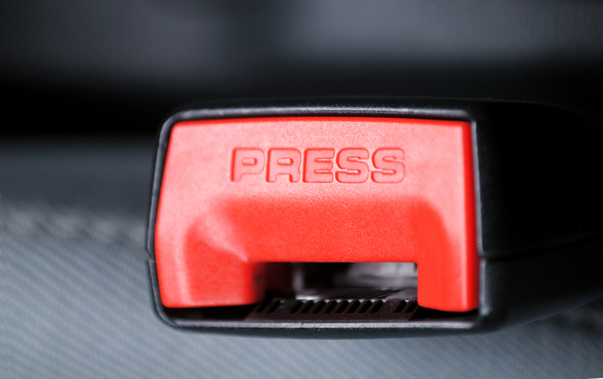
Seat Belt Law - MN
P
Minnesota’s seat belt law is a primary offense, meaning drivers and passengers in all seating positions — including in the backseat — must be buckled up or in the correct child restraint.
Buses are exempt from seat belt law for passengers.
This Photo by Unknown Author is licensed under CC BY-ND

Slide 223
Seat Belt Safety
P
FMCSA Regulations on the Use of Seat Belts.
(a) Drivers. No driver shall operate a commercial motor vehicle, and a motor carrier shall not require or permit a driver to operate a commercial motor vehicle, that has a seat belt assembly installed at the driver’s seat unless the driver is properly restrained by the seat belt assembly.
(b) Passengers. No driver shall operate a property-carrying commercial motor vehicle, and a motor carrier shall not require or permit a driver to operate a property-carrying commercial motor vehicle, that has seat belt assemblies installed at the seats for other occupants of the vehicle unless all other occupants are properly restrained by such seat belt assemblies.
Source: CFR § 392.16, 81 FR 36479, June 7, 2016; 81 FR 43957, July 6, 2016

Slide 224
Unit 5.17 Weigh Stations
P
Not Relevant for Transit, Still Must Learn
This unit satisfies FMCSA’s ELDT requirements for unit C1.15.

Slide 225
Weigh Stations
P
Not Relevant for Transit, Still Must Learn
What to check at a weigh station:
Inspecting weight (total and per axle)
Equipment – ensure it is in working order, headlights, tires, etc.
Proper names on doors
DOT number
Proof of annual inspection
Paperwork and permits are in order

Slide 226
Weigh Stations
P
Not Relevant for Transit, Still Must Learn
Video: How a MN Weigh Station Operates 2016. MnDOT—10 minutes

Slide 227
Weigh Stations
P
Not Relevant for Transit, Still Must Learn
All vehicles rated 10,000 GVW or more are required to stop at open weigh stations for inspections. They may wave you through or they may inspect your vehicle.
There are only a handful of weigh stations in MN, so this will not affect too many buses. If you are at the weigh station, you could be subject to an inspection similar to the DOT inspections on the road.
DOT inspections — what to expect:
  They may pull you over for something as simple as a headlight out, or just a random stop.
  This is a roadside inspection, they will look for basics like lights, Q’Straint placement, tires, etc. They will also interview the driver looking for signs of intoxication etc. They can also show up at your shop at any time to inspect any buses you have in house.

Slide 228
Weigh Stations
P
Not Relevant for Transit, Still Must Learn

Slide 229
Unit 5.18 Security and Crime
P
This unit satisfies FMCSA’s ELDT requirements for unit C1.16.

Slide 230

Security & Crime
P
Video: Recognizing Signs. Metro Transit—8 minutes

Slide 231
Unit 5.19 Penalties and Fines
P
This unit satisfies FMCSA’s ELDT requirements for unit C1.18.

Slide 232
Penalties & Fines
P
Any violation can result in a fine. If violation is not corrected, that’s a fine too.
Violations have set minimum and maximum amounts.
Fines are based on type of violation, if it is a repeat offense, and if it caused death, serious illness, severe injury or destruction of property.
Once an enforcement case is settled, it becomes a matter of public record.
2021 all baseline penalties were increased approximately 1.17%.
New in 2021: DOT Clearinghouse violations – drivers, employers, medical review officer or service agent could be fined up to $5,833 for violating any provision in the Drug & Alcohol Clearinghouse.

Slide 233
Penalties & Fines
P
What is the Pre-Employment Screening Program (PSP)? A program that provides carriers, individual drivers, and industry service providers access to commercial drivers’ safety records from the Federal Motor Carrier Safety Administration’s (FMCSA) Motor Carrier Management Information System (MCMIS). Records are available
24 hours a day via the PSP website.
A PSP record contains a driver’s most recent 5 years of crash data and the most recent 3 years of roadside inspection data from the FMCSA MCMIS database.
Driver-related regulation violations will be documented in your PSP record.

Slide 234
Penalties & Fines
P
Loss of Driving Privileges
You may not drink alcohol while you are on-duty or consume any alcoholic beverage within four hours before you go on duty. If you are found to have a blood alcohol concentration of .08 percent or more while operating a non-commercial vehicle, your Class D driving privileges will be revoked and you will be disqualified from driving CMVs for at least one year.
Commercial License Disqualifications
You will lose your CDL for at least one year for a first offense if:
  You drive a CMV under the influence of alcohol or a controlled substance (for example, illegal drugs).
  You refuse to submit to an alcohol or drug test.
  You drive a CMV when your blood alcohol concentration is 0.04 percent or more.

Slide 235
Penalties & Fines
P
Commercial License Disqualifications (Continued)
You will lose your CDL for at least one year for a first offense if:
  Your blood alcohol concentration is less than 0.04 percent, but you have any detectable amount, you will be put out of service for 24 hours.
  You leave the scene of an accident involving a CMV that you were driving.
  You use a CMV to commit a felony.
  You drive with a revoked, suspended, canceled, denied or disqualified CDL.
  You cause a fatality through negligent or criminal operation of a CMV.
  You commit an offense in another state that would be grounds for disqualification in Minnesota.

Slide 236
Penalties & Fines
P
If a first disqualifying offense occurs while you are operating a CMV that is placarded for hazardous materials, you will lose your CDL for at least three years.
A second disqualifying offense will result in losing your CDL privileges for life. You will also lose your CDL for life if you use a CMV to commit a felony involving a controlled substance.
Other Offenses
If you have committed two serious traffic violations while operating a CMV within a three-year period, you will lose your CDL for at least 60 days.
If you have committed three serious traffic violations while operating a CMV within a three-year period, you will lose your CDL for at least 120 days.

Slide 237
Unit 5.20 Other Emergency Procedures
P
This unit satisfies FMCSA’s ELDT requirements for unit C1.2

Slide 238
Other Emergency Procedures
P
On-board fires
Seconds count when evacuating a transit vehicle in a fire or smoke emergency. Shut off electrical power and evacuate the vehicle immediately and contact dispatch.
Fire extinguishers are small and should only be used to protect your exits while you evacuate the vehicle. Remember PASS:
  Pull the pin.
  Aim toward the fire.
  Squeeze the handle.
  Sweep at the base of the fire.
Fires are included in the FMCSA’s definition of accidents if there is a fatality, or injuries that require someone to immediately be transported to a medical facility away from the scene, or damage that requires the CMV to be towed.

Slide 239

Other Emergency Procedures
P
Managing Security Breaches
Video: Security and Threat Awareness — Warning Signs. FTA—18 minutes
This video also fulfills part of the requirement for Security and Crime — Techniques for recognizing and minimizing physical risks from criminal activities.

Slide 240
Other Emergency Procedures
P
Emergency exits are marked
  The primary exit is the door at the front of the vehicle. Emergency roof hatches and windows are only used when doors are blocked, or the vehicle is on its side.
Source: National RTAP. Emergency Management 2 the Point training

Slide 241
Other Emergency Procedures
P
Evacuating Passengers
Evacuation is recommended when the risks of staying on board are greater than the risks involved in having the passengers off the vehicle.
If there is evidence of smoke or fire, evacuate the passenger first, then investigate the cause.
Calmly brief passengers why evacuation is necessary and communicate which exits to use, and where they should gather after leaving the vehicle.
When evacuating passengers in wheelchairs/mobility device, remember your priority is to save the passenger’s life. Depending on the conditions of the emergency, you may not be able to evacuate the passenger in their mobility device or use the lift.
In the case of an emergency, you may ask able-bodied passengers to assist with an evacuation. Stay calm and provide clear instructions.
Source: National RTAP. Emergency Management 2 the Point training

Slide 242
Other Emergency Procedures
P
Medical Emergencies
Policies will vary agency to agency. Know your agency’s policies about how to handle medical emergencies.
You should pull over to a safe place and call 911, or you may be required to contact dispatch to call 911. You will need to provide details such as the location of your vehicle and a brief description of the emergency.
Medical emergencies are best managed by trained professionals. If your agency allows, provide First Aid up to the level of your formal training.

Slide 243
Other Emergency Procedures
P
Emergency stopping
Move off roadway to safe location. Turn on four-way flashers. Avoid soft shoulders which may not support weight of vehicle.
Secure vehicle. Set parking park, place transmission in neutral park and shut engine off. If the vehicle is on a grade, turn the front wheels against the curb to prevent a rollaway (if no curb, block the rear well against the grade).
Manage passengers. Communicate with passengers; ask to remain seated onboard unless evacuation is required.
Placing warning devices. Set flares/triangles to warn approaching motorists within 10 minutes of stop on any shoulder or travel portion of the highway
Source: FMCSA Model Training Curriculum for Motorcoach Drivers

Slide 244
Other Emergency Procedures
P
Deploy various emergency hazard signals
When the vehicle is stopped on a highway or shoulder for any reason other than a necessary traffic stop activate the 4-way flashers/hazard lights and place reflective triangles to warn other traffic of your location in the following manner:
  On a hill or obstructed view: Place reflective triangles 100 ft in front of vehicle and 10 ft and 100-500 ft behind. It is important to place the rear triangle at a point back down the road so warning can be provided.
  Two-way or undivided highway: Place reflective triangles 100 ft in front of vehicle and 100 ft and 10 ft behind the vehicle.
  One-way or divided highway: 200 ft, 100 ft, and 10 ft behind vehicle/approaching traffic.
Source: Minnesota Commercial Driver’s License Manual

Slide 245
Other Emergency Procedures
P
Dealing with mechanical breakdowns and vehicle defects while enroute
Do not ignore signs and warnings of potential issues simply because the bus still runs. Pay close attention to any symptoms of indications that the bus is not running normally.
When you feel a vibration or unusual noise, try to localize it from the driver’s seat. Then stop the bus in a safe location and inspect the coach to find the source of the problem.
Stay calm and communicate with your passengers to keep them calm.
Inspect your bus. Whether you think you’ve identified the source or were unable to, notify your agency and ask for further direction. Many times, describing the symptoms you observed can help mechanics troubleshoot the problem and determine if it is safe to continue.
Source: FMCSA Model Training Curriculum for Motorcoach Drivers

