Slide 1

Entry-Level Driver Training (ELDT) Theory Curriculum
Prepared for Minnesota Transit Agencies by Minnesota RTAP
CLASS A WITH PASSENGER ENDORSEMENT
Last Updated August 30, 2024

Slide 2
Symbols Guide
B
Class B
P
Passenger Endorsement
A
Class A
B→A
Class B to A
Not relevant to public transit, but you must still train on this for ELDT
Not Relevant for Transit, Still Must Learn

Slide 3
Introduction
This training was developed by the Minnesota Rural Transit Assistance Program (RTAP) in collaboration with transit professionals and trainers throughout the state.
Some of the content may not apply to your role as a public transit operator; however, all of it must be covered to meet the ELDT requirement for your CDL.
Please consult your instructor with any questions about what content applies to your role as a transit operator.

Slide 4
Section 1: Basic Operation
P
B
A
B→A

Slide 5
Unit 1.1 Orientation
P
B
A
B→A
This unit satisfies FMCSA’s ELDT requirements for units A1.1.1, BA1.1.1, and B1.1.1, and C1.3.

Slide 6
P
B
A
B→A
Orientation
This training is for new drivers pursuing a CDL.
Many subjects will be reviewed to ensure that you understand safety fundamentals and essential regulatory requirements for driving.
In this curriculum, you will also be taught your responsibilities not directly related to CMV driving, such as proper cargo securement.

Slide 7
P
B
A
B→A
Orientation
The training will also cover the ramifications, including driver disqualification provisions and fines for non-compliance along with an overview of the applicability of state and local laws relating to the safe operation of the CMV, stopping at weigh stations/scales, hazard awareness of vehicle size and weight limitations, low clearance areas. and bridge formulas.
Consequences for non-compliance may include loss of CDL driving privileges and fines for you and the carrier/employer.

Slide 8
P
B
A
B→A
Orientation
Knowing the weight of your vehicle is important to safety. Roads and other road structures (such as parking lots) are built to handle maximum weights. There is a significant weight difference between large trucks and buses and other vehicles on the road, which means there are greater consequences with there is an accident.
GVW - Gross vehicle weight. The greater of the unloaded weight of a vehicle plus the weight of the load; or the value specified by the manufacturer as the maximum gross weight or gross vehicle weight rating (GVWR).
GVWR - Gross vehicle weight rating. Means the value specified by the vehicle manufacturer as the loaded weight of a single motor vehicle.
Axle Weight = The weight transmitted to the ground by one axle or one set of axles.
Sources: Minnesota Commercial Driver's License Manual and Minnesota Commercial Truck and Passenger Regulations, 2021

Slide 9
P
B
A
B→A
Orientation
The size and design of your vehicle impacts how it maneuvers and where you can travel.
Height is measured from level road surface to top of load or vehicle. CMVs can be too tall for some of the clearances of bridges and other fixed objects such as canopies at hotels, clinics, etc. Tall vehicles also have a higher center of gravity and have a higher risk of roll overs than smaller vehicles.
Ground Clearance (also known as ride height) is the minimum distance between the lower end of the vehicle body and the road. When you load a vehicle with passengers or cargo, the available height is lowered. Low ground clearance is difficult on rough roads. The underbelly of the vehicle can get scratched, or it can get hung up on the tracks at a railroad crossing. Vehicles with higher ground clearance are more likely to turn over.
Sources: Minnesota Commercial Driver's License Manual ; Minnesota Commercial Truck and Passenger Regulations, 2021 and www.fmcsa.dot.gov/ourroads/limited-maneuverability

Slide 10
P
B
A
B→A
Orientation
The vehicle’s width, length, rear overhang impact it’s tail swing. The rear overhang impacts tail swing the most. Tail swing occurs when the movement of the rear portion of the vehicle swings in the opposite direction of the front end, while the front end turns. You must account for these factors to avoid hitting objects with the rear of your vehicle.
Rear Overhang is the distance between the center of the rear axle to the bumper/bed of the vehicle. The greater the distance, the larger the swing when turning.
Length is a bumper-to-bumper measurement. Maximum length in Minnesota for a single motor vehicle without requiring a special permit is 45 feet.
Width is measuring from the widest points on each side of the vehicle or load, exclusive of side rear view mirrors or load securement devices, which may extend an additional 3 inches on each side of vehicle. Maximum width allowed without requiring a special permit is 8 feet, 6 inches.
Sources: Minnesota Commercial Driver's License Manual ; Minnesota Commercial Truck and Passenger Regulations, 2021 and www.fmcsa.dot.gov/ourroads/limited-maneuverability

Slide 11
P
B
A
B→A
Not Relevant for Transit, Still Must Learn
Orientation
Wheels, rims and tires
The wheel is the metal part the tire is fit into. The rim is the other edge of the wheel. Tires are the rubber portion of the wheel that grips the road.
Tire rating: Tires are rated on treadwear, traction performance, temperature resistance and tire load. These ratings are marked on the sidewall of the tire.
Tire Load is the maximum safe weight a tire can carry at a specified pressure. This rating is stated on the side of each tire.
The steering wheels (the wheels that determine the direction your vehicle moves) are the front axle tires and wheels.
Sources: Minnesota Commercial Driver's License Manual and www.nhtsa.gov/equipment/tires

Slide 12
P
B
A
B→A
Not Relevant for Transit, Still Must Learn
Orientation
You will notice that the steering wheel on a CMV is a lot larger than a car’s steering wheel. It is lower, and oriented in the horizontal plane. It is just as easy to turn as a car’s wheel, but it takes many turns to go from a full right turn to a full left turn.
Mirrors: You have a side mirror on each side of the vehicle.
Headlights, parking lights, & turn signals are seen just above the bumper. Clearance lights are present across the very top of the motor coach.
Note the large windshields, which may be one or multiple pieces of glass.
Source: FMCSA Model Training Curriculum for Motorcoach Drivers

Slide 13
P
B
A
B→A
Not Relevant for Transit, Still Must Learn
Orientation
Brakes systems can be hydraulic or air. All CMVs have service brakes, parking brakes and emergency breaks. Most large CMVs are equipped with air brakes.
Engine Compartment: Often located in the front of smaller buses and in the back on large buses.
Electrical system basic components are the starter motor, battery and alternator.
Sources: FMCSA Model Training Curriculum for Motorcoach Drivers and fleetnetamerica.com/blog/post/electrical-systems-in-heavy-duty-vehicles

Slide 14
P
B
A
B→A
Not Relevant for Transit, Still Must Learn
Orientation
Proper Cargo Securement
Blocking is used in the front, back, and/or sides of a piece of cargo to keep it from sliding. Blocking is shaped to fit snugly against cargo and secured to the cargo deck to prevent cargo movement.
Bracing goes from the upper part of the cargo to the floor and/or walls of the cargo compartment.
Cargo Tie-down
  On flatbed trailers or trailers without sides, cargo must be secured to keep it from shifting or falling off. In closed vans, tie-downs can also be important to prevent cargo shifting that may affect the handling of the vehicle. Tie-downs must be of the proper type and proper strength.
  The aggregate working load limit of any securement system used to secure an article or group of articles against movement must be at least one-half times the weight of the article or group of articles. Proper tie-down equipment must be used, including ropes, straps, chains, and tensioning devices (winches, ratchets, clinching components). Tie-downs must be attached to the vehicle correctly (hooks, bolts, rails, rings).
Source: Minnesota Commercial Driver's License Manual

Slide 15
P
B
A
B→A
Not Relevant for Transit, Still Must Learn
Orientation
Proper Cargo Securement, continued
Header Boards
  Front-end header boards (“headache racks”) protect you from your cargo in case of a crash or emergency stop. Make sure the front-end structure is in good condition. The front-end structure should block the forward movement of any cargo you carry.
Source: Minnesota Commercial Driver's License Manual

Slide 16
P
B
A
B→A
Orientation
What is a commercial motor vehicle?
A vehicle having
a gross vehicle weight rating (GVWR) of 10,001 pounds or more;
designed to transport >15 passengers, including the driver;
or transporting hazardous materials in quantities requiring the vehicle to be placarded.
Reference: Section 204 of the Motor Carrier Safety Act of 1984 (MCSA) (Pub. L. 98-554, Title II, 98 Stat. 2832, at 2833)

Slide 17
P
B
A
B→A
Not Relevant for Transit, Still Must Learn
Orientation
What is a combination vehicle?
A combination vehicle is formed when a truck tractor or straight truck has a trailer added to it.

Slide 18
Orientation
P
Not Relevant for Transit, Still Must Learn
Weigh Stations
What to check at a weigh station:
Inspecting weight (total and per axle)
Equipment – ensure it is in working order, headlights, tires, etc.
Proper names on doors
DOT number
Proof of annual inspection
Paperwork and permits are in order

Slide 19
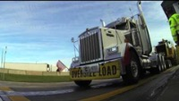
Orientation
P
Not Relevant for Transit, Still Must Learn
Video: How a MN Weigh Station Operates 2016. MnDOT —10:22 minutes

Slide 20
Orientation
P
Not Relevant for Transit, Still Must Learn
ALL vehicles rated 10,000 GVW or more are required to stop at open weigh stations for inspections. They may wave you through or they may inspect your vehicle.
There are only a handful of weigh stations in MN, so this will not affect many buses. At the weigh station you could be subject to an inspection similar to DOT roadside inspections.
DOT inspections — what to expect:
They may pull you over for something as simple as a headlight out, or just a random stop.
This is a roadside inspection, they will look for basics like lights, Q’Straint placement, tires, etc.
They will also interview the driver looking for signs of intoxication etc. They can also show up at your shop at any time to inspect any buses you have in house.

Slide 21
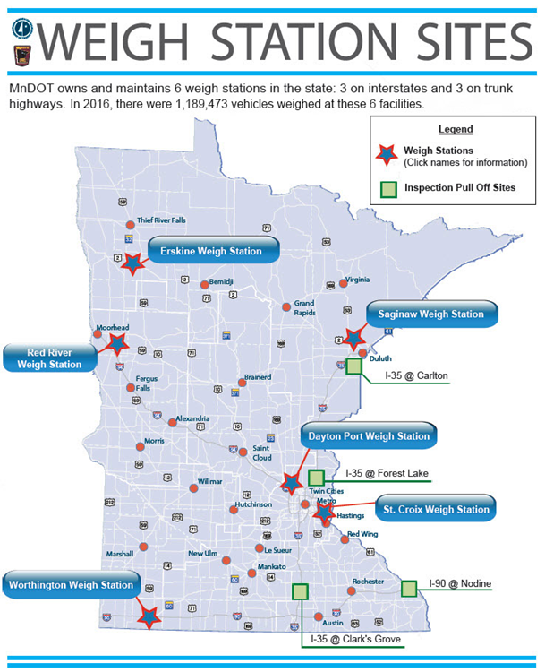
Orientation
P
Not Relevant for Transit, Still Must Learn

Slide 22
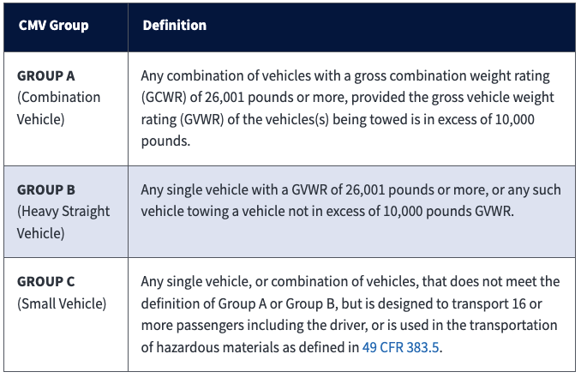
P
B
A
B→A
Orientation
What are the 3 commercial motor vehicle groups according to FMCSA?

Slide 23
P
B
A
B→A
Orientation
What vehicles require a CDL in Minnesota?
A combination of vehicles in which
  the gross combination weight (GCW) >26,000 pounds
  the towed unit has a gross vehicle weight (GVW)* >10,000 pounds
A single vehicle with a GVW >26,000 pounds
A vehicle designed to transport >15 passengers, including the driver
Any size vehicle that requires hazardous materials placards
Any size vehicle outwardly equipped and identified as a school bus

Slide 24
P
B
A
B→A
Orientation
What are Federal Motor Carrier Safety Regulations (FMCSRs) and Hazardous Materials Regulations (HMRs) and Where are They Published?
What: Set minimum safety standards for motor carriers and drivers.
Where: Title 49 of the U.S. Code of Federal Regulations (CFR)
Organized into Sections and Parts, designated by a numbered entry. Citations appear as follows: 49 CFR 390 or 49 CFR 390.15, where:
  Title: 49
  Part: 390
  Section: 15
  Title 49 governs transportation

Slide 25
P
B
A
B→A
Orientation
What are the characteristics of passenger-carrying CMVs?
Per the FMCSA, “a bus is a motor vehicle designed, constructed and/or used to transport passengers. A motorcoach is a bus designed with an elevated passenger deck located over a baggage compartment. A minibus is designed to transport 16 or more passengers (including the driver) and is typically built on a small truck chassis.”

Slide 26
P
B
A
B→A
Orientation
Safety fundamentals
Understanding potential hazards
Scanning the roadway for present or developing hazards
Allowing yourself time to react to hazards
Understanding your options in reacting to hazards present
When you consistently apply these fundamental concepts, your risk of being involved in preventable collisions will decrease.
Source: FMCSA Model Training Curriculum for Motorcoach Drivers

Slide 27
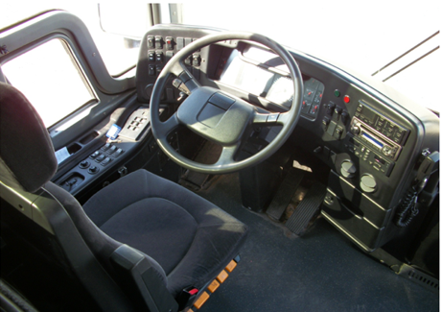
P
B
A
B→A
Orientation
Seat Adjustment
The seat is adjusted in two major ways:
up and down (height) and forward and back.
Both adjustments should permit you to reach
and operate the accelerator, brake, and any other
foot controls easily; the seat position should
allow you to depress the brake pedal all the way
to the floor.
The height adjustment should eliminate pressure to the bottom of your thigh when your foot is on the accelerator. A seat that is too high can affect circulation to your legs and feet.
The forward and back adjustment should let you easily touch the top of the steering wheel. When this is set properly, your elbows will be slightly bent when your hands are at the 8 and 4 o’clock positions on the steering wheel.
Source: FMCSA Model Training Curriculum for Motorcoach Drivers
Notes:
What are Federal Motor Carrier Safety Regulations (FMCSRs) and Hazardous Materials Regulations (HMRs) and Where are They Published?
The Federal Motor Carrier Safety Regulations (FMCSRs) and Hazardous Material Regulations (HMRs) set forth minimum safety standards for motor carriers and drivers. They are published in Title 49 of the U.S. Code of Federal Regulations (CFR) and organized into Sections and Parts, designated by a numbered entry. Citations appear as follows: 49 CFR 390 or 49 CFR 390.15, where:
Title: 49
Part: 390
Section: 15
Title 49 governs transportation.

Slide 28
P
B
A
B→A
Orientation
Mirror Adjustment – Flat Mirrors
If necessary, move the arm holding each mirror so that you have an unobstructed view of the entire mirror.
Rotate both flat mirrors horizontally until the inside edges pick up the rear corners of the coach body. This is just to permit you to see what is happening right next to the coach. Rotating them inward any further is a common mistake and will limit their benefit — you don’t need to see the side of the coach — you need to see what is along the outside of the coach.
Rotate the left (driver side) flat mirror vertically until the bottom one­-third of the mirror shows the roadway. That is, the horizon is about one-third of the way from the bottom of the mirror.
Rotate the right flat mirror vertically until the bottom two-thirds of the mirror shows the roadway. The horizon should be about one-third of the way from the top of the mirror. You should be able to see the right rear wheel(s) of the coach.
Source: FMCSA Model Training Curriculum for Motorcoach Drivers

Slide 29
P
B
A
B→A
Orientation
Mirror Adjustment
Source: FMCSA Model Training Curriculum for Motorcoach Drivers

Slide 30
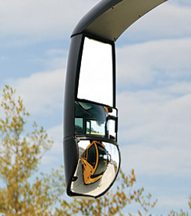
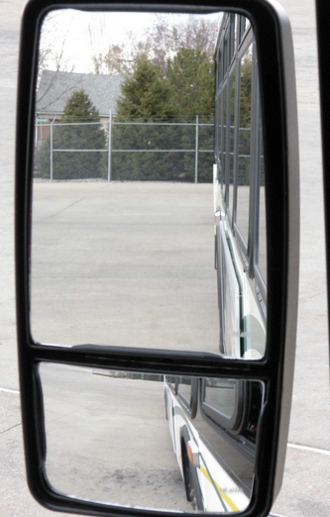
P
B
A
B→A
Orientation
Mirror Adjustment – Convex Mirrors
Because of their curvature, convex mirrors can show you areas that the flat mirrors do not. They help you see further out to the left and right and they allow you to see the roadway closer to the front of the coach, minimizing, but not eliminating, the left and right blind spots. They are very common, though not all buses may have them, so be sure you always set your flat mirrors properly even if you have convex mirrors on most coaches you operate.
Source: FMCSA Model Training Curriculum for Motorcoach Drivers
Notes:
The Federal Motor Carrier Safety Regulations (FMCSRs) and Hazardous Material Regulations (HMRs) set forth minimum safety standards for motor carriers and drivers. They are published in Title 49 of the U.S. Code of Federal Regulations (CFR) and organized into Sections and Parts, designated by a numbered entry. Citations appear as follows: 49 CFR 390 or 49 CFR 390.15, where:
Title: 49
Part: 390
Section: 15
Title 49 governs transportation.

Slide 31
P
B
A
B→A
Orientation
Mirror Adjustment – Convex Mirrors
Some convex mirrors are mounted on flat mirrors and are not adjustable. If your convex mirrors can be adjusted independently of your flat mirrors, follow this procedure to set them:
  Rotate each convex mirror horizontally until the inside edge of its field of view overlaps with the outside edge of the flat mirror’s field of view. Drivers with separately adjustable convex mirrors frequently set them in such a way that the views in the convex mirrors overlap a lot with the views in the flat mirrors. There should always be some overlap, but there should not be much.
  Tilt the left (driver’s side) convex mirror vertically until a point 40 feet from the mirror can be seen in the top edge of the mirror. (The end of the coach is about 40 feet away.)
  Tilt the right convex mirror vertically until the bottom edge of its field shows the roadway just behind the door.

Slide 32
P
B
A
B→A
Orientation
Mirror Adjustment – Convex Mirrors
The convex mirrors should supplement the information provided by the flat mirrors.
When set this way, they will let you see areas that the flat mirrors cannot show you. If you can see a vehicle in your convex mirror but not in your flat mirror, you can be sure it is beside the vehicle, not in back of the vehicle.
Source: FMCSA Model Training Curriculum for Motorcoach Drivers

Slide 33
P
B
A
B→A
Orientation
Spare Tire Storage
If your bus is equipped with a spare tire, please review the location of the spare tire(s) with your supervisor and how to access it.

Slide 34
P
B
A
B→A
Orientation
Bridge Formulas
You must keep weights within legal limits. States have maximums for GVWRs, GCWRs, and axle weights.
Often, maximum axle weights are set by a bridge formula. A bridge formula permits less maximum axle weight for axles that are closer together. This is to prevent overloading bridges and roadways.
Overloading can have negative effects on steering, braking, and speed control.
Overloaded trucks have to go very slowly on upgrades and gain too much speed on downgrades. Stopping distance increases. Brakes can fail when forced to work too hard. During bad weather or in mountains, it may not be safe to operate at legal maximum weights. Take this into account before driving.
You can find information on Minnesota’s bridge formulas on this website

Slide 35
P
B
A
B→A
Orientation
Height Limitations and Clearances
No vehicles in Minnesota may exceed a height of 13 feet, 6 inches without a special permit
When overpasses are lower than 14-feet, 6-inches (a foot above regulation height) MnDOT posts either a bridge height to notify drivers or a low clearance’ sign.
You also may be able to search for low clearance bridges and overpasses in your state/region, so you are prepared when trip planning.

Slide 36
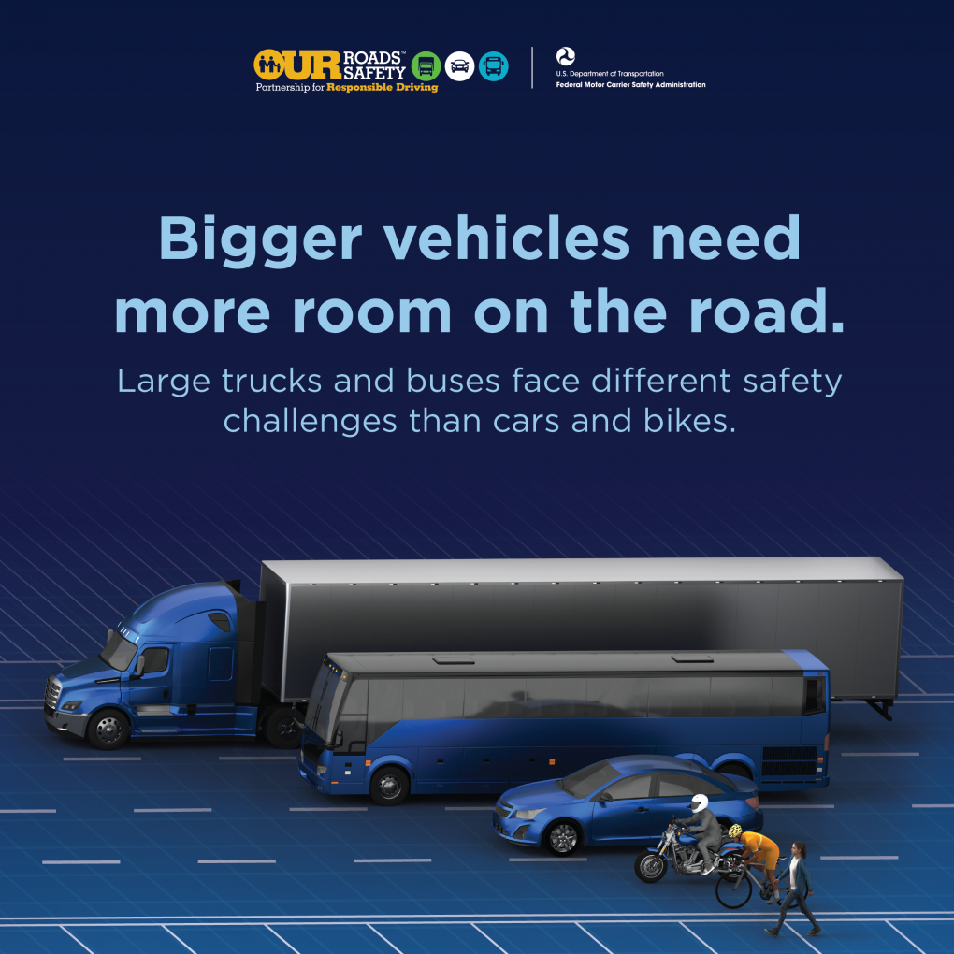
P
B
A
B→A
Orientation
Hazard Awareness of Vehicle Size and Weight Limitations
Size differences greatly affect how truck and bus drivers operate – and all road users should be aware of their unique safety challenges to help keep everyone on our roads safe.
Trucks are often 20 to 30 times heavier than passenger vehicles.
The huge mass of a truck or bus increases the risk of more severe crash damage, injuries and fatalities.

Slide 37
P
B
A
B→A
Orientation
Hazard Awareness of Vehicle Size and Weight Limitations
Tall vehicles have a higher center of gravity, roll over more easily than smaller vehicles and must go much slower on curves and ramps.
Large vehicles generate wind gusts that can push smaller vehicles into other lanes.
Smaller vehicles can be pushed or pulled under a commercial vehicle with high ground clearance.
Drivers must obey all posted signs regarding maximum truck width, length, height and weight limits.

Slide 38
Unit 1.2 Control Systems/Dashboard
B
A
B→A
This unit satisfies FMCSA’s ELDT requirements for units A1.1.2, BA.1.1.2, and B1.1.2

Slide 39
Control Systems/Dashboard
B
A
B→A
Dashboard Gauges:
Oil Pressure
Ammeter and/or Voltmeter
Coolant Temperature
Engine Oil Temperature
Warning Lights & Buzzers (Oil, coolant, charging circuit warning lights should go out right away)
Lights:
Headlights
Dimmer Switch
Turn Signal
Four-Way Flashers
Clearance, Identification, Marker Light Switch(es)

Slide 40
Control Systems/Dashboard
B
A
B→A
Vehicle Controls:
Steering Wheel
Clutch
Accelerator (Gas Pedal)
Brake Controls:
  Foot Brake
  Trailer Brake (if equipped)
  Parking Brake
  Retarder Controls (if equipped)
Transmission Controls
Interaxle Differential Lock (if equipped)
Horn(s)
Windshield Wiper/Washer
Mirrors & Windshield

Slide 41
Control Systems/Dashboard
B
A
B→A
Emergency Equipment:
Spare Electrical Fuses (unless vehicle as circuit breakers)
Three Red Reflective Triangles
Properly Charged & Rated Fire Extinguisher
Tire Chains
Tire-Changing Equipment
Accident-Reporting Kit (Packet)
List of Emergency Phone Numbers

Slide 42
Control Systems/Dashboard
B
A
B→A
How to read the instrument panel
Start engine.
Engage parking brake.
Put gearshift in neutral (or “park” if automatic).
Start engine and listen for unusual noises
If equipped, check the ABS indicator lights. Light on dash should come on and then turn off. If it stays on the ABS is not working properly.

Slide 43
Control Systems/Dashboard
B
A
B→A
Gauges should look like this:
Oil pressure: Moves to normal within seconds after engine starts.
Air pressure:
  Builds from 50 to 90 psi within 3 minutes.
  Build air pressure to governor cut-out (usually around 120 – 140 psi). Know your vehicles requirements.
Ammeter and/or voltmeter: Fall within normal range(s).
Coolant temperature: Gradual rise to normal operating range.
Engine oil temperature: Gradual rise to normal operating range
Notes:
Gauges should look like this:
Oil pressure: Moves to normal within seconds after engine starts.
Air pressure:
Builds from 50 to 90 psi within 3 minutes.
Build air pressure to governor cut-out (usually around 120 – 140 psi). Know your vehicles requirements.
Ammeter and/or voltmeter: Fall within normal range(s).
Coolant temperature: Gradual rise to normal operating range.
Engine oil temperature: Gradual rise to normal operating range

Slide 44
Control Systems/Dashboard
B
A
B→A
Seatbelts
Make sure your seatbelt is secured and pulled tight before driving
The driver’s seat should have a seat belt. Always use it for safety.
Notes:
Gauges should look like this:
Oil pressure: Moves to normal within seconds after engine starts.
Air pressure:
Builds from 50 to 90 psi within 3 minutes.
Build air pressure to governor cut-out (usually around 120 – 140 psi). Know your vehicles requirements.
Ammeter and/or voltmeter: Fall within normal range(s).
Coolant temperature: Gradual rise to normal operating range.
Engine oil temperature: Gradual rise to normal operating range

Slide 45
Control Systems/Dashboard
B
A
B→A
Before driving, make sure your mirrors are in their correct position
360º Awareness
Check your mirrors
every 3-5 Seconds

Slide 46
Control Systems/Dashboard
B
A
B→A
Mirrors and Blind Spots
To maximize your vision in your rearview and side mirrors:
  Adjust the driver’s side mirror by resting your head against the driver’s side window and moving the mirror so that you barely see the side of your own vehicle
  Move your head the same distance to the right and repeat with the outside mirror. Now when a vehicle leaves your field of vision from the inside mirror it is picked up by the outside mirrors. This adjustment also helps reduce nighttime headlight glare from behind
All vehicles have blind spots. You need to know your vehicle’s blind spots and be aware of other vehicles’ blinds pots. As signs on large vehicles often warn, “if you can’t see my mirror, I can’t see you”
Regularly checking your mirrors and the road ahead will increase your awareness, improve your recognition time and may speed reaction time
Source: National RTAP. Safety Training and Rural Transit Training Module

Slide 47
Control Systems/Dashboard
B
A
B→A
Brakes
Many buses are equipped with air brake systems that rely on an air supply and release system to actuate the service or parking brake.
Air storage tanks are filled with compressed air by the compressor, which is powered by the engine.
When the driver steps on the brake pedal, air flows from the storage tanks into the brake chambers, causing the brake to engage.
For parking brakes, air is depleted from the system, allowing decompression of springs that cause the parking brake to engage.
An air pressure gauge located on the dashboard indicates the availability of air pressure for safe vehicle operation, and the system includes warning tones and/or lights to warn of low air pressure.

Slide 48
Control Systems/Dashboard
B
A
B→A
Steering, Accelerating, Shifting, and Parking
To drive a vehicle safely, you must be able to control its speed and direction. Safe operation of a commercial vehicle requires skills in:
  Accelerating
  Steering
  Shifting gears
  Braking
Fasten your safety belt when on the road. Apply the parking brake when you leave your vehicle.
Do not roll back when you start. You may hit someone behind you. Partly engage the clutch before you take your right foot off the brake. Put on the parking brake whenever necessary to keep from rolling back. Release the parking brake only when you have applied enough engine power to keep from rolling back. On a tractor-trailer equipped with a trailer brake hand valve, the hand valve can be applied to keep from rolling back.
Review your vehicle’s dashboard with your instructor.

Slide 49
Unit 1.3 Pre-Trip, Enroute, and Post-Trip Inspections
*Note that the CDL Manual Now Refers to this as "Vehicle Inspections"
P
B
A
B→A
This unit satisfies FMCSA’s ELDT requirements for units A1.1.3, BA.1.1.3, B1.1.3, and C1.4

Slide 50
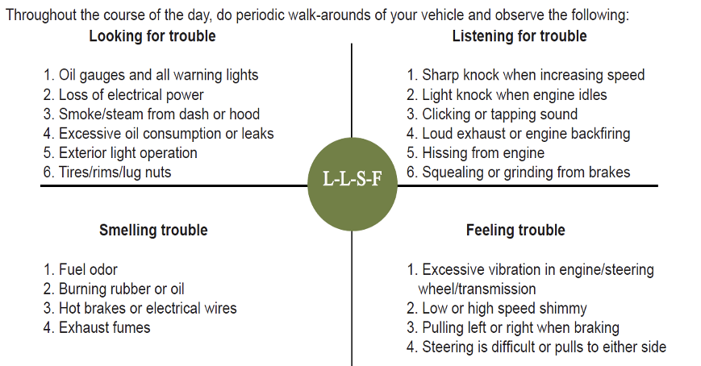
Pre-Trip, Enroute, & Post-Trip Inspections (Referred to as Vehicle Inspections in the CDL Manual)
P
B
A
B→A
Enroute Inspections
Source: National RTAP. Emergency Procedures for Rural Transit Drivers Training Module

Slide 51
Pre-Trip, Enroute, & Post-Trip Inspections (Referred to as Vehicle Inspections in the CDL Manual)
P
B
A
B→A
Pre-trip, enroute, and post-trip inspections are essential to a safe trip
What is your organization’s policy regarding inspecting your vehicle?
Where are the blind spots on the vehicle you drive?
Proper mirror adjustment: will it eliminate all your blind spots?
How should you adjust your mirrors?

Slide 52
Pre-Trip, Enroute, & Post-Trip Inspections (Referred to as Vehicle Inspections in the CDL Manual)
P
B
A
B→A
Passenger Safety Issue One: Pre-trip Inspection - Prepare for vehicle walk-around
Start the engine & turn on the fast idle.
Make sure the transmission is in neutral or park & the parking brake is set.
Turn on inside & outside lights & 4-way flashers.
Turn on heater or A/C, depending on weather.
Briefly test horn & windshield washer/wipers.
* It is important to check that the parking brake is working

Slide 53
Pre-Trip, Enroute, & Post-Trip Inspections (Referred to as Vehicle Inspections in the CDL Manual)
P
B
A
B→A
FMCSA § 392.7 and § 396.11
This law states that no CMV shall be driven unless the driver is satisfied that the following parts and accessories are in good working order or fail to use these parts when needed
Service brakes, including trailer brake connections
Parking (hand) brake
Steering mechanism
Lighting devices and reflectors
Wheels and rims
Emergency equipment
Tires
Horn
Windshield wiper or wipers
Rear-vision mirror or mirrors
Coupling devices

Slide 54
Pre-Trip, Enroute, & Post-Trip Inspections (Referred to as Vehicle Inspections in the CDL Manual)
P
B
A
B→A
FMCSA § 392.7 and § 396.11
Drivers transporting intermodal equipment (like trailers) must additionally inspect the following:
Lighting devices, lamps, markers, and conspicuity marking material
Wheels, rims, lugs, tires
Air line connections, hoses, and couplers
King pin upper coupling device
Rails or support frames
Tie down bolsters
Locking pins, clevises, clamps, or hooks
Sliders or sliding frame lock

Slide 55
Pre-Trip, Enroute, & Post-Trip Inspections (Referred to as Vehicle Inspections in the CDL Manual)
P
B
A
B→A
American Association of Motor Vehicle Administrators (AAMVA)'s Vehicle Inspection Checklist Instructions
"You are only required to inspect the items on the CDL Vehicle Inspection checklist. You may use this checklist for your test and check off items as you have completed them, NO additional markings or writing may be placed on this list. You MUST name, point to and/or touch and fully explain what you are inspecting each safety critical item for. If you do not do so, you will not get credit for the item(s)"

Slide 56
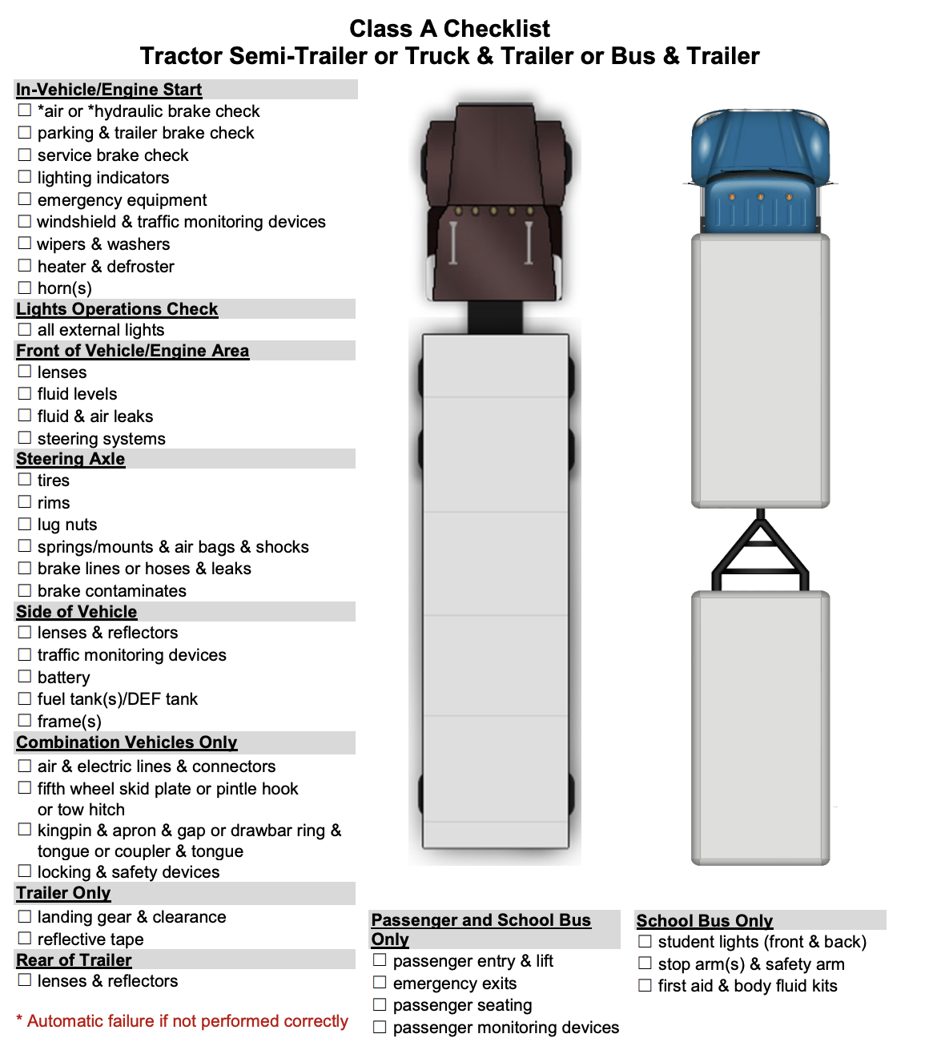
Pre-Trip, Enroute, and Post-Trip Inspections (Referred to as Vehicle Inspections in the CDL Manual)
P
B
A
B→A
From the Minnesota CDL Manual. See the manual for a larger version.

Slide 57
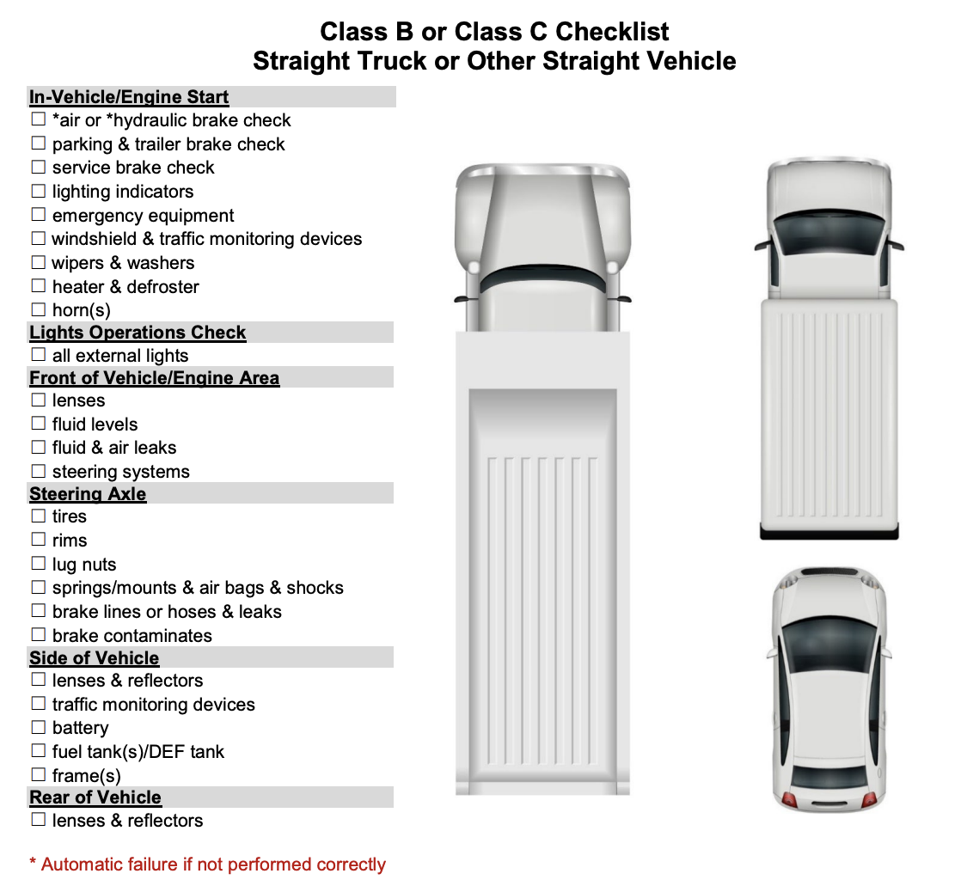
Pre-Trip, Enroute, and Post-Trip Inspections (Referred to as Vehicle Inspections in the CDL Manual)
P
B
A
B→A
From the Minnesota CDL Manual. See the manual for a larger version.

Slide 58
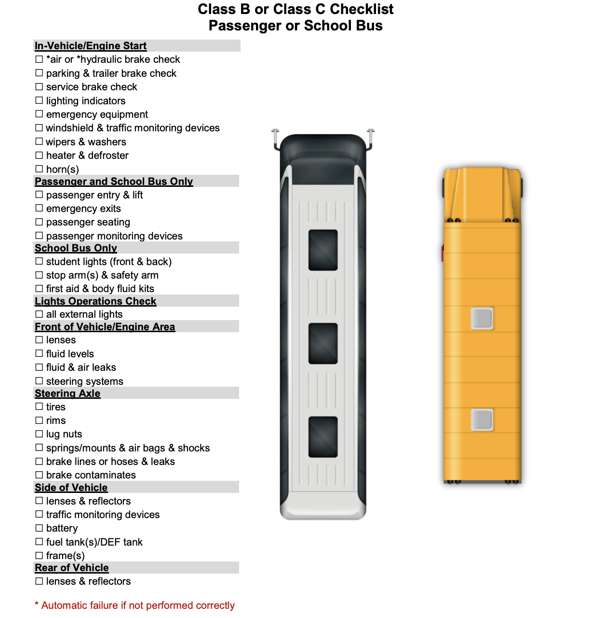
Pre-Trip, Enroute, & Post-Trip Inspections (Referred to as Vehicle Inspections in the CDL Manual)
P
B
A
B→A
From the Minnesota CDL Manual. See the manual for a larger version.

Slide 59
Pre-Trip, Enroute, & Post-Trip Inspections (Referred to as Vehicle Inspections in the CDL Manual)
P
B
A
B→A
Basic Pre-trip Inspection
Check the overall appearance of the coach when approaching
Review the previous trip vehicle inspection report
Conduct a walk-around inspection
Check the headlights, auxiliary lights, and four-way flashers
Check the stop lights and turn signals
Check the engine compartment
Adjust the seat/mirrors and inspect the interior compartment
Air-brake system check

Slide 60
Pre-Trip, Enroute, & Post-Trip Inspections (Referred to as Vehicle Inspections in the CDL Manual)
P
B
A
B→A
Check the Overall Appearance
As you approach the bus, note its general condition.
Do you notice any damage?
Is it leaning to one side?
Is there anything hanging from underneath?
Look under the bus for any fresh fluids. If fresh fluid is observed under the engine area, a leak can be further investigated/confirmed by inspecting the engine compartment. If you see any confirmed leaks or suspicious fresh fluid puddles, try to determine the fluid type and have the leak evaluated by a mechanic or supervisor.

Slide 61
Pre-Trip, Enroute, & Post-Trip Inspections (Referred to as Vehicle Inspections in the CDL Manual)
P
B
A
B→A
Review the Previous Trip Vehicle Inspection Report (VIR)
Check the previous VIR and make a mental note of any reported defects or issues – you will be checking the status of these during the rest of your inspection. Any safety-related defects must be corrected before the vehicle is used again and any repairs performed should be accompanied by the mechanic’s signature.
After verifying that any safety deficiencies have been repaired, you must sign the appropriate area at the bottom of the VIR (Driver’s Signature).

Slide 62
Pre-Trip Inspections (Referred to as Vehicle Inspections in the CDL Manual)
P
B
A
B→A
Conduct a Walk-Around Inspection
Enter the vehicle and unlock all luggage bays (if applicable). Exit the coach, checking to see that the stairwell is clear of debris. Once outside, check to see that the door(s) opens and closes properly.
Check to make sure the mirror support brackets are firmly fixed.

Slide 63
Pre-Trip Inspections (Referred to as Vehicle Inspections in the CDL Manual)
P
B
A
B→A
As you walk around the bus, check:
The condition of each tire and wheel.
Each tire to ensure it is not flat.
Loose or missing lug nuts, rust marks, and cracked wheels
For oil on tires or wheels
Cuts, bulges, cracks, not enough tread, or uneven tread wear on the tires
Loose or separated treads
All auxiliary lights and reflectors are clean and not broken.

Slide 64
Pre-Trip Inspections (Referred to as Vehicle Inspections in the CDL Manual)
P
B
A
B→A
Check the windshield for cleanliness and damage. Allowable conditions:
  Any crack not over 1-inch wide, as long as it’s not intersected by any other crack.
  Any damaged area that can be covered by a quarter, as long as it’s more than three inches from any other damaged area.
Check the spring tension on the wiper arms and check the wiper blades for damage and signs of age (stiff rubber).
Check each luggage and service access bay for unusual objects or packages, utilizing door pins or other locking mechanisms when present to ensure the bay doors remain open. Check door operation in the process.

Slide 65
Pre-Trip Inspections (Referred to as Vehicle Inspections in the CDL Manual)
P
B
A
B→A
Check the exterior safety equipment:
Spare tire
Tire chains or similar traction aides (if needed)
Reflective triangles (three) and spare fuses (if not kept inside passenger compartment)
As you walk around the bus, check for damages or missing parts.
If you find a problem during any of the above checks, have the condition checked/fixed if it would affect the safe operation of the bus. You should not use a bus that is not in safe operating condition.

Slide 66
Pre-Trip Inspections (Referred to as Vehicle Inspections in the CDL Manual)
P
B
A
B→A
Check Headlights, Auxiliary Lights and Four-way Flashers
With the engine off and the parking brake on, turn on your four-way flashers, headlights, and all auxiliary lights (parking, clearance and identification lights).
Exit the coach, checking the operation of the stairwell and landing lights. Walk around the coach and check to see operation of all the headlights, tail lamps, four-ways and auxiliary lights. Go back inside and, watching the light patterns in front of the coach, toggle your high beams to ensure they are operational.

Slide 67
Pre-Trip Inspections (Referred to as Vehicle Inspections in the CDL Manual)
P
B
A
B→A
Check the Engine Compartment
Check the overall condition of the belts and hoses. Are any of the belts loose or frayed? Are any of the hoses cracked, loose, or rotting?
Look for signs of leaking fluids in engine compartment and underneath the coach.
Check the engine bay for unnecessary or unusual buildup of grease, oil, dirt or other materials that could fuel a potential fire. If the engine is equipped with a fire suppression system, check disbursement nozzles for cleanliness and potential obstruction.
Locate the alternator. Ensure that all battery cables leading to/from the alternator are secured and not chaffed or free to rub against another component.

Slide 68
Pre-Trip Inspections (Referred to as Vehicle Inspections in the CDL Manual)
P
B
A
B→A
Check the Engine Compartment (continued)
With the engine off, check the oil level by taking the dipstick out, wiping it with a paper towel, re-inserting it all the way, and examining the dipstick. If the level is low, oil should be added and a close inspection for leaks should be performed before the trip.
With the engine turned off, check the coolant level using the sight glass or alternate method. If it is low on a pre-trip inspection, have it serviced and inspect closely for any evidence of leaks.
Turn the engine on. Check the transmission fluid level after letting the engine idle for at least two minutes.
CAUTION: Never remove the radiator cap when the engine is hot or has recently been running. Severe steam burns could result.

Slide 69
Pre-Trip Inspections (Referred to as Vehicle Inspections in the CDL Manual)
P
B
A
B→A
Adjust seat/mirrors and inspect the interior.
Adjust the seat for yourself and check the seat belt for proper operation.
After you have adjusted your seat, adjust your mirrors for optimal vision.
Make sure that the parking brake is on and the gearshift is in “neutral.”
Turn on the master control switch and ensure the engine is running.
Operate the windshield wipers and washer. Inspect the windshield for damage.

Slide 70
Pre-Trip Inspections (Referred to as Vehicle Inspections in the CDL Manual)
P
B
A
B→A
Check the oil pressure. If you have a gauge, you should have pressure immediately; if you have a warning light only, the warning light should go off. If not, shut the engine off; otherwise, leave the engine running. If you have an oil gauge, the oil pressure may not reach its normal level until the engine warms up. Listen for any unusual noises.
Check the coolant temperature gauge: temperature should begin to climb to the normal operating range. If you only have a coolant temperature warning light, the light should go off.
Check the voltmeter/battery gauge to see that alternator is charging. If you only have a battery/alternator warning light, the light should go off.

Slide 71
Pre-Trip Inspections (Referred to as Vehicle Inspections in the CDL Manual)
P
B
A
B→A
Check that the air pressure gauge indicates that air pressure is building
Check that the coach’s heating, air conditioning, defroster and ventilation system is working properly.
Check the public-address system and adjust as necessary.
Test your horn.
Check the play in your steering wheel. As you turn the wheel left and right, you should feel tension after turning the wheel 1 to 2 inches. Listen for unusual noises.
Check the instrument and other panels for any warning lights, such as anti-lock braking system (ABS), tire pressure monitor, etc.
Release and re-apply the parking brake.

Slide 72
Pre-Trip Inspections (Referred to as Vehicle Inspections in the CDL Manual)
P
B
A
B→A
Check Emergency Equipment
Check the fire extinguisher for proper mounting and charge.
Locate emergency triangles and spare fuses (if these are kept in a storage area outside/under the coach, they should be checked during the exterior walk-around).
Check the passenger seats and seat belts (if equipped) for damage.
Check that emergency exit windows and roof hatches are marked and releases are functional. Re-secure any unlatched emergency exit windows and hatches.
Check each overhead rack (if so equipped) and areas under seats for any suspicious objects or packages.
Check the restroom for damage, cleanliness and supplies, such as toilet tissue and paper towels. Check the restroom door lock and “occupied” sign.

Slide 73
Pre-Trip Inspections (Referred to as Vehicle Inspections in the CDL Manual)
P
B
A
B→A
Check the Air Brake System
Brakes are a critical safety component. If any of the following tests are not passed, be sure the condition is corrected before starting your trip.
When conducting brake system checks, be sure the coach is on a flat surface, as there will be times when no brakes are engaged. If the coach is not or cannot be located on a flat surface, wheel chocks should be used from the beginning of the system check until just prior to the “parking brake test”.

Slide 74
Pre-Trip Inspections (Referred to as Vehicle Inspections in the CDL Manual)
P
B
A
B→A
Static Leakage Test
Place the transmission in neutral, apply the parking brake (if not already applied) and stop the engine. Take note of the air pressure reading and wait for one minute - the air pressure must not drop more than 2 psi during this minute. Now release the parking brake and wait another minute. The air pressure gauge must not drop more than 2 psi in this second minute. Reapply the parking brake.
Applied Leakage Test
With the engine still off and the parking brake released, apply the service brake firmly and hold. The initial drop in air pressure must not be more than 10 psi. After the system settles (needle stops moving) continue to hold the pedal down for one full minute. The pressure should not drop by more than 3 psi in this minute. Re-apply the parking brake.

Slide 75
Pre-Trip Inspections (Referred to as Vehicle Inspections in the CDL Manual)
P
B
A
B→A
Low Air Warning System Test
The purpose of this test is to be sure that the low-air pressure warning system is functioning properly.
With the engine still off, release the parking brake, apply and release the service brake repeatedly to reduce the air pressure. When the air pressure gauge reaches 80 psi, turn on the master control switch, but do not turn on the engine. Continue reducing the air pressure until the low air pressure warning light and buzzer come on. This should occur between 75 psi and 55 psi.

Slide 76
Pre-Trip Inspections (Referred to as Vehicle Inspections in the CDL Manual)
P
B
A
B→A
Emergency Brake Test
Next, continue reducing the air pressure. When the system air pressure reaches about 20 psi, the parking brake knob should “pop out” to indicate that the emergency brake system has activated the spring/parking brake.
Air Pressure Build-Up Test
Start the engine - the air pressure should begin building. Let the air pressure build up until the low air pressure warning buzzer stops. Continue to let the air pressure build. It should not require more than about one minute for the air pressure to go from discharged (5-20 psi) up to between 120 and 130 psi.

Slide 77
Pre-Trip Inspections (Referred to as Vehicle Inspections in the CDL Manual)
P
B
A
B→A
Governor Cut-Out Test
When the pressure has climbed to between 120 and 130 psi, the governor should cause the air compressor to cut out. When it cuts out, the compressor sound will stop, and the gauge needle will stop moving.
Governor Cut-In Test
Reduce the air pressure by making applications of the service brake. Before the pressure drops below 85 psi, the compressor should cut-in and begin to build air into the system.

Slide 78
Pre-Trip Inspections (Referred to as Vehicle Inspections in the CDL Manual)
P
B
A
B→A
Parking Brake Test
With the parking brake still engaged, place the bus into gear and try to move the coach – applied parking brakes should keep the coach from moving.
Service Brake Test
Release the parking brake and drive forward slowly – the coach should move freely with no brake drag.
Apply the service brake while holding the steering wheel lightly to determine whether the brakes apply without pulling to either side. Drive forward slowly a third time and apply the service brake gradually to check for smoothness (make sure there is no unusual jerkiness when stopping).

Slide 79
Enroute Inspections (Referred to as Vehicle Inspections in the CDL Manual)
P
B
A
B→A
If you have interim stops on the way to your final destination check for:
Tires/wheels: are there any flats or tires leaking air? Look for signs of hub oil on wheels and check tires/wheels for excessive heat.
Lights
Leaks (oil, coolant, etc.)
Verify all compartments are closed
Check for damage
Note obstacles to pulling out/backing out

Slide 80
Post-Trip Inspections (Referred to as Vehicle Inspections in the CDL Manual)
P
B
A
B→A
At the end of your trip, you may need to document your trip and any defects discovered during your pre-trip, enroute or post-trip inspection on a Driver Vehicle Inspection Report (DVIR). This varies by industry and agency.
At a minimum you would note the condition of the following on your report:
  Service Brake
  Parking Brake
  Steering Mechanism
  Lighting Devices & Reflectors
  Tires
  Wheels & Rims
  Mirrors
  Horn
  Windshield Wipers
  Emergency Equipment

Slide 81
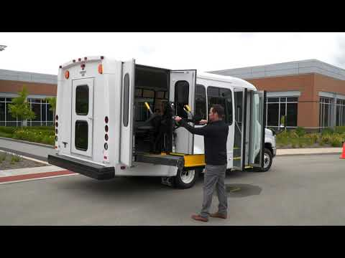
Cycling Accessible Lifts
P
Video: How to Operate a Wheelchair Lift. Braun—15:47 minutes

Slide 82
Cycling Accessible Lifts
P
B→A
Cycle the lift or ramp, checking for smooth operation
Inspect the securement system, including floor tracks, anchorages, straps/tie-downs, seat belts and folding seats to ensure necessary components are present and functional
* If lift is not operational, check with dispatch to determine
if you must change buses

Slide 83
Unit 1.4 Basic Control
A
B
A
B
B→A
This unit satisfies FMCSA’s ELDT requirements for units A1.1.4, BA.1.1.4, and B1.1.4

Slide 84
Basic Control
A
B
A
B
B→A
Basic control of your vehicle requires safe operation of a commercial vehicle requires skill in:
Accelerating:
Speed up smoothly and gradually, so the vehicle does not jerk. Rough accelerating can cause mechanical damage.
When pulling a trailer, rough acceleration can damage the coupling. Speed up gradually when you have poor traction. If you use too much power, the drive wheels will spin, and you could lose control.
If your drive wheels begin to spin, take your foot off the accelerator. Do not roll back when you start. If you have a manual transmission partly engage the clutch before you take your right foot off the brake.
Put on the parking brake whenever necessary. Release the parking brake only when you have applied enough engine power to keep the truck from rolling backwards. You may also use the hand valve on a tractor trailer to prevent you from rolling backwards.

Slide 85
Basic Control
A
B
A
B
B→A
Basic Control of Your Vehicle requires safe operation of a commercial vehicle requires skill in (continued):
Steering: Hold the steering wheel firmly with both hands. Your hands should be on opposite sides of the wheel. If you hit a pothole, the wheel could pull away from your hands unless you have a firm hold.
Stopping: Push the brake pedal down gradually. Control the brake pressure so the vehicle comes to a smooth, safe stop. The amount of brake pressure you need will depend on your speed and how quickly you need to stop.
Backing Safely: Backing is always dangerous. Avoid it whenever you can. You want to plan ahead before you park. Try to park so you’ll be able to pull forward when you leave.

Slide 86
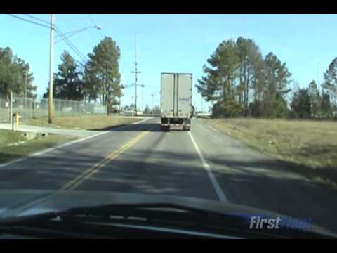
Basic Control — Executing Sharp Turns
A
B
A
B
B→A
Video: Making Turns Safely. FirstFleet—4:37 minutes

Slide 87
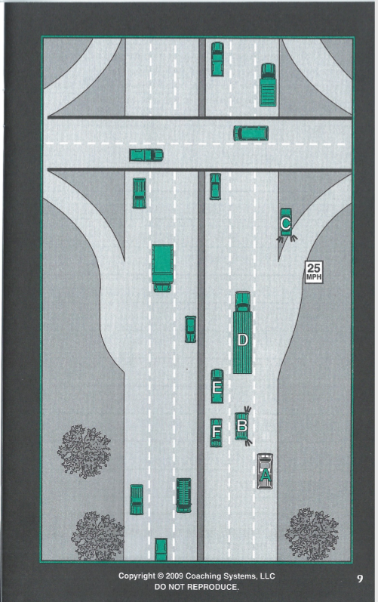
Basic Control
B
A
B→A
In this situation these drivers are on a multi lane highway. What are the hazards (if any) that A is facing what should A do to minimize the risk?
If Exiting:
If continuing on the Highway:

Slide 88
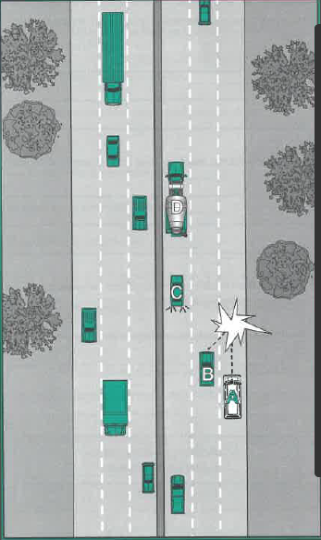
Basic Control
B
A
B→A
In this situation “A” was driving on a multi-lane highway with no other vehicles in front or behind. The driver of “B” pulled right into “A’s” lane colliding with A.
A said they couldn’t do anything to prevent the collision.
How would have you handled this situation?

Slide 89
Basic Control
B
A
B→A
How can “covering the brake” assist you?
What components make up your total stopping distance?
What are the variables for each of the components of your total stopping distance?

Slide 90
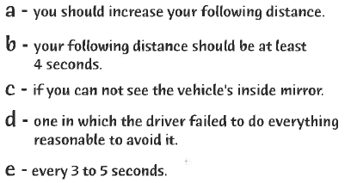
Basic Control
B
A
B→A
1. When traveling in ideal conditions ____
2. You should assume that you are in another driver’s blind spot _____
3. You should check your mirrors _____
4. In adverse weather conditions _____
5. A preventable collision is ______

Slide 91
Basic Control
B
A
B→A
What is owning the intersection?
Should you ever wave another driver through an intersection?
Who has the right of way?
What is the proper way to stop at a stop sign?

Slide 92
Basic Control- Maneuvering in Restricted Areas
B
A
B→A
Roadway Work Zones: Speeding traffic is the number one cause of injury and death in roadway work zones. When possible, avoid work zones and use any detours that are available. When you must drive through a work zone:
Pay attention. Be aware of all signage throughout work zones that can indicate reduced speeds, lane changes and other important information. Avoid distractions. Scan ahead for changing traffic patterns and be alert to vehicles entering your blind spots.
Slow down and be prepared to stop. Keep a sharp eye out for road workers and flag crews. Decrease your speed even further when a worker is close to the roadway. Don’t allow your speed to creep up as you drive through long sections of road construction. Decrease your speed for adverse weather or road conditions.
When approaching lane closures, move into the open lane as soon as possible. Be sure to pay close attention to vehicles around you that could be in your blind spot.

Slide 93
Basic Control – Centering the vehicle
B
A
B→A
Keep in mind positioning a large truck is different than a car. In many cases, the back may be wider than the cab, so you need to position yourself accordingly.
Use your mirrors to determine whether you are properly positioned in your lane. Watch that each side of your vehicle is equal distance to the lines on the road.
In poor visibility where you cannot see roads, err on the side of caution by driving closer to the left side of the lane if possible. This is especially important if there is a lot of snow on the ground, as you will not be able to see how wide the shoulder is and whether there is a steep pavement drop-off. Once you have a hard time gaining control of the vehicle, especially in winter.
Beware of high winds! If you are driving in an area prone to wind tunnels or during bad weather, you need to pay extra attention to your lane positioning. Be especially alert on bridges, overpasses and when driving next to another large vehicle that may be temporarily blocking the wind.

Slide 94
Unit 1.5 Shifting/Operating Transmissions
B
A
B→A
Not Relevant for Transit, Still Must Learn
This unit satisfies FMCSA’s ELDT requirements for units A1.1.5, BA1.1.5, and B1.1.5.
Notes:
https://youtu.be/L1KFOK-CkMA (link to the embedded video)

Slide 95
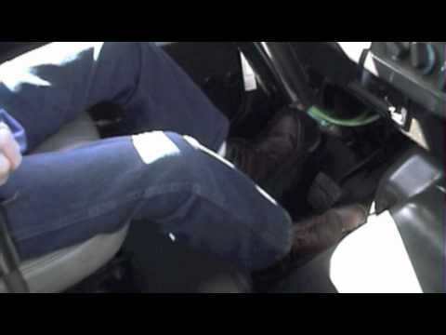
Shifting/Operating Transmissions
B
A
B→A
Not Relevant for Transit, Still Must Learn
Video: CDL Shifting & Down Shifting. Dootson School of Trucking—7:56 minutes
Notes:
https://youtu.be/L1KFOK-CkMA (link to the embedded video)

Slide 96
Shifting/Operating Transmissions
B
A
B→A
Not Relevant for Transit, Still Must Learn
Correct shifting of gears is important to maintaining
vehicle control and improved fuel economy
Most heavy vehicles with unsynchronized manual transmissions require double clutching to change gears. If equipped with a synchronized manual transmission, double clutching is NOT required. This is the basic method:
  Release accelerator, push in clutch and shift to neutral at the same time.
  Release clutch.
  Let engine and gears slow down to the rpm required for the next gear (this takes practice).

Slide 97
Shifting/Operating Transmissions
B
A
B→A
Not Relevant for Transit, Still Must Learn
Shifting an Unsynchronized Manual Transmission (Continued)
  Push in clutch and shift to the higher gear at the same time.
  Release clutch and press accelerator at the same time.
  Shifting gears using double clutching requires practice. If you remain too long in neutral, you may have difficulty putting the vehicle into the next gear. If so, don’t try to force it. Return to neutral, release clutch, increase engine speed to match road speed and try again.

Slide 98
Shifting/Operating Transmissions
B
A
B→A
Not Relevant for Transit, Still Must Learn
There are two ways of knowing when to shift:
  Use Engine Speed (rpm). Study the driver’s manual for your vehicle and learn the operating rpm range. Watch your tachometer and shift up when your engine reaches the top of the range.
    Some newer vehicles use “progressive” shifting: the rpm at which you shift becomes higher as you move up in the gears. Find out what’s right for the vehicle you will operate.
  Use Road Speed (mph). Learn what speeds each gear is good for. Then, by using the speedometer, you’ll know when to shift up.
With either method, you may learn to use engine sounds to know when to shift.
Push in clutch and shift to the higher gear at the same time.

Slide 99
Shifting/Operating Transmissions
B
A
B→A
Not Relevant for Transit, Still Must Learn
Basic Procedures for Shifting Down
Release accelerator, push in clutch and shift to neutral at the same time.
Release clutch.
Press accelerator, increase engine and gear speed to the rpm required in the lower gear.
Push in clutch and shift to lower gear at the same time.
Release clutch and press accelerator at the same time.

Slide 100
Shifting/Operating Transmissions
B
A
B→A
Not Relevant for Transit, Still Must Learn
Downshifting, like upshifting, requires knowing when to shift.
Use either the tachometer or the speedometer and downshift at the right rpm or road speed.
Downshift:
  Before starting down a hill. Slow down and shift down to a speed you can control without using the brakes hard. Otherwise, the brakes can overheat and lose their braking power. Make sure you are in a low enough gear, usually lower than the gear required to climb the same hill.
  Before entering a curve. Slow down to a safe speed and downshift to the right gear before entering the curve.

Slide 101
Shifting/Operating Transmissions
B
A
B→A
Not Relevant for Transit, Still Must Learn
Multi-speed rear axles and auxiliary transmissions are used on many vehicles to provide extra gears. You usually control them by a selector knob or switch on the gearshift lever of the main transmission. There are many different shift patterns. Learn the right way to shift gears in the vehicle you will drive.
Source: https://www.wikihow.com/Shift-a-Semi-Truck

Slide 102
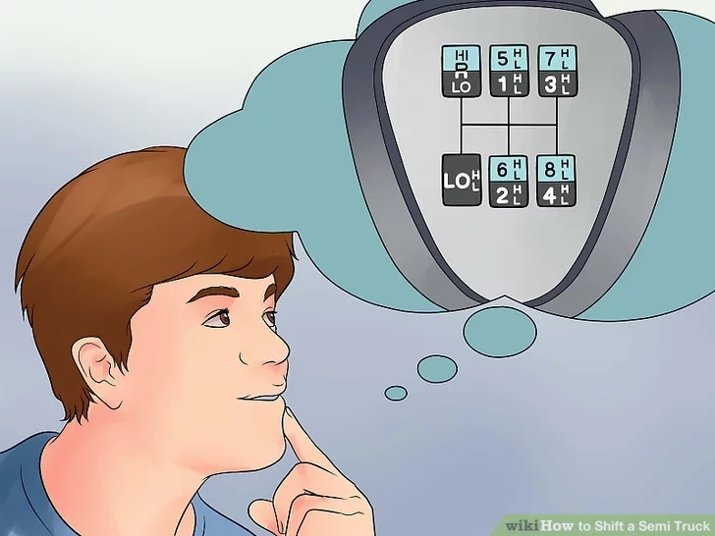
Shifting/Operating Transmissions
B
A
B→A
Not Relevant for Transit, Still Must Learn

Slide 103
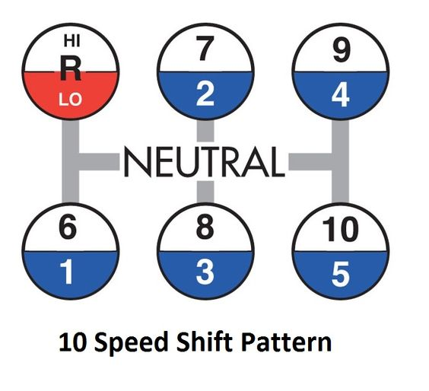
Shifting/Operating Transmissions
B
A
B→A
Not Relevant for Transit, Still Must Learn

Slide 104
Unit 1.6 Backing and Docking
B
A
B→A
This unit satisfies FMCSA’s ELDT requirements for units A1.1.6, BA1.1.6, and B1.1.6.

Slide 105
Parking Lots
B
A
B→A
Use extra caution in parking lots.
  Often, other drivers disregard the common rules of the road when in parking lots.
  Proceed slowly, scan around your vehicle, and be ready to sound horn.
When parking, leave yourself an out.

Slide 106
Docking
B
A
B→A
G.O.A.L. = Get Out And Look
Always have a good look at the docking area and the surrounding area before setting up to commence backing up.
Look for obstacles, especially things that are below the site line. These things will most likely not be visible in the mirrors, once the driver starts to back up.

Slide 107
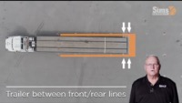
Docking — Alley Docking (Now Referred to as Backing in the CDL Manual
B
A
B→A
Video: Alley Docking. Sims University—2:19 minutes

Slide 108
Docking
B
A
B→A
Setting up for a dock is an important skill for new drivers
Positioning the truck correctly is essential to successful alley docking.*
If the truck isn’t positioned correctly, it can be nearly impossible to do a 45 degree back up maneuver, and the risk of incurring damage to equipment or property escalates!
THE MOST DIFFICULT PROFESSIONAL DRIVER SKILL – BACKING UP THE TRUCK
*The CDL manual now refers to alley docking as backing.

Slide 109
Docking
B
A
B→A
Three rules to consider when preparing to alley dock*
  Exit the truck to look multiple times
  Ask for parked cars or obstacles to be moved.
  Refuse to back into an impossible setting.
Don’t let pride and embarrassment get in the way.
  It’s not easier to try it without following the rules.
  If you mess up and hit something, the scars on your driving record which is bad news.
  They could save you from worse embarrassment if you rip the bumper off a car or tear the front end off an expensive rig!
*The CDL manual now refers to alley docking as backing.

Slide 110
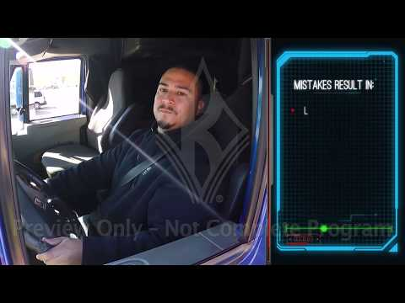
Types of Backing Set-ups
B
A
B→A
Video: Driver Training Series: Backing Techniques. J. J. Keller & Associates, Inc.—8:47 minutes

Slide 111
Backing & Docking
B
A
B→A
Backing the vehicle can be very dangerous and should only done when absolutely necessary.
If you must back:
  If possible, get out of the vehicle to assess any hazards/obstacles. G.O.A.L. = Get Out And Look!
  Use an adult spotter to alert you to possible hazards
  Check carefully in all directions, including the rear
  Turn on four-way flashers
  Honk the horn in short continuous beeps while in motion
Mirrors and a spotter do not relieve you of the responsibility to back the vehicle safely. Backing up should only be done if there is no alternative.
If possible, pull through and use the forward stall when parking, this will prevent you from having to back up when you leave.
Source: National RTAP. Safety Training and Rural Transit Training Module

Slide 112
Using a Spotter to Back Up
B
A
B→A
The driver and the spotter should discuss the proposed maneuver before the driver begins and use highly visible and obvious hand signals at all times. Hand signals should be agreed upon prior to the commencement of the maneuver.
The spotter should maintain eye contact with the driver’s eyes in the mirror even if this requires changing position frequently.
The spotter should continue to signal even when the driver’s maneuver is unchanging or proceeding normally. Don’t signal just when something different needs to happen or when the driver needs to stop.
If the spotter needs to stop spotting momentarily for any reason, make sure the driver stops the vehicle. Resume the maneuver only after spotting is resumed.
Maintain a safe distance or position from the vehicle while spotting and make sure there aren’t any obstructions to your walking path prior to beginning the maneuver.

Slide 113
Using a Spotter to Back Up
B
A
B→A
Use hand signals, not verbal signals. However, in an emergency the spotter may supplement hand signals with a verbal warning.
If the driver is unclear at any point about the spotter’s signals the vehicle should be stopped immediately. Resume the maneuver when the driver and spotter have clarified the signals.
The vehicle should be stopped while the driver is looking away from the spotter for any reason including checking the other mirror.
When spotting, concentrate on spotting, not talking to someone in the vicinity.

Slide 114
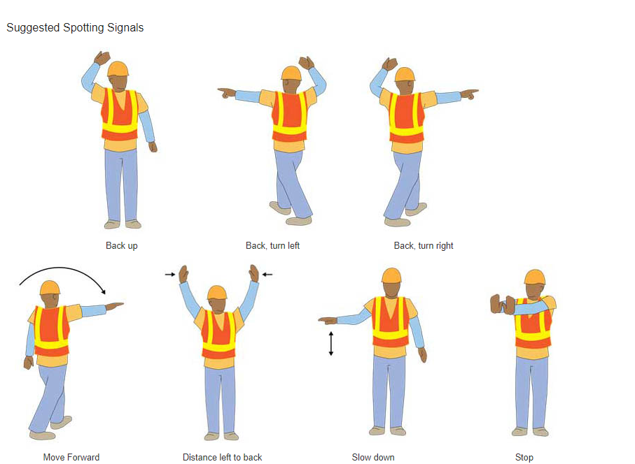
Using a Spotter to Back Up
B
A
B→A
OSHA Suggested Spotting Signals

Slide 115
Skid Control/Recovery, Jackknifing, & Other Emergencies
B
A
B→A
How to respond to brake failure due to loss of hydraulic pressure:
When the system will not build up pressure, the brake pedal will feel spongy or go to the floor. Actions you can try:
  Downshift – A lower gear will help to slow the vehicle.
  Pump the brakes – This may generate enough hydraulic pressure to stop the vehicle.
  Use the parking brake – The parking or emergency brake is separate from the hydraulic brake system. Therefore, it can be used to slow the vehicle. However, be sure to press the release button or pull the release lever at the same time you use the emergency brake so you can adjust the brake pressure and keep the wheels from locking up.

Slide 116
Skid Control/Recovery, Jackknifing, & Other Emergencies
B
A
B→A
Find an Escape Route
While slowing the vehicle, look for an escape route — an open field, side street or escape ramp. Turning uphill is a good way to slow and stop the vehicle. Make sure the vehicle does not start rolling backward after you stop. Put it in low gear, apply the parking brake and, if necessary, roll back into some obstacle that will stop the vehicle.

Slide 117
Unit 1.7 Coupling and Uncoupling
A
B→A
Not Relevant for Transit, Still Must Learn
This unit satisfies FMCSA’s ELDT requirements for units A1.1.7 and BA1.1.7.

Slide 118
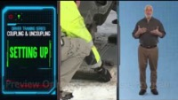
Coupling & Uncoupling
A
B→A
Not Relevant for Transit, Still Must Learn
Video: Coupling & Uncoupling: Driver Training Series. J. J. Keller & Associates, Inc.—7:12 minutes

Slide 119
B
A
B→A
Section 2: Safe Operating Procedures

Slide 120
Unit 2.1 Visual Search
B
A
B→A
This unit satisfies FMCSA’s ELDT requirements for units A1.2.1, BA1.2.1, and B1.2.1

Slide 121
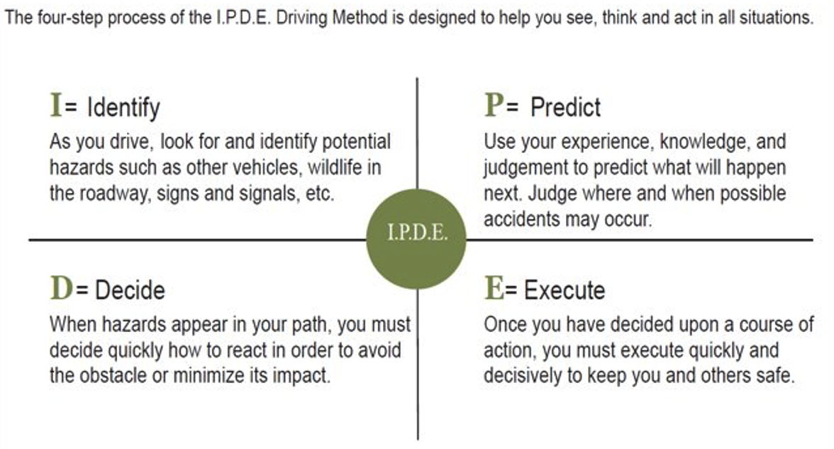
IPDE Method
B
A
B→A
Source: National RTAP. Safety Training and Rural Transit Training Module

Slide 122
Visual Search
B
A
B→A
Pedestrians
When driving, it is important to remember that you’re sharing the road. Tips to raise your awareness of pedestrians:
Watch for children dashing out into traffic: Cover the brake, drive slowly, and be ready to stop
Yield to pedestrians at marked and unmarked crosswalks: On multi-lane roadways, if you come too close to a pedestrian, you may block the next driver from seeing the pedestrian and he/she is crossing the roadway.
Don’t pass vehicles stopped at crosswalks: and be prepared to stop for pedestrians who are walking in marked on unmarked crosswalks
Source: National RTAP| Information taken directly from “Sharing the Road with Pedestrians: A Guide for Motorists and Pedestrians” © 2011 Arizona DOT, created by Pima County (AZ) Bicycle and Pedestrian Program, Matthew Zoll, Program Manager.

Slide 123
Visual Search
B
A
B→A
Pedestrians (continued)
Yield to pedestrians when making turns:
  Left turns: scan the cross-walk before turning and be aware that your windshield may partially block your view
  Right turns: Where allowed, only make a right turn on red after coming to a complete stop.
Exit driveways slowly and carefully: Expect pedestrians on the sidewalk, especially near schools, commercial areas, and neighborhoods.
Watch for pedestrians along the roadway: This is especially important if you are driving on a street with no sidewalks
Source: National RTAP| Information taken directly from “Sharing the Road with Pedestrians: A Guide for Motorists and Pedestrians” © 2011 Arizona DOT, created by Pima County (AZ) Bicycle and Pedestrian Program, Matthew Zoll, Program Manager.

Slide 124
Visual Search
B
A
B→A
Pedestrians (continued)
Yield to pedestrians in parking lots: Remember that your vehicle can do a lot of damage even only at 5mph.
Obey signals at a pedestrian hybrid beacon: These signals remain off until a pedestrian presses a button. Flashing or solid yellow means prepare to stop, followed by a solid red meaning stop. Flashing red means stop or remain stopped until the pedestrian has crossed the street.
Laws vary from state to state, so make sure you’re familiar with local laws about pedestrian safety.
Source: National RTAP| Information taken directly from “Sharing the Road with Pedestrians: A Guide for Motorists and Pedestrians” © 2011 Arizona DOT, created by Pima County (AZ) Bicycle and Pedestrian Program, Matthew Zoll, Program Manager.

Slide 125
Visual Search
B
A
B→A
Sharing the Road with Bicyclists
Bicyclists have the right to ride in the street (the extent varies by state), even with no marked bike lanes
Bicyclists tend to position themselves to the right of the faster moving traffic, which means they constantly cross paths with buses pulling over to make stops.
You shouldn’t drive in bike lanes, unless you are pulling into a service area or making a turn. In both situations, always use your turn signal and check your mirrors. If there is a cyclist riding parallel to you, slow down to let him/her get ahead of the bus before you pull over.
Source: National RTAP, information taken directly from “Share the Road — Buses and Bicycles” video by Chicago Transit Authority and Chicago DOT.

Slide 126
Visual Search
B
A
B→A
Sharing the Road with Bicyclists
You shouldn’t drive in bike lanes, unless you are pulling into a service area or making a turn. In both situations, always use your turn signal and check your mirrors. If there is a cyclist riding parallel to you, slow down to let him/her get ahead of the bus before you pull over.
Even when car traffic backs up, bicyclists usually still have a clear path and can be traveling quickly.
When passing a cyclist, travel at a steady speed and remain at least 3 feet away from the cyclist, more if traffic allows. If there is not enough room to pass, slow down until it is safe.
Source: National RTAP, information taken directly from “Share the Road — Buses and Bicycles” video by Chicago Transit Authority and Chicago DOT.

Slide 127
Visual Search
B
A
B→A
Sharing the Road with Bicyclists
At intersections, yield to merging cyclists when the bike lane ends and watch for cyclists that move to wait at the front of the line of traffic during a red light.
When making a left turn, oncoming traffic can hide cyclists. Once oncoming traffic clears, pause before turning to ensure there are no cyclists in your path.
Check sidewalks for children on bicycles.
Always assume a cyclist could be there and check!
Bicycling laws vary from state to state so check your local laws.
Source: National RTAP, information taken directly from “Share the Road — Buses and Bicycles” video by Chicago Transit Authority and Chicago DOT.

Slide 128
#3 Keep your Eyes Moving ®
B
A
B→A
Peripheral vision is 180°
Central cone vision is 3°
Blank and fixed stares
Keep your eyes moving every 2 seconds

Slide 129
#3 Keep your Eyes Moving ®
B
A
B→A
Don’t fixate
Scan the entire area
Don’t forget the front, sides and top
Back slowly

Slide 130
Personal Safety for Truck Drivers
B
A
B→A
Not Relevant for Transit, Still Must Learn
Be aware of your surroundings, especially at night. Stick to well-lit areas and plan your routine to limit the time you spend outside your truck when it is dark outside.
Keep your cell phone charged and with you, so you may call for help.
Drive slowly so you can easily stop if someone gets in your path.
Avoid parking on the ends of rows, where it tends to have more moving traffic and where tired drivers who may not see you are likely to park.
Park near other trucks because there is safety in numbers.
Inspect your truck before you move out. Walk around your vehicle before leaving the truck stop to be sure no one has tampered with your truck when you were away from it.
Secure your load and don’t talk about what you are hauling in public. This helps keep your cargo safe and secure. Use a padlock on the door or rachet strap to secure cargo.

Slide 131
Personal Safety for Truck Drivers
B
A
B→A
Not Relevant for Transit, Still Must Learn
Do your research ahead of time. Check truck stop reviews. Select stops that take extra security measures, such as using security cameras or hiring overnight security guards. Be aware that in some states overnight and extended stays are illegal at rest stops.
Protect yourself. Check the rules of carrier for what weapons and safety tools can be used. Pepper spray and even a heavy-duty flashlight can come in handy.
Lock your doors, when you step away from the vehicle AND when you are inside. Keep blinds closed to keep you and your possessions out of sight.
Follow social distancing recommendations and health precautions.
Shipper/Receiver locations: Contact the shipping or delivery location ahead of time to get the most current and timely conditions and ask about any safety issues in the area that might be present. If you are stopped by a crowd or protest, stay in the truck and safely keep moving, slowly. Call 911 for help. You have every right to assume people assaulting you in your vehicle present a danger.

Slide 132
Unit 2.2 Communication
B
A
B→A
This unit satisfies FMCSA’s ELDT requirements for units A1.2.2, BA1.2.2, and B1.2.2

Slide 133
Communication
B
A
B→A
Other drivers can’t know what you are going to do until you tell them.
Turn Signals — Rules for Using Them
Signal early
Signal continuously
Cancel your signal
Lane Changes
Put your turn signal on before lane changes.
Change lanes slowly and smoothly
Slowing Down
Warn drivers when you need to slow down. Light taps on the brake pedal should warn drivers. If you’re driving very slowly or stopped, use emergency four-way flashers

Slide 134
Communication
B
A
B→A
When to Warn Other Drivers
Trouble Ahead: The size of your vehicle may make it hard for drivers behind you to see hazards ahead. If you see a hazard that will require slowing down, warn the drivers behind by flashing your brake lights.
Tight Turns: brake early and slow gradually so other drivers know you’re about to turn.
Stopping on the Road: warn others by flashing your brake lights. Don’t stop suddenly.
Driving Slowly: Alert drivers with your emergency flashers if you need to drive very slowly.

Slide 135
Communication
B
A
B→A
Use Your Horn When Needed. Your horn can let others know you’re there. It can help to avoid a crash. Use your horn when needed. However, it can startle others and could be dangerous when used unnecessarily.
Proper use of headlights
Do not “flash” your high beam lights at oncoming traffic because it can blind the oncoming driver and increases the chance of an accident.
Use low-beam headlights when it is cloudy, raining, snowing, or foggy.
It is a good idea to drive with your headlights on, even on sunny days. This will help other drivers see you.
Use your hazard lights (also called emergency flashers) to show a hazard or collision is ahead or if you are having trouble with your vehicle.

Slide 136
Communication
B
A
B→A
Proper use of eye contact.
When Confronted by an Aggressive Driver: Avoid direct eye contact.
Make eye contact with pedestrians and bicyclists to indicate that you see them. This does not guarantee that they see you. Always be prepared to for them to do the unexpected and be prepared to stop.

Slide 137
Unit 2.3 Distracted Driving
P
B
A
B→A
This unit satisfies FMCSA’s ELDT requirements for units A1.2.3, BA1.2.3, B1.2.3, and C1.13

Slide 138
Distracted Driving
P
B
A
B→A
FMCSRs prohibit the use of cellphones and texting while driving
The rule applies to interstate truck and bus drivers and drivers who transport placardable quantities of hazardous materials.
What’s prohibited:
Texting, defined as entering alphanumeric text into, or reading text from, an electronic device. This includes, but is not limited to, short message service, e-mailing, instant messaging, a command or request to access a Web page, or pressing more than a single button to initiate or terminate a voice communication using a mobile phone or engaging in any other form of electronic text retrieval or entry, for present or future communication.

Slide 139
Distracted Driving
P
B
A
B→A
FMCSRs prohibit the use of cellphones and texting while driving
This rule restricts a CMV driver from reaching for or holding a mobile phone to conduct a voice communication, as well as dialing by pressing more than a single button. CMV drivers who use a mobile phone while driving can only operate a hands-free phone located in close proximity.

Slide 140
Distracted Driving
P
B
A
B→A
What happens if a driver is caught using a hand-held phone or texting while driving?
The rule imposes sanctions for driver offenses, including civil penalties up to $2,750 and driver disqualification for multiple offenses. Motor carriers are also prohibited from requiring or allowing their drivers to text or use a hand-held mobile phone while driving and may be subject to civil penalties up to $11,000. Violations will impact SMS results. Texting and calling on a hand-held phone carry the maximum violation severity weighting.

Slide 141
Distracted Driving
P
B
A
B→A
Types of Distractions
Visual Distractions: Takes eyes off the road
Manual Distractions: Takes hands off the wheel
Cognitive Distractions: Takes mind away from safe operation
Simply put…
Anything that takes your eyes off the road is a distraction.

Slide 142
Distracted Driving
P
B
A
B→A
Self-Created Distractions
Texting
Speaking on your cell phone
Adjusting seat positions while driving
Adjusting climate controls
Adjusting interior mirrors
Using vehicle mirrors for personal grooming
Eating and/or drinking
Singing with the radio, CD, or other audio

Slide 143
Distracted Driving
P
B
A
B→A
Company Created Distractions:
Communication radios
  Does your company require you to respond to dispatch while you are driving?
Cell phones, if your company uses them in place of standard communications equipment
Fare boxes
Destination signs

Slide 144
Distracted Driving
P
B
A
B→A
Distractions created outside of your vehicle:
Operating at high speed
Calculating speeds and distances
Responding to other drivers and obstacles
Pedestrians
Bicyclists
Looking for addresses

Slide 145
P
B
A
B→A
Why is this important?

Slide 146
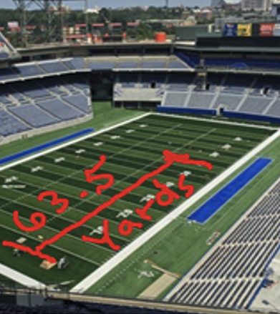
Distracted Driving
P
B
A
B→A
If you take your eyes off the road for 2 seconds at 65 mph
Traveling at 95.33 feet per second for two seconds means you travelled
  190.66 feet
  63.5 yards
  Nearly two-thirds length of a football field

Slide 147
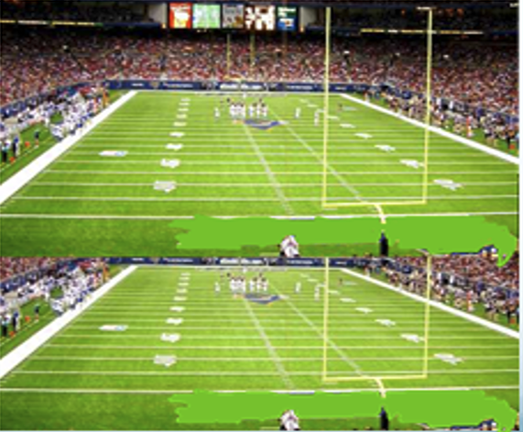
Distracted Driving
P
B
A
B→A
Sending or reading a text takes your eyes away from the road on average 4.6 seconds’
At 65 mph you will have driven the length of 1.2 football fields, BLIND!

Slide 148
Distracted Driving
P
B
A
B→A
When you take one hand off the wheel to:
  Use the two-way radio, cell phone or other on-board equipment (GPS, farebox)
  Adjust the mirror, seat, or climate control
  Secure items in the vehicle
  Eat or drink
You have GREATLY reduced your response time to anything that happens outside of your vehicle.

Slide 149
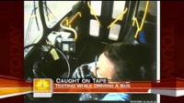
Distracted Driving
P
B
A
B→A
Let’s see what can happen in 5 seconds
Video: Texting While Driving Caught on Tape. Today Show—2:27 minutes

Slide 150
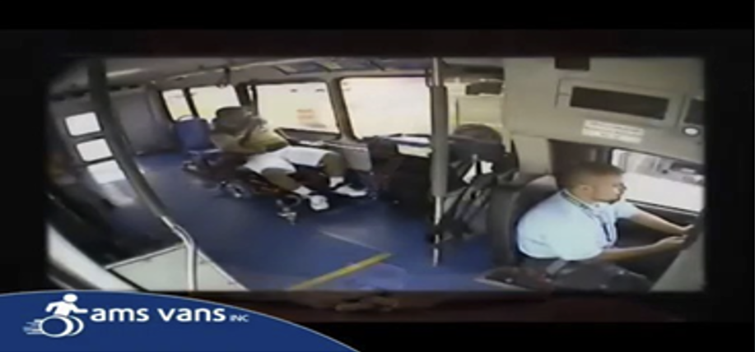
Distracted Driving
P
B
A
B→A
Here’s what the driver was doing:

Slide 151
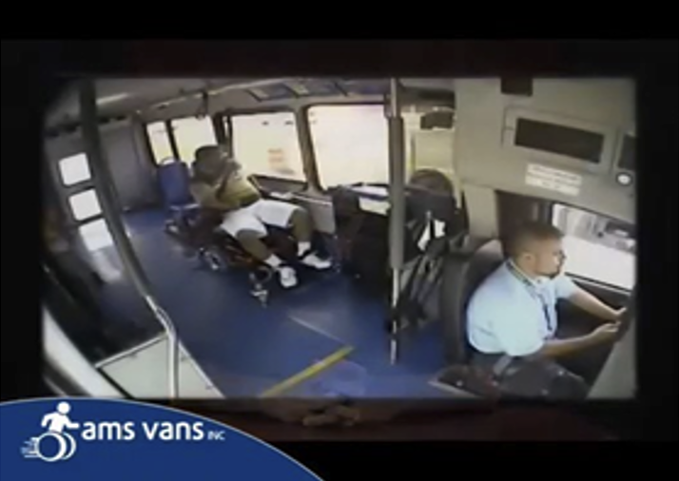
Distracted Driving
P
B
A
B→A
Look closely, notice the driver has
  One hand on the wheel
  And the other hand
  and his eyes on his cell phone

Slide 152
Defensive Driving
P
B
A
B→A
Defensive Driving is driving to save lives, time, and money despite the conditions around you and the actions of others

Slide 153
Defensive Driving
P
B
A
B→A
Making safe and legal driving decisions
Creating a safe, stress-free environment around your vehicle
Driving to your destination safely without a ticket, crash, or affecting others’ safety
Practicing common sense, courtesy, and cooperation
Recognizing the risks of hazardous driving behaviors and conditions

Slide 154
The Five Keys
P
B
A
B→A
Aim high in steering.
Get the big picture.
Keep your eyes moving.
Leave yourself an out.
Make sure they see you.

Slide 155
Distracted Driving
P
B
A
B→A
What is distracted driving?
Any activity that could divert a person’s attention away from the primary task of driving. The three types of distractions are manual (taking your hands off the wheel), visual (taking your eyes off the road), and cognitive (taking your mind off driving). All distractions endanger passenger, driver, and bystander safety.
Distractions include:
  Texting, using a cell phone or smart phone
  Eating or drinking
  Talking to passengers
  Grooming
  Reading, including maps
  Using a navigation system
  Watching a video
  Adjusting music or audio, on the radio or another device
Make sure you are aware of your company’s policies regarding communication devices.
Source: US DOT National Highway Safety Administration Distraction Website

Slide 156
Defensive Driving
P
B
A
B→A
  Act in time
  Always stay alert, focus on the driving task so you don’t lose response time.
  Choose the safest driving maneuver to avoid a crash.
  Remember: other drivers may act in time, but they may act incorrectly.
Notes:
156
Act in Time.
Always stay alert, focus on the driving task so you don’t lose response time.
Choose the safest driving maneuver to avoid a crash.
Remember other drivers may act in time, but they may act incorrectly.

Slide 157
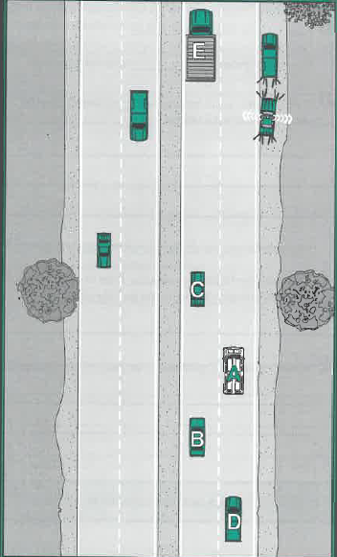
Defensive Driving
P
B
A
B→A
If you were the driver of “A” in this situation, how would you handle this situation?

Slide 158
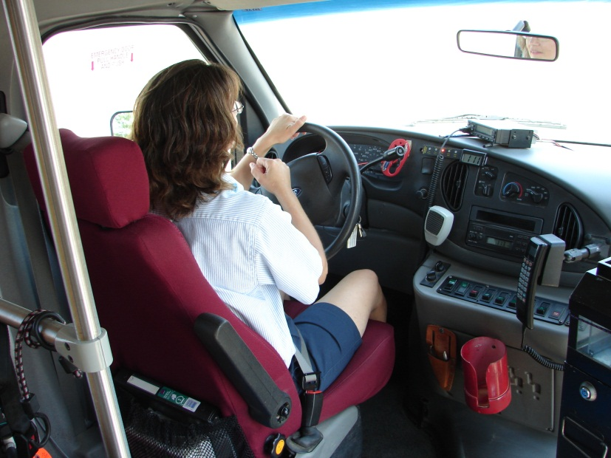
Defensive Driving
P
B
A
B→A
Avoid backing your vehicle
4-second following distance
Don’t rush
Maintain a “cushion of safety”
Be aware of your surroundings

Slide 159
Distracted Driving
P
B
A
B→A
It is a MYTH that we can multi-task
All brains focus in the same way
We can shift our attention quickly, but we cannot pay attention to more than one thing at a time
More than divided, our attention is diverted.

Slide 160
Unit 2.4 Speed Management
B
A
B→A
This unit satisfies FMCSA’s ELDT requirements for units A1.2.4, BA1.2.4, and B1.2.4

Slide 161
Speed Management
B
A
B→A
Total braking distance is a combination of the following:
Perception Distance: How far your vehicle travels from the time your eyes see a hazard until your brain recognizes it.
Reaction Distance: The distance traveled from the time your brain recognizes the hazard and your foot pushes the brake pedal.
Braking Distance: The distance required to stop the vehicle once brakes are applied
Speeding reduces your ability to steer safely around curves or obstacles, extends the necessary stopping distance, and increases the distance your vehicle travels while you react to the situation.
Source: National RTAP. Safety Training and Rural Transit Training Module

Slide 162
Speed Management
B
A
B→A
Note that braking distance increases with air brakes, due to the lag time for brakes to activate. Factors such as weather, visibility and road conditions can also increase braking distance.
Calculating Reaction Distance
To calculate reaction distance, take the first digit of the speed of your vehicle plus the total speed.
Example: 25 mph + 2 + 27 feet reaction distance.
Add braking distance to calculate stopping distance from moment of reaction until the vehicle is stopped.
Source: National RTAP. Safety Training and Rural Transit Training Module

Slide 163
Speed Management
B
A
B→A
When traveling behind another vehicle, keep speed at a level that allows for safe stopping. While there are rules of thumb regarding following distance, what is safe will depend upon the driver, the vehicle, weather conditions, road conditions, traffic conditions, and speed of travel.
How much space do you need?
One second of space for each 10 feet of vehicle (below 40 mph)
Add one second for speeds greater than 40mph
Example: (For a 30 ft bus in slower city traffic): 3 seconds between you and the vehicle in front of you
Example: (for a 30 ft bus on an interstate) 4 second minimum between you and the vehicle in front of you.
Source: National RTAP. Safety Training and Rural Transit Training Module

Slide 164
Speed Management
B
A
B→A
The 1,000 and 4 Rule
When the vehicle ahead passes a fixed point, like a sign, tree, or pole, begin counting “one thousand one, one thousand two, one thousand three, one thousand four.” If you pass the same point before reaching “one thousand four,” you are following too closely.
Source: National RTAP. Safety Training and Rural Transit Training Module

Slide 165
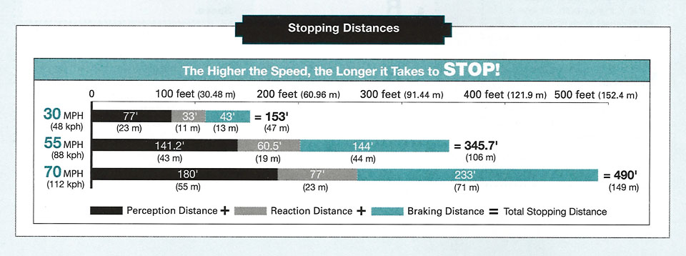
Stopping Distances
B
A
B→A
The Higher the Speed, the Longer it Takes to STOP!
Notes:
165
The Higher the Speed, the Longer it Takes to STOP!

Slide 166

Speeding
B
A
B→A
Contributing factor in fatal crashes.
#1 unsafe driving behavior that
contributes to violations and crashes.
Most common driving error:
Exceeding the posted speed limit or
driving at an unsafe speed
  Costs nearly $41 billion annually.
Notes:
166
Contributing factor in fatal crashes.
#1 unsafe driving behavior that contributes to violations and crashes.
Exceeding the posted speed limit or driving at an unsafe speed was the most common driving error and it costs nearly $41 billion annually.

Slide 167
Determining the Safest Driving Speed
B
A
B→A
Know the speed limit.
Assess the driving conditions.
  The legal and posted speed limit may still be too fast.
  Adjust your vehicle speed to the conditions that require a slower and safe speed.
Notes:
167
Know the speed limit.
Assess the driving conditions.
The legal and posted speed limit may still be too fast.
Adjust your vehicle speed to the conditions that require a slower and safe speed.

Slide 168
Determining the Safest Driving Speeded
B
A
B→A
For every 10mph over 50 mph, the risk of death
in a traffic crash is doubled.
You may be required to reduce your speed
in many driving situations, including weather conditions
Increasing speed decreases your field of vision and puts you at greater risk of being involved in a crash.
Notes:
168
For every 10 miles per hour over 50 miles and hour, the risk of death in a traffic crash is doubled.
Review the chart.

Slide 169
Determining the Safest Driving Speeded
B
A
B→A
Minnesota’s basic speed law requires you to drive at a speed no faster than is reasonable under existing conditions. These include weather, traffic, and road conditions.
Driving faster than the posted speed limit is illegal.
  The posted speed limit is the maximum speed permitted on that particular road.
  The speed limit on two-lane highways with a posted speed limit of 55 mph or higher is increased by 10 mph when the driver is lawfully passing another vehicle in the same direction.
Minimum speed limits may be posted on some roads.
  It is illegal to drive slower than the posted minimum speed under normal weather, traffic, and road conditions.
Note: If you approach an intersection at an unlawful speed, you lose the right-of-way privilege associated with driving at a lawful speed.

Slide 170
Unit 2.5 Space Management
B
A
B→A
This unit satisfies FMCSA’s ELDT requirements for units A1.2.5, BA1.2.5, and B1.2.5

Slide 171
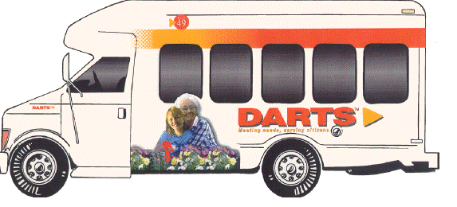
#4 Leave Yourself an Out ®
B
A
B→A
Think “space” when pulling up to a car in front of you or selecting a parking/backing environment

Slide 172
Stopping Distances
B
A
B→A
The Higher the Speed, the Longer it Takes to STOP!
Notes:
172
The Higher the Speed, the Longer it Takes to STOP!

Slide 173
Right of Way
B
A
B→A
“Nobody ever yielded their way into a collision.”
It is not about who has the right of way.
It is about who shall yield the right of way.
Notes:
173
It is not about who has the right of way.
It is about who shall yield the right of way.

Slide 174
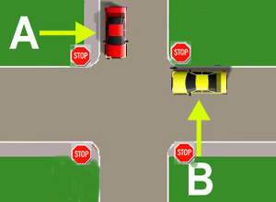
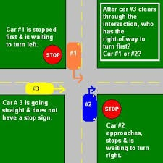
Right of Way
B
A
B→A

Slide 175
Right of Way & Yielding
B
A
B→A
Right-of-way and yielding laws help traffic flow smoothly and safely. They are based on courtesy and common sense. Violation of these laws is a leading cause of traffic crashes.
Drivers in the right lane must yield to transit buses attempting to merge from a bus stop or shoulder.
Two vehicles reach an intersection at the same time and… | The rule is…
No traffic light or signal to control the intersection | Driver on left yields to vehicle on right
All-way stop signs or flashing red lights control the intersection | Driver on left yields to vehicle on right
Notes:
When two vehicles reach an intersection at the same time, and there is no traffic light or signal: the driver of the vehicle on the left must yield to the vehicle on the right.
When two vehicles reach an intersection at the same time, and all-way stop signs or flashing red traffic lights control the intersection, the driver on the left must yield right of way to the driver on the right
Drivers in the right lane of traffic must yield right of way to transit and metro mobility buses attempting to merge from a bus stop or shoulder.
This includes yielding the right of way to any school bus attempting to enter that lane from a shoulder, a right-turn lane, or other location where the school bus has stopped to load or unload passengers. The school bus must use the left turn signal to indicate intent to move into the right-hand lane of traffic.

Slide 176
Right of Way
B
A
B→A
A majority of urban crashes occur at intersections.
Intersection crashes in rural areas, although less common are often more serious because speed limits are higher.
Right-of-way violations are related to more injuries than any other improper driving behavior.
Notes:
176
A good majority of urban crashes occur at intersections.
Intersection crashes in rural areas, although less common are often more serious because speed limits are higher.
Right-of-way violations are related to more injuries than any other improper driving behavior.

Slide 177
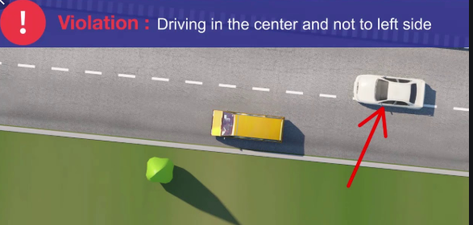
Driving Left of Center
B
A
B→A
Only pass in the left lane when it is clearly visible and is free of oncoming traffic for the space needed to completely pass.
The center of the road is the center of the road, whether or not it’s marked
Notes:
Original first point: No vehicle shall be driven to the left side of the center of the roadway in overtaking and passing another vehicle proceeding in the same direction unless such left side is clearly visible and is free of oncoming traffic for a sufficient distance ahead to permit such overtaking and passing to be completely made ...

Slide 178
Tailgating
B
A
B→A
Final unsafe driving behavior that results in many crashes and violations.
Biggest hazard is a rear-end collision.
Ability to stop depends on vehicle weight, speed, road surface, driver and weather conditions.
Notes:
178
Final unsafe driving behavior that results in many crashes and violations.
Biggest hazard is a rear-end collision.
Ability to stop depends on vehicle weight, speed, road surface, driver and weather conditions.

Slide 179
Distracted Driving
B
A
B→A
What to do with a tailgater? Stay Calm.
Continue driving the speed limit and obey traffic laws
Be extra cautious if you need to brake
Get safely out of the way – signal and change lanes if on a multi-lane road
Drive at a comfortable, do not be pressured to drive outside of your comfort zone. That’s simply swapping one unsafe situation for another.
AVOID CONFRONTATION – Let them pass – don’t give him dirty looks and make any rude hand gestures!

Slide 180
Delayed Acceleration
B
A
B→A
You are the first vehicle at an intersection.
When the light turns green, wait two seconds before accelerating.
Never enter an intersection you cannot exit.
Wait for the intersection to clear before entering it.
Be courteous despite other drivers being in a hurry.
Notes:
180
You are the first vehicle at an intersection.
When the light turns green, wait two seconds before accelerating.

Slide 181
Unit 2.6 Night Operation
B
A
B→A
This unit satisfies FMCSA’s ELDT requirements for units A1.2.6, BA1.2.6, and B1.2.6

Slide 182
Night Operation
B
A
B→A
You are at greater risk when you drive at night due to poor lighting, glare, and other factors that increase hazard recognition time as well as driver reaction time.
Poor lighting: some areas may have bright streetlights, but many do not. On most rural roads you will probably have to depend entirely on your headlights. Less light means you will not be able to see hazards as clearly or as soon. Dirty headlights only produce a fraction of the light they should, so keep headlights clean.
Glare: You can be blinded for a short time by bright lights, and it takes time to recover. The risks are greater for drivers who visual recovery time is higher.
Source: National RTAP. Safety Training and Rural Transit Training Module

Slide 183
Night Operation
B
A
B→A
Visual Recovery Time: This is the time it takes night vision to return after encountering a bright light. Causes of increased visual recovery time include age (this increases as you get older), high blood pressure and diabetes.
Other Drivers: There is an increased number of tired and intoxicated drivers on the road at night. Recognition and reaction time are both slowed by exhaustion and intoxication.
Windshield and Mirrors: Bright lights refract off dirt on windshields and mirrors creating glare, so it is particularly important at night to have clean windshields and mirrors.
Source: National RTAP. Safety Training and Rural Transit Training Module

Slide 184
Night Operation
B
A
B→A
Headlights: You should turn lights on approximately one hour before it gets dark and leave them on until the sun has risen above the horizon and the lights can no longer be seen on the road surface.
Consult with your agency find out what local laws or agency policies regarding headlight use apply.
At night, low beams allow you to see about 250 ft ahead of you. High beams extend your sight distance to 350-400 ft. If using high beams, dim within 1,000 feet of other vehicles. Defensive driving indicates that you adjust your speed to keep stopping distance within your sight distance. If a vehicle approaches with its high beam lights on, look towards the edge of the road on your right. Do not flash your bright lights at the drivers as it temporarily impairs their ability to see the road and your vehicle.
Source: National RTAP. Safety Training and Rural Transit Training Module

Slide 185
Night Operation
B
A
B→A
If your lights fail:
  Try high and low beams (one may work)
  Pull safely off the roadway and inform your passengers
  Set up the emergency warning equipment (triangles, flares)
  Call the dispatcher for further instructions
Turn signals and brake lights: at night your turn signals and brake lights are even more important for communicating with other drivers. Make sure you have clean, working turn signals, brake lights, taillights, clearance lights and reflectors.
Source:National RTAP.Safety Training and Rural Transit Training Module

Slide 186
Night Operation
B
A
B→A
Good vision is critical for safe driving
Can’t see hazards as quickly at night – increasing response time and chance of crashes
Regular eye checkups are important: you can’t fix what you don’t know
It’s illegal not to wear corrective lenses if its on your license
Avoid tinted lenses at night
Look at the right side of the road/side lines when someone with bright lights on approaches to avoid being blinded. Two seconds of blindness can be dangerous at 55 mph.

Slide 187
Night Operation
B
A
B→A
Fatigue negatively impacts vision and judgement
Fatigue is physical or mental tiredness that can be caused by physical or mental strain, repetitive tasks, illness or lack of sleep
Drivers may experience short bursts of sleep lasting only a few seconds or fall asleep for longer periods of time
Crashes tend to occur when sleepiness is more pronounced
Most people are less alert at night
If you are tired, the only safe cure is sleep

Slide 188
Night Operation
B
A
B→A
Night Driving Procedures Pre-trip* Procedures
Be rested and alert
Clean and unscratched glasses, no sunglasses
During pre-trip*: Clean lights and reflectors you can reach
Dim lights
  Oncoming vehicle: within 1,000 feet
  Following vehicle: 200 feet
Do not flash your brights/high beams at those who have theirs on, it increases chance of crash by blinding oncoming driver
Use high beams when safe and legal
Bright cab makes is harder to see outside.
Adjust interior lights & instrument lights
*The CDL Manual now refers to pre-trip inspection as vehicle inspection

Slide 189
Unit 2.7 Extreme Driving Conditions
B
A
B→A
This unit satisfies FMCSA’s ELDT requirements for units A1.2.7, BA1.2.7, and B1.2.7

Slide 190
Extreme Driving Conditions
B
A
B→A
Fog can occur any time, be unexpected, and deteriorate visibility rapidly – avoid driving
If you must drive through it consider:
  Obey fog-related warning signs
  Slow down before entering
  Use low-beams and fog lights, even in daytime
  Be alert for those who may have forgotten to turn on their lights
  Turn on 4-way flashers so vehicles behind you can notice your vehicle
  Watch for vehicles on side of the road
  Taillights and headlines may not be the true indication of where the road is
  Use roadside reflectors as guides to determine how the road curves
  Listen for traffic you can’t see
  Avoid passing other vehicles
  Don’t stop along the side of the road unless necessary

Slide 191
Extreme Driving Conditions
B
A
B→A
Adverse Conditions and Reduced Visibility
Dust, smoke, fog, rain, and snow can all reduce visibility while driving. If you find yourself in this situation, keep the following in mind:
Slow down
Turn on your lights
User your low beans. High beams reflecting off snow, rain or dust tend to reduce visibility
Increase following distance to two or three times that of normal driving conditions
Avoid stopping in or alongside the roadway in dense fog, smoke, or snow; this could result in a serious rear-end collision from traffic behind you. If you must stop, turn off your lights, so you do not lead other cars off the road.
Source: National RTAP. Safety Training and Rural Transit Training Module

Slide 192
Extreme Driving Conditions
B
A
B→A
Driving Through Water
Avoid driving through water if at all possible. If you are unable to avoid driving through deep puddles or flowing water, you should:
Slow down
Place transmission in low gear
Increase engine RPM and cross the water
After you exit the water, maintain light pressure on the brakes for a short distance to heat them up and dry them out
Make a test stop when safe to do so — check behind to make sure no one is following and apply the brakes to be sure they work correctly.
NEVER drive your vehicle through swiftly running water or standing pools whose depth cannot be judged. A few inches of a strong current can undermine roadbeds as well as carry your vehicle off the roadway.
Source: National RTAP. Safety Training and Rural Transit Training Module

Slide 193
Extreme Driving Conditions
B
A
B→A
Winter Driving
During the pre-trip* inspection, pay particular attention to tire tread, vehicle heating system, and on-board emergency equipment.
Increase following distance by two or three times normal
Take curves at slower speeds; brake prior to curve
Anticipate stops early and slow down gradually
Ice tends to form on shaded and elevated areas sooner and remain longer than in areas that are exposed to the sun.
Source: National RTAP. Safety Training and Rural Transit Training Module
*The CDL Manual now refers to pre-trip inspection as vehicle inspection

Slide 194
Extreme Driving Conditions
B
A
B→A
Winter Driving (continued)
Pre-trip*:
  Extra attention to coolant and antifreeze levels
  Make sure defrosters and heaters work
  Windshield Wipers
    Are in good condition and tight against the window
    Washer works and fluid is full
    If they fail while in service, stop safely and fix
  Tires have enough tread – AT LEAST
    4/32" Font
    2/32" Other
*The CDL Manual now refers to pre-trip inspection as vehicle inspection

Slide 195
Extreme Driving Conditions
B
A
B→A
Winter Driving (continued)
  Chains:
    Carry the right number of chains and extra cross-links.
    Fit your drive tires.
    Check the chains for broken hooks, worn or broken cross-links, and bent or broken side chains.
    Learn how to put the chains on before you need to do it in snow and ice.
    Note the use of tire chains are illegal in MN

Slide 196
Extreme Driving Conditions
B
A
B→A
Summer Driving
During the pre-trip* inspection pay particular attention to tire condition, vehicle cooling/ventilation system, and on-board emergency equipment
While driving, check engine temperature gauge and watch for coolant spills
In extremely hot weather:
  Inspect tires every two hours or 100 miles, whichever comes first. If tires are too hot to touch, remain stopped until tires cool down.
  Watch for “bleeding tar” that has risen to the road surface as it can make the surface more slippery
Source: National RTAP. Safety Training and Rural Transit Training Module
*The CDL Manual now refers to pre-trip inspection as vehicle inspection

Slide 197
Extreme Driving Conditions
B
A
B→A
Check Lights and Reflectors
  Check to be sure they are clean and working properly before and during drive in bad weather
Check Windows and Mirrors:
  Remove ice and snow
  Use scraper, snow brush and defroster as necessary
Check Hand holds, Steps and Deck Plates:
  Remove ice and snow to reduce danger of slipping
Check Radiator Shutters and Winter front:
  Remove ice from shutters
  Ensure winter front is not closed too tightly to prevent engine from overheating

Slide 198
Extreme Driving Conditions
B
A
B→A
Check Exhaust System
  Leaks can promote poisonous CO2 in your vehicle
  Look and listen for leaks, loose parts
Slippery Surfaces: Proceed with caution
  Drive slowly and smoothly on slippery roads
  Don’t drive if very slippery
  Start gently and slowly
  Check for ice, especially on bridges and overpasses
  A lack of spray from other vehicles is an indicator of ice on the road
  Turn gently and don’t brake in curve
  Don’t use engine brake or speed retarder
  Adjust speed for conditions, avoid passing slower vehicles
  Note: As the temperature rises to melting ice, road becomes more slippery – slow down even more!

Slide 199
Extreme Driving Conditions
B
A
B→A
Steep Grades
  Look for grade signs posted. Don’t guess at grades.
  It takes time to climb or descend grade. Don’t rush.
  Don’t make the mistake of letting the truck go at the bottom of the hill and thinking you’re in the clear.
  There could be a patch of ice on the road or an unexpected curve. Pay attention and go slow until you reach the bottom.
  When you’re ascending a grade, keep in mind it’s possible to overheat a CMV even in winter months. Keep your eye on the temperature gauge.
  If the hill is slippery, do not follow in the tracks of the vehicle ahead of you.

Slide 200
Extreme Driving Conditions
B
A
B→A
Sharp Curves
On curves – Many curves have reduced speed limits, though large trucks should often reduce their speed more than passenger cars before a curve. Hitting the brakes during a curve can result in the truck’s wheels locking and it can throw the truck into a skid. Higher speeds on curves can also trip a rollover crash.
On exit and entrance ramps – Trucks take longer to slow down than passenger cars, and the lower speed limit for on and off ramps is often too high for a semi-truck. These ramps can also have sharp curves that require a much lower speed.
Just because a driver was technically complying with the speed limit does not mean that the driver was driving at a safe speed for the conditions of the road.

Slide 201
Section 3 Advanced Operating Practices
B
A
B→A

Slide 202
Unit 3.1 Hazard Perception
B
A
B→A
This unit satisfies FMCSA’s ELDT requirements for units A1.3.1, BA1.3.1, and B1.3.1

Slide 203
Hazard Perception
B
A
B→A
A hazard is any road condition or other road user (driver, bicyclist, pedestrian) that is a possible danger. For example, a car in front of you is headed toward the freeway exit, but the car’s brake lights come on and the driver begins braking hard. This could mean that the driver is uncertain about taking the offramp. He/she might suddenly return to the highway. This car is a hazard. If the driver of the car cuts in front of you, it is no longer just a hazard; it is an emergency.

Slide 204
Hazard Perception
B
A
B→A
Seeing Hazards Lets You Be Prepared
You will have more time to act if you see hazards before they become emergencies. In the example above, you might make a lane change or slow down to prevent an accident if the car suddenly cuts in front of you. Seeing this hazard gives you time to check your mirrors and signal a lane change. Being prepared reduces the danger. A driver who did not see the hazard until the slow car pulled back on the highway in front of him/her would have to do something very suddenly. Sudden braking or a quick lane change is much more likely to lead to an accident.

Slide 205
Hazard Perception
B
A
B→A
There are often clues that will help you see hazards. The more you drive, the better you get at spotting hazards. Slow down and be very careful if you see any of the following road hazards:

Slide 206
Hazard Perception
B
A
B→A
Work zones: When people are working on the road it is a hazard. There may be narrower lanes, sharp turns or uneven surfaces. Other drivers are often distracted and drive unsafely. Workers and construction vehicles may get in the way. Drive slowly and carefully near work zones. Use your four-way flashers or brake lights to warn drivers behind you.
Drop-offs: Sometimes the pavement drops off sharply near the edge of the road. Driving too close to the edge can tilt your vehicle toward the side of the road. This can cause the top of your vehicle to hit roadside objects (signs, tree limbs, etc.). It also can be hard to steer as you cross the drop-off, whether going off the road or coming back on.

Slide 207
Hazard Perception
B
A
B→A
Foreign objects: Things that have fallen on the road can be hazards. They can be a danger to your tires and wheel rims, damage electrical and brake lines, or become caught between dual tires and cause severe damage. Some obstacles that can appear to be harmless can be very dangerous. For example, cardboard boxes may be empty, but they also may contain solid or heavy material capable of causing damage. The same is true of paper and cloth sacks. Remain alert for objects of all sorts, so you avoid them without making sudden, unsafe moves.
Offramps/onramps: Freeway and turnpike exits can be particularly dangerous for commercial vehicles. Offramps and onramps often have speed limit signs posted. Remember, these speeds may be safe for automobiles but may not be safe for larger vehicles or heavily loaded vehicles. Exits that go downhill and turn at the same time can be especially dangerous. The downgrade makes it difficult to reduce speed. Braking and turning at the same time can be a dangerous practice. Make sure you are going slow enough before you get on the curved part of an offramp or onramp.

Slide 208
Hazard Perception
B
A
B→A
Perception Distance: The distance your vehicle travels from the time you spot a hazard to the time you decide to take action.
Reaction Distance: The distance your vehicle travels as you move your foot from the accelerator to the brake pedal and begin braking. Different situations can make reaction time slower: feeling sick, aging, etc.
Braking Distance: The distance your vehicle travels after the brakes begin to take hold, until your vehicle comes to a complete stop.

Slide 209
Hazard Perception
B
A
B→A
Hazardous Drivers, Vehicles and Pedestrians
To protect yourself and others, you must know when other drivers may do something hazardous. Some clues to these types of hazards include:
People who cannot see others - Be alert for drivers whose vision is blocked. Vans, loaded station wagons and cars with the rear window blocked are examples.
Rental trucks - Drivers often are not used to the limited vision they have to the sides and rear of the truck.
Vehicles with frosted, ice-covered or snow-covered windows.
Partially hidden vehicles - Vehicles may be partly hidden by blind intersections or alleys. If you can see only the rear or front end of a vehicle but not the driver, then he/she cannot see you. Be alert because he/she may back out or enter into your lane. Always be prepared to stop

Slide 210
Hazard Perception
B
A
B→A
Delivery trucks - The driver’s vision often is blocked by packages or vehicle doors. Drivers of step vans, postal vehicles and local delivery vehicles often are in a hurry and may suddenly step out of their vehicle or drive into the traffic lane.
Parked vehicles - Parked vehicles can become hazards when passengers start to get out. Or they may suddenly start up and drive into your path. Watch for movement inside the vehicle or movement of the vehicle itself that shows people are inside. Watch for brake lights or backup lights, exhaust and other clues that a driver is about to move.
Stopped buses - Passengers may cross in front of or behind the bus, and they often cannot see you.

Slide 211
Hazard Perception
B
A
B→A
Pedestrians and bicyclists - Walkers, joggers and bicyclists may be on the road with their backs to the traffic, so they cannot see you. They also may be wearing electronic devices so they cannot hear you either. On rainy days, pedestrians may not see you because of hats or umbrellas. They may be hurrying to get out of the rain and may not pay attention to the traffic.
People who are distracted - Watch for where they are looking. If they are looking elsewhere, they cannot see you. But be alert even when they are looking at you; they may think they have the right-of-way.
Children - Children tend to act quickly without checking traffic. Children playing with one another may not look for traffic and are a serious hazard.
Talkers - Drivers or pedestrians talking to one another may not be paying close attention to the traffic.

Slide 212
Hazard Perception
B
A
B→A
Workers - People working on or near the roadway creates a distraction for other drivers, and the workers themselves may not see you.
Ice cream trucks - Children may be nearby and may not see you.
Disabled vehicles - Drivers changing a tire or fixing an engine often do not pay attention to the dangers of roadway traffic. They often are careless. Jacked-up wheels or raised hoods are hazard clues.
Accidents - People involved in the accident may not look for traffic. Passing drivers tend to look at the accident. People often run across the road without looking. Vehicles may slow down or stop suddenly.
Shoppers - People in and around shopping areas often are not watching traffic because they are looking for stores or looking into store windows.

Slide 213
Hazard Perception
B
A
B→A
Turning vehicles - Drivers signaling a turn may slow more than expected or stop. If they are making a tight turn into an alley or driveway, they may go very slow. If they are blocked by pedestrians or other vehicles, they may stop on the roadway. Vehicles turning left may stop for oncoming vehicles.
Confused drivers - Confused drivers often change direction suddenly or stop without warning. Confusion is common near freeway interchanges and major intersections. Tourists unfamiliar with the area can be very hazardous. Clues to tourists include car-top luggage and out-of-state license plates. Unexpected actions (stopping in the middle of a block, changing lanes for no apparent reason, back-up lights suddenly going on) are clues to confusion. Hesitation is another clue, including driving very slowly, using brakes often or stopping in the middle of an intersection. You also may see drivers looking at street signs, maps and house numbers. These drivers may not be paying attention to you.

Slide 214
Hazard Perception
B
A
B→A
Slow drivers - Motorists who fail to maintain normal speed are hazards. Seeing slow-moving vehicles early can prevent a crash. Some vehicles, by their nature, are slow and seeing them is a hazard clue (mopeds, farm implements, construction machinery, tractors, etc.). Some will have the Slow-Moving Vehicle symbol to warn you. Watch for a red triangle with an orange center.
Drivers in a hurry - Drivers may feel your commercial vehicle is preventing them from getting where they want to go on time. Such drivers may pass you without a safe gap in the oncoming traffic, cutting too close in front of you. Drivers entering the road may pull in front of you to avoid being stuck behind you, causing you to brake. Be aware of this and watch for drivers who are in a hurry.

Slide 215
Hazard Perception
B
A
B→A
Impaired drivers - Drivers who are sleepy, have had too much to drink, are on drugs, or are ill are hazards. Some clues to these drivers include:
  Weaving across the road or drifting from one side to another.
  Leaving the road (dropping right wheels onto the shoulder or bumping across a curb in a turn).
  Stopping at the wrong time (stopping at a green light or waiting too long at a stop).
  Open window in cold weather.
  Speeding up or slowing down suddenly, driving too fast or too slow.
  Be alert for drunk drivers and sleepy drivers late at night.

Slide 216
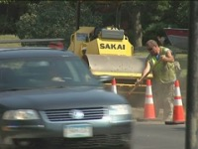
Hazard Perception
B
A
B→A
Video: Driving Through Road Construction. City of Bloomington—2:32 minutes

Slide 217
Hazard Perception
B
A
B→A
Visual Search: Check your mirrors every 3 – 5 seconds. Use the “Lean and Look” technique. Move in your seat to check your blinds spots. Your vehicle has many obstacles to look around.
You look for hazards in order to have time to plan a way out of any emergency. When you see a hazard, think about the emergencies that could develop and figure out what you would do. Always be prepared to take action based on your plans. This way, you will be a prepared, defensive driver who will improve not only your own safety but the safety of everyone on the road.

Slide 218
Unit 3.2 Skid Control/Recovery, Jackknifing, and Other Emergencies
B
A
B→A
This unit satisfies FMCSA’s ELDT requirements for units A1.3.2, BA1.3.2, and B1.3.2

Slide 219
Skid Control/Recovery, Jackknifing, & Other Emergencies
B
A
B→A
5 Ways to control an unintentional skid:
Slow down
Accelerate slowly
Brake slowly by pumping the brakes
Don’t jerk or suddenly turn the steering wheel
Look ahead and anticipate
If your vehicle starts to skid:
Ease up on the accelerator
Do not brake
Turn the steering wheel in the direction you want to go (sometimes called “turning into the skid”)
Source: National RTAP. Safety Training and Rural Transit Training Module

Slide 220
Skid Control/Recovery, Jackknifing, & Other Emergencies
B
A
B→A
A power skid occurs as a result of too much acceleration, causing the drive wheels to lose traction and spin free of the road. This usually results in fishtailing, with the rear of the vehicle sliding to one side or the other.
Braking skids occur when wheels lock up and slide along the surface of the road (often when wet or slippery). The vehicle will continue in the same direction and will not respond to steering until rolling friction is re-established. These can be unpredictable and hard to control because all four wheels are involved.
Source: National RTAP. Safety Training and Rural Transit Training Module

Slide 221
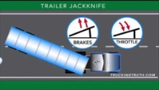
Skid Control/Recovery, Jackknifing, & Other Emergencies
B
A
B→A
Tips for getting out of a trailer jackknife:
Video: Tips for getting out of a trailer jackknife. Trucking Truth—0:31 minutes

Slide 222
Skid Control/Recovery, Jackknifing, & Other Emergencies
B
A
B→A
If your vehicle has good directional control, you will be able to keep the vehicle moving in the direction in which you steer it. This is important in preventing crashes.

Slide 223
Skid Control/Recovery, Jackknifing, & Other Emergencies
B
A
B→A
Stopping on a slippery surface: A wet road can double the stopping distance. A safe driver will reduce their speed about 1/3, from 55 to 35 on a wet road. Packed snow calls for a reduction in speed of or more and if the surface is icy a driver must reduce speed to a crawl.
Water left on the road can lead to hydroplaning. It is like water skiing. The tires lose their contact with the road and have little or no traction. An alert driver can regain control of the truck by releasing the accelerator and pushing in on the clutch. This will slow the vehicle and let the wheel turn freely. It is impossible to stop the vehicle by simply using the brake. It does not take a lot of water to hydroplane and it can happen with speeds as low as 30 MPH

Slide 224
Skid Control/Recovery, Jackknifing, & Other Emergencies
B
A
B→A
Evasive Steering helps you avoid a crash.
Stopping is not always the safest thing to do in an emergency. When you do not have enough room to stop, you may have to steer away from what is ahead. Remember, you can almost always turn to miss an obstacle more quickly than you can stop (however, top-heavy vehicles and tractors with multiple trailers may overturn).
Steering quickly: To turn quickly, you must have a firm grip on the steering wheel with both hands. A quick turn can be made safely if it is done correctly

Slide 225
Skid Control/Recovery, Jackknifing, & Other Emergencies
B
A
B→A
Evasive Steering helps you avoid a crash.
Stopping is not always the safest thing to do in an emergency. When you do not have enough room to stop, you may have to steer away from what is ahead. Remember, you can almost always turn to miss an obstacle more quickly than you can stop (however, top-heavy vehicles and tractors with multiple trailers may overturn).

Slide 226
Skid Control/Recovery, Jackknifing, & Other Emergencies
B
A
B→A
Steering quickly
To turn quickly, you must have a firm grip on the steering wheel with both hands. A quick turn can be made safely if it is done correctly
Do not apply the brakes while you are turning. It is very easy to lock your wheels while turning. If that happens, you may skid out of control.
Do not turn any more than needed to clear whatever is in your way. The more sharply you turn, the greater the chances of a skid or rollover.
Be prepared to “countersteer,” that is, to turn the wheel back in the other direction once you have passed whatever was in your path. Unless you are prepared to countersteer, you will not be able to do it quickly enough. Think of emergency steering and countersteering as two parts of one driving action.

Slide 227
Skid Control/Recovery, Jackknifing, & Other Emergencies
B
A
B→A
Where to steer
If an oncoming driver has drifted into your lane, a move to your right is best. If that driver realizes what has happened, the natural response will be to return to his/her own lane. If something is blocking your path, the best direction to steer will depend on the situation.
If you have been using your mirrors, you will know which lane is empty and can be safely used.
If the shoulder is clear, going right may be best. No one is likely to be driving on the shoulder, but someone may be passing you on the left. You will know if you have been using your mirrors.
If you are blocked on both sides, a move to the right may be best. At least you will not force anyone into an opposing traffic lane and a possible head-on collision.

Slide 228
Skid Control/Recovery, Jackknifing, & Other Emergencies
B
A
B→A
Off road recovery
In some emergencies, you may have to drive off the road. It may be less risky than facing a collision with another vehicle. Most shoulders are strong enough to support the weight of a large vehicle and, therefore, offer an available escape route. Following are guidelines if you must leave the road:
Avoid braking - If possible, avoid using the brakes until your speed has dropped to about 20 mph. Then brake very gently to avoid skidding on a loose surface.
Keep one set of wheels on pavement if possible - This helps to maintain control of the vehicle.
Stay on the shoulder - If the shoulder is clear, stay on it until your vehicle has come to a complete stop. Signal and check your mirrors before pulling back onto the road.

Slide 229
Skid Control/Recovery, Jackknifing, & Other Emergencies
B
A
B→A
Returning to the Road
If you are forced to return to the road before you can stop, use the following procedures:
Hold the wheel tightly and turn sharply enough to get right back on the road safely. Do not try to edge gradually back on the road. If you do, your tires might grab unexpectedly, and you could lose control.
When both front tires are on the paved surface, countersteer immediately. The two turns should be made as a single “steer-countersteer” move.

Slide 230
Skid Control/Recovery, Jackknifing, & Other Emergencies
B
A
B→A
How to respond to brake failure due to loss of hydraulic pressure:
When the system will not build up pressure, the brake pedal will feel spongy or go to the floor. Actions you can try:
  Downshift – A lower gear will help to slow the vehicle.
  Pump the brakes – This may generate enough hydraulic pressure to stop the vehicle.
  Use the parking brake – The parking or emergency brake is separate from the hydraulic brake system. Therefore, it can be used to slow the vehicle. However, be sure to press the release button or pull the release lever at the same time you use the emergency brake so you can adjust the brake pressure and keep the wheels from locking up.

Slide 231
Skid Control/Recovery, Jackknifing, & Other Emergencies
B
A
B→A
Find an Escape Route
While slowing the vehicle, look for an escape route — an open field, side street or escape ramp.
Turning uphill is a good way to slow and stop the vehicle. Make sure the vehicle does not start rolling backward after you stop. Put it in low gear, apply the parking brake and, if necessary, roll back into some obstacle that will stop the vehicle.

Slide 232
Skid Control/Recovery, Jackknifing, & Other Emergencies
B
A
B→A
How to respond to brake failure on downgrades
Going slow enough and braking properly will almost always prevent brake failure on long downgrades. Once the brakes have failed, look outside your vehicle for something to stop it.
Use an escape ramp. If there is one, there will be signs posted. Ramps are usually located a few miles from the top of the downgrade. Some escape ramps use soft gravel that resists the motion of the vehicle and brings it to a stop. Others turn uphill, using the hill to stop the vehicle and soft gravel to hold it in place.
If no escape ramp is available, take the least hazardous escape route you can, such as an open field or a side road that flattens out or turns uphill. Make the move as soon as you know your brakes do not work. The longer you wait, the faster the vehicle will go and the harder it will be to stop.

Slide 233
Skid Control/Recovery, Jackknifing, & Other Emergencies
B
A
B→A
How to respond to tire failures
Quickly knowing you have a tire failure will let you have more time to react. Having just a few seconds to remember what it is you are supposed to do can help you. The major signs of tire failure are:
Sound - The loud “bang” of a blowout is an easily recognized sign. Because it can take a few seconds for your vehicle to react, you might think it was another vehicle. But any time you hear a tire blow, you are safest to assume it is yours.
Vibration - If the vehicle thumps or vibrates heavily, it may be a sign that one of the tires has gone flat. With a rear tire, that may be the only sign you get.
Feel - If the steering feels “heavy,” it is probably a sign that one of the front tires has failed. Sometimes, failure of a rear tire will cause the vehicle to slide back and forth or “fishtail.” However, dual rear tires usually prevent this.

Slide 234
Skid Control/Recovery, Jackknifing, & Other Emergencies
B
A
B→A
Faced with possible tire failure, you should do the following:
Hold the steering wheel firmly. If a front tire fails, it can twist the steering wheel out of your hand. The only way to prevent this is to keep a firm grip on the steering wheel with both hands at all times.
Stay off the brake. It is natural to want to brake in an emergency. However, braking when a tire has failed could cause loss of control. Unless you are about to run into something, stay off the brake until the vehicle has slowed down. Then brake very gently, pull off the road and stop.
Check the tires. After you have come to a stop, get out and check all the tires. Do this even if the vehicle seems to be handling all right. If one of your dual tires goes, the only way you may know it is by getting out and looking at the tires.

Slide 235
Skid Control/Recovery, Jackknifing, & Other Emergencies
B
A
B→A
A rollover crash takes place when the wheels of a vehicle lose contact with a road, causing the vehicle to tip over. While any vehicle can roll, those with narrow wheelbases and high centers of gravity, such as tall SUVs, buses, and commercial trucks, tip over more often than others.
Rollover Causes — excessive speed on curves, cargo issues and other driver errors. Examples of driver errors:
  Overcorrecting or oversteering
  Driving too fast in windy or slippery conditions
  Having to stop short and slam on the brakes
  Making sudden movements
Like any accident, follow your agency’s accident reporting procedures.

Slide 236
Skid Control/Recovery, Jackknifing, & Other Emergencies
B
A
B→A
Examples of actions that create and worsen unsafe situations:
Knowingly using defective equipment or not properly maintaining a vehicle increases chance equipment failure and accidents
Speeding (including driving too fast for conditions) reduces time to react
Inattentive or distracted driving reduces opportunity to spot potential hazards and respond to them
Illegal passing can limit visibility for both the CMV driving and others
Following too closely decreases the time and space the CMV driver has to void a collision if the vehicle in front of a truck makes an erratic turn, slows suddenly, or stops quickly, even at speeds below 65 miles per hour.
Failing to yield can lead to dangerous head-on collisions and T-bone collisions.
“Camping” in the left lane forces vehicles to pass on the right, where the CMV driver has massive blind spots.

Slide 237
Unit 3.3 Railroad (RR)-Highway Grade Crossings and Drawbridges
P
B
A
B→A
This unit satisfies FMCSA’s ELDT requirements for units A1.3.3, BA1.3.3, B1.3.3, and C1.14

Slide 238
Railroad (RR)-Highway Grade Crossings & Drawbridges
P
B
A
B→A
Drawbridges
Stop at drawbridges that do not have a signal light or traffic control attendant
Stop at least 50 feet before the draw of the bridge. Look to make sure the draw is completely closed before crossing. You do not need to stop, but must slow down and make sure it’s safe, when:
  There is a traffic light showing green.
  The bridge has an attendant or traffic officer who controls traffic whenever the bridge opens.

Slide 239
Railroad (RR)-Highway Grade Crossings & Drawbridges
P
B
A
B→A
Railroad Grade Crossing Environments Overview
Highway-railroad grade crossings are intersections where a highway crosses a railroad at-grade. They are also called level crossings in Canada & other countries.
To avoid collisions, warning/control devices are required at grade crossings
Active Grade Crossings have:
  Active warning and control devices such as bells, flashing lights, & gates
  Passive warning devices such as crossbucks (x-shaped signs that mean yield to the train), yield, or stop signs and pavement markings.
Passive Grade Crossings have only passive warning devices. These warning/control devices are specified in the Manual of Uniform Traffic Control Devices (MUTCD).

Slide 240
Railroad (RR)-Highway Grade Crossings & Drawbridges
P
B
A
B→A
Grade crossings may be public or private:
  Public grade crossings are roadways that are under the jurisdiction of, and maintained by, a public authority.
  Private grade crossings are on privately owned roadways, such as on a farm or industrial area, and are intended for use by the owner or by the owner’s licensees & invitees. A private crossing is not intended for public use and is not maintained by a public highway authority.

Slide 241
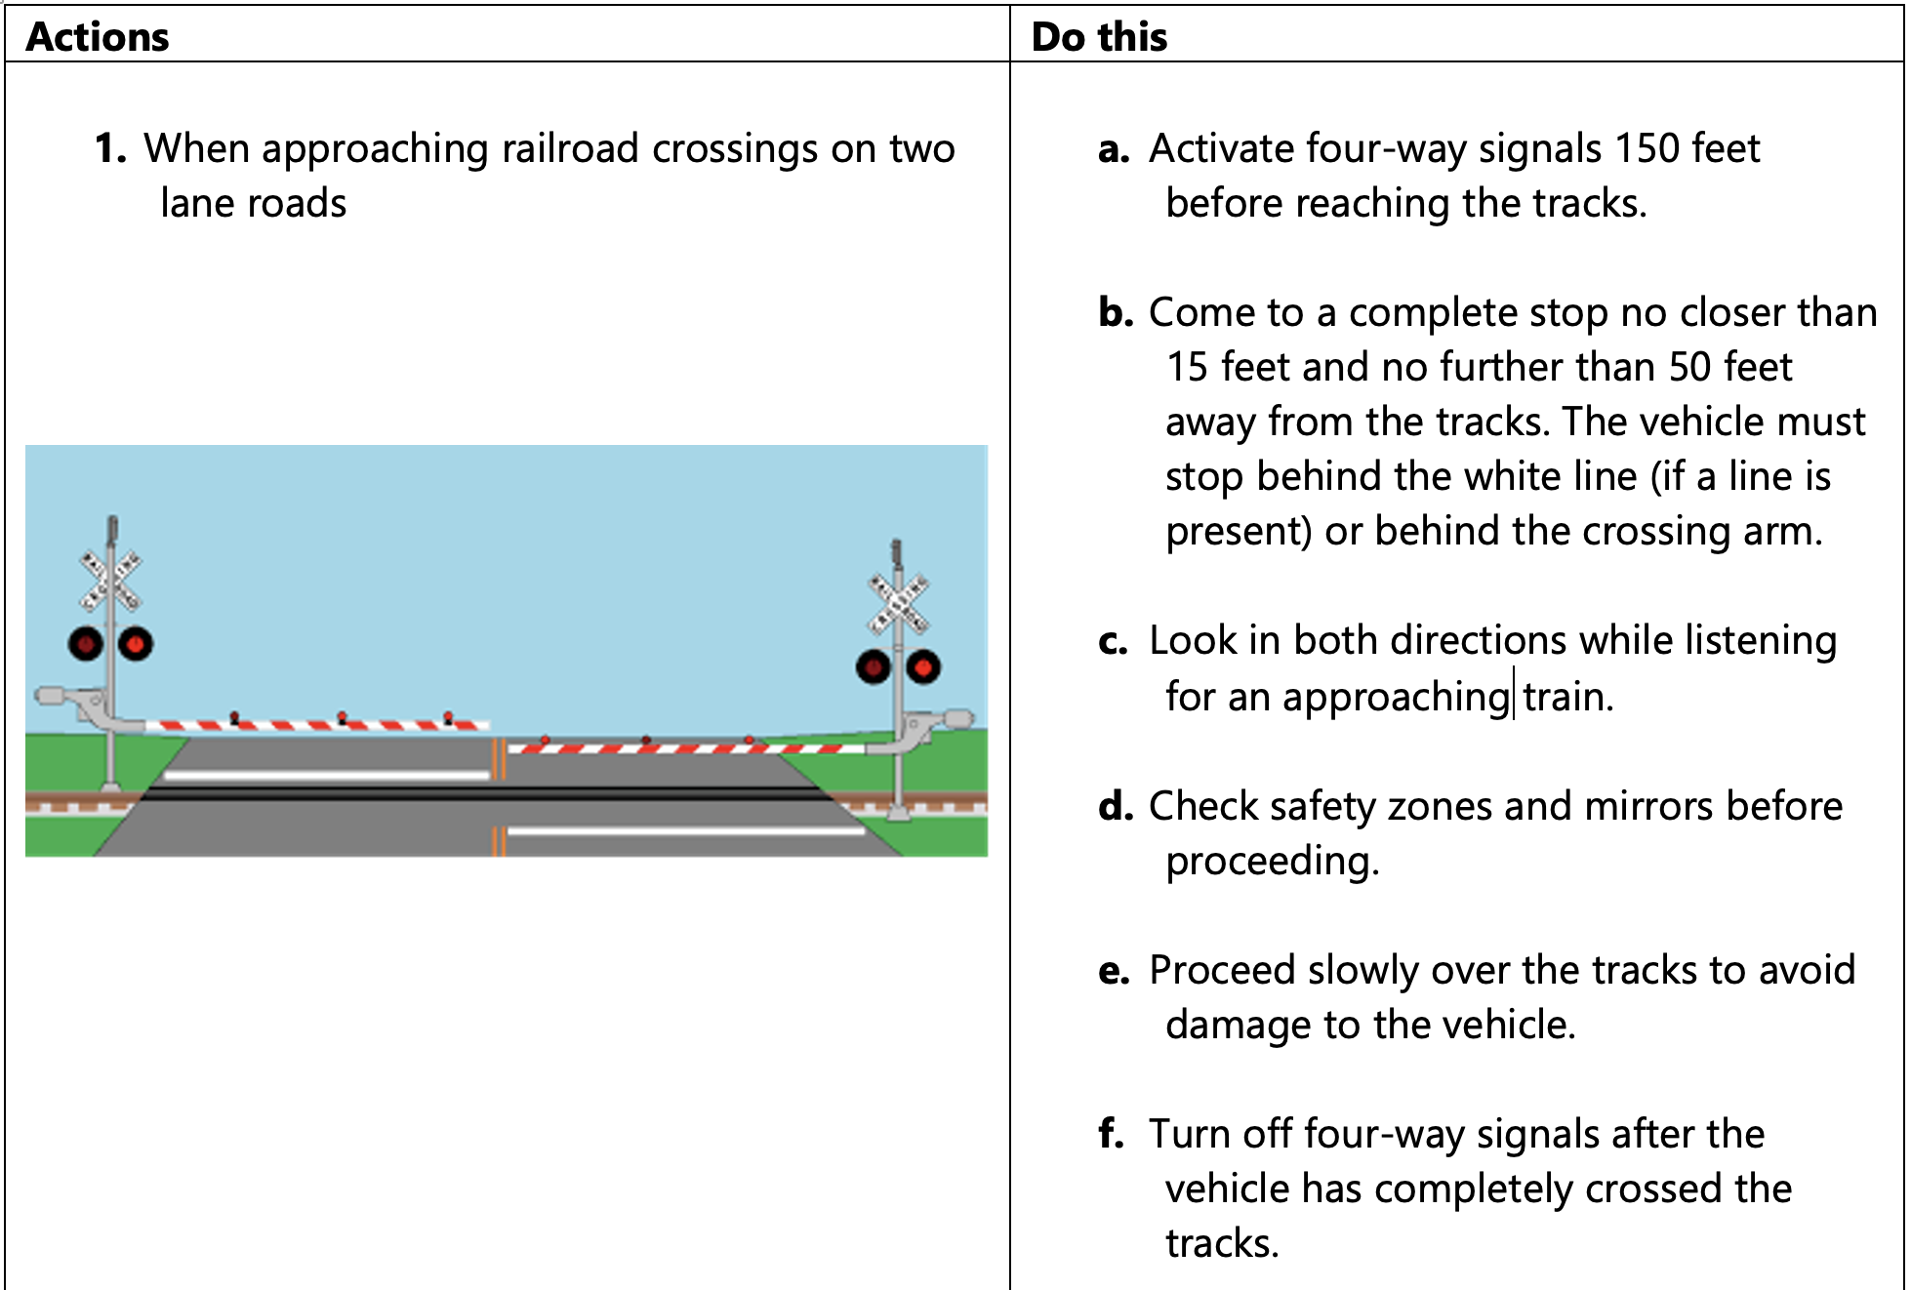
Railroad (RR)-Highway Grade Crossings & Drawbridges
P
B
A
B→A

Slide 242
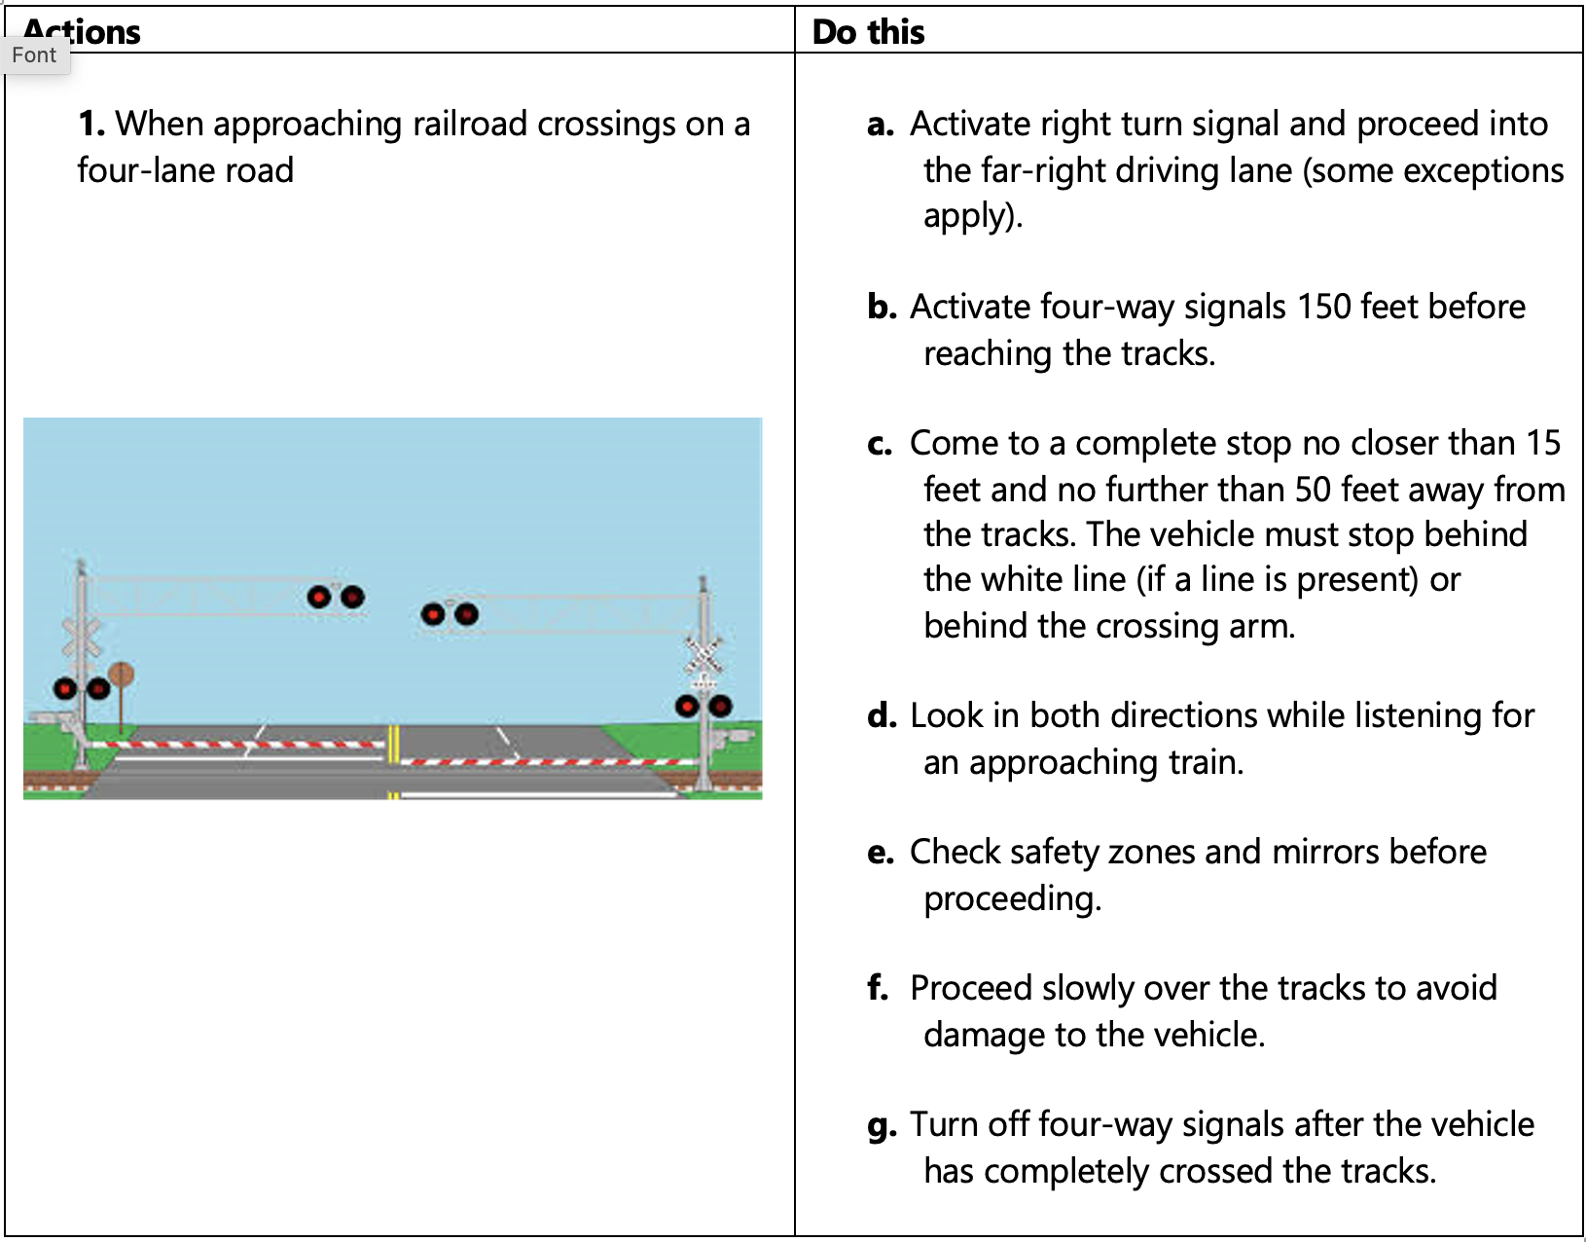
Railroad (RR)-Highway Grade Crossings & Drawbridges
P
B
A
B→A

Slide 243
Railroad (RR)-Highway Grade Crossings & Drawbridges
P
B
A
B→A
These vehicles are required to stop at all railroad grade crossings:
Buses carrying passengers
School buses (whether carrying passengers or not)
Placarded vehicles
Railroad Grade Crossing Violation
You will be disqualified from operating a commercial motor vehicle for:
60 days if you are convicted of a railroad grade crossing violation.
120 days if, during any three-year period, you are convicted of two railroad grade crossing violations arising from separate incidents.
One year if, during any three-year period, you are convicted of three or more railroad grade crossing violations arising from separate incidents.

Slide 244
Railroad (RR)-Highway Grade Crossings & Drawbridges
P
B
A
B→A
11 times more likely to be fatal
Do not shift gears while crossing tracks
Don’t rely on RR crossing warning lights or gates
Watch for vehicles that are required to stop at crossings
Never race a train to the crossing
Look for a second train
  Eliminate all distractions & noises to listen for trains

Slide 245
Railroad (RR)-Highway Grade Crossings & Drawbridges
P
B
A
B→A
Stalling on Railroad Tracks
Once you begin crossing the tracks, do not hesitate. Cross without stopping.
If your vehicle becomes stalled on railroad tracks and a train is approaching, leave the vehicle.
To avoid being struck by debris from the collision keep a safe distance from the tracks.
Walk quickly in a 45-degree angle away from the tracks in the direction from which the train is approaching.

Slide 246
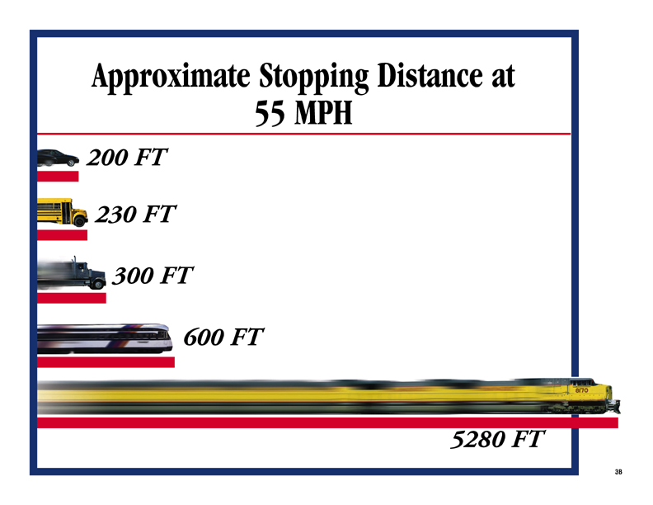
Railroad (RR)-Highway Grade Crossings & Drawbridges
P
B
A
B→A

Slide 247
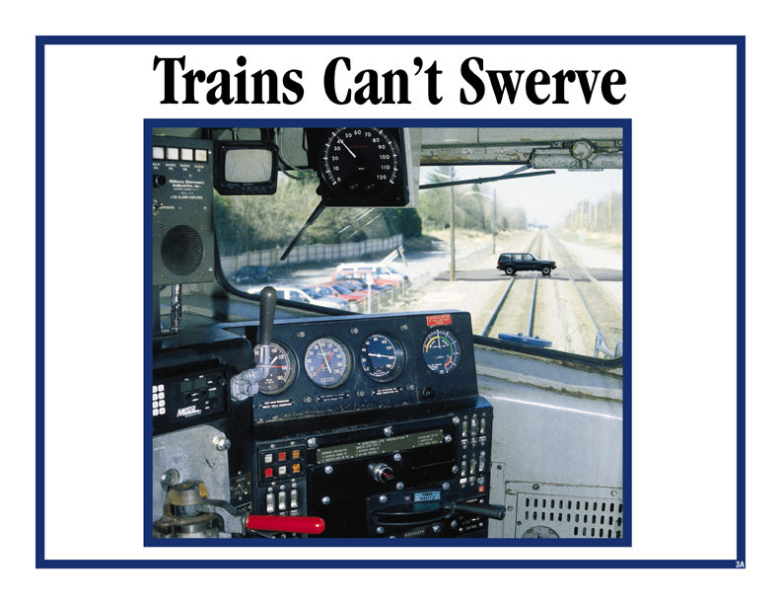
Railroad (RR)-Highway Grade Crossings & Drawbridges
P
B
A
B→A

Slide 248
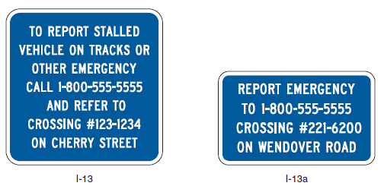
Railroad (RR)-Highway Grade Crossings & Drawbridges
P
B
A
B→A
Emergency Notification System (ENS) for Highway-Rail Grade Crossings
Every highway-rail crossing has an Emergency Notification System (ENS) sign that provides a 24/7/365 phone number to call to report problems or emergencies at the railroad location.
The blue colored ENS sign is located on the railroad crossing posts or the metal control box near the tracks. The ENS is for those emergencies that would require stopping train traffic due to an obstruction, disabled vehicle, or any other problem at the crossing.
By providing the DOT number on the sign, the dispatchers know exactly where the grade crossing is and can notify trains moving in that direction to either come to a stop or be placed on a speed restriction.

Slide 249
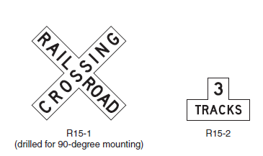
Railroad (RR)-Highway Grade Crossings & Drawbridges
P
B
A
B→A
Grade Crossing Signs
As a minimum, one Crossbuck sign shall be used on the right side of each highway approach to every highway-rail grade crossing, alone or in combination with other traffic control devices.
If automatic gates are not present & if there are two or more tracks at the highway-rail grade crossing, the number of tracks shall be indicated on a supplemental Number of Tracks (R15-2) sign of inverted T shape mounted below the Crossbuck sign

Slide 250
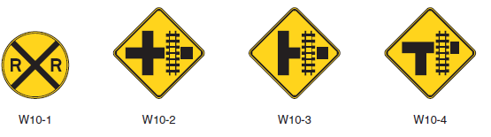
Railroad (RR)-Highway Grade Crossings & Drawbridges
P
B
A
B→A
Advance Warning Signs
If the distance between the railroad tracks and the parallel highway, from the edge of the tracks to the edge of the parallel roadway, is 100 ft or more, a W10-1 sign will exist in advance of the highway rail grade crossing
If the distance between the railroad tracks & a parallel highway, from the edge of the tracks to the edge of the parallel roadway, is less than 100 ft, W10-2, W10-3, or W10-4 signs exist on each approach of the parallel highway to warn road users making a turn that they will encounter a highway-rail grade crossing soon after making a turn

Slide 251
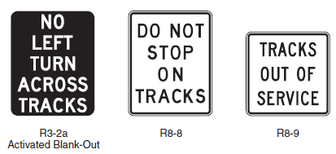

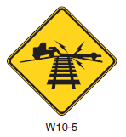
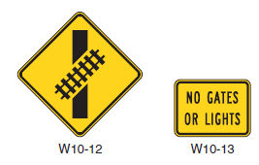
Railroad (RR)-Highway Grade Crossings & Drawbridges
P
B
A
B→A
Other Rail Grade Signs Examples
If the highway profile conditions are sufficiently abrupt to create a hang-up situation for long wheelbase vehicles or for trailers with low ground clearance, the Low Ground Clearance Highway-Rail Grade Crossing Sign (W10-5) is present
Turn prohibition signs (R3-2a) that are associated with preemption shall be visible only when the highway-rail grade crossing restriction is in effect.

Slide 252
Railroad (RR)-Highway Grade Crossings & Drawbridges
P
B
A
B→A
Clearance around tracks
Minnesota Administrative Rules, Transportation Department Chapter 8830, Part 8830.9951 – Required clearance:
  8 feet, 6 inches from the center of the track
  Vertical clearance of 22 feet
Per MnDOT’s Railroad-Highway Grade Crossing Safety Improvement Program, crossings that have a sight distance obstruction or an alignment, which creates unsafe conditions at that grade crossing, may be identified for possible closure.
Per Chapter 2 of the Federal Highway Administration’s Highway-Rail Crossing Handbook, crossings with sight distance deficiencies which cannot be corrected should consider use of active devices at the stop.
Stop your vehicle within 50 feet, but no less than 15 feet from the nearest rail. Listen and look in both directions along the track.

Slide 253
Section 4 Vehicle Systems and Reporting Malfunctions
B
A
B→A

Slide 254
Unit 4.1 Identification and Diagnosis of Malfunctions
B
A
B→A
This unit satisfies FMCSA’s ELDT requirements for units A1.4.1, BA1.4.1, and B1.4.1.

Slide 255
Identification & Diagnosis of Malfunctions
B
A
B→A
Major vehicle systems
Frame
Suspension System
Axles
  Engine
  Diesel vs. Gas
Fuel System
Air Intake & Exhaust System
Lubrication System
  Maintaining the Lubrication System
  Oil Filter System
Cooling System
Electrical System
  Charging Circuit
  Cranking Circuit
  Ignition Circuit
  Lighting & Accessory Circuits
Drive Train
  Clutch
  Transmission
  Drive Shaft & Universal Joints
  Differential

Slide 256
Identification & Diagnosis of Malfunctions
B
A
B→A
Brake System
  Air Brakes
  Air Brake System Operation
  Antilock Brake Systems
  Checking for Defects
Wheels & Tires
  Wheels
  Tires
  Tread Design
  Proper Tire Inflation & Care
Steering System
  Wheel Alignment
  Power Steering
Coupling System
  Fifth Wheel
  Kingpin

Slide 257
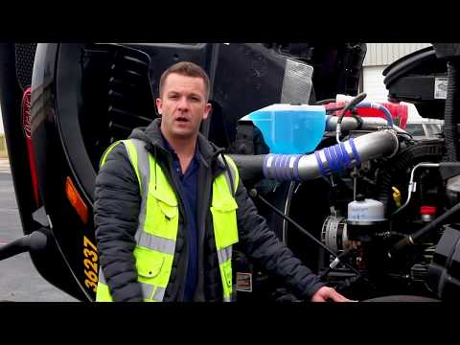
Identification & Diagnosis of Malfunctions
B
A
B→A
Key Components and How to Inspect Them on a Class A Vehicle
Video: Class A CDL Pre-Trip Engine Compartment Inspection & Training. Wilson Logistics—12 minutes

Slide 258
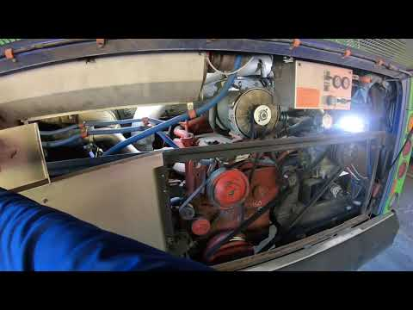
Identification & Diagnosis of Malfunctions
B
A
B→A
Key Components and How to Inspect Them on a Class B Vehicle
Video: CDL Transit Bus Engine Pre-Trip Inspection. GMT Training— 3 minutes

Slide 259

Identification & Diagnosis of Malfunctions
B
A
B→A
Key Components and How to Inspect Them on a Truck Bus
Video: Truck Bus Pre-Trip Inspection. GMT Training—35 minutes

Slide 260

Identification & Diagnosis of Malfunctions
B
A
B→A
Overview of the Function of an Engine and Its Importance to Safe Operation of Your Vehicle
Video: CDL Instructional Video—Engine Components. Texas Department of Public Safety—5 minutes

Slide 261
Identification & Diagnosis of Malfunctions
B
A
B→A
Check the Engine Compartment
Oil level
Coolant level in radiator; condition of hoses
Power steering fluid level; hose condition
Windshield washer fluid level
Battery fluid level, connections and tie-downs (battery may be located elsewhere)
Automatic transmission fluid level (may require engine to be running)
Check belts for tightness and excessive wear (alternator, water pump, air compressor)—learn how much “give” the belts should have when adjusted right, and check each one
Leaks in the engine compartment (fuel, coolant, oil, power steering fluid, hydraulic fluid, battery fluid)
Cracked, worn electrical wiring insulation.

Slide 262

Identification & Diagnosis of Malfunctions
B
A
B→A
Tires and Axles
Video: CDL Instructional Video—The Axles. Texas Department of Public Safety— 5 minutes

Slide 263

Identification & Diagnosis of Malfunctions
B
A
B→A
Overview of the Function of Coupling Systems and Their Importance to Safe Operation of Your Vehicle
Video: CDL Instructional Video — Coupling Systems. Texas Department of Public Safety—8 minutes

Slide 264

Identification & Diagnosis of Malfunctions
B
A
B→A
Overview of the Function of the Exterior of your Vehicle and its Importance to Safe Operation of Your Vehicle
Video: CDL Instructional Video — The Exterior. Texas Department of Public Safety—5 minutes

Slide 265


Identification & Diagnosis of Malfunctions
B
A
B→A
Suspension
Suspension is the system of tires, tire air, springs, shock absorbers and linkages that connects a vehicle to its wheels and allows relative motion between the two.
Check that your vehicle isn’t leaning in one direction, this could indicate an issue with the suspension.

Slide 266
Unit 4.2 Roadside Inspections
P
B
A
B→A
Not Relevant for Transit, Still Must Learn
This unit satisfies FMCSA’s ELDT requirements for units A1.4.2, BA1.4.2, B1.4.2, and C1.17.

Slide 267
Roadside Inspections
P
B
A
B→A
Not Relevant for Transit, Still Must Learn
What to expect during a roadside inspection:
Vehicles and drivers are examined to ensure compliance with state statutes and federal regulations pertaining to vehicle equipment, load securement, driver qualifications, hours of service, and a host of other requirements.
There are 8 levels of inspection that could be performed.
Here’s what to expect during a standard inspection:
CDL
Alcohol and Drug use
Medical Examiner’s and Skill Performance Evaluation (SPE)
Certificates
Hours of Service Compliance

Slide 268
Roadside Inspections
P
B
A
B→A
Not Relevant for Transit, Still Must Learn
What to expect during a standard inspection (continued)
Record of duty status
Seatbelt usage
Vehicle inspection reports
Brake, electrical, exhaust, and fuel systems
Cargo securement
Coupling devices
Driveline/driveshaft mechanisms
Frames
Hazardous materials compliance

Slide 269
Roadside Inspections
P
B
A
B→A
Not Relevant for Transit, Still Must Learn
What to expect during a standard inspection (continued)
Lighting devices (headlamps, taillamps, turn signals, etc.)
Steering mechanisms
Suspensions
Tires (including hubs, rims, wheels)
Van and open-top trailer bodies
Windshield wipers

Slide 270
Roadside Inspections
P
B
A
B→A
Not Relevant for Transit, Still Must Learn
What is Out-of-Service (OOS)?
A driver is not permitted to drive after being on duty in excess of the maximum periods permitted, as detailed in 49 CFR 395.13. Motor carriers cannot require or permit a driver who has been declared out-of-service to operate a CMV until the driver may lawfully do so.
Out-of-Service (OOS) order means a declaration by an authorized enforcement officer of a Federal, State, Canadian, Mexican, or local jurisdiction that a driver, a commercial motor vehicle, or a motor carrier operation is out of service pursuant to 49 CFR 386.72, 392.5, 392.9a, 395.13, or 396.9, or compatible laws, or the North American Standard Out-of-Service Criteria.

Slide 271
Roadside Inspections
P
B
A
B→A
Out-of-Service (OOS) criteria:
No driver shall drive after being on duty in excess of the maximum periods permitted by this part.
No driver required to maintain a record of duty status under § 395.8 or § 395.15 of this part shall fail to have a record of duty status current on the day of examination and for the prior seven consecutive days.
You will be put out-of-service for 24 hours if you have any detectable amount of alcohol under .04%. If your blood alcohol concentration (BAC) is .04% or more, you will lose your CDL for at least 1 year for a first offense.
Federal and state inspectors also may inspect your vehicles. If they judge the vehicle to be unsafe, they will put it “out of service” until it is fixed.

Slide 272
Roadside Inspections
P
B
A
B→A
Ramifications and penalties for operating a CMV when subject to an OOS order as defined in § 390.5.
You will lose your CDL:
For at least 90 days if you have committed your first violation
of an OOS order.
For at least one year if you have committed two violations
of an OOS order in a 10-year period.
For at least three years if you have committed three or more violations of an out-of-service order in a 10-year period.

Slide 273
Unit 4.3 Maintenance
B
A
B→A
Not Relevant for Transit, Still Must Learn
This unit satisfies FMCSA’s ELDT requirements for units A1.4.3, BA1.4.3, and B1.4.3.

Slide 274
Maintenance
B
A
B→A
Not Relevant for Transit, Still Must Learn
Vehicles and drivers are examined to ensure compliance with state statutes and federal regulations pertaining to vehicle equipment, load securement, driver qualifications, hours of service, and a host of other requirements.

Slide 275
Maintenance
B
A
B→A
General checking guidelines
Is it cracked, bent, or broken?
Is it properly mounted and secured?
Are there any missing bolts or mounting hardware?
Is it leaking?
For belts: is it torn or cut? Is the tension is at the proper amount?

Slide 276

Maintenance
B
A
B→A
Engine
Inspect any hoses and electrical wire to ensure
they are properly mounted and secured,
not cracked, bent, or broken, and any electrical wires
aren’t spliced, frayed or exposed.
Check hoses to make sure there are no
abrasions, bulges, or cuts. If they have fluid
or air, check that they’re not leaking.
Check that your coolant reservoir is not cracked
or broken and that it is properly mounted and secured,
the cap is on tight, and it is filled to the manufacturer’s
specifications and above the minimum fill line.
Inspect your water pump.

Slide 277
Maintenance
B
A
B→A
Service Brakes, Including Trailer Brake Connections Inspection
Brake adjustment, either manually or with automatic slacks, ensuring their rate of travel is at the proper distance.
Anti-lock brake warning light operation.
Air hoses and tubing, preferably with the brakes applied.
All hardware, ensuring it is in place and secure.
The thickness of linings and drums.
No presence of air leaks.
The proper operation of the low-air warning system.

Slide 278
Maintenance
B
A
B→A
Tire Inspection
Air pressure should be the same for all tires and not to high or too low.
Tread should be at least 4/32-inch tread depth in every major groove on front tires. You need 2/32 inch on other tires. No fabric should show through the tread or side wall.
Cuts or damage
Mismatched sizes
Tread separation
Dual tires that come in contact with each other or parts of the vehicle.
Radial and bias-ply tires used together.
Cut or cracked valve stems.
Re-grooved, recapped or retreaded tires on the front wheels of a bus.
These are prohibited.

Slide 279
Maintenance
B
A
B→A
Steering System Defects
Missing nuts, bolts, cotter keys, or other parts.
Bent, loose, or broken parts, such as steering column, steering gear box, or tie rods.
If power steering equipped, check hoses, pumps and fluid level; check for leaks.
Steering wheel play of more than 10 degrees (approximately two (2) inches movement at the rim of a 20-inch steering wheel) can make it hard to steer.

Slide 280
Maintenance
B
A
B→A
Wheel and Rim Problems
Damaged rims.
Rust around wheel nuts may mean the nuts are loose — check tightness. After a tire has been changed, stop a short while later and re-check tightness of nuts.
Missing clamps, spacers, studs, or lugs means danger.
Mismatched, bent, or cracked lock rings are dangerous.
Wheels or rims that have had welding repairs are not safe.

Slide 281
Maintenance
B
A
B→A
Bad Brake Drums or Shoes
Cracked drums.
Shoes or pads with oil, grease, or brake fluid on them.
Shoes worn dangerously thin, missing or broken.

Slide 282
Maintenance
B
A
B→A
Suspension Systems
Broken suspension parts can be extremely dangerous look for:
Spring hangers that allow movement of axle from proper position.
Cracked or broken spring hangers.
Missing or broken leaves in any leaf spring. If 1/4 or more are missing, it will put the vehicle “out of service,” but any defect can be dangerous
Broken leaves in a multi-leaf spring or leaves that have shifted so they might hit a tire or other part.
Leaking shock absorbers
Torque rod or arm, U-bolts, spring hangers, or other axle positioning parts that are cracked, damaged or missing
Air suspension systems that are damaged and/or leaking
Any loose, cracked, broken or missing frame members.

Slide 283
P
B
A
Not Relevant for Transit, Still Must Learn
Handling & Documenting of Cargo
Use loading process as an opportunity to screen baggage. In addition to the physical task at hand, drivers must be able to recognize potential suspicious packages and baggage. Look for
  Packages that appear to be unusually heavy in size, emit unusual odors or wet, or contain significant amounts of liquid or contain unusual objects such as wire, metal pipe, many bottles/thermoses, nails and ball-bearings.
  Passengers who appear overly possessive or concerned about their luggage
  Passenger carry-ons that are larger and could have been stowed in the luggage bay
Secure baggage bay doors with a lock pin (if equipped)
Source: FMCSA Model Training Curriculum for Motorcoach Drivers

Slide 284


P
B
A
Handling & Documenting of Cargo
Proper handling and securement of devices
associated with ADA compliance: Wheelchair/Aid securement
Set brakes (manual) or power chair off (powered)
4-point tie-down
Do not attach tie-downs to wheels or any removable parts
Do not attach tie-downs to the folding cross brace of a wheelchair
Attach the straps as high as possible on the chair
Route each tie-down strap in a straight line; do not bend
around a wheel or other object
Tighten all straps, but do not over-tighten
Test the chair to be sure you cannot move it in any direction
Secure passenger to chair
Source: FMCSA Model Training Curriculum for Motorcoach Drivers

Slide 285
P
B
A
Handling & Documenting of Cargo
Proper handling and securement of devices associated with ADA compliance:
Transporting oxygen
Oxygen concentrators are portable devices that concentrate the oxygen from the atmosphere to deliver higher concentrations of oxygen to the user. They do not pose any threats to safety.
Oxygen tanks/cylinders contain pure oxygen gas. These tanks are pressurized metal cylinders and will have some type of valve system at the top of the cylinder where the oxygen dispenses. Pure oxygen gas is a classified as a hazardous material.
Limit cylinders in passenger compartment to what’s practical (currently in use or will be needed before next scheduled stop)
Extra cylinders must be secured in the luggage bays with valves protected from contact with other stowed items
Total amount of oxygen stowed in cargo bays should be < 99 lbs.
Source: FMCSA Model Training Curriculum for Motorcoach Drivers

Slide 286
P
B
A
Not Relevant for Transit, Still Must Learn
Handling & Documenting of Cargo
Proper Cargo Securement
Blocking is used in the front, back, and/or sides of a piece of cargo to keep it from sliding. Blocking is shaped to fit snugly against cargo. It is secured to the cargo deck to prevent cargo movement.
Bracing is also used to prevent movement of cargo. Bracing goes from the upper part of the cargo to the floor and/or walls of the cargo compartment.
Cargo Tie-down
  On flatbed trailers or trailers without sides, cargo must be secured to keep it from shifting or falling off. In closed vans, tie-downs can also be important to prevent cargo shifting that may affect the handling of the vehicle. Tie-downs must be of the proper type and proper strength.
  The aggregate working load limit of any securement system used to secure an article or group of articles against movement must be at least one-half times the weight of the article or group of articles. Proper tie-down equipment must be used, including ropes, straps, chains, and tensioning devices (winches, ratchets, clinching components). Tie-downs must be attached to the vehicle correctly (hooks, bolts, rails, rings).
Source: Minnesota Commercial Driver’s License Manual Also featured in Orientation

Slide 287
P
B
A
Not Relevant for Transit, Still Must Learn
Handling & Documenting of Cargo
Proper Cargo Securement, continued
Header Boards
  Front-end header boards (“headache racks”) protect you from your cargo in case of a crash or emergency stop. Make sure the front-end structure is in good condition. The front-end structure should block the forward movement of any cargo you carry.
Source: Minnesota Commercial Driver’s License Manual Also featured in Orientation

Slide 288
P
B
A
Not Relevant for Transit, Still Must Learn
Handling & Documenting of Cargo
Safe and Efficient loading/unloading tips
Load heavy items first
Create a wall
Use efficient clips for strapping
Label everything
Create a template for inventory
Use moving equipment, such as forklifts
Source: www.stokesquipment.com

Slide 289
P
B
A
Not Relevant for Transit, Still Must Learn
Handling & Documenting of Cargo
Tips to Prevent Cargo Theft
No unattended, loaded trailers, whenever possible; especially in high cargo theft areas.
Use high security rear door locks and air cuff locks.
If it is unavoidable to stage/drop a load, consider installing landing gear locks as well.
Usage of hard security devices, such as locks and seals,
Leveraging appropriate technology,
Reinforcing cyber-security to prevent access to key information.﻿﻿
Source: www.travelers.com

Slide 290


Handling & Documenting of Cargo
P
B
A
Not Relevant for Transit, Still Must Learn
Source: Minnesota Commercial Driver’s License Manual

Slide 291

Handling & Documenting of Cargo
P
B
A
Not Relevant for Transit, Still Must Learn
Video: Avoid Violations!! Must know information on HAZMAT LOADS. ET Transport—5 minutes

Slide 292
Unit 5.2 Environmental Compliance Issues
B
A
Not Relevant for Transit, Still Must Learn
This unit satisfies FMCSA’s ELDT requirements for units A1.5.2 and B1.5.2.

Slide 293
Environmental Compliance Issues
B
A
Not Relevant for Transit, Still Must Learn
Air Pollution
  Emissions: Driving empty vehicles, also known as “deadheading” contributes to air pollution without the benefit of hauling goods or people. Partial loads are also a waste, contributing to unnecessary emissions and fuel expenses.
  Idling: An idling vehicle releases harmful chemicals, gases and particle pollution (“soot”) into the air, contributing to ozone, regional haze, and global climate change.
  Idle Reduction Technology: In extreme weather conditions, drivers must idle, however a device can be used to allow operators to shut down the main propulsion engine while providing services (e.g. heat, air conditioning, and/or electricity) to the vehicle or equipment while the equipment is parked or stationary.

Slide 294
Environmental Compliance Issues
B
A
Not Relevant for Transit, Still Must Learn
Fuel Efficiency
Vehicle Maintenance: When the engine is running at peak efficiency. It reduces pollution.
Vehicle Inspection: Prevent environmental hazards by properly securing cargo and driving slowly around turns.
Driving Habits & Behaviors:
  Simple actions as slowing acceleration, gentler braking, and avoiding engine idling can make a huge difference over time. By not speeding, drivers can also maximize fuel economy and prevent accidents.
  Efficient packing of loads can mean fewer trucks are needed to transport goods. This can lower the amount of greenhouse gases released in the atmosphere.

Slide 295
Environmental Compliance Issues
B
A
Not Relevant for Transit, Still Must Learn
Hazardous Materials
Hazardous Materials endorsement is required to transport hazardous material.
Vehicles transporting certain types or quantities of hazardous materials must display diamond-shaped, square on point, warning signs called placards.
Sometimes permits are required to transport certain explosives or bulk hazardous wastes. States and counties may require the use of special hazardous materials routes.
Emergency Response: The Emergency Response phone number must be monitored while the shipment is in transit. The information must appear on the shipping paper or in a separate paper with the shipping paper and includes a description of the hazardous material, immediate hazards to health, immediate methods for handling small or large fires and spills or leaks, and preliminary first aid measures.
Incident Notification/Reporting: As soon as practical, but no later than 12 hours must call the National Response Center.

Slide 296
Unit 5.3 Hours of Service Requirements
P
B
A
B→A
Not Relevant for Transit, Still Must Learn
This unit satisfies FMCSA’s ELDT requirements for units A1.5.3, BA1.5.3, B1.5.3, and C1.11.

Slide 297
Hours of Service (HOS) Requirements
P
B
A
B→A
Not Relevant for Transit, Still Must Learn
The hours of service (HOS) regulations are designed to improve safety for the motoring public by reducing Commercial Motor Vehicle (CMV) driver fatigue.
There are different HOS regulations for Property-Carrying Drivers and Passenger-Carrying Drivers. This training covers Passenger-Carrying Drivers HOS regulations. Drivers
Source: FMCSA

Slide 298
Hours of Service (HOS) Requirements
P
B
A
B→A
Not Relevant for Transit, Still Must Learn
Hours-of-service rules as they apply to intrastate transportation in Minnesota
Who is Subject to the Hours of Service Rules?
A For-Hire Motor Carrier
A Private Carrier when operating vehicles over 10,000 pounds Gross Vehicle Weight (GVW)
A Person transporting solid waste...including recyclable materials and waste tires, as described in 221.025(b), when operating a vehicle(s) with a GVW over 10,000 pounds or more
A Person transporting hazardous material (HM) of a type or quantity that requires the vehicle to be marked or placarded
A Transit Service receiving operating assistance from either MnDOT or the Metropolitan Council (MCTO, St. Cloud, and Duluth transit systems excepted).

Slide 299
Hours of Service (HOS) Requirements
P
B
A
B→A
Not Relevant for Transit, Still Must Learn
Passenger-Carrying Drivers HOS Regulations
10-Hour Driving Limit: May drive a maximum of 10 hours after 8 consecutive hours off duty.
15-Hour Limit: May not drive after having been on duty for 15 hours, following 8 consecutive hours off duty. Off-duty time is not included in the 15-hour period.
60/70-Hour Limit: May not drive after 60/70 hours on duty in 7/8 consecutive days.
Sleeper Berth Provision: Drivers using a sleeper berth must take at least 8 hours in the sleeper berth and may split the sleeper berth time into two periods provided neither is less than 2 hours. All sleeper berth pairings MUST add up to at least 10 hours.
Adverse Driving Conditions: Drivers are allowed to extend the 10-hour maximum driving time and 15-hour on-duty limit by up to 2 hours when adverse driving conditions are encountered.
Short-Haul Exception: A driver is exempt from the requirements if the driver operates within a 150 air-mile radius of the normal work reporting location, and the driver does not exceed a maximum duty period of 14 hours. Drivers using the short-haul exception in §395.1(e)(1) must report and return to the normal work reporting location within 14 consecutive hours and stay within a 150 air-mile radius of the work reporting location.

Slide 300
Hours of Service (HOS) Requirements
P
B
A
B→A
Not Relevant for Transit, Still Must Learn
Definitions of time
On-duty: All time a driver spends performing work or being ready to work, until being relieved by the carrier of all responsibility. “On-duty” time also includes any compensated work performed by the driver for a carrier or non-motor carrier entity.
Driving: All time spent at the driving controls of a commercial motor vehicle in operation.
Off-duty: The driver has been relieved of all responsibilities for the vehicle and its cargo or passengers and the driver is free to pursue activities of his/her own choosing.
Sleeper Berth: All time spent resting in a sleeper berth as defined in 49 CFR Section 393.76.
Carriers must maintain true and accurate records of a driver’s HOS. Drivers must record their daily activities on a Record of Duty Status (RODS), unless they meet all the conditions for the short haul provision or are otherwise excepted/exempted.

Slide 301
Hours of Service (HOS) Requirements
P
B
A
B→A
Not Relevant for Transit, Still Must Learn
Electronic Logging Device (ELD)
Technology that automatically records a driver’s driving time and other HOS data. It monitors the engine run time, moving, miles and engine hours.
All carriers and drivers subject to the HOS regulations must use ELDs unless exempted or excepted.
Motor carriers and drivers may only use ELDs that are self-certified and registered on FMCSA’s website: https://eld. fmcsa.dot.gov/list.

Slide 302
Hours of Service (HOS) Requirements
P
B
A
B→A
Not Relevant for Transit, Still Must Learn
Exceptions to the ELD Rule:
Drivers who operate under the Short-Haul Provision.
Drivers who use paper RODS for not more than 8 days in
any 30-day period.
Drivers who conduct driveaway-towaway operations
in which the vehicle being driven is the commodity being delivered.
Drivers of vehicles manufactured before model year 2000.
Record Retention: At least six months.

Slide 303
Hours of Service (HOS) Requirements
P
B
A
B→A
Not Relevant for Transit, Still Must Learn
What happens to drivers/carriers who violate the HOS rules?
Drivers will be placed Out of Service (OOS) if they
  Exceed maximum hours permitted at the time of the stop/inspection, or
  Fail to keep proper record of duty status for current day and 7 prior consecutive days.
An OOS driver shall not be required or permitted to drive, and a driver may not drive until they have hours available. Drivers may be issued citations when found to be in violation of the HOS rules.
Carriers who require or permit drivers to violate the HOS rules may fined.
Driving (or allowing a driver to drive) more than 3 hours beyond the 11-hour driving-time limit may be considered an “egregious” violation and make the carrier and/or driver subject to the maximum civil penalties. Fines to drivers can range from around $1,000-$19,000 depending on the severity. The carrier may also pay a fee. If the violation involves hazardous material, the fine can exceed $75,000.

Slide 304
Hours of Service (HOS) Requirements
P
B
A
B→A
Not Relevant for Transit, Still Must Learn
Tips to avoid and recognize fatigue
Get enough sleep before getting behind the wheel. If you become drowsy while driving, be sure to choose a safe place to pull over and rest.
Maintain a healthy diet. Skipping meals or eating at irregular times may lead to fatigue.
Take a nap. Naps should last at least 10 minutes. An ideal nap is 45 minutes. Allow at least 15 minutes after waking to fully recover before starting to drive.
Avoid medication that may induce drowsiness. Cold pills are one of the most common medications that make you drowsy. If you must drive with a cold, it is safer to suffer a cold than drive under the effects of the medicine.
Recognize the signals and dangers of drowsiness. Frequent yawning, heavy eyes and blurred vision may indicate drowsy.
Do not rely on “alertness tricks” to keep you awake. Behaviors such as smoking, turning up the radio, drinking coffee, opening the window, and other “alertness tricks” are not real cures for drowsiness and may give you a false sense of security.

Slide 305
Unit 5.4 Fatigue and Wellness Awareness
P
B
A
B→A
This unit satisfies FMCSA’s ELDT requirements for units A1.5.4, BA1.5.4, B1.5.4, and C1.11.

Slide 306
Driver Fatigue
P
B
A
B→A
No driver shall operate a commercial motor vehicle,
and a motor carrier shall not require or permit a driver
to operate a commercial motor vehicle , while the driver’s ability or alertness is so impaired, or so likely to become impaired, through fatigue, illness, or any other cause,
as to make it unsafe for him/her to begin or continue
to operate the commercial motor vehicle.

Slide 307
Fatigue & Wellness Awareness
P
B
A
B→A
According to FMCSA, these are the core risk factors for professional drivers
Smoking: increases heart disease, lung disease, and chance of contracting cancer
Obesity: increases risk for cardiovascular diseases, hypertension and diabetes, can increase problems with arthritis, back, and joint pain.
Hypertension (high blood pressure): increases risk of heart disease, kidney failure and stroke, symptoms may include fatigue, severe headache, chest pain, breathing difficulty, irregular heartbeat
Source: National RTAP: Emergency Procedures for Rural Transit Drivers Training Module

Slide 308
Fatigue & Wellness Awareness
P
B
A
B→A
Core risk factors for professional drivers:
Stress: increases the incidence of hypertension and cardiovascular, gastrointestinal and immune deficiencies, risk factor in other diseases like depression and obesity.
Poor eating habits: can be one of the most decisive factors in individual health.
Lack of physical activity: Can increase the risk of physiological illness such as depression, anxiety, and stress, as well as physical illnesses like obesity, hearth disease, hypertension and some cancers.
Source: National RTAP: Emergency Procedures for Rural Transit Drivers Training Module

Slide 309
Driver Fatigue
P
B
A
B→A
In today’s economy, many people have more than one job.
You have many bills to pay, mouths to feed; and one job does not quite make it.
So you pick-up a “part-time” job to make ends meet.
Since there are only 24 hours in one day
  You catch a nap here and there
  Sleep 3 or 4 hours
  Then start the day over

Slide 310
Driver Fatigue
P
B
A
B→A
After a few days of this routine, you think you can do this
But then you notice that while you are driving,
  You feel a little drowsy
  You start shifting around in your seat
  You stare blankly at the road
  You do not remember the past few miles
  You start yawning and your eyes close

Slide 311

Driver Fatigue
P
B
A
B→A
Driver Behavior Safety Series: Fatigue — National Safety Council (1:12)

Slide 312
Driver Fatigue
P
B
A
B→A
According to a Sleep in America poll:
  1% or as many as 1.9 million drivers have had a car crash or a near miss
  due to drowsiness in the past year
  54% or 105 million drivers have driven while drowsy at least once
  in the past year
  28% or 54 million drivers do so at least once per month
Chronic and acute driver fatigue decreases your ability to recognize and respond to oncoming hazards. Fatigue impairs your driving, like alcohol impairment. Remember, you a driving a larger vehicle and larger vehicles can do more damage.
Staying alert to be able to think clearly and quickly respond to potential hazards is important factor to driver safety.

Slide 313
Driver Fatigue
P
B
A
B→A
As a professional transit driver/operator you may be exposed to a broad array of biological, physical, & ergonomic hazards, as well as various stressors.
/ 313

Slide 314
Wellness Awareness
P
B
A
B→A
Musculoskeletal Disorders (MSDs)
MSDs are injuries or pain in the body’s joints, ligaments, muscles, nerves, tendons, & structures that support limbs, neck, & back.

Slide 315
Wellness Awareness
P
B
A
B→A
Work-related Musculoskeletal Disorders (WMSDs)
WMSDs can be associated with work patterns:
  Fixed or constrained body positions
  Force concentrated on small parts of the body

Slide 316
Wellness Awareness
P
B
A
B→A
  A pace of work that does not allow sufficient recovery
  Heat, cold, & vibration

Slide 317
Wellness Awareness
P
B
A
B→A
Things you can do to lessen the risks include:
Adjust your driver seat area properly so that you have full access to all controls, permitting a comfortable arm position
Adjust all mirrors properly

Slide 318
Wellness Awareness
P
B
A
B→A
Adjust & re-adjust lumbar support throughout the day
Take advantage of non-driving time to stretch your back & leg muscles. Stretching enhances circulation & reduces muscle tension.

Slide 319
Unit 5.5 Post-Crash Procedures
P
B
A
This unit satisfies FMCSA’s ELDT requirements for units A1.5.5, B1.5.5, and C1.1.

Slide 320
Accident & Emergency Handling Procedures
P
B
A
In an accident or emergency, your responsibilities range from having the ability to protect yourself and your passengers from injury or death, to protecting yourself and your agency afterwards from fraudulent or excessive liability claims.

Slide 321
Accident & Emergency Handling Procedures
P
B
A
When there is an accident or emergency involving your vehicle or passengers, you are responsible for handling the situation in a way that lessens the risk of injury or death to your passengers and to yourself.

Slide 322
Accident & Emergency Handling Procedures
P
B
A
You must have thorough knowledge, and understanding, of the basic accident and emergency handling procedures in order to maintain that trust.

Slide 323
Accident & Emergency Handling Procedures
P
B
A
The four basic accident and emergency handling procedures are:
    Keep calm
    Protect your passengers, yourself, your vehicle
    Contact your dispatcher
    Complete the required reports
Each situation is going to be different. Therefore, 2 and 3 may be reversed while 1 and 4 remain constant.

Slide 324
Accident & Emergency Handling Procedures
P
B
A
These four steps are basic – your agency should have a very detailed and in-depth policy/guideline to follow in the event of an accident or incident.
Become familiar with these policies.

Slide 325
Post-Accident Procedures
P
B
A
The first thing to do at an accident scene is to keep another accident from happening in the same spot.
To protect the area:
Try to get it to the side of the road. This will help prevent another accident and allow traffic to move.
Put on your flashers.
Set out reflective triangles to warn other traffic.
Make sure other drivers can see them in time
to avoid the accident.

Slide 326
Post-Accident Procedures
P
B
A
Assess your own physical condition post-accident
Are you capable of assisting passengers to safety?
If you are incapacitated, attempt to notify authorities of the accident or assign another person responsibility to notify the authorities.

Slide 327
Post-Accident Procedures
P
B
A
If you have a cell phone or CB radio, call for assistance before you get out of your vehicle. If not, wait until after the accident scene has been properly protected, then call or send someone to call the police. Try to determine where you are so you can give the exact location.

Slide 328
Evacuation
P
B
A
As a driver, you have an important responsibility
for the welfare and safety of your passengers.
You must be prepared to provide evacuation assistance to all passengers.

Slide 329
The Evacuation Decision
P
B
A
If you smell smoke, see smoke, or smell gasoline or diesel fumes, evacuate the vehicle immediately.
Do not assume it is NOT an emergency.

Slide 330
Evacuation
P
B
A
Passengers in wheelchairs present two elements for assessment:
The first is whether or not conditions permit operation of the lift.
The second is whether or not to evacuate the passenger in their mobility device.

Slide 331
Evacuation
P
B
A
Passengers may be reluctant to leave their wheelchair behind because without it they become totally immobile. However, saving the passenger’s life is first priority.
If time and conditions permit, the wheelchair can be recovered later.

Slide 332
Evacuation
P
B
A
Be sure to identify portable oxygen devices
and remove them from the vehicle.
Alert fire fighters to their presence and location.

Slide 333
Communicating with Passengers & helpers
P
B
A
In an emergency, most passengers will look to you, the driver, for direction. You represent authority and must take initial control and take the lead.
Passengers should be advised that help is on the way, but for their safety, it is best that they leave or be assisted from the vehicle.

Slide 334
Communicating with Passengers & helpers
P
B
A
The use of able-bodied passengers or passers-by, must be done with great care. The ability to remain calm and give clear and concise instructions to helpers will prevent unnecessary injuries.
Make it clear what commands will be used to start whatever you will be doing.

Slide 335
Communicating with Passengers & helpers
P
B
A
Remember – as the driver of your vehicle, you are responsible for directing passengers and passers-by in giving assistance. However, once public safety personnel arrive on the scene, they will assume command and control of the emergency. At that point, your responsibility is seeing to the needs of your passengers.

Slide 336
Fire Extinguishers
P
B
A
An essential piece of emergency equipment and all vehicles should have one.
A typical fire extinguisher has only 15-20 seconds of retardant.
In order for a fire extinguisher to be effective it must be used properly.

Slide 337
Fire Extinguisher Operation
P
B
A
  P. A. S. S.
      Pull the pin
      Aim toward fire
      Squeeze the handle
      Sweep at the base of the fire

Slide 338
Special Considerations for Fires
P
B
A
Fire extinguishers are an extremely valuable tool, but you must always remember that they are small and have a limited capacity. When confronted with a fire, your first concern should be in protecting the safety of your passengers and yourself. The fire extinguisher should be used to protect your exits while you evacuate the vehicle.

Slide 339
Post-Crash Testing Requirements
P
B
A
Post-crash drug and alcohol tests are always required when there is a human fatality.
It is required in the following circumstances only if the driver was issued a citation:
  Someone was injured and given immediate medical attention away from the scene
  A vehicle damaged enough to require towing
Reasonable suspicion is a reason to require testing; however, it doesn’t fall under the “post-crash” testing requirements.

Slide 340
Unit 5.6 External Communications
B
A
Not Relevant for Transit, Still Must Learn
This unit satisfies FMCSA’s ELDT requirements for units A1.5.6 and B1.5.6.

Slide 341
External Communications
B
A
Not Relevant for Transit, Still Must Learn
Effective communication with enforcement officials keeps the inspection smooth and quick. Treat inspectors with courtesy and respect.
Answer questions succinctly and clearly. There is no need to overshare.
Be organized and prepared. Have applicable documentation ready, including
  Driver’s licenses
  Medical cards
  Vehicle registration
  Information regarding your annual inspection
  Daily vehicle inspection reports (DVIRs)
  Any relevant permits
  Shipping documentation
  Record of duty status (RODS)
Roadside vehicle inspection process: There are eight levels of inspections.

Slide 342
External Communications
B
A
Not Relevant for Transit, Still Must Learn
What to expect during a roadside vehicle inspection
Procedures are similar regardless of location. Procedures will vary based on inspection level and how many enforcement personnel are conducting the inspection. For driver-only inspections, there may only be one enforcement official; for inspections that include a check of the vehicle multiple inspectors may work as a team.
The inspector usually starts by greeting you. The inspector may ask strictly for driver-related documents or may also want to see company and vehicle related documents. Many companies keep insurance and other documents in a specific location.
The inspector will interview you about your trip and the company you work for. The inspector will be probing your knowledge of the regulations and assessing your ability to communicate sufficiently, and complete paperwork as required.
Following the interview, the inspector will review the documentation collected, including your license and logs. Your medical certification status will be verified, and you may asked to show vehicle inspection reports if you are on a multi-day trip.
Source: FMCSA Model Training Curriculum for Motorcoach Drivers

Slide 343

External Communications
B
A
Not Relevant for Transit, Still Must Learn
Level I: North American Standard Inspection (most comprehensive)
Source: FMCSA Model Training Curriculum for Motorcoach Drivers

Slide 344
External Communications
B
A
Not Relevant for Transit, Still Must Learn
Level II: Walk-Around Driver/Vehicle Inspection
A Level II inspection is similar to a Level I inspection. The largest difference is in the vehicle inspection portion– for a Level II, this will include only those components or portions of systems that can be inspected without physically getting under the vehicle. There is no change in the driver inspection portion from a Level I.
Level III: Driver/Credential/Administration Inspection
A Level III inspection is focused solely on driver credentials and is the quickest inspection type.
Level IV: Special Inspections
Typically includes the review of a specific item. These are typically performed in support of a specific study or to confirm or deny a certain trend.
Source: FMCSA Model Training Curriculum for Motorcoach Drivers

Slide 345
External Communications
B
A
Not Relevant for Transit, Still Must Learn
Level V: Vehicle-Only Inspection
Includes all the items in a Level I North American Standard Inspection conducted at any location without needing a driver to be present.
Level VI: North American Standard Inspection for Transuranic Waste and Highway Route Controlled Quantities (HRCQ) of Radioactive Material
Review of select radiological shipments and if the CMV is compliant with regulations surrounding the transport of radioactive materials. The inspection includes enhancements to the North American Standard Level I Inspection, radiological requirements, and the North American Standard Out-of-Service Criteria for Transuranic Waste and Highway Route Controlled Quantities of Radioactive material.
Level VII: Jurisdictional Mandated Commercial Vehicle Inspection
Doesn’t fit into the requirements of any of the other inspection levels. It includes things like school buses, taxis, courtesy shuttles, limos, etc.
Source: FMCSA Model Training Curriculum for Motorcoach Drivers

Slide 346
External Communications
B
A
Not Relevant for Transit, Still Must Learn
FMCA English language proficiency requirements
FMCSR Section 391.11(b)(2) says that all drivers must “read and speak the English language sufficiently to converse with the general public, to understand highway traffic signs and signals in the English language, to respond to official inquiries, and to make entries on reports and records.”
A driver who is unable to meet the language requirements may be placed OOS.
Implications of violating Federal and state regulations
Driving records are kept at the state and at the FMCSA will be looked at by employers and potential employers. Violations may cause a driver’s CDL to be revoked.
Employers can be held liable for the actions of employees who operate vehicles as part of their duties. Violations, accidents and inspection infractions can all lead to an increase in insurance rates and costly litigation.

Slide 347
Unit 5.7 Whistleblower/Coercion
B
A
Not Relevant for Transit, Still Must Learn
This unit satisfies FMCSA’s ELDT requirements for units A1.5.7 and B1.5.7.

Slide 348
Whistleblower/Coercion
B
A
Not Relevant for Transit, Still Must Learn
Title 29, part 1978 - Procedures for the handling of retaliation complaints under the employee protection provision of the Surface Transportation Assistance Act of 1982 (STAA), as amended.
Covered Employees:
Private-sector drivers (including independent contractors while personally operating a commercial motor vehicle) and other workers (including mechanics and freight handlers) involved in activities directly affecting commercial motor vehicle safety or security.
A commercial motor vehicle covered by STAA is defined as any self-propelled or towed vehicle used on the highway in commerce principally to transport cargo or passengers. To qualify for coverage, such a vehicle must also:
  Have a vehicle weight rating or gross vehicle weight of at least 10,001 pounds (whichever is greater);
  Be designed to transport more than 10 passengers, including the driver; or,
  Transport materials deemed hazardous by the Secretary of Transportation in a quantity requiring placarding (posting) under applicable regulations.

Slide 349
Whistleblower/Coercion
B
A
Not Relevant for Transit, Still Must Learn
Protected Activity — Under STAA, employers may not discharge or retaliate against you for:
  filing a complaint, initiating or participating in a proceeding regarding a violation of a commercial motor vehicle safety or security rule
  cooperating with certain federal safety or security investigations
  providing relevant information to authorities investigating an accident or incident resulting in injury or death or property damage that occurred in connection with commercial motor vehicle transportation
  refusing to operate a vehicle in a way that violates federal commercial motor vehicle safety, health, or security rules, or because you were concerned for possible serious injury to yourself or to the public due to a vehicle’s safety or security condition
  accurately reporting hours of service (HOS)
You may also be covered if you were perceived as having engaged in the activities described above. In addition, you may also be protected under STAA if you have been harassed or coerced about following safety regulations.

Slide 350
Whistleblower/Coercion
B
A
Not Relevant for Transit, Still Must Learn
What Is Retaliation? It is an adverse action against an employee because of activity protected by STAA. Retaliation can include several types of actions, such as:
  Firing or laying off
  Blacklisting
  Demoting, reducing pay or hours
  Denying overtime or promotion
  Disciplining
  Denying benefits
  Failing to hire or rehire
  Intimidation, or making threats
  Reassignment affecting promotion prospects
Deadline for Filing Complaints
Complaints must be filed within 180 days after the alleged retaliatory action occurred or after the date on which the employee became aware of the action.

Slide 351
Whistleblower/Coercion
B
A
Not Relevant for Transit, Still Must Learn
How to File a STAA Complaint
Submit complaint to your local OSHA office (mail, fax, email or hand-deliver, or online)
To file a complaint electronically, please visit www.osha.gov/whistleblower/WBComplaint.html.
Call 1-800-321-OSHA (6742) or go online (www.osha.gov/html/RAmap.html) to be connected to the closest area office.
When OSHA receives a complaint, the agency will first review it to determine whether certain basic requirements are met, such as whether the complaint was filed on time. If so, the complaint will then be investigated according to the procedures required by 29 CFR Part 1978.

Slide 352
Whistleblower/Coercion
B
A
Not Relevant for Transit, Still Must Learn
Results of the Investigation
If the evidence supports an employee’s complaint of retaliation, OSHA will issue an order requiring the employer to, as appropriate, put the employee back to work, pay lost wages, restore benefits, and other possible relief.
The exact requirements will depend on the facts of the case. If the evidence does not support the employee’s complaint, OSHA will dismiss the complaint.
After OSHA issues a decision, the employer and/or the employee may request a full hearing. The administrative law judge’s decision may be appealed. The employee may also file a complaint in federal court if the Department does not issue a final decision within 210 days. See 49 U.S.C. § 31105.

Slide 353
Unit 5.8 Trip Planning
B
A
This unit satisfies FMCSA’s ELDT requirements for units A1.5.8 and B1.5.8.

Slide 354
Trip Planning
B
A
Not Relevant for Transit, Still Must Learn
In the long run, trip planning will make you a safer and more efficient driver.
Make trip planning an integral part of your pre-trip* inspection.
To find out how many hours of driving time it will take to get to your destination you will need to determine how many miles to your destination. To allow for breaks and unexpected delays use an average speed of 50 miles per hour when trip planning. If you’re in an area with steep grades, reduce this to 45 mph.
Remember in the US you are allowed to drive 11 hours in a 14-hour window. You are then required to take 10 hours off to reset the 14-hour window.
*The CDL Manual now refers to pre-trip inspection as vehicle inspection

Slide 355
Trip Planning
B
A
Not Relevant for Transit, Still Must Learn
If you will be driving through a big city, trip plan to drive through the city during an off-peak time of day to avoid rush hour traffic (only when it will not impact the scheduled delivery time with a customer).
Make sure to consider the availability of parking at your destination and plan for extra time if you think parking will be hard to find.
Use Multiple Resources for Directions
Google Maps and Apple Maps can be good resources using their satellite view.
Motor Carriers Road Atlas: can be used to get a clear picture of where you will be driving and to get a broader view of how you are going to get there.
A reliable Truck GPS will be helpful when you get close to your destination.

Slide 356
Trip Planning
B
A
Not Relevant for Transit, Still Must Learn
Always plan for the safest route. Consider the road conditions you will encounter and the safety of the areas you plan to rest.
Look for obstacles along the route that could cause delays, including border crossings, road closures, tolls, construction, and anticipated heavy traffic in any cities you will be driving through.
Plan Your Breaks
For 10-hour breaks, have a primary and secondary location planned in case there is low parking at one location
For 30-minute breaks, have an idea of where you want to stop but stay flexible based on your situation and location.

Slide 357
Trip Planning
B
A
Not Relevant for Transit, Still Must Learn
Pros and Cons of Global Positioning System (GPS) Software
Pros
GPS is powered by satellites so It can be accessed from anywhere.
GPS maps can be easier to read and follow than physical maps
Most GPS maps will provide you with alternate locations, saving you time if your primary route is slower than usual or unavailable.
Cons
GPS can take up a large portion of your device’s battery, so you’ll need to have a plan in place to recharge it or keep it connected to a power source.
GPS tracking can be disturbed in certain areas, such as caves, canyons or forests.
GPS devices can be distracting for the driver. It’s important to keep your eyes on the road, not the device.

Slide 358
Trip Planning
B
A
Not Relevant for Transit, Still Must Learn
Make sure to check the forecast for the weather conditions around your route. Dial 511 or check the state’s DOT website to find out how the weather is affecting road conditions.
Always update your ETA throughout the day
Railroad-Highway Grade Crossing Safe Clearances
The Highway-Rail Grade Crossing; Safe Clearance Final Rule prohibits drivers subject to the Department of Transportation’s commercial vehicle safety rules from entering a highway-rail grade crossing unless there is enough space to drive completely through the crossing without stopping. (And, in any case, drivers should never enter and drive through a crossing unless it is absolutely safe to do so!)
The bottom part of the railroad crossing sign will say “Low Ground Clearance” to alert drivers of the potential for hang-up.

Slide 359
Trip Planning
B
A
Not Relevant for Transit, Still Must Learn
Correct identification of restricted routes: Can use trip planning software made for CMV drivers (software for general driving public won’t include all the information needed); a road atlas; and watch for signs as driving, especially if through a small town. Signs will state weight limit per axle.
Selecting fuel-efficient routes eliminates miles off delivery routes and saves time, fuel and is better for the environment.
It is important to know the Federal and State requirements on the need for permits for safety and to avoid fines and penalties, including ability to drive.
Vehicle size and weight limitations: The legal limits for a vehicle’s size and weight are 80,000 pounds, 53' long, 13½' high and 8½' wide. If your vehicle exceeds those numbers, it’s likely overweight or hauling an oversize load. Because the regulations aren’t the same in every state add this to your trip planning. If you exceed the limits, you will need a permit.

Slide 360

Trip Planning
B
A
Not Relevant for Transit, Still Must Learn
Video: How to TRIP PLAN in the United States for CDL Drivers Learning to Navigate | Logbooks. Smart Drive Test—14:18 minutes

Slide 361
Unit 1.5.9 Drugs/Alcohol
B
A
This unit satisfies FMCSA’s ELDT requirements for units A1.5.9 and B1.5.9.

Slide 362
Drugs/Alcohol
B
A
Not Relevant for Transit, Still Must Learn
Public Transit employees are subject to drug and alcohol testing under FTA (49 CFR Part 655) and DOT (49 CFR Part 40), not FMCSA (49 CFR Part 382) rules.
Testing occurs Pre-employment (drug), post-accident, reasonable suspicion, random, return-to-duty and follow-up tests are required.
DOT requires employers to provide their employees with:
  information about alcohol misuse,
  Employer’s policy and the testing requirements
  how and where drivers can get help for alcohol and controlled substance abuse.
DOT drug testing is conducted by analyzing a driver’s urine specimen. The analysis is performed at laboratories certified and monitored by the Department of Health and Human Service
Source: www.transportation.gov/odapc/employees_covered_under_DOT_testing_regulation_49_CFR_Part_40

Slide 363
Drugs/Alcohol
B
A
Not Relevant for Transit, Still Must Learn
Tested for the following drugs:
  Marijuana
  Cocaine
  Opioids (Codeine, morphine, heroin, hydrocodone, hydromorphone, oxycodone, oxymorphone)
  Phencyclidine (PCP)
  Amphetamines, Methamphetamines, and Methylenedioxymethamphetamine (MDMA)
Prescription medicine and OTC drugs are allowed; however, it must be prescribed to you to by a licensed physician. The use of the substance has been prescribed at a dosage level consistent with safe performance of your duties and you use it at the dosage prescribed.
Source: https://www.ecfr.gov/current/title-49/part-382

Slide 364
Drugs/Alcohol
B
A
Not Relevant for Transit, Still Must Learn
DOT drug and alcohol rule violations (test positive or refuse a test)
Reporting for or remaining on duty with an alcohol concentration of 0.04 or greater is a misdemeanor.
Using or possessing ANY alcohol while performing safety-sensitive
Using alcohol within 4 hours of reporting for or receiving notice to report to duty
Refusing a test is the same as testing positive
Source: https://www.ecfr.gov/current/title-49/part-382

Slide 365
Drugs/Alcohol
B
A
Not Relevant for Transit, Still Must Learn
Rule violation results in:
Immediate removal from performing safety-sensitive functions.
You cannot return to duty until you have been evaluated by Substance Abuse Professional (SAP); completed a course or treatment prescribed by the SAP; undergone a follow-evaluation by the same SAP to determine your compliance with recommendations; and test negative for drugs and/or alcohol.
Unannounced “follow-up” testing for drugs and/or alcohol at least 6 times during the first 12 months of active service with the chance of unannounced testing for up to 60 months (as prescribed by the SAP).
Source: https://www.ecfr.gov/current/title-49/part-382

Slide 366
Unit 5.10 Medical Requirements
B
A
This unit satisfies FMCSA’s ELDT requirements for units A1.5.10 and B1.5.10.

Slide 367
Medical Requirements
B
A
All CDL holders and drivers applying for a Commercial Learner Permit (CLP) must certify their commercial operating status. CDL holders and CLP applicants subject to medical examination requirements will need to submit a valid medical examiner’s certificate to the Department of Public Safety.
Minnesota drivers applying for an original, renewal or duplicate commercial driver’s license (CDL) and Minnesota drivers applying for a commercial learner’s permit (CLP) will be required to self-certify their medical certification status by completing the Commercial Driver License Medical Self-certification Form.
  This form is available on the DVS Website at drive.mn.gov.
  CDL holders subject to medical examination requirements must provide a valid medical examiner’s certificate and any accompanying medical waivers at the time of application. The medical examiner’s certificate information will be noted on the individual’s driving record.
  Commercial drivers granted a medical waiver are required to have the medical waiver in their possession while driving commercial motor vehicles

Slide 368
Medical Requirements
B
A
A Department of Transportation (DOT) physical examination must be conducted by a licensed “medical examiner” listed on the Federal Motor Carrier Safety Administration (FMCSA) National Registry.
A DOT physical exam is valid for up to 24 months. The medical examiner may also issue a medical examiner’s certificate for less than 24 months when it is desirable to monitor a condition, such as high blood pressure.
If the medical examiner finds that the person examined is physically qualified to drive a commercial motor vehicle (CMV), the medical examiner will furnish one copy of the results to the person who was examined and complete a Medical Examiner’s Certificate.

Slide 369
Medical Requirements
B
A
The DOT physical covers:
  Vision
  Hearing
  Blood pressure/heart rate
  Urinalysis
  Physical Examination
General qualifications of drivers: Only those who are qualified to drive a CMV should drive a CMV

Slide 370
Medical Requirements
B
A
Qualifications include
  Is at least 21 years old
  Can read and speak the English language sufficiently to speak with the general public, to understand highway traffic signs and signals in the English language, to respond to official inquiries, and to make entries on reports and records
  Can safely operate the type of commercial motor vehicle they drives
  Is physically qualified to drive a commercial motor vehicle
  Has a currently valid commercial motor vehicle operator’s license
  Has prepared and furnished the Carrier with the list of any violations
  Is not disqualified to drive a commercial motor vehicle
  Has successfully completed a driver’s road test and has been issued a certificate of driver’s road test or has presented an operator’s license or a certificate of road test which the Carrier has accepted as equivalent to a road test

Slide 371
Medical Requirements
B
A
Responsibilities of drivers
Carrier shall not require or allow a person to drive a CMV unless the person:
  Can determine whether the cargo they transport (including baggage in a passenger-carrying CMV) has been properly located, distributed, and secured in or on the vehicle
  Is familiar with methods and procedures for securing cargo in or on the vehicle

Slide 372
Medical Requirements
B
A
Disqualification of drivers
Means you lose the right to drive a CMV and your Carrier also cannot require or ask you to drive. Events that disqualify:
  Alcohol influence (0.04 alcohol concentration) or lower, if the state has a lower rate.
  Refusing test for alcohol influence
  Under the influence of OR transporting, possessing or illegally using a Schedule I controlled substance, an amphetamine, a narcotic drug, a formulation of an amphetamine, or a derivative of a narcotic drug
  Leaving the scene of an accident
  Committing a felony involving using the CMV
  Violating out of service orders
  Texting while driving or using hand-held mobile phone while driving

Slide 373
Medical Requirements
B
A
Physical qualifications for drivers
Must be medically certified to drive (for CDL and CLP), have Medical Certification with you while driving. You may receive a Medical Variance from the FMCSA.
  Through June 22, 2025: If you submitted the current medical examiner’s certificate to the state, you need keep the document with you for 15 days after the date it was issued as valid proof
  After June 23, 2025: No need to have with you
  If you have a Medical Variance, you must always have this document with you while driving CMV

Slide 374
Medical Requirements
B
A
Physical qualifications (continued)
Has no loss of a foot, a leg, a hand, or an arm, or has been granted a skill performance evaluation certificate (can get variance); not on insulin or have a clinical diagnosis of conditions that could impact your ability to safely control vehicle (such as heart, respiratory, high blood pressure, epilepsy, mental health disorders, or alcoholism). Must pass hearing and vision standards. Not use any of the drugs or substances identified as to disqualify the driver.

Slide 375
Unit 5.11 Fueling
P
This unit satisfies FMCSA’s ELDT requirements for unit C1.5.

Slide 376
Fueling
P
Avoid fueling your bus with riders on board unless absolutely necessary. Never refuel in a closed building with riders on board.
Refuel with Engine Off Turn off your engine before fueling a motor vehicle containing hazardous materials. Someone must always be at the nozzle, controlling fuel flow.
To avoid fire, follow correct safety procedures for fueling the vehicle.

Slide 377
Unit 5.12 Idling
P
This unit satisfies FMCSA’s ELDT requirements for unit C1.6.

Slide 378
Idling Restrictions – Set by Local Jurisdictions
P
2021 MN State Statute: “All operators of diesel school buses must minimize, to the extent practical, the idling of school bus engines and exposure of children to diesel exhaust fumes.”
Minneapolis: Restricts all non-traffic idling to three minutes per hour (five minutes for diesel trucks and buses) — with some exceptions. You can idle up to 15 minutes in a one-hour period if the outside air temperature is less than zero degrees.
Owatonna: No longer than 15 minutes within a 5-hour period in residential districts.
St. Cloud: No longer than 5 minutes on West St. Germain from
8th Ave. to 10th Ave.

Slide 379
Idling Restrictions
P
It’s important to comply with all state and local idling laws. Limiting idling will also have an impact on your fuel savings.
The consequences of non-compliance include adverse
health effects to yourself, your passengers, and others:
  Vehicle motors release particulate matter, dirt, nitrous oxides, hydrocarbons, carbon monoxide and carbon dioxide into the air. These chemicals are linked to increased rates of cancer, heart and lung disease and asthma and are the major source of human-caused global warming.
  An idling car emits more pollutants than a moving car, so reducing unnecessary idling is an easy way we can all do something to improve air quality.

Slide 380
Idling Restrictions – Set by Local Jurisdictions
P
The consequences of noncompliance may also include penalties.
Penalties vary by state and local laws. For example, in Minneapolis the violations are punishable as criminal offenses, which may include fines, depending on the violation.

Slide 381
Unit 5.13 Passenger Safety Awareness Briefing
P
This unit satisfies FMCSA’s ELDT requirements for unit C1.8.

Slide 382
Passenger Safety Awareness Briefing
P
Emergency exits - Point out the location of all emergency exits (push-out windows, roof vent, and side door) and explain how to operate them. Emphasize that, whenever possible, the motorcoach door should be the primary exit choice. Encourage able-bodied passengers to assist any injured or mobility-impaired passengers during an emergency evacuation. Provide passengers with sufficient guidance to ensure compliance with FMSCA 49 CFR 392.62, “Safe operation, buses.”

Slide 383
Passenger Safety Awareness Briefing
P
Seat Belt Use - If equipped, recommend the use of shoulder/lap seat belts whenever passengers occupy any seating position.
Emergency Contact - Advise passengers to call 911 by cellular telephone in the event of an emergency.
Driver Direction - Advise passengers to look to the driver for direction and follow his/her instructions.
Fire Extinguisher - Point out the location of the fire extinguisher.
Restroom Emergency Push Button or Switch - Inform motorcoach passengers of the emergency signal device in the restroom.

Slide 384
Passenger Safety Awareness Briefing
P
Avoiding Slips and Falls - Warn passengers to exercise care when boarding and exiting the motorcoach and to use the handrail when ascending or descending steps. Encourage passengers to remain seated as much as possible while the motorcoach is in motion. If it is necessary to walk while the motorcoach is moving, passengers should always use handrails and supports.

Slide 385
Unit 5.14 Passenger Management
P
This unit satisfies FMCSA’s ELDT requirements for unit C1.9.

Slide 386
Passenger Management
P
Procedures for safe loading of passengers
Select a safe loading area and position the vehicle so passengers have a short, clear path to the vehicle’s entrance.
Keep passengers away from hazards such as benches, sewer grates, or other obstacles that can create hazards while boarding
If you’re stopped on a roadway engage your four-way flashers
If you will need to use a wheelchair lift, park the vehicle where the lift can be used and accessed.
Stay by the loading door so you can assist any passengers who need it.

Slide 387
Passenger Management
P
Procedures for safe unloading of passengers
Select a safe location that avoids the need for passengers to cross in front of or behind the vehicle into traffic.
If you’re parked on a roadway, engage four-way flashers
Do not open the exit door until you have assessed the exit area to see if it is safe to exit. Warn passengers about any hazards.
Stay near the door to assist any passengers who need it.

Slide 388
Passenger Management
P
Rules for Standing Passengers
Some vehicles allow “standees” meaning passengers who ride while standing in a designated area
Do not drive while any passengers are in front of the “standee line.” Passengers must always be behind that line when the vehicle is moving.
The standee line will be located just behind the driver’s seat and will be marked on the floor.

Slide 389
Passenger Management
P
How to deal with disruptive passengers.
Your employer may have specific policies and procedures for dealing with disruptive passengers, here are some general guidelines:
Every situation will be different. You will need to use your best judgement and people skills to try to defuse the situation and keep your passengers safe.
Never attempt to deal with a confrontational or combative passenger while the vehicle is in motion.

Slide 390
Passenger Management
P
How to deal with disruptive passengers.
Do your best to de-escalate the situation. If a passenger yells, do not yell back. Respond with a calm and assertive tone and non-threatening body language.
Use clear statements that inform the passenger of the rules and reflect their frustrations, so they know that you understand them.
If the situation becomes physical, you may decide to involve law enforcement. Follow your employer’s procedure to contact law enforcement and notify your employer.
If the combative individual is near the front of the bus, attempt to persuade them to exit the bus. If they’re near the rear, you may need to use the front of the bus to evacuate other passengers.
Remember: your job is to protect yourself and your passengers.

Slide 391
Unit 5.15 Americans With Disabilities Act (ADA) Compliance
P
This unit satisfies FMCSA’s ELDT requirements for unit C1.10.

Slide 392
What is the ADA?
P
The ADA is an extensive civil rights law designed to remove barriers that prevent individuals with disabilities from enjoying the same opportunities that are available to persons without disabilities.

Slide 393
ADA Compliance
P
A substantial part of the ADA covers:
any public entity that provides designated public transportation or intercity or commuter rail transportation;
any private entity that provides specified public transportation;
any private entity that is not primarily engaged in the business of transporting people but operates a demand responsive or fixed route system.

Slide 394
ADA Compliance
P
In general, the law prohibits public entities from denying individuals with disabilities the opportunity to use transportation services, if the individuals are capable of using the system.

Slide 395
ADA Compliance
P
The law requires that all buses be built with an accessible entrance, lift or ramp, securement areas & securement systems.
The ADA requires operators to assist & be courteous to passengers with disabilities & also to permit service animals on the vehicles.
It is not a violation of the ADA, or discrimination, to refuse to provide service to an individual with a disability because that individual engages in violent, seriously disruptive, or illegal conduct.

Slide 396
ADA Compliance
P
ADA Section (37.5(h))
“Service may not be refused solely because the individual’s disability results in appearance or involuntary behavior that may offend, annoy, or inconvenience employees or other passengers of the transit system.”

Slide 397
ADA Compliance
P
The ADA prohibits operators from passing customers with disabilities at stops & requires drivers to make audible stop an announcements
The entity is not required to enforce a request for non-disabled or non-elderly passengers to move from priority seating areas or wheelchair securement locations. (37.167(j)(3))
The professional driver/operator must know how to operate all accessible features on the vehicle.
You must ask passengers if they need assistance & specifically what type of assistance they may require.

Slide 398
ADA Compliance
P
The ADA requires service be provided to a Personal Care Attendant (PCA).
In a paratransit operation, the PCA is not required to pay.
This fare exemption does not apply to fixed route operation.

Slide 399
ADA Compliance
P
Requirements Under the Law
The ADA states that a vehicle operator must use the accessibility related equipment in the vehicle.
Permit passengers with disabilities who do not use wheelchairs or other mobility devices, including standees, to use the lift.

Slide 400
ADA Compliance
P
Assisting Passengers with Mobility Issues
Always ask your passenger if they would like assistance.
A passenger should never have to ask for assistance because the driver failed to offer it.
Different wheelchairs operate differently within a vehicle. Medline Standard and Jazzy Select Wheelchairs are not designed to be used as a seat on the bus. You cannot require it, but you can recommend the passenger be moved to a vehicle seat and the wheelchair secured.
There is a wheelchair available on the market that is safe to use as a seat in a moving vehicle. That chair is a WC19. That standard was created by the Rehabilitation Engineering and Assistive Technology Society of North America (RESNA) and accepted as a Federal Motor Vehicle Safety Standard by the National Highway Traffic Safety Administration (NHTSA). This chair has been tested under crash conditions and is safe for an individual to sit in while riding.

Slide 401
ADA Compliance
P
Lift Operation
  Some wheelchairs weigh more than 600 lbs. when occupied.
At a minimum, all occupied wheelchairs weighing up to 600 pounds and measuring 30 inches in width and 48 inches in length (formerly known as a “common wheelchair”) must be transported.
  If a lift has the minimum design load of 600 pounds, there is no requirement for an agency to transport a heavier occupied device. Do not guess and do not weigh the passenger.
  If the device fits on the lift and the lift raises, transport the passenger and the device.

Slide 402
ADA Compliance
P
Lift Operations
Operate the lift, or ramp, at all stops when needed or requested.
Immediately report lift, or ramp, failures.
Allow passengers with disabilities to board the lift either forward or backwards.
Transport any mobility device that fits on the lift, or ramp, & within the “envelope” for securement.

Slide 403
ADA Compliance
P
Secure mobility devices using the available securement system.
If the mobility device absolutely cannot be secured using the existing securement system, explain to the passenger that he or she is not secured. If the passenger still wants to be transported, you must provide the ride.
The passenger cannot refuse securement of their mobility device.

Slide 404
ADA Compliance
P
Permit passengers with disabilities to travel with respirators or a portable oxygen supply.
Permit service animals to accompany passengers with disabilities on your vehicle.
Announce all transfer points, major intersections & destination points as well as any stops requested by the passenger.
Manually assist any passenger having difficulty utilizing the vehicle ramp.

Slide 405
ADA Compliance
P
Under the law, you cannot require passengers with disabilities to:
Transfer from a mobility device to a regular seat. You may recommend they do so.
Use designated seats if the person does not want to.
Have a Personal Care Attendant.

Slide 406
ADA Compliance
P
You must stop for all customers with disabilities and use the lift, or ramp, and securement equipment as needed. Passing by persons with disabilities violates the ADA.
If all securement areas are in use – stop & advise the customer of the situation & that another vehicle will be along shortly.
Remember – passengers using assistive devices, such as crutches, canes or walkers, & passengers who have difficulty using stairs are permitted to use the lift & ramp.
Always instruct the passenger to hold the railing for additional safety.
Some disabilities are hidden; therefore, you may not deny anyone this service if requested.

Slide 407
ADA Compliance
P
Service Animals
Included in the ADA regulations, is the right of a person traveling with a service animal to have equal access to public transportation and accommodations. (35.136)
According to the FTA, a service animal means any guide dog, signal dog, or other animal individually trained to work or perform tasks for an individual with a disability.
Emotional support animals are not considered service animals under the ADA, but they may be permitted based on local or state laws.
Service animals are not required to be professionally trained, nor are they required to wear a special vest or harness to identify them as service animals.

Slide 408
ADA Compliance
P
Service Animals— If the individual says it’s a service animal, it’s a service animal.
A transit agency may ask two things to determine if an animal is a service animal:
  Is the animal required because of a disability?
  What work or task has the animal been trained to perform
A service animal can be excluded if it:
  It is out of control and the handler doesn’t take effective action to control it.
  It is not housebroken.
“Under control” means that the animal is harnessed, leashed, or tethered while in public places. If the individual’s disability prevents the use of those devices, the person must use voice, signal or another means to control the animal.

Slide 409
ADA Compliance
P
  Service Animals
  A transit system may exclude any animal from your vehicle when the animal’s behavior poses a direct threat to the health or safety of others.
  You may NOT make assumptions about any animal based on past experience with other animals or breed type.
  Each situation must be considered individually
  Tips for Providing Assistance
  ASK the passenger what you can do to assist
  Do not touch or give commands to a service animal unless asked to do so by the handler
  If necessary, remind passengers that the service animal is working and not to distract it
  When a service animal must ride the lift, be extremely alert and safety conscious

Slide 410
ADA Compliance
P
  Cognitive Disabilities
  Some passengers may have disabilities that affect:
  Thinking
  Learning
  Awareness
  Communication/language
  Orientation
  Processing information
  Judgment
  Decision making
  Memory
  Emotional control

Slide 411
ADA Compliance
P
  Hearing Impairment
The major barrier facing a person with a hearing impairment is one of communication
Many persons with a hearing impairment rely upon their eyes for signals to aid understanding

Slide 412
ADA Compliance
P
  Visual Impairment
Always ask a person with a visual impairment what kind of assistance (if any) they would like first. Use a normal tone and address the person directly.
When assisting a person with a visual impairment you might:
  Permit the passenger to grasp your arm.
  Show the passenger where your arm is by placing his/her hand on your arm.
  Stand alongside and slightly ahead of the person you are guiding.
  Walk at a normal pace or a pace comfortable for you and the person you are guiding.
Alert the person to changes in the walking surface and surrounding obstructions.
Hesitate before going up or down steps or curbs.
Make certain you vocally indicate the need to “step up” or “step down.”

Slide 413
Unit 5.16 Safety Belt Safety
P
This unit satisfies FMCSA’s ELDT requirements for unit C1.12.

Slide 414

Seat Belt Law - MN
P
Minnesota’s seat belt law is a primary offense, meaning drivers and passengers in all seating positions — including in the backseat — must be buckled up or in the correct child restraint.
Buses are exempt from seat belt law for passengers.
This Photo by Unknown Author is licensed under CC BY-ND

Slide 415
Seat Belt Safety
P
FMCSA Regulations on the Use of Seat Belts.
(a) Drivers. No driver shall operate a commercial motor vehicle, and a motor carrier shall not require or permit a driver to operate a commercial motor vehicle, that has a seat belt assembly installed at the driver’s seat unless the driver is properly restrained by the seat belt assembly.
(b) Passengers. No driver shall operate a property-carrying commercial motor vehicle, and a motor carrier shall not require or permit a driver to operate a property-carrying commercial motor vehicle, that has seat belt assemblies installed at the seats for other occupants of the vehicle unless all other occupants are properly restrained by such seat belt assemblies.
Source: CFR § 392.16, 81 FR 36479, June 7, 2016; 81 FR 43957, July 6, 2016

Slide 416
Unit 5.17 Weigh Stations
P
Not Relevant for Transit, Still Must Learn
This unit satisfies FMCSA’s ELDT requirements for unit C1.15.

Slide 417
Weigh Stations
P
Not Relevant for Transit, Still Must Learn
What to check at a weigh station:
Inspecting weight (total and per axle)
Equipment – ensure it is in working order, headlights, tires, etc.
Proper names on doors
DOT number
Proof of annual inspection
Paperwork and permits are in order

Slide 418
Weigh Stations
P
Not Relevant for Transit, Still Must Learn
Video: How a MN Weigh Station Operates 2016. MnDOT—10 minutes

Slide 419
Weigh Stations
P
Not Relevant for Transit, Still Must Learn
All vehicles rated 10,000 GVW or more are required to stop at open weigh stations for inspections. They may wave you through or they may inspect your vehicle.
There are only a handful of weigh stations in MN, so this will not affect too many buses. If you are at the weigh station, you could be subject to an inspection similar to the DOT inspections on the road.
DOT inspections — what to expect:
  They may pull you over for something as simple as a headlight out, or just a random stop.
  This is a roadside inspection, they will look for basics like lights, Q’Straint placement, tires, etc. They will also interview the driver looking for signs of intoxication etc. They can also show up at your shop at any time to inspect any buses you have in house.

Slide 420
Weigh Stations
P
Not Relevant for Transit, Still Must Learn

Slide 421
Unit 5.18 Security and Crime
P
This unit satisfies FMCSA’s ELDT requirements for unit C1.16.

Slide 422

Security & Crime
P
Video: Security and Threat Awareness — Warning Signs. FTA—18 minutes

Slide 423

Security & Crime
P
Video: Recognizing Signs. Metro Transit—8 minutes

Slide 424
Unit 5.19 Penalties and Fines
P
This unit satisfies FMCSA’s ELDT requirements for unit C1.18.

Slide 425
Penalties & Fines
P
Any violation can result in a fine. If violation is not corrected, that’s a fine too.
Violations have set minimum and maximum amounts.
Fines are based on type of violation, if it is a repeat offense, and if it caused death, serious illness, severe injury or destruction of property.
Once an enforcement case is settled, it becomes a matter of public record.
2021 all baseline penalties were increased approximately 1.17%.
New in 2021: DOT Clearinghouse violations – drivers, employers, medical review officer or service agent could be fined up to $5,833 for violating any provision in the Drug & Alcohol Clearinghouse.

Slide 426
Penalties & Fines
P
What is the Pre-Employment Screening Program (PSP)? A program that provides carriers, individual drivers, and industry service providers access to commercial drivers’ safety records from the Federal Motor Carrier Safety Administration’s (FMCSA) Motor Carrier Management Information System (MCMIS). Records are available
24 hours a day via the PSP website.
A PSP record contains a driver’s most recent 5 years of crash data and the most recent 3 years of roadside inspection data from the FMCSA MCMIS database.
Driver-related regulation violations will be documented in your PSP record.

Slide 427
Penalties & Fines
P
Loss of Driving Privileges
You may not drink alcohol while you are on-duty or consume any alcoholic beverage within four hours before you go on duty. If you are found to have a blood alcohol concentration of .08 percent or more while operating a non-commercial vehicle, your Class D driving privileges will be revoked and you will be disqualified from driving CMVs for at least one year.
Commercial License Disqualifications
You will lose your CDL for at least one year for a first offense if:
  You drive a CMV under the influence of alcohol or a controlled substance (for example, illegal drugs).
  You refuse to submit to an alcohol or drug test.
  You drive a CMV when your blood alcohol concentration is 0.04 percent or more.

Slide 428
Penalties & Fines
P
Commercial License Disqualifications (Continued)
You will lose your CDL for at least one year for a first offense if:
  Your blood alcohol concentration is less than 0.04 percent, but you have any detectable amount, you will be put out of service for 24 hours.
  You leave the scene of an accident involving a CMV that you were driving.
  You use a CMV to commit a felony.
  You drive with a revoked, suspended, canceled, denied or disqualified CDL.
  You cause a fatality through negligent or criminal operation of a CMV.
  You commit an offense in another state that would be grounds for disqualification in Minnesota.

Slide 429
Penalties & Fines
P
If a first disqualifying offense occurs while you are operating a CMV that is placarded for hazardous materials, you will lose your CDL for at least three years.
A second disqualifying offense will result in losing your CDL privileges for life. You will also lose your CDL for life if you use a CMV to commit a felony involving a controlled substance.
Other Offenses
If you have committed two serious traffic violations while operating a CMV within a three-year period, you will lose your CDL for at least 60 days.
If you have committed three serious traffic violations while operating a CMV within a three-year period, you will lose your CDL for at least 120 days.

Slide 430
Unit 5.20 Other Emergency Procedures
P
This unit satisfies FMCSA’s ELDT requirements for unit C1.2

Slide 431
Other Emergency Procedures
P
On-board fires
Seconds count when evacuating a transit vehicle in a fire or smoke emergency. Shut off electrical power and evacuate the vehicle immediately and contact dispatch.
Fire extinguishers are small and should only be used to protect your exits while you evacuate the vehicle. Remember PASS:
  Pull the pin.
  Aim toward the fire.
  Squeeze the handle.
  Sweep at the base of the fire.
Fires are included in the FMCSA’s definition of accidents if there is a fatality, or injuries that require someone to immediately be transported to a medical facility away from the scene, or damage that requires the CMV to be towed.

Slide 432
Other Emergency Procedures
P
Managing Security Breaches
Video: Security and Threat Awareness — Warning Signs. FTA—18 minutes

Slide 433
Other Emergency Procedures
P
Emergency exits are marked
  The primary exit is the door at the front of the vehicle. Emergency roof hatches and windows are only used when doors are blocked, or the vehicle is on its side.
Source: National RTAP. Emergency Management 2 the Point training

Slide 434
Other Emergency Procedures
P
Evacuating Passengers
Evacuation is recommended when the risks of staying on board are greater than the risks involved in having the passengers off the vehicle.
If there is evidence of smoke or fire, evacuate the passenger first, then investigate the cause.
Calmly brief passengers why evacuation is necessary and communicate which exits to use, and where they should gather after leaving the vehicle.
When evacuating passengers in wheelchairs/mobility device, remember your priority is to save the passenger’s life. Depending on the conditions of the emergency, you may not be able to evacuate the passenger in their mobility device or use the lift.
In the case of an emergency, you may ask able-bodied passengers to assist with an evacuation. Stay calm and provide clear instructions.
Source: National RTAP. Emergency Management 2 the Point training

Slide 435
Other Emergency Procedures
P
Medical Emergencies
Policies will vary agency to agency. Know your agency’s policies about how to handle medical emergencies.
You should pull over to a safe place and call 911, or you may be required to contact dispatch to call 911. You will need to provide details such as the location of your vehicle and a brief description of the emergency.
Medical emergencies are best managed by trained professionals. If your agency allows, provide First Aid up to the level of your formal training.

Slide 436
Other Emergency Procedures
P
Emergency stopping
Move off roadway to safe location. Turn on four-way flashers. Avoid soft shoulders which may not support weight of vehicle.
Secure vehicle. Set parking park, place transmission in neutral park and shut engine off. If the vehicle is on a grade, turn the front wheels against the curb to prevent a rollaway (if no curb, block the rear well against the grade).
Manage passengers. Communicate with passengers; ask to remain seated onboard unless evacuation is required.
Placing warning devices. Set flares/triangles to warn approaching motorists within 10 minutes of stop on any shoulder or travel portion of the highway
Source: FMCSA Model Training Curriculum for Motorcoach Drivers

Slide 437
Other Emergency Procedures
P
Deploy various emergency hazard signals
When the vehicle is stopped on a highway or shoulder for any reason other than a necessary traffic stop activate the 4-way flashers/hazard lights and place reflective triangles to warn other traffic of your location in the following manner:
  On a hill or obstructed view: Place reflective triangles 100 ft in front of vehicle and 10 ft and 100-500 ft behind. It is important to place the rear triangle at a point back down the road so warning can be provided.
  Two-way or undivided highway: Place reflective triangles 100 ft in front of vehicle and 100 ft and 10 ft behind the vehicle.
  One-way or divided highway: 200 ft, 100 ft, and 10 ft behind vehicle/approaching traffic.
Source: Minnesota Commercial Driver’s License Manual

Slide 438
Other Emergency Procedures
P
Dealing with mechanical breakdowns and vehicle defects while enroute
Do not ignore signs and warnings of potential issues simply because the bus still runs. Pay close attention to any symptoms of indications that the bus is not running normally.
When you feel a vibration or unusual noise, try to localize it from the driver’s seat. Then stop the bus in a safe location and inspect the coach to find the source of the problem.
Stay calm and communicate with your passengers to keep them calm.
Inspect your bus. Whether you think you’ve identified the source or were unable to, notify your agency and ask for further direction. Many times, describing the symptoms you observed can help mechanics troubleshoot the problem and determine if it is safe to continue.
Source: FMCSA Model Training Curriculum for Motorcoach Drivers

